Slide 1
Advanced Statistical Programming (ACCA7022)
Data Visualisation with R
From Basics to Advanced Plots

Slide 2
Learning Outcomes
Understand the principles of effective data visualization and the "grammar of graphics" (ggplot2 philosophy).
Create basic to advanced static plots (scatterplots, bar charts, boxplots, heatmaps) using ggplot2 and base R.
Customize plots with labels, themes, colors, and annotations for clarity and impact.
Transform data (with dplyr) and use faceting to compare subgroups.
Build interactive visuals (e.g., with plotly) and export plots for reports/publications.
Apply best practices to avoid misleading visuals and ensure accessibility.
Complete a project to analyze real-world data and communicate insights visually.

Slide 3
Introduction
Why visualize data?
  Discover patterns, communicate insights, detect outliers.
Why use R for visualization?
  Free, open-source, powerful packages (ggplot2, plotly, lattice).

Slide 4
Tools for Visualization in R
Base R Graphics: Quick but less flexible (plot(), barplot()).
ggplot2: Elegant, layered syntax (grammar of graphics).
Interactive: plotly, ggiraph.
Maps: leaflet, ggmap.

Slide 5
Setting Up
Install packages:
install.packages(c("ggplot2", "dplyr", "tidyr", "plotly"))
Load libraries:
library(ggplot2)

Slide 6
Grammar of Graphics (ggplot2)
Components:
  Data: Your dataset.
  Aesthetics (aes()): Mapping variables to axes/colors.
  Geometries (geom_*): Bars, points, lines.
  Facets: Small multiples.
  Themes: Customize appearance.

Slide 7
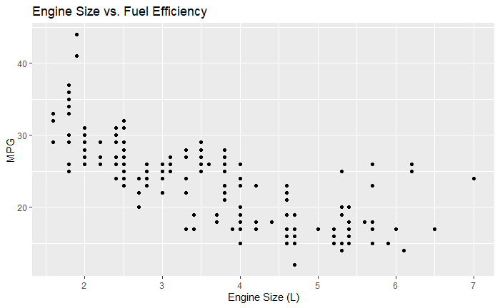
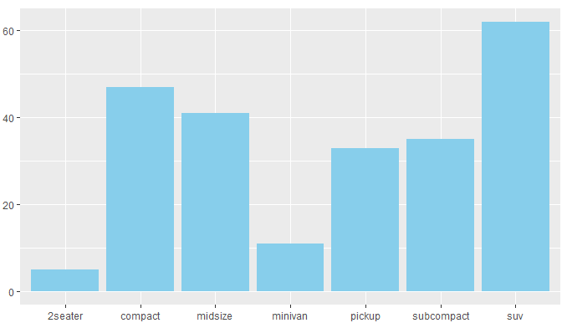
Basic Plots in ggplot2
Scatterplot:
  ggplot(mpg, aes(x = displ, y = hwy)) + geom_point() +
  labs(title = "Engine Size vs. Fuel Efficiency", x = "Engine Size (L)", y = "MPG")
Bar Chart:
  ggplot(mpg, aes(x = class)) + geom_bar()

Slide 8
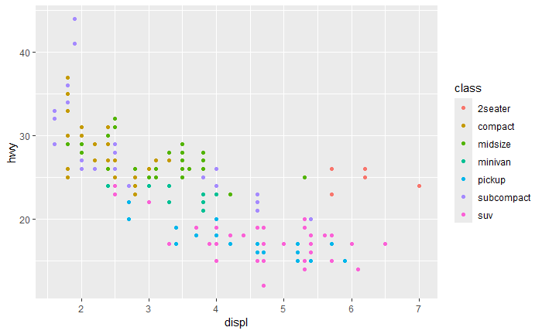
Customizing Plots
Add titles/labels:
  ggplot(mpg, aes(x = displ, y = hwy)) + geom_point() +
  labs(title = "Fuel Efficiency", x = "Engine Size", y = "MPG")
Adjust colors:
  ggplot(mpg, aes(x = displ, y = hwy, color = class)) + geom_point()

Slide 9
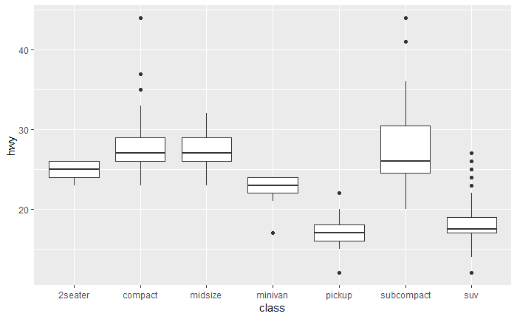
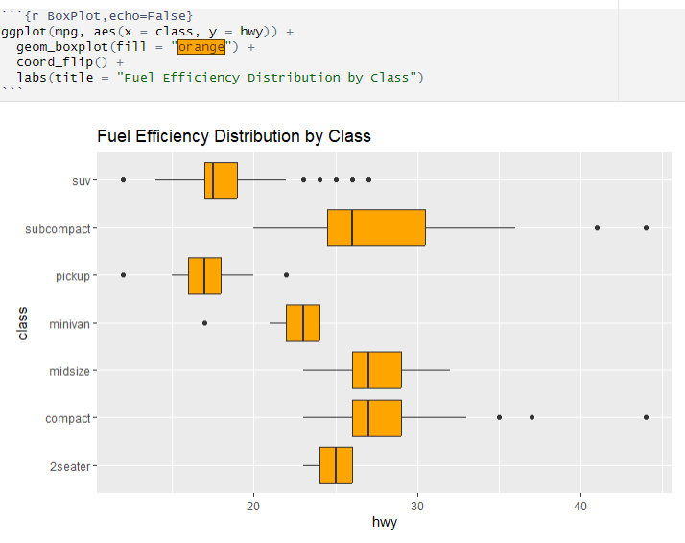
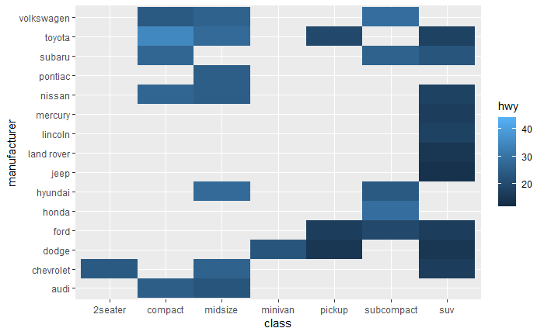
Advanced Plots
Boxplots:
ggplot(mpg, aes(x = class, y = hwy)) + geom_boxplot()
Heatmaps:
ggplot(mpg, aes(x = class, y = manufacturer)) + geom_tile(aes(fill = hwy))

Slide 10
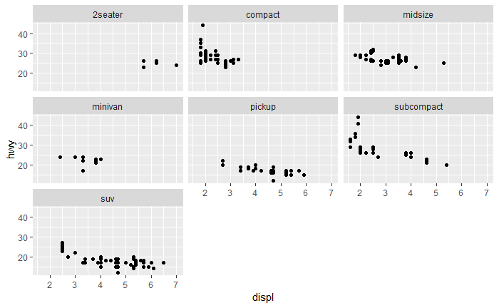
Faceting
Split plots by a variable:
ggplot(mpg, aes(x = displ, y = hwy)) + geom_point() + facet_wrap(~class)

Slide 11
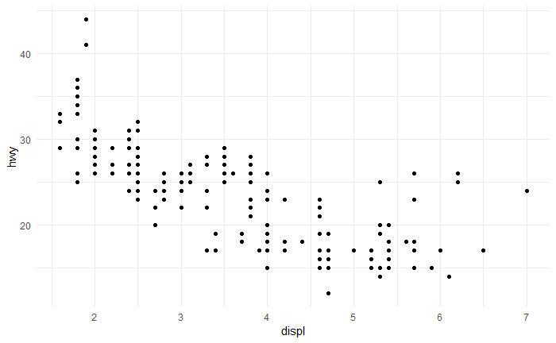

Themes and Style
Use built-in themes:
  ggplot(mpg, aes(x = displ, y = hwy)) + geom_point() + theme_minimal()
Customize with theme():
theme(axis.text.x = element_text(angle = 45, hjust = 1))

Slide 12
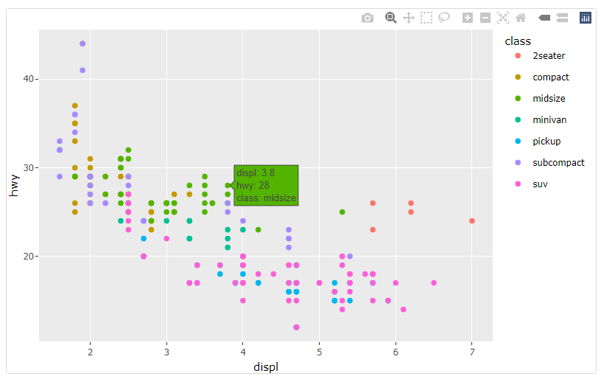
Interactive Plots (plotly)
library(plotly)
p <- ggplot(mpg, aes(x = displ, y = hwy, color = class)) + geom_point()
ggplotly(p)

Slide 13
Saving Plots
Export with ggsave():
ggsave("plot.png", width = 8, height = 6, dpi = 300)

Slide 14
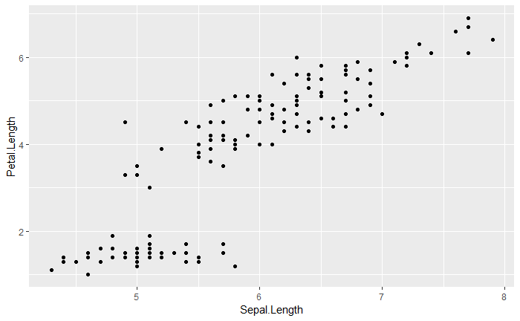
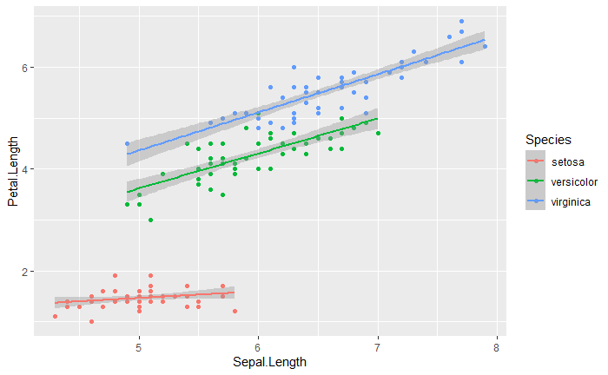
Hands-On Exercise - Iris
Task: Create a scatterplot of iris dataset (Sepal.Length vs. Petal.Length).
Challenge: Color points by Species and add a trendline (geom_smooth())

Slide 15
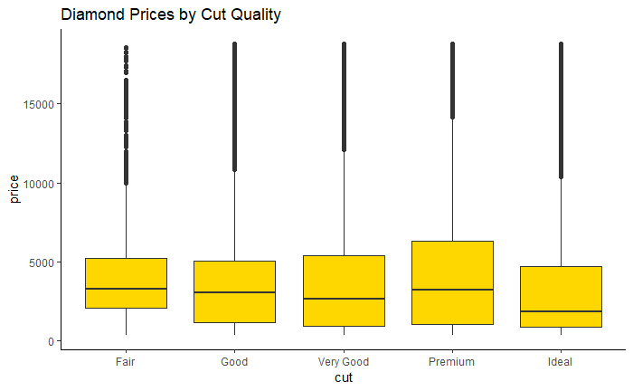
Hands-On Exercise - Diamond
Use the diamonds dataset to:
Plot the distribution of price by cut (use a boxplot).
Add a title and customize the theme.

Slide 16
Resources
R for Data Science: Visualization Chapter
ggplot2 Cheatsheet

