Slide 1
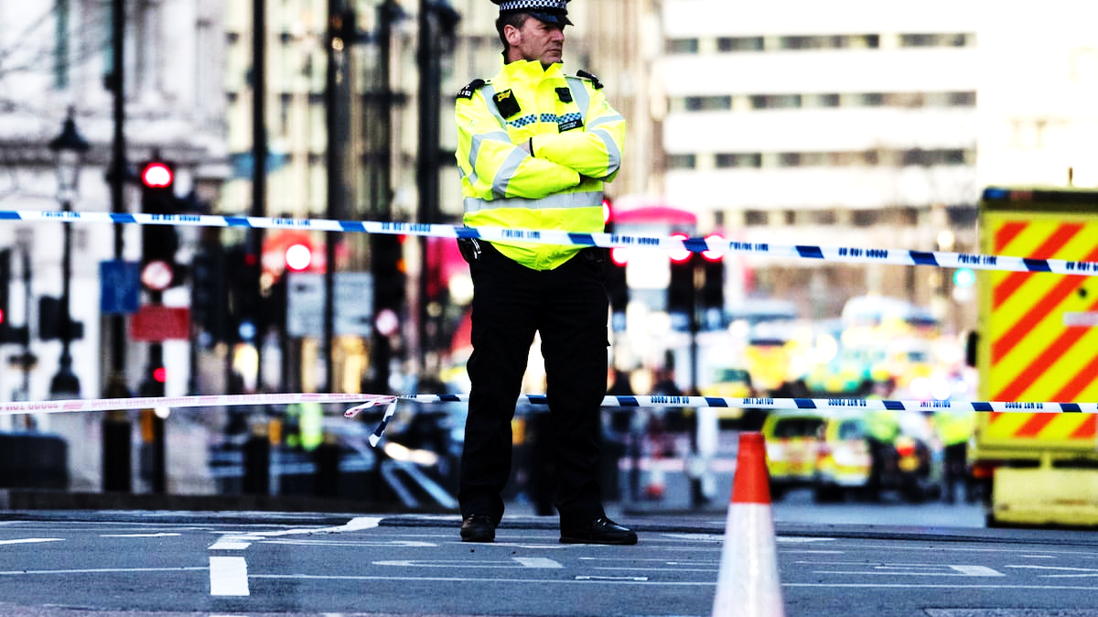
Police Powers
By Zita Draper

Slide 2

Content
Aims and Learning Objectives.
The remaining weeks.
Police Powers.
Case examples.
Scenario activities.
Summary,
Thank you, any questions?

Slide 3

Aims and Learning Objectives
The aim of today’s session is to discuss police powers.
By the end of today’s session students should be able to demonstrate their understanding of police powers using scenario’s.

Slide 4

What are police powers?
They are the powers of the police.
They include elements such as stop and search, arrest and much much more.
They are governed by the codes of practice alongside the Police and Criminal Evidence Act 1984.
Notes:
Codes of practice can be omitted as evidence in the event that they are breached.

Slide 5

Stop and Search

Slide 6

Powers of stop and search
The powers in relation to stop and search fall under S.2 of the Police and Criminal Evidence Act 1984;
However, we also see mention of them in Section 1.
In order to stop and search someone the police officer must have reasonable grounds.
Further guidance is found under Code A.

Slide 7
What is code A?
344222 PACE Jan 08 Main

Slide 8

Code A summarised
There need to be genuine suspicion.
There needs to be suspicion that the object will be found given all the facts and the circumstances and a reasonable person would think the same.
We see this in cases such as R v Chalkey; R v Jeffries.

Slide 9

Entry, Search and Seize

Slide 10
Without a Warrant
If believe that a suspect is in a property, they can enter without a warrant in line with S.17 of the Police and Criminal Evidence Act 1984 to execute a warrant or recapture someone. Or to save a life or prevent any serious damage.
Section 18 of the Police and Criminal Evidence Act 1984- enter the property of someone who has been arrested for a serious offence. But only if they have reasonable grounds to believe that evidence of that offence or other offences on the premises. The purpose being to seize or retain anything. However, this needs to be authorised by an individual of inspector rank or higher. Their authorisation is not needed if the suspect is there for effective investigation.

Slide 11
Continued
S.32 – Where an individual who is arrested and search in an area that is not the police station. The officer must believe that there is a presence of danger to the suspect themselves or others. To enter premises (only for indictable offence) if the individual was there at the time of the arrest or just before. The main purpose of this would be for evidence. To search, the officer must have reasonable belief that the premises may contain evidence, and the extent of the search must be one that is reasonably required to discover evidence.

Slide 12
Continued
Most of the powers are included (Search Property or persons) under Code B.
Code B - Police can enter premises without permission if the owner or occupiers allows.
But the occupier still need to be given written notice.
Notes:
With searches a notice of powers and rights must be served – includes what power it falls under and explains the right of the occupier of the property.

Slide 13

With a warrant
S.8 of the Police and Criminal Evidence Act 1984 – Expresses that a magistrate can issue a warrant, if reasonable grounds to believe that a serious offence has taken place. Used to get the evidence that is of value and if the evidence is admissible in court.

Slide 14
What is information is needed in the warrant?
Research S.15 of the Police and Criminal evidence act 1984.
Feedback to the class.
Notes:
S.16 Code B para 6,7 and 8 tell use about elements such as the right to seize and retain material.

Slide 15

Seizing
Dealt with under S.19 of the Police and Criminal Evidence Act 1984.
The powers conferred by subsections (2), (3) and (4) below are exercisable by a constable who is lawfully on any premises.
(2)The constable may seize anything which is on the premises if he has reasonable grounds for believing—
(a)that it has been obtained in consequence of the commission of an offence; and
(b)that it is necessary to seize it in order to prevent it being concealed, lost, damaged, altered or destroyed.
(3)The constable may seize anything which is on the premises if he has reasonable grounds for believing—
(a)that it is evidence in relation to an offence which he is investigating or any other offence; and
(b)that it is necessary to seize it in order to prevent the evidence being concealed, lost, altered or destroyed.

Slide 16

Arrest

Slide 17
Rights of those arrested
Section 29 – if you attend the station voluntarily and are not charged or arrested, they can leave at any point.
Section 30 – suspects must be taken to a police station. The police station must have all the proper facilities.
Section 31- if attending the police station either voluntarily or due to being arrested an individual can be charged for different offences.

Slide 18
Arrest with or without a warrant
An individual can be arrested with or without a warrant.
All arrests should be based on necessity and whether it is necessary to arrest the individual. This would usually be to establish elements such;
To establish name and address of the individual.
Prevent injury or loss.
Investigation.
Absconding.

Slide 19
Arrest with a warrant
Entrick v Carrington
The case tells us that the arrest warrant should include the name of the individual and offence that they are suspecting of committing.
The Warrant will be issued by a magistrate – and must include the above details.

Slide 20

Arrest without a warrant
Falls under S.24 of the Police and Criminal Evidence Act 1984 and Code G.
Let’s take a look; Police and Criminal Evidence Act 1984
Let’s take a look at Code G; PACE Code G 2012 (accessible) - GOV.UK

Slide 21
Arrest
During the arrest the police must identify themselves.
The individual has to be told they are being arrested and the reason why.
The individual should also be told why your arrest is needed and that you are not free to leave.
During arrest an induvial should also be cautioned. No longer have the right to silence – because of S.34 CJPOA 1994.
Notes:
Now under the codes of practice; You do not have to say anything. But it may harm your defence if you do not mention when questioned something which you later rely on in court. Anything you do say may be given in evidence.

Slide 22
Custody

Slide 23
How long can someone be held in custody?
Initially 24 hours.
This can be extended under S.42 of the Police and Criminal Evidence Act 1984 for up to 36 hours.
After this under S.43 and S.44 a magistrate can extend it further.
Longest someone can be held without charge with permission by a magistrate is 96 hours.
Notes:
36 hours superintendent need to approve or above.

Slide 24
Upon arrival at the police station
When in custody, they will meet a custody sergeant. Their job is to ensure that all legislation and codes are upheld and that the detention is a lawful one. (Custody Record)
Custody is dealt with under Code C and Part IV of the Police and Criminal Evidence Act 1984.
Notes:
Custody officer – must be at least a sergeant and not involved in investigating the crime.

Slide 25
Continued
S.46 of the Police and Criminal Evidence Act 1984 – the charged individual must be brought before a magistrate as soon as possible. No later than the day following the charge unless there are exceptions.
Once in custody – the detention must be reviewed.

Slide 26

Rights whilst in custody?
Custody officer must inform the individual that they have the right to have someone informed of their arrest. They can be told orally or via writing.
An individual has the right to;
Food.
Water.
Legal Advice.
Medical aid
Notice in your language.
Interpreter.
Notes:
Codes of practice.
Different person who deals with ensure that the detention is reviewed.

Slide 27
Continued
The right to legal advice – can be wavered via signing this on the custody record.
Upon review of detention the individual must be reminded that they have the right to legal advice. In addition to before the interview and before identification processes.
This is governed under Code C in particular part 1.

Slide 28

Children and vulnerable adults
Children’s rights include extra elements.
Contact must be made to a parent/ guardian.
The use of an appropriate adult.
This includes during searches.
Notes:
S.57 – notify parent/ guardian.

Slide 29
Code E
Code E – interviewing – recorded and written.
Anything said outside of the interview must be written down.
There must be a note of the interview.
Notes:
For triable either way or serious offences – recording.

Slide 30

Samples
S.62 – intimate samples of someone not charged.
S.61 – can take fingerprints without consent.
S.3 of the Police and Criminal Evidence Act – Non intimate body samples.
S.55 – deals with intimate searches.

Slide 31
When is evidence lawful?
All evidence need to be collected in the correct way and should follow the correct procedure.
If the evidence is collected unlawfully this does not mean that is inadmissible in court.
However, s.78 applies.
Notes:
Students to research S.78.
Take into consideration the circumstances.

Slide 32
Key cases include….
R v Mason [1988]
R v Alladice [1988]
R v Dunn [1990]
Research one of the above cases and feedback to the class.

Slide 33
Rights
Confession must not be under oppression – S.76 of the Police and Criminal Evidence Act 1984.

Slide 34

What next?

Slide 35
What happens next?
The individual will be taken before a magistrate if charged.
The decision then will be remanded in custody or released on police bail.
Let’s take a look at bail.
Notes:
A guarantee for bail may be used.

Slide 36

What is bail?
Governed by Bail Act 1976 –
There are times when someone will not be given bail;
1. Risk that the individual would not surrender to custody.
2. A risk that the individual will commit further offences.
3. Will interfere with the course of justice.
4. No bail to protect themselves.

Slide 37

Example
Refuse Bail.
Likely because of the risk that others would attack her

Slide 38
Bail
Can be granted by police to appear in front of a magistrate or report back to the police station. The custody officer decides this.
Bail can have conditions attached to it.
In pairs list some of these conditions.
Notes:
S.34(5) and S.37 (2) and S.34(2) of PACE 1984 - Can also be released pending further investigation.
S.37 7 A – if need to be sent to CPS.
Bail is not available for the offence of murder.

Slide 39
Activity
Take a look at the scenarios on Moodle in relation to police powers.
Have the police breached any of their powers?

Slide 40
Next week and the following week
2 Dec.
Human Rights
3 Dec.
Freedom of Assembly and Association
9 Dec.
Introduction to Judicial Review
10 Dec.
Drop-in session (Via appointment only)

Slide 41
Summary
Police Powers.
Governed by the Police and Criminal Evidence Act 1984.
Governed by the codes of practice.
Encompasses a number of elements from search – bail.

Slide 42

Thank you!
Any Questions?

