Slide 1

Artificial Intelligence (ACCA7026)
Introduction to Artificial Intelligence

Slide 2
Artificial Intelligence
Instructor Malik Uzair Mehmood
(m.Mehmood@uwtsd.ac.uk)
Textbooks + Notes 1- Russell, S. and Norvig, P. (2009) Artificial
(Essentials) Intelligence: A Modern Approach (3nd edition), Prentice Hall
2- Goodfellow, I; Bengio, Y; Courville, A; Bach, F (2017), Deep Learning, MIT Press
3- Class Slides
4- Resources uploaded on Moodle

Slide 3
Learning Outcomes
Critically analyse, evaluate and justify selected AI methods and techniques used to solve complex problems.
Analyse given problems and subsequently synthesise and evaluate appropriate solutions using selected AI methods and techniques.

Slide 4
Assessment Policy
Writing assignment (50%)
Final Exam (50%)
Class Engagement

Slide 5
Lecture Outline
Defining Human and Machine Intelligence
A Brief History of AI
Exploring the Core Sub-domains (ML, DL, NLP, CV)
ANI, AGI & Generative AI
Applications and Ethical Considerations
Q&A

Slide 6

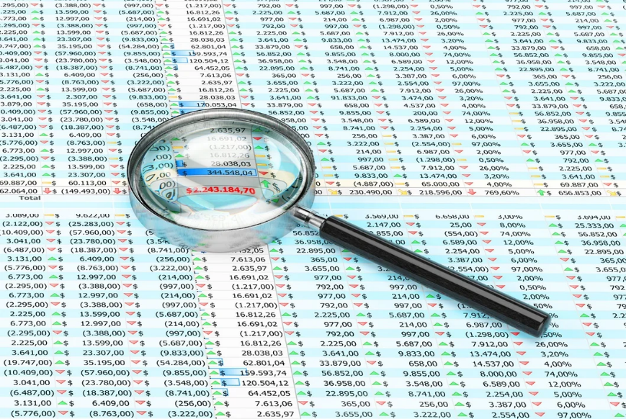
Hypothetical Scenario
You're interning at a social media company. The content team has been experimenting with different post types (e.g., photos, videos, text) to increase user engagement. Your manager comes to you and asks:
'What is the average number of likes, shares, and comments for each post type, and is there one type that clearly performs better than the others?.
How will you solve the problem?

Slide 7
Follow up question
Before I publish a new post, can I predict how much engagement it will receive?
Would this require AI? If yes, what information would the system need?”

Slide 8
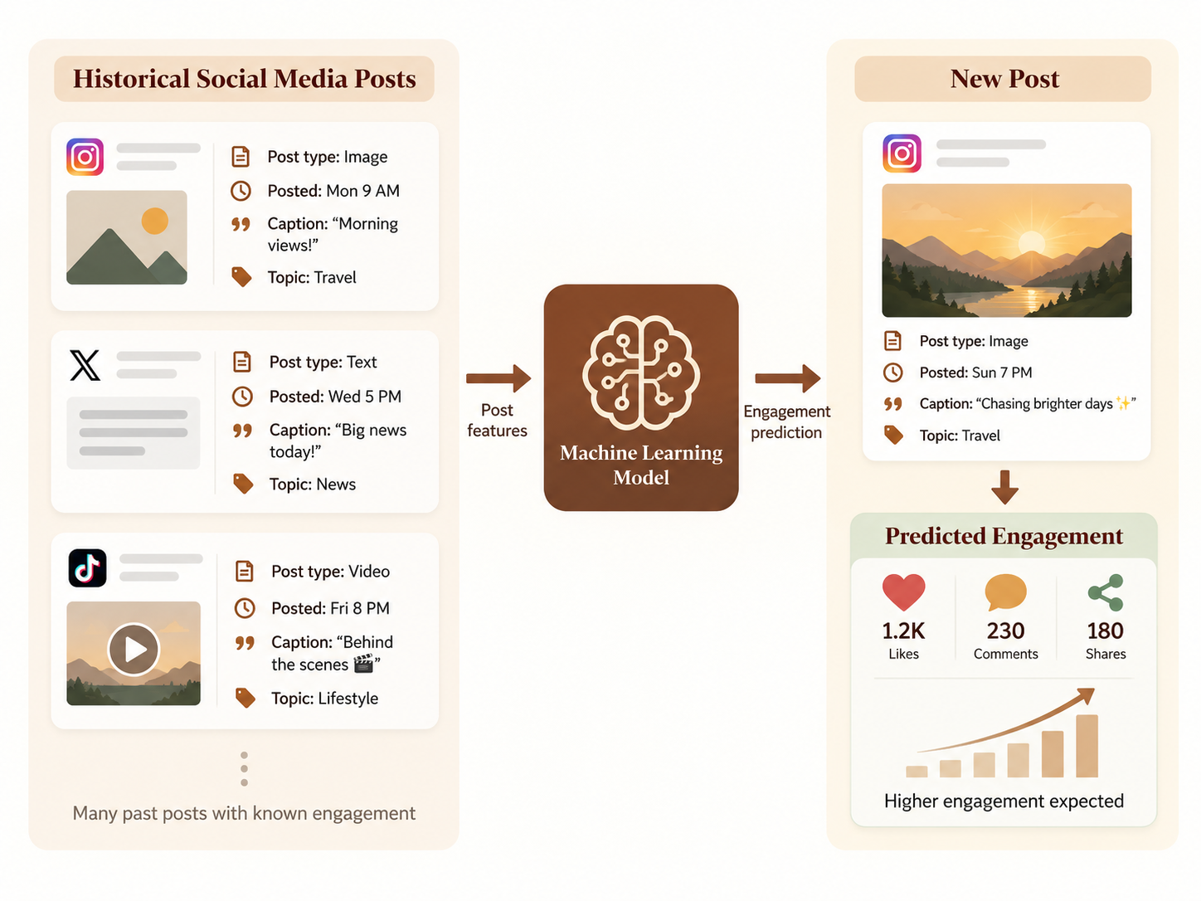
Predicting Social Media Engagement with AI

Slide 9
Why is AI a Critical Skill Today?
"Data is the new oil for the digital age." –Neelie Kroes[1].
46% of UK employers struggled to fill data roles [2].
High Demand career Opportunities (Data Scientist, Data analyst, Machine Learning engineer etc.)
Empowering Academic and Scientific Research
Efficiency, Reproducibility, and Scalability

Slide 10
What comes to your mind when you think of intelligence?

Slide 11
What is Intelligence?
It's more than just being "smart."
Ability to acquire and apply knowledge and skills.
Reasoning and abstract thought.
Problem-solving and planning.
Learning from experience.
Adapting to new situations.

Slide 12
The Spectrum of Human Intelligence
Intelligence isn't monolithic [3]. Psychologist Howard Gardner proposed a theory of "Multiple Intelligences," including:
Logical-Mathematical: (Problem-solving, deduction)
Linguistic: (Language, communication)
Spatial: (Visualizing the world in 3D)
Bodily-Kinesthetic: (Physical coordination, dexterity)
Musical: (Rhythm, pitch)
Interpersonal: (Understanding others' feelings)
Intrapersonal: (Understanding your own feelings)

Slide 13
From Human to Artificial Intelligence
The fundamental question of AI is:
“Can a machine replicate these facets of intelligence?”
If so, how? We can't just program "understanding" or "creativity." We need a different approach.
This leads to the formal definition of our field.

Slide 14
Defining Artificial Intelligence
“The science and engineering of making intelligent machines [4].“ (John McCarthy ,1956)
“Artificial intelligence is the study of agents that perceive their environment through sensors and act upon that environment through actuators, with the aim of maximizing some notion of cumulative performance [5] .”(Russel & Norvig,2009)

Slide 15
Turing Test
In 1950, Alan Turing posed a question in his seminal paper “Computing Machinery and Intelligence” [6].
Question:
“Can machines think?”

Slide 16
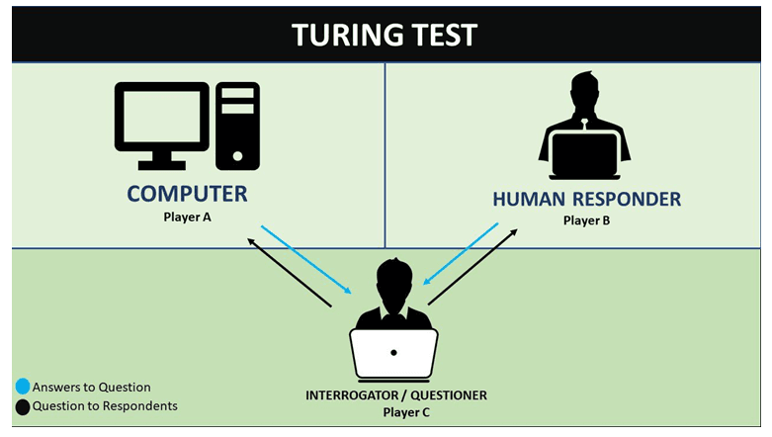
Turing Test
[1]

Slide 17
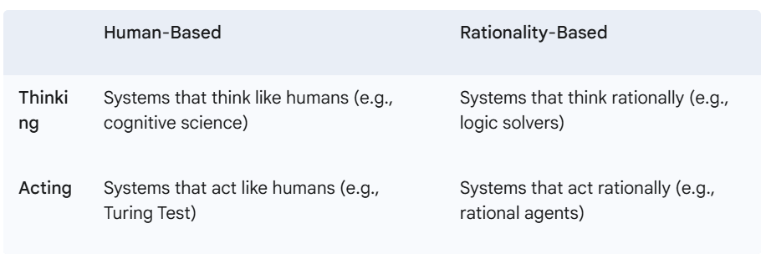
Four Approaches to AI (Russell and Norvig, 2009)
The dominant approach today is Acting Rationally.
We want agents that make optimal decisions to achieve their goals.

Slide 18
A Brief History of AI

Slide 19
The Early Days (1940s-1960s)
1943: McCulloch & Pitts propose the first model of an artificial neuron [8].
1950: Alan Turing proposes the "Turing Test" to measure machine intelligence [6].
1956: The Dartmouth Workshop, where the term "Artificial Intelligence" is coined. A period of intense optimism. Early successes in game playing (checkers) and logic puzzles [9].

Slide 20
The First "AI Winter" & Expert Systems (1970s-1980s)
Early promises were unfulfilled. The complexity of real-world problems was vastly underestimated.
Funding dried up, leading to the "AI Winter.“
Silver Lining: Rise of Expert Systems. Rule-based systems that encoded expert knowledge (e.g., in medicine) to make decisions. They were successful but brittle.

Slide 21
The Data-Driven Era (1990s-2000s)
A shift from programming rules to learning from data.
The internet generated massive datasets.
Computing power increased dramatically.
1997: IBM's Deep Blue defeats world chess champion Garry Kasparov. A major symbolic victory [10].

Slide 22
The Deep Learning Revolution (2010s-Present)
2012: AlexNet wins the ImageNet competition by a huge margin, kickstarting the Deep Learning boom [11].
2016: Google DeepMind's AlphaGo defeats Lee Sedol, the world Go champion—a task thought to be a decade away [12].
Late 2010s/Early 2020s: The rise of large-scale Transformer models leads to powerful Generative AI (like GPT-3, DALL-E, Midjourney).

Slide 23
Question for you
Looking at the history, what were the two main ingredients that enabled the recent AI explosion?

Slide 24
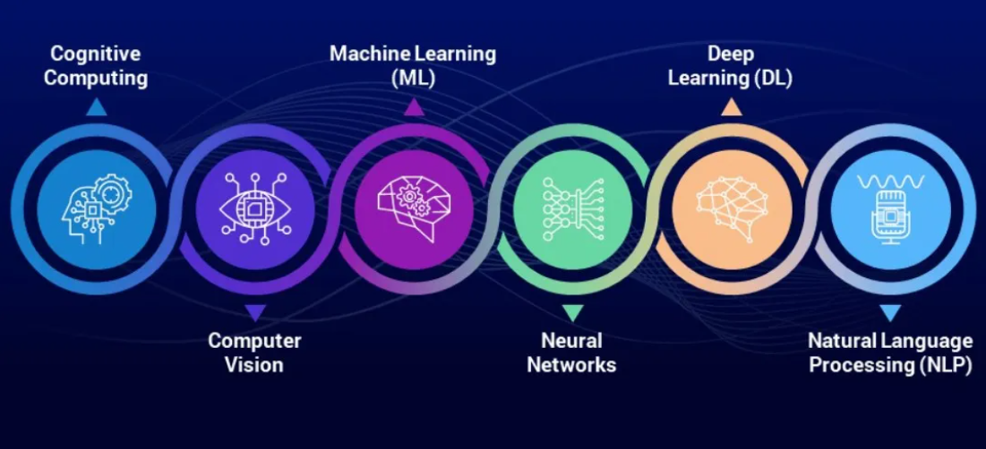
Landscape of AI
[13]

Slide 25
Machine Learning (ML)
"The field of study that gives computers the ability to learn without being explicitly programmed [1].“
The core idea is to use algorithms to find patterns in data.
The "learned" patterns form a model, which can then make predictions on new, unseen data.
Example: A spam filter isn't programmed with a list of all spam words. It learns the features of spam from a large dataset of emails.
References:
[1] A. L. Samuel, “Some studies in machine learning using the game of checkers,” IBM Journal of Research and Development,
vol. 3, no. 3, pp. 210–229, 1959. doi: 10.1147/rd.33.0210

Slide 26
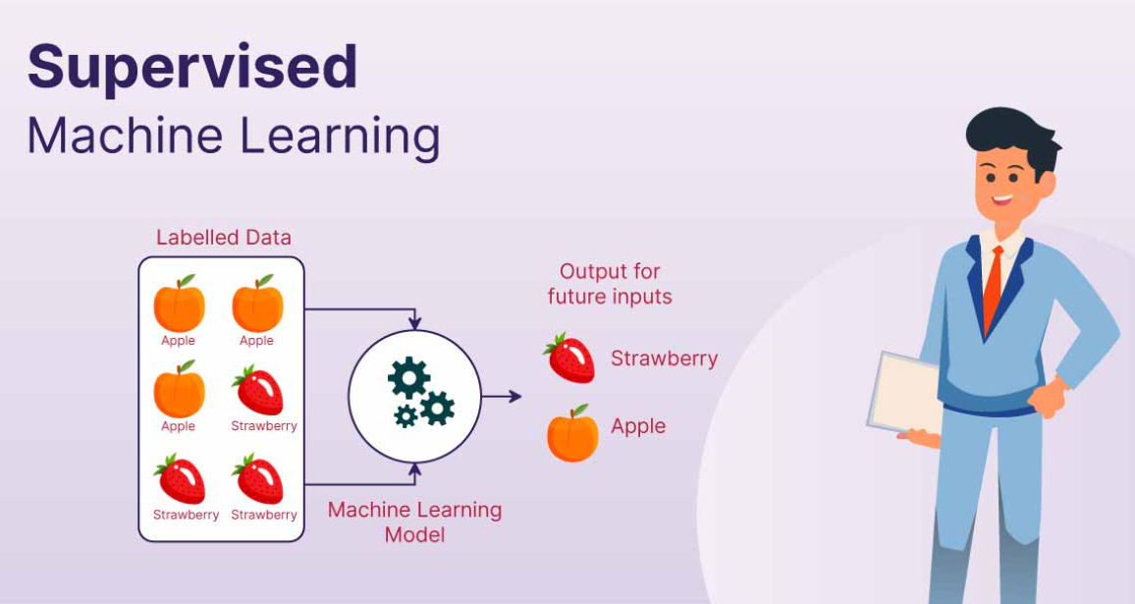
Types of Machine Learning
Supervised Learning:
  Learning from labelled data (input-output pairs).
  Goal: Predict the output for new inputs.
  Analogy: Learning with a teacher.
  Examples: Image classification, spam detection.
[14]

Slide 27
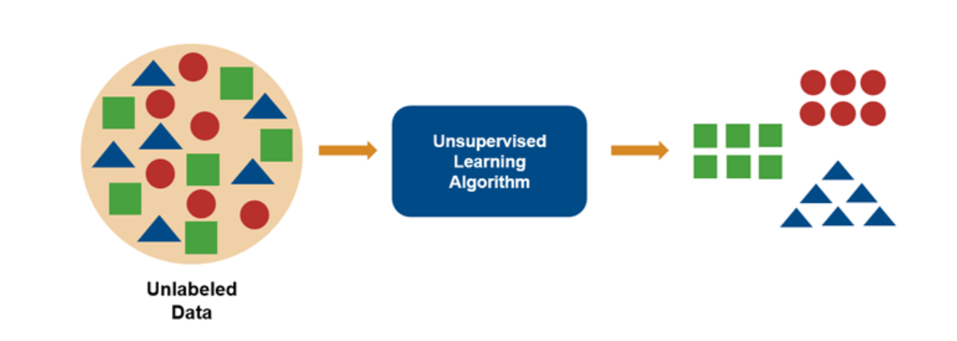
Types of Machine Learning (Continued)
Unsupervised Learning:
  Learning from unlabelled data.
  Goal: Discover hidden structures or patterns.
  Analogy: Finding patterns on your own.
  Examples: Customer segmentation, anomaly detection.
[15]

Slide 28
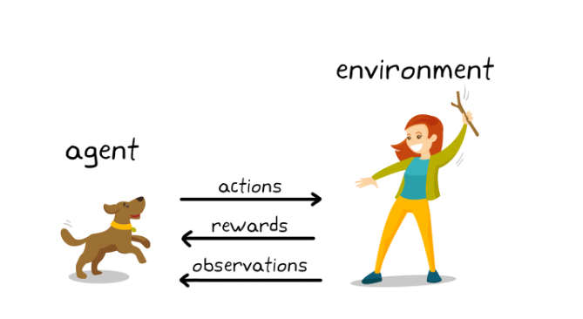
Types of Machine Learning (Continued)
Reinforcement Learning:
  Learning through trial and error in an environment.
  Goal: Maximize a cumulative reward signal.
  Analogy: Training a dog with treats.
  Examples: Game playing (AlphaGo), robotics.
[16]

Slide 29
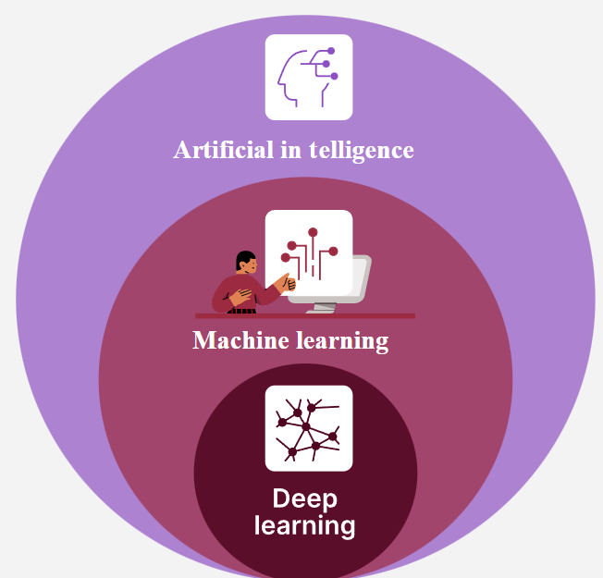
Deep Learning (DL)
A subfield of ML based on Artificial Neural Networks (ANNs) with many layers (hence "deep").
Inspired by the structure of the human brain.
Excels at finding intricate patterns in large, unstructured datasets like images, sound, and text.
It's the technology behind most modern AI breakthroughs.
[17]

Slide 30
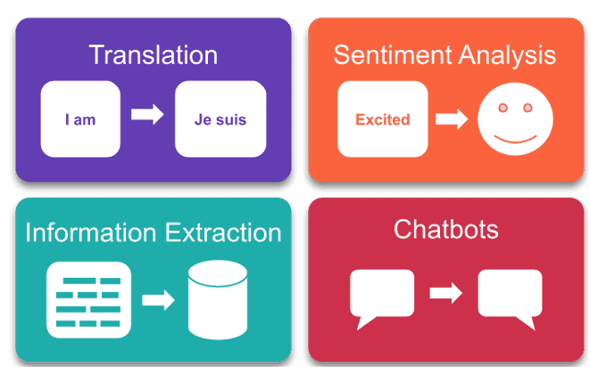
Natural Language Processing (NLP)
Goal: Enable computers to understand, interpret, and generate human language.
Key Tasks:
  Sentiment Analysis: Is a review positive or negative?
  Machine Translation: Google Translate.
  Named Entity Recognition: Finding people, places, and organizations in a text.
  Question Answering: Chatbots and virtual assistants.
[18]

Slide 31
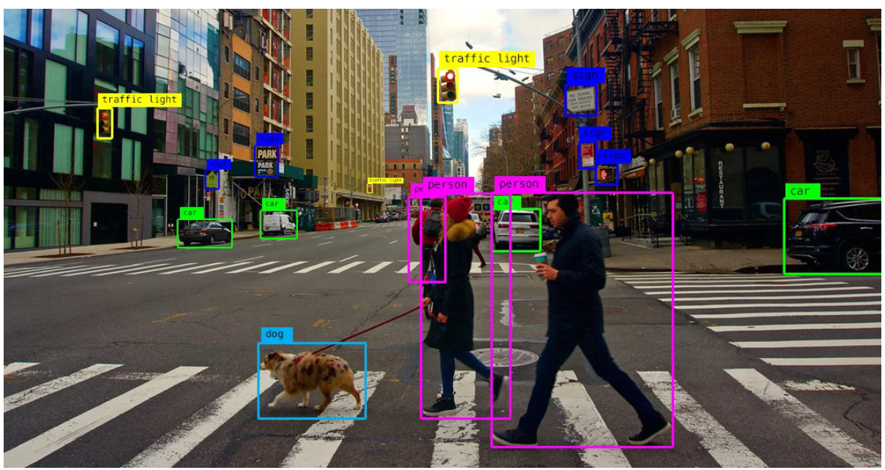
Computer Vision (CV)
Goal: Enable computers to "see" and interpret visual information from images and videos.
Key Tasks:
  Image Classification: What object is in this image?
  Object Detection: Where are the objects in this image? (Draws bounding boxes).
  Facial Recognition: Identifying individuals.
  Medical Imaging Analysis: Detecting tumors in scans.
[19]

Slide 32
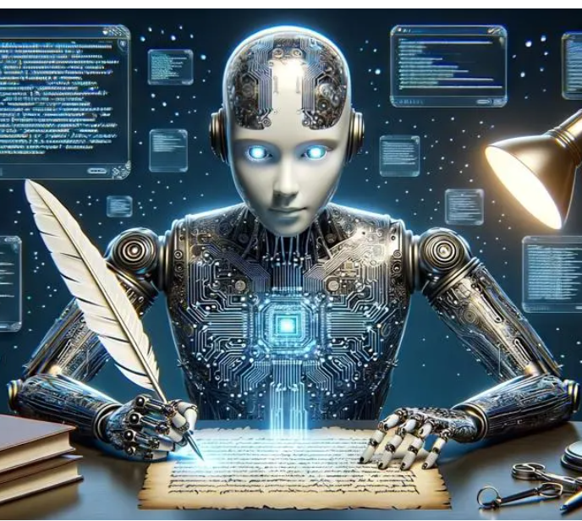
Generative AI (GenAI)
A newer, revolutionary class of AI.
Instead of just predicting or classifying (Discriminative AI), Generative AI creates new content.
This content can be text, images, code, music, or synthetic data.
It learns the underlying patterns and distribution of a dataset and can then generate new samples from that distribution.

Slide 33
Large Language Models (LLMs)
The engine behind most modern text-based Generative AI (e.g., GPT, Llama, Gemini).
They are Deep Learning models (specifically, a type called a Transformer) trained on vast quantities of text data from the internet.
They work by predicting the next most probable word in a sequence, allowing them to generate coherent and contextually relevant text.
Attention is all you need [1].
References:
[1] [1] A. Vaswani, N. Shazeer, N. Parmar, J. Uszkoreit, L. Jones, A. N. Gomez, Ł. Kaiser, and I. Polosukhin,
"Attention is all you need," in Proc. Adv. Neural Inf. Process. Syst. (NeurIPS), vol. 30, 2017. [Online].
Available: https://papers.nips.cc/paper_files/paper/2017/file/3f5ee243547dee91fbd053c1c4a845aa-Paper.pdf

Slide 34
How Sub-domains Combine: The Self-Driving Car
A self-driving car is a great example of an integrated AI system:
Computer Vision: Identifies pedestrians, other cars, traffic lights, and lane markings.
Sensor Fusion (ML): Combines data from cameras, LiDAR, and radar to build a 3D model of the world.
Reinforcement Learning: The driving policy (when to accelerate, brake, turn) is often trained through millions of simulated miles.
NLP: Understands voice commands from the passenger.

Slide 35
Class Activity 2 - The AI System Design Challenge
You are hired by a large hospital to reduce patient waiting times and improve diagnosis accuracy.
How will you design such a system?
Task (in small groups, 10 minutes)

Slide 36
Activity Discussion

Slide 37
Types of AI by capability
We can classify AI based on its level of "intelligence" relative to humans.
  Artificial Narrow Intelligence (ANI)
  Artificial General Intelligence (AGI)
  Artificial Superintelligence (ASI)

Slide 38
Artificial Narrow Intelligence (ANI)
Also called "Weak AI”.
This is all the AI that exists today.
ANI is designed and trained for one specific task.
It can be incredibly powerful at that task, often superhuman, but it has no general awareness or ability outside its domain.
Examples: Siri, Netflix recommendation engine, AlphaGo, spam filters, Google Search.

Slide 39
Artificial General Intelligence (AGI)
Also called "Strong AI.“
This is hypothetical; it does not yet exist.
AGI is a machine with the ability to understand, learn, and apply its intelligence to solve any problem that a human being can.
It possesses consciousness, self-awareness, and the ability to transfer knowledge between different domains.
This is the type of AI you often see in science fiction (e.g., Data from Star Trek).

Slide 40
Artificial Superintelligence (ASI)
Also called "Superintelligence.“
This is purely theoretical.
An intellect that is much smarter than the best human brains in practically every field, including scientific creativity, general wisdom, and social skills.
The concept raises profound questions about the future of humanity and the existential risks associated with creating something far more intelligent than ourselves (the "control problem").
Subject of serious debate by philosophers and researchers like Nick Bostrom [1]
References:
[1] N. Bostrom, Superintelligence: Paths, Dangers, Strategies. Oxford, U.K.: Oxford Univ. Press, 2014.

Slide 41
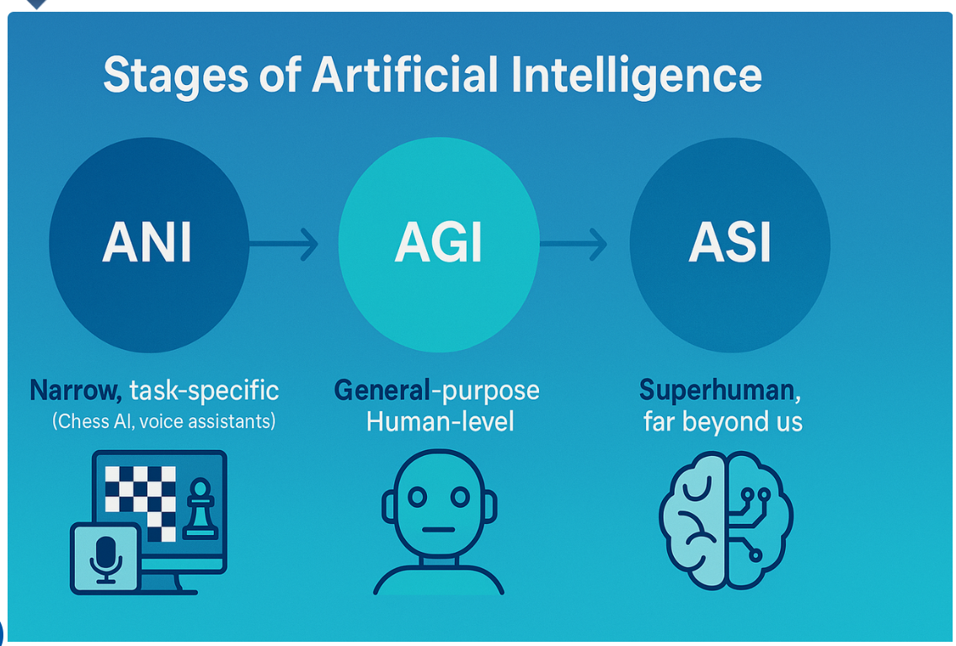
The Spectrum: ANI to AGI to ASI
[20]

Slide 42
Why AI Matters: Applications Across Industries
AI is not a niche technology; it's becoming a foundational layer of our digital world.
Healthcare: Drug discovery, medical imaging, personalized treatment.
Finance: Fraud detection, algorithmic trading, credit scoring.
Retail: Recommendation engines, supply chain optimization.
Entertainment: Generative art and music, special effects, game development.
Science: Climate modeling, protein folding (AlphaFold), material science.

Slide 43
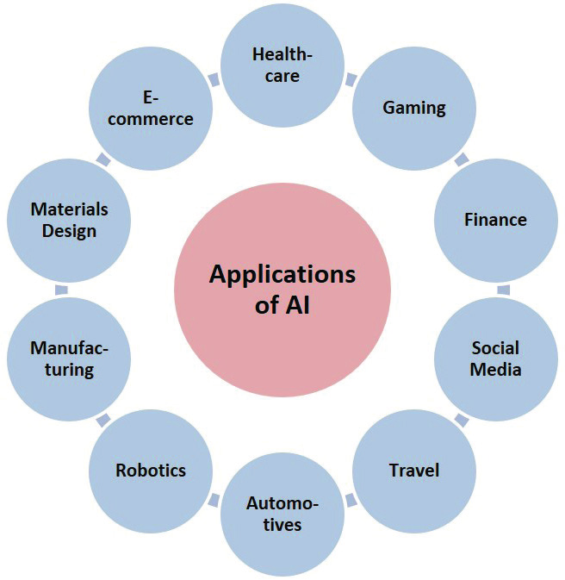
AI applications across industries
[21]

Slide 44
Class Activity 3 – Brainstorming the applications of AI
Brainstorm any areas where AI could be applied.
Don’t just think the term AI instead try breaking it down to what subdomain of AI will be solving that problem.
Brainstorm in groups of 2.
Discussion

Slide 45
The Ethical Dimension
With great power comes great responsibility.
The deployment of AI raises critical ethical questions that we, as technologists and citizens, must address.

Slide 46
Key Ethical Challenges
Bias: AI models can inherit and even amplify biases present in their training data, leading to unfair outcomes (e.g., in hiring or loan applications).
Privacy: AI systems often require vast amounts of data, creating concerns about surveillance and data protection.
Job Displacement: Automation of both manual and cognitive tasks.
Accountability & Transparency: When an AI system makes a mistake (e.g., a self-driving car accident), who is responsible? How can we understand the "black box" decisions of complex models?
Misinformation: Generative AI can be used to create realistic fake news, images (deepfakes), and propaganda at scale.

Slide 47
The Bias Problem: A Vicious Cycle
Example 1: The Biased Animal Identifier 🐾
An AI model is trained to identify animals in photos. The training dataset is built by scraping images from popular wildlife photography websites.
The Data: These websites are filled with thousands of stunning, high-quality photos of lions, tigers, and bears, but very few photos of more obscure animals like the axolotl or the pangolin.
The Learned Bias: The model becomes an expert at identifying common animals but performs poorly on the rare ones. It learns that if something is a four-legged mammal, it's statistically much more likely to be a bear than a pangolin. It may misclassify a pangolin as an armadillo or simply fail to identify it at all.
The Vicious Cycle: If this model is used in a nature app, it will constantly succeed with common animals, reinforcing its accuracy for that data. When it fails on a pangolin, users may not be able to correct it, or the incorrect "armadillo" tag gets confirmed. The system never learns to get better at identifying the underrepresented animals, creating a cycle where popularity equals accuracy.

Slide 48
Interactive Session 3 - Ethical Discussion
Scenario: A bank develops an AI model to automate mortgage loan approvals. The model is trained on the bank's loan application data from the last 30 years. The model learns that applicants from certain postcodes have historically had a higher rejection rate and therefore flags new applications from these areas as higher risk.
Question for the class: What is the primary ethical risk here? How could this system create a harmful feedback loop and potentially violate fair lending laws?

Slide 49
Key Takeaways
AI is the broad science of making machines intelligent. It's a field with a long history of booms and busts.
Machine Learning and Deep Learning are the engines of modern AI, driven by data and computational power.
AI is a toolkit of specialized domains (NLP, CV) that can be combined to solve complex problems.
All AI today is Narrow AI (ANI).
The dream of General AI (AGI) and Superintelligent AI (ASI) remains a distant, long-term goal.
The ethical implications of AI are not an afterthought; they are central to its responsible development and deployment.

Slide 50
Recommended Reading & Resources
Core Textbook:
  Russell, S., & Norvig, P. (2021). Artificial Intelligence: A Modern Approach (4th ed.).
For Staying Current:
  ArXiv (cs.AI, cs.LG, cs.CL sections)
  Distill.pub (for visual, intuitive explanations)
  Reputable Tech Journals and AI Newsletters (e.g., MIT Technology Review, The Batch)

Slide 51
References
[1]https://ec.europa.eu/commission/presscorner/detail/en/SPEECH_12_149
[2] https://www.gov.uk/government/publications/quantifying-the-uk-data-skills-gap/quantifying-the-uk-data-skills-gap
[3] Gardner, H. (1983). Frames of Mind: The Theory of Multiple Intelligences. Basic Books.
[4] McCarthy, J. (2007). What is Artificial Intelligence?. Stanford University. Retrieved from http://jmc.stanford.edu/articles/whatisai/whatisai.pdf
[5] Russell, S. and Norvig, P. (2009) Artificial
(Essentials) Intelligence: A Modern Approach (3nd edition), Prentice Hall
[6] A. M. Turing, "Computing machinery and intelligence," Mind, vol. LIX, no. 236, pp. 433–460, 1950.
[7] https://botpenguin.com/glossary/turing-test
[8] W. S. McCulloch and W. Pitts, “A logical calculus of the ideas immanent in nervous activity,” The Bulletin of Mathematical Biophysics, vol. 5, no. 4, pp. 115–133, 1943. doi:
[9] J. McCarthy, M. L. Minsky, N. Rochester, and C. E. Shannon, "A proposal for the Dartmouth summer research project on artificial intelligence," Dartmouth College, Hanover, NH, 1955. [Online]. Available: http://www-formal.stanford.edu/jmc/history/dartmouth/dartmouth.html
[10] [10] S. Campbell, M. Hsu, and J. Hoane Jr., “Deep Blue,” Artificial Intelligence, vol. 134, no. 1–2, pp. 57–83, 2002.

Slide 52
References
[11] A. Krizhevsky, I. Sutskever, and G. E. Hinton, “ImageNet classification with deep convolutional neural networks,” in Proc. Advances in Neural Information Processing Systems (NeurIPS), Lake Tahoe, NV, USA, 2012, pp. 1097–1105.
[12] D. Silver et al., “Mastering the game of Go with deep neural networks and tree search,” Nature, vol. 529, no. 7587, pp. 484–489, Jan. 2016.
[13]https://swisscognitive.ch/2021/08/28/fields-of-artificial-intelligence/
[14] https://www.shiksha.com/online-courses/articles/supervised-learning-real-life-analogy-and-applications/
[15] https://www.mathworks.com/discovery/unsupervised-learning.html
[16] https://www.mathworks.com/discovery/reinforcement-learning.html
[17] https://www.iso.org/artificial-intelligence/deep-learning
[18] https://navigate360.com/blog/what-is-natural-language-processing/
[19] https://www.algotive.ai/blog/what-is-computer-vision-and-how-does-it-work-with-artificial-intelligence
[20] https://ingage.institute/2025/04/understanding-the-stages-of-artificial-intelligence-ani-agi-and-asi/
[21] https://www.researchgate.net/figure/Major-applications-of-AI_fig2_370351166

Slide 53
QUESTIONS?

