Slide 1

Week 6: Enchantment
Nick Campion
Sophia Centre for the Study of Cosmology in Culture,
University of Wales Trinity Saint David,

Slide 2
The reason for the topic
Because
The modern ‘Re-enchantment’ of western society,
Or desire for ‘Re-enchantment’ amongst some people
Is widely assumed by sociologists to be a major reason for the modern growth of belief in astrology (as well as alternative spiritualities, New Age ideas, the occult and so on).
Astronomers often appeal to the wonder or awe of the sky to justify astronomy

Slide 3
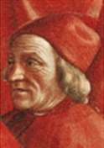
DEFINITIONS OF ENCHANTMENT
Literally from the Latin cantare, to sing.
In English to ‘chant’ is to utter words often in a monotone, or with little variation in tone, often to achieve an enlightening effect – as in plain chant in religious ritual.
(also repetitive chanting in political and sports crowds)
The Oxford Concise Dictionary:
‘enchant as to : ‘Bewitch, charm, delight…(cantare sing…), from the French chanter, to sing.
Associations with witchcraft, magic
Spanish encantar = to love
Marsilio Ficino : ‘remember that song is a most powerful imitator of all things. It imitates the intentions and passions of the soul as well as words’.[1]
[1] Ficino, Marsilio, Three Books on Life, ed. Kaske, Carole C. and Clark, John R., Center for Medieval and Early Renaissance Studies, Binghamton: State University of New York at Binghamton, 1989, III.21, p. 359.

Slide 4

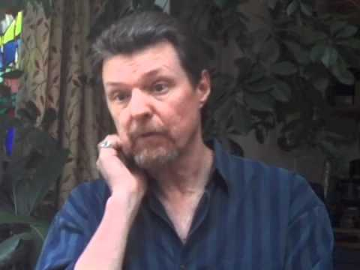
What is Enchantment?:
Patrick Curry
Patrick is currently writing a book on enchantment.
Perhaps best defined by the state of being in love, in which the entire world becomes full of meaning, and ordinary perceptions of individuality, time and space disappear.
Primary enchantment: occurs spontaneously
Secondary enchantment: is evoked by ritual, action (singing, reciting myth, dance, theurgy, magic....)

Slide 5
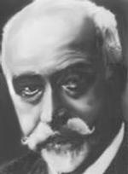
Participation Mystique
Lucien Levy-Bruhl
The ‘illusion’ amongst ‘primitive’ people that, as individuals, they can be fully integrated with the environment and cosmos, and actively engage with it.

Slide 6

Enchantment
“As the negotiation of the gaps or disjunctures separating human beings from complete power over their lives, enchantment conjoins the plane of immediate human experience to a desirable state of affairs through the mediation of such symbolic devices as rituals, incantations or charms. […] Enchantment consists of an apparatus of belief whose form of representation or enactment is thought to exert influence over the realities it configures.
But enchantment is not limited to the spells and magic of premodern metaphysics (or modern consumerism). By means of religion, morality and aesthetics, Nietzsche once averred, “man likes to believe that … he is touching the heart of the world”.
D. Morgan, 'The Enchantment of Art: Abstraction and Empathy from German Romanticism to Expressionism', Journal of the History of Ideas, 57 (1996), pp. 317-341. Citing F. Nietzche, Human All Too Human, 16 (§4)
(David Morgan – Duke University)

Slide 7
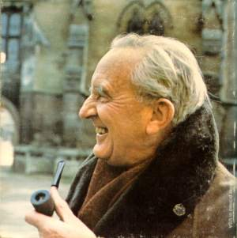
What is Enchantment?:
J.R.R. Tolkien
Faërie contains many things besides elves and fays, and besides dwarfs, witches, trolls, giants, or dragons: it holds the seas, the sun, the moon, the sky; and the earth, and all things that are in it: tree and bird, water and stone, wine and bread, and ourselves, mortal men, when we are enchanted… Faërie itself may perhaps most nearly be translated by Magic – but it is magic of a peculiar mood and power, at the farthest pole from the vulgar devices of the laborious, scientific magician.[1]
[1] Tolkein, J.R.R., Tree and Leaf, London: Unwin 1964, pp. 15-16.

Slide 8
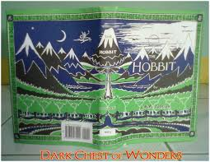
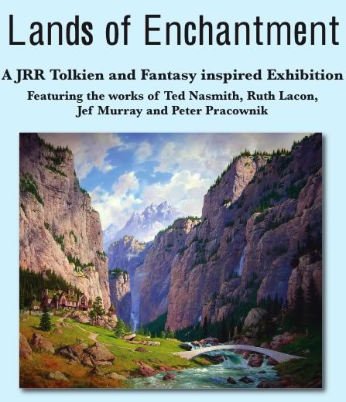
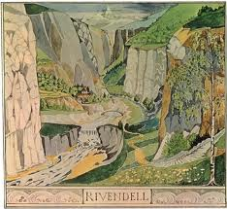
Tolkein’s enchanted landscape

Slide 9
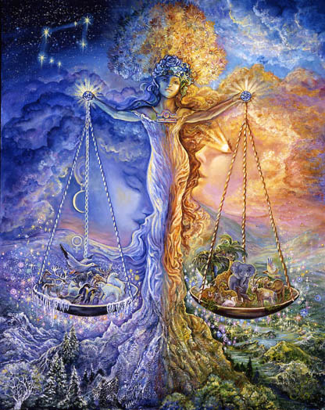

Modern Enchantment, or Glamour (imitation enchantment)?
Venus shop in Glastonbury; zodiac image

Slide 10
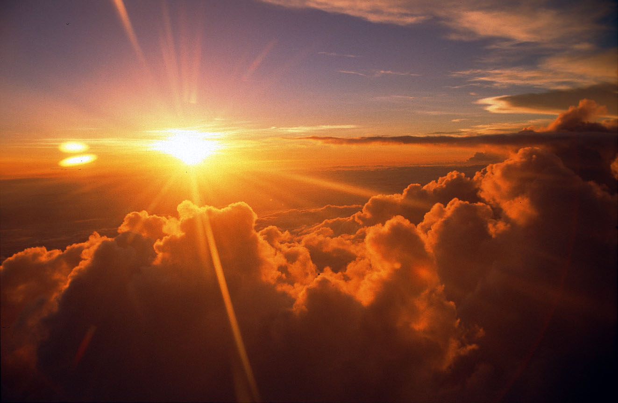
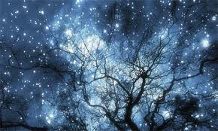
The sky and enchantment?
The awe of the heavens as a theory for the origin of astronomy.
E.g Pannekoek, A., A History of Astronomy, London: George Allen and Unwin Ltd., 1961p 19-20.
‘The heavens are telling the glory of God, and the firmament proclaims his handiwork’ Psalms, 19.1.

Slide 11
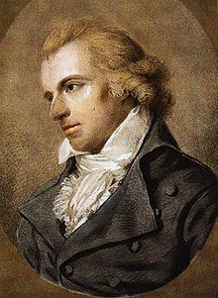
THE HISTORICAL THEORY
The Protestant Reformation in 16th century Europe:
Rejection of the magic and mystery of the Roman Catholic Church
Combined with rejection of folk magic amongst ordinary people
The German playwrite and poet Friedrich Schiller (1759-1805) referred to
die Entgötterung der Natur, the ‘disgodding of nature’,
The ‘progressive removal of mind, or spirit, from phenomenal appearances’
= The Romantic rejection of the perceived alienating rationalism of the Enlightenment.

Slide 12
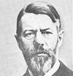

Max Weber 1864-1920
Disenchantment
The combined effect of the Protestant Reformation and the scientific revolution was to ‘disenchant’ humanity.
‘The increasing intellectualization and rationalisation do not, therefore, indicate an increased and general knowledge of the conditions under which one lives.
It means something else, namely, the knowledge or belief that if one but wished one could learn it any time. Hence, it means that principally there are no mysterious incalculable forces that come into play, but rather that one can, in principle, master all things by calculation. This means that the world is disenchanted. One need no longer have recourse to magical means in order to master the spirits, as did the savage, for whom such mysterious powers existed. Technical means and calculations perform the service. This above all is what intellectualization means’.[1]
[1] Weber, Max, From Max Weber: Essays in Sociology, ed. H.H. Garth and C. Mills Wright, London: Kegan Paul, Trench, Trubner & Co., 1947, p. 139.

Slide 13
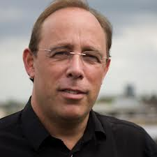
Wouter Hanegraaff defines Disenchantment
‘The social pressure exerted upon human beings to deny the spontaneous tendency of participation, by accepting the claims of a culturally established ideology according to which instrumental causality amounts to a worldview capable in principle of rationally explaining all aspects of reality’.
Hanegraaff, W.J., 2003. How magic survived the disenchantment of the world. In Religion Vol. 33, pp.357-380 (p. 377).

Slide 14
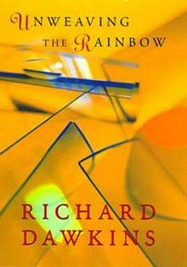
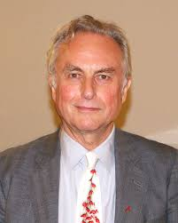
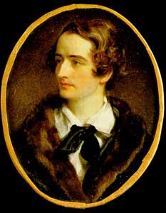
A famous metaphor - unweaving the rainbow
The Romantic poet John Keats wrote in his poem Lamia in 1820, that Philosophy )i.e., Natural Philosophy, what we would call science) ‘unweaved’ the rainbow, or, as could say, destroyed enchantment.
Part II
Do not all charms fly
At the mere touch of cold philosophy?
There was an awful rainbow once in heaven:
We know her woof, her texture; she is given
In the dull catalogue of common things.
Philosophy will clip an Angel’s wings,
Conquer all mysteries by rule and line,
Empty the haunted air, and gnomed mine -
Unweave a rainbow, as it erewhile made
The tender-person’d Lamia melt into a shade.
http://www.gutenberg.org/ebooks/2490
(Lamia was the daughter of Libya and Belus, a child-devouring daemon.)
The rainbow was the one seen by Noah at the end of the great flood.
Answered by Richard Dawkins in Unweaving the Rainbow, London: Penguin, 1998, who argued that science can be enchanting

Slide 15
THE SOCIOLOGICAL THEORY
Widely accepted.
Generally:
Europe was disenchanted in the 16th/17th c
Science and technology are disenchanting.
The appeal of alternative spiritualities is their ability to re-enchant.
But is this true?

Slide 16
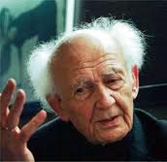
The Modern World as Disenchanted: Zygmunt Bauman
‘All in all, postmodernity can be seen as restoring to the world what modernity, presumptuously, had taken away; as a re-enchantment of the world that modernity tried hard to dis-enchant”[1]
[1] Bauman, Zygmunt, Intimations of Postmodernity, London: Routledge, 1992, p. x.

Slide 17
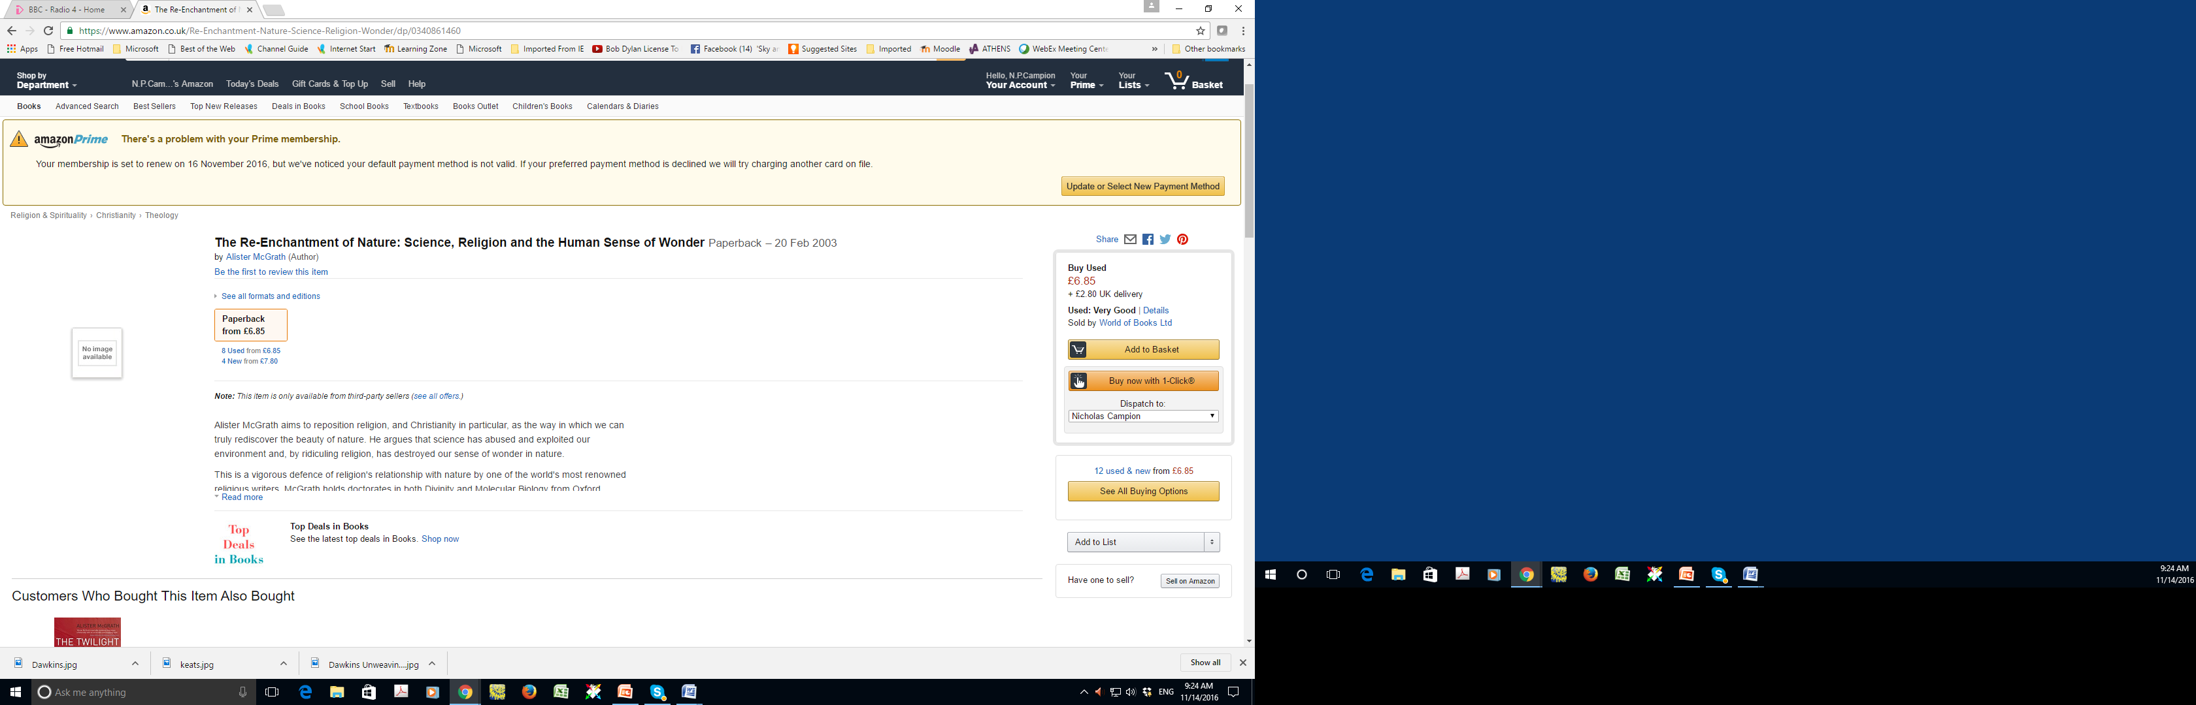
Re-enchantment

Slide 18
COUNTER-ARGUMENTS to Enchantment Theory
1.Historical – was magic really banished by the Reformation and Scientific Revolution?
Did Protestantism, with its advocacy of an intense personal relationship with God encourage enchantment?
Were rural people untouched by developments amongst the educated elite?
2.Sociological
What is the evidence to suggest that ‘belief’ in astrology, spirituality, is increasing?
(NB In my PhD I argued that there is no evidence)
3.Astrology
Regarding astrology in particular, is there any evidence that its appeal is based in a desire for enchantment?
4.Science and Astronomy
Is Weber’s view too narrow.
Can science and astronomy be enchanting?

Slide 20
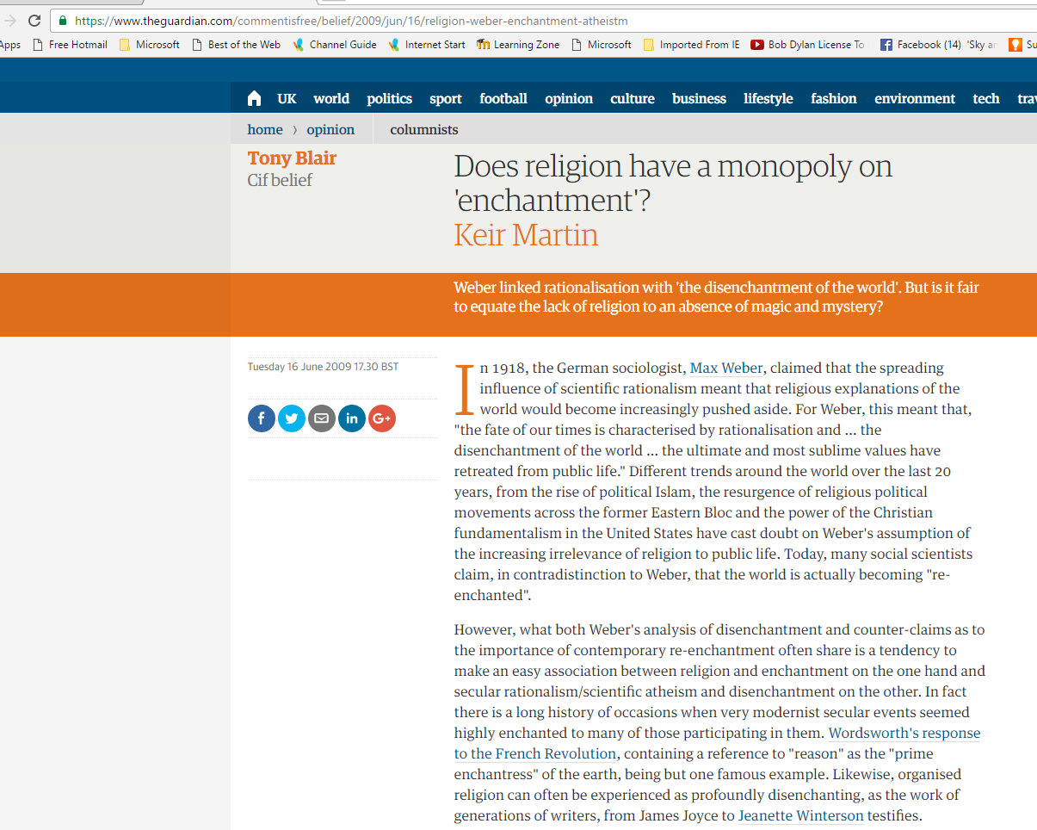

Slide 21
Can astronomy be enchanting?
With the naked eye…
Eclipses
Crescent Moons
With a telescope…
First sight of the rings of Saturn or the phases of Venus

Slide 22
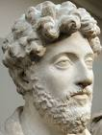
Astronomy as star-gazing and Enchantment: Marcus Aurelius
‘Survey the circling as though yourself were in mid-course with them. Often picture the changing and re-changing dance of the elements. Visions of this kind purge away the dross of our earth-bound life’.[1]
[1] . Marcus Aurelius, Meditations, trans. Maxwell Staniforth, Harmondsworth, Middlesex: Penguin, 1964, V.47, p. 112; see also IX.29, p. 144. See also Plato, Republic, 2 Vols, trans. Paul Shorey, Cambridge Mass., London: Harvard University Press 1937, 516B.

Slide 23
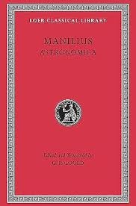
Manilius: Reason as Liberation (not disenchanting)
Before their times man lived in ignorance: he looked without comprehension at the outward appearance and saw not the design of nature’s works: he gazed in bewilderment at the strange new light of heaven, now sorrowing at its loss, now joyful at its birth....It (reason) freed men’s minds from wondering at portents by wresting from Jupiter his bolts and power of thunder and ascribing to the winds the noise and to the clouds the flame.[1]
[1] Manilius, Astronomica, I. 66-69, 105-8. CHECK

Slide 24
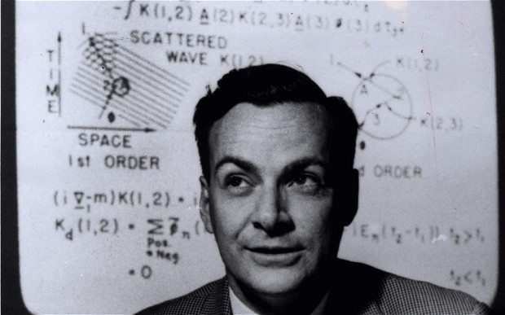
Science as enchanting: public descriptions of science:
description of a talk by the physicist Richard Feynman:
‘Scientists are sometimes accused of diminishing the beauty of the natural world by explaining it in terms of scientific ideas and processes. Not so, according to the late Nobel prize-winning physicist Richard Feynman, who says knowledge about the inner structure of flowers only adds to the excitement, mystery and awe of nature’.[1]
[1] http://www.abc.net.au/rn/inconversation/stories/2008/2276846.htm
http://www.youtube.com/watch?v=PsgBtOVzHKI

Slide 25
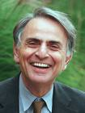
Carl Sagan: Re-enchantment through astronomy
We have grown distant from the Cosmos. It has seemed remote and irrelevant to everyday concerns, but science has found not only that the universe has a reeling and ecstatic grandeur, not only that it is accessible to human understanding, but also that we are, in a very real and profound sense, a part of that Cosmos, born from it, our fate deeply connected with it. The most basic human events and the most trivial trace back to the universe and its origins.[1]
[1] Sagan, Carl, Cosmos: the Story of Cosmic Evolution, Science and Civilisation, London: Warner Books 1994, p. 12.

Slide 26
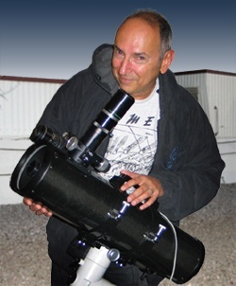
David Levy: enchantment through watching the sky
‘I was filled with a sense of the solar system in motion… Instead of watching Mercury meander across a silent backdrop, we watched it move gracefully from one solar feature to another…the closest planet to the Sun is capable of putting up a marvellous show’.[1]
[1] Levy, David H., ‘Our Memorable Mercury Transit’, Sky and Telescope, May 2007, pp. 84-5.

Slide 27
David Levy 2
‘About a minute later I saw Mercury’s first contact with the Sun’s photosphere, the surface visible in white light. Experiencing that double entry was an adventure we couldn’t have enjoyed before the development of hydrogen alpha filters.’[1]
(my italics)
Levy, David H., ‘Our Memorable Mercury Transit’, Sky and Telescope, May 2007, pp. 84-5.
Levy’s observing group included Eli Maor, author of the 2006 Princeton University Press publication, Venus in Transit.
Maor, Levy tells us, ‘is as interested in how the mathematics of the solar system allow such rare events as he is moved by the physical beauty of them’.[2]
[1] Levy, David H., ‘Our Memorable Mercury Transit’, Sky and Telescope, May 2007, p. 84.
[2] Levy, David H., ‘Our Memorable Mercury Transit’, Sky and Telescope, May 2007, p. 85.

Slide 28

Heather Couper
British astronomer and author
‘Astronomy is not just about the science. It’s visionary, inspirational and romantic’.[1]
[1] Heather Couper, ’Cosmic Quest’, BBC Radio 4, 29 May 2008.

Slide 29
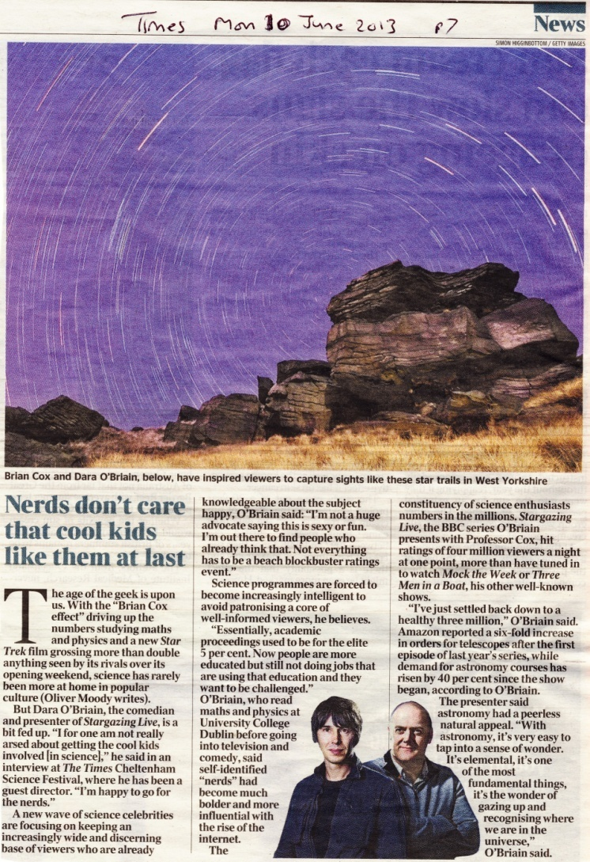
TV Presenter Dara O’Briain on the success of the programme Stargazing Live, which has three million viewers as opposed to two million for his comedy shows.:
‘With astronomy it’s very easy to tap into a sense of wonder. It’s elemental, it’s one of the most fundamental things, it’s the wonder of gazing up and recognising where we are in the universe’.
Dara O’Briain cited in Anon, ‘Nerds don’t care that cool kids like them at last’, The Times , 10 June 2013, p. 7.

Slide 30
Questions about Astrology?
Now: Is astrology enchanting or disenchanting?
Then: Did it originate in enchantment?
Does it require enchantment in order to be practised?
Does it require enchantment in order to be practised effectively?

Slide 31
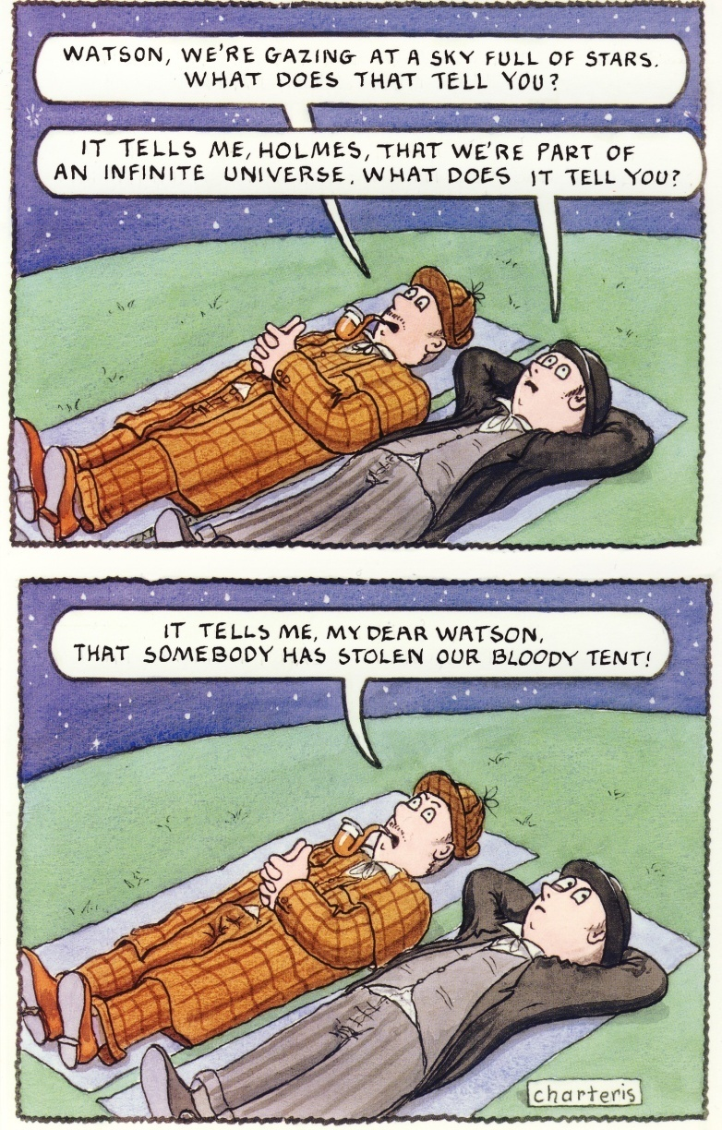
Is everyone enchanted by the sky?

Slide 32
Conclusion and Questions
The theory of enchantment, disenchantment and re-enchantment is one of the major theoretical models used to frame and understand contemporary interest in and practice of astrology in the west.
How is it possible for one person to tell whether another is enchanted?
If enchantment is an inner experience, how can one measure its effect?
There are two linked versions of the theory – the Historical and Sociological. Both are persuasive and widely accepted.
But, like all academic theories, they are open to question and revision.

Slide 33
Further Reading
Start with the reading for this week on Moodle
Search the web for primary and secondary (academic) sources.
Check JSTOR
Campion, Nicholas , ‘Enchantment and the Awe of the Heavens’, in Corsini, Enrico, (ed.),Proceedings of the sixth conference on the Inspiration of Astronomical Phenomena, Prvo, Utah: Astronomical Society of the Pacific, 2011, pp. 415-22.

