Slide 1
Introduction to Simulation
Network Simulation
Simon Downes
Material provided by Dr Carlene Campbell

Slide 2
What is Simulation?
A Simulation is the imitation of the operation of a real-world process or system over time.
Simulation allows us to examine the system’s behaviour under different scenarios
It is a form of modelling technique used to solve various real-world problems.

Slide 3
Why is Simulation important?
It is cost effective (in terms of cost & time)
It is more affordable
It is use by a wide range of industries and businesses as the first stage in testing new products and services.
  Simulation -> testbed -> trials -> implementation in the physical world.
It allows us to examine the system’s behaviour under different conditions

Slide 4
What is a Model?
A model is define as a representation of a system
  The main purpose of the model is to study that system, that affects the problem under investigation.
A computer model is a computer program that attempts to simulate an abstract model of a particular system.

Slide 5
Types of Model
Mathematical
Physical
Simulation model is a type of mathematical model of a system
A mathematical model uses symbolic notation and mathematical equations to represent a system.
Notes:
A mathematical model uses symbolic notation and mathematical equations to represent a system.
A physical model is a larger or smaller version of an object such as enlargement of an atom or scaled down version of the solar system.

Slide 6
Types of Simulation Model
  Continuous state or discrete state
  Continous-time or discrete time models
  Deterministic or probavilistic
  Linear or nonlinear models
  Open and closed models
  Stable or unstable models
  Local or distributed

Slide 7
Module simulation focus
  This module will focus on two simulation systems:
  Communication Systems
  Computer Networks Systems

Slide 8
Simulation of Communication System
The performance of communication systems can be evaluated using formula-based calculations, waveform-level simulation, or through hardware prototyping and measurements.
Simulation-based approaches to performance evaluation, systems can be modelled with almost any level of detail desired (subject, of course, to certain limitations).
The design space can be explored more finely than is possible with formula-based approaches or measurements.
Simulation-based approach can be combined with mathematical and empirical models easily, and incorporate measured characteristics of devices and actual signals into analysis and design.
Notes:
Empirical data:
Experimental
Observed

Slide 9
Simulation of Communication System
Simulated waveforms can be used as test signals for verifying the functionality of hardware.
A simulation-based approach can be used to create a rapid prototyping environment for analysis and design of communication and signal-processing systems, an environment in which software models can be combined with hardware data and real signals to produce designs that are timely, cost-effective, and error-free.
The primary disadvantage of the simulation approach is the computational burden, which can be reduced by a careful choice of modeling and simulation techniques.

Slide 10
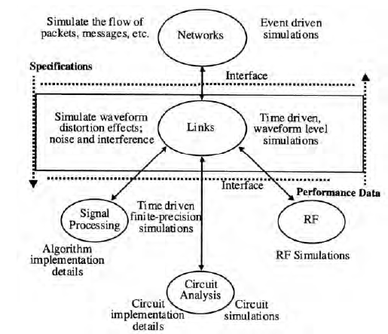
Hierarchical view of communication systems
Notes:
Communication links deal with the transmission of information-bearing waveforms over different types of communication channels (free space, cables, wires, optical fibers, etc.). For digital transmission systems, the performance of communication links is measured in terms of bit error characteristics, and the bit error rate performance is estimated by simulating the flow of waveforms using models for functional blocks such as modulators, encoders, filters, amplifiers, and channels. Whereas network simulations are used to establish specifications for
communication links, link-level simulations are used to verify that the link design meets these
specifications. The performance parameters obtained at the link-level simulation are exported up to the network-level simulator to verify the performance of the network.
Figure 1.1 deals with implementation of components such as filters and equalizers using either analog or digital technologies. Circuit simulators like Spice or digital simulators like HDL (Hardware Description Language) are used to simulate, verify functionality, and characterize the behavior of the components. Link-level simulations establish the specifications for implementation, and simulation at the implementation level is used to provide behavioral models which are exported back to the link level. An example of a behavioral model is the transfer function for a filter.

Slide 11
Matlab simulation example
Notes:
To illustrate the approach used in waveform-level simulations, a simplified model of a “generic” digital communication system shown in Figure 2. This model shows only a subset of the functional blocks in a typical digital communication system, and for discussion purposes, assume the interest is in evaluating the error-rate performance of this system as a function of the parameters of the filters (orders and bandwidths), the nonlinear amplifier (saturation level or peak power and operating point), and the signal-to-noise ratios for the two Gaussian noise sources. Assuming that the performance of the system is determined by the signal distortions introduced by the filters and the nonlinear amplifier, and by the two noise sources.

Slide 12
Simulink
Simulink is an “add-­‐on” to MATLAB.
You need to have MATLAB in order to use Simulink
Simulink is used Simulations of dynamic models
In Simulink we create a Graphical Block Diagram for the system (based on the differential equations(s))
http://www.mathworks.com/videos/simulink-­‐overview-­‐61216.html
Simulink is a layer 2 (Datalink) simulation tool
Matlab is a layer 1 (Physical) simulation tool

Slide 13
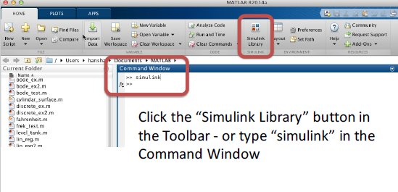
Start Simulink from Matlab

Slide 14
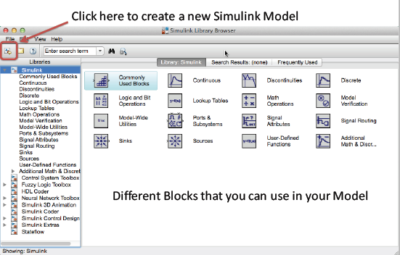
Simulink Library Browser

Slide 15
Simulink Model Editor

Slide 16
NetSim
Netsim is a network simulation tool that allows you to create network:
  Scenarios
  Model
  Traffic
  Study performance metrics
Notes:
A network is a set of hardware devices connected together, either physically or logically to exchange information.
A simulation is the imitation of the operation of real-world process or system over time.
Network Simulation is a technique where a program models the behaviour of a network either calculating the interaction between the different network entities (host/routers, data links, packets, etc) using mathematical formulae, or actually capturing and playing back observation from a production network. The behaviour of the network and the various applications and services it supports can then be observed in a test; various attributes of the environment can also be modifies in a controlled manner to assess how the network would behave under different conditions.

Slide 17
What does NetSim provide?
Simulation: NetSim provides simulation of various protocols working in various networks as follows:
      Internetworks,
      Legacy Networks,
      BGP Networks,
      Advanced Wireless Networks,
      Cellular Networks,
      Wireless Sensor Networks,
      Personal Area Networks,
      LTE/LTE-A Networks,
      Cognitive Radio Networks, and
      Internet of Things.
  Users can open the experiments and save the experiments as desired. The different experiments can also be analyzed using the analytics option in the simulation menu.
Programming
Notes:
Programming: NetSim covers various programming exercises along with concepts, algorithms, pseudo code and flowcharts. Users can also write their own source codes in C/C++ and can link them to NetSim.
Some of the programming concepts are Address resolution protocol (ARP), Classless inter domain routing (CIDR), Cryptography, Distance vector routing, shortest path, Subnetting etc.

Slide 18
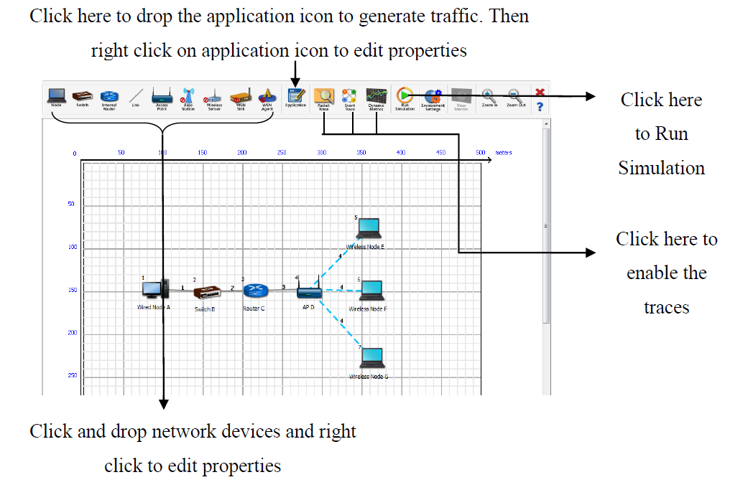
NetSim Network Model
www.youtube.com/tetcos.
Notes:
Network model: A Network model is a flexible way of representing devices and their relationships. Networking devices like hubs, switches, routers, nodes, connecting wires etc. are used to create a network model.
Scenario: A Scenario is a narrative describing foreseeable interactions of types of input data and its respective output data in the system.
Network performance: To measure the performance of a network, performance metrics constitutes of Network Statistics.

Slide 19
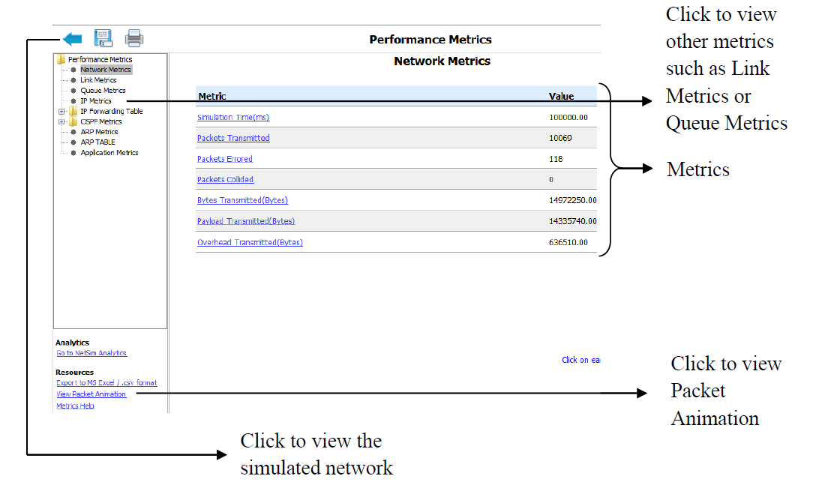
NetSim network Statistics
What are network statistics?
  Network statistics are network performance related metrics displayed after simulating a network. The report at the end of the completion of a simulation experiment include metrics like throughput, simulation time, frames generated, frames dropped, frames errored, collision counts etc, and their respective values.
Notes:
What are network statistics?
Network statistics are network performance related metrics displayed after simulating a network. The report at the end of the completion of a simulation experiment include metrics like throughput, simulation time, frames generated, frames dropped, frames errored, collision counts etc, and their respective values.
What is Packet Animation?
When running simulation, options are available to play and record animations which allow users to watch traffic flow through the network for in-depth visualization and analysis.

Slide 20
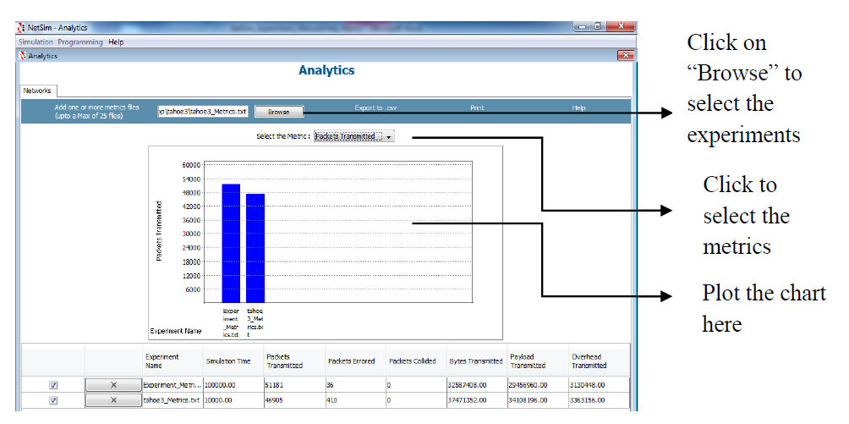
NetSim Analytics example
What is NetSim analytics used for?
  It is used to compare and analyze various protocols scenarios under Internetworks, Legacy Networks, BGP Networks, Advanced Wireless Networks – MANET and Wi-Max, Cellular Networks, Wireless Sensor Networks, Zigbee Networks, Internet of Things, LTE/LTE-A Networks and Cognitive Radio Networks. Parameters like utilization, loss, queuing delay, transmission time etc of different sample experiments are compared with help of graphs.
Notes:
What is NetSim analytics used for?
It is used to compare and analyze various protocols scenarios under Internetworks, Legacy Networks, BGP Networks, Advanced Wireless Networks – MANET and Wi-Max, Cellular Networks, Wireless Sensor Networks, Zigbee Networks, Internet of Things, LTE/LTE-A Networks and Cognitive Radio Networks. Parameters like utilization, loss, queuing delay, transmission time etc of different sample experiments are compared with help of graphs.

Slide 21
Questions?

