Slide 1




Slide 2
Table of content
Summary of research proposal
Evaluation of research proposal
Alternative approaches & considerations
Expected findings & contributions
References

Slide 3
Table of content
Summary of research proposal
Evaluation of research proposal
Alternative approaches & considerations
Expected findings & contributions
References

Slide 4

2. Summary of research proposal (1/5)
Background & context
2.1x

Slide 5
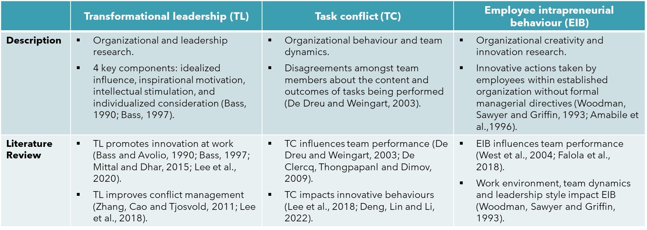
2. Summary of research proposal (2/5)
Key concepts

Slide 6

2. Summary of research proposal (3/5)
Research objectives

Slide 7

2. Summary of research proposal (4/5)
Research methodology

Slide 8

2. Summary of research proposal (5/5)
Expected findings

Slide 9
Table of content
Summary of research proposal
Evaluation of research proposal
Alternative approaches & considerations
Expected findings & contributions
References

Slide 10
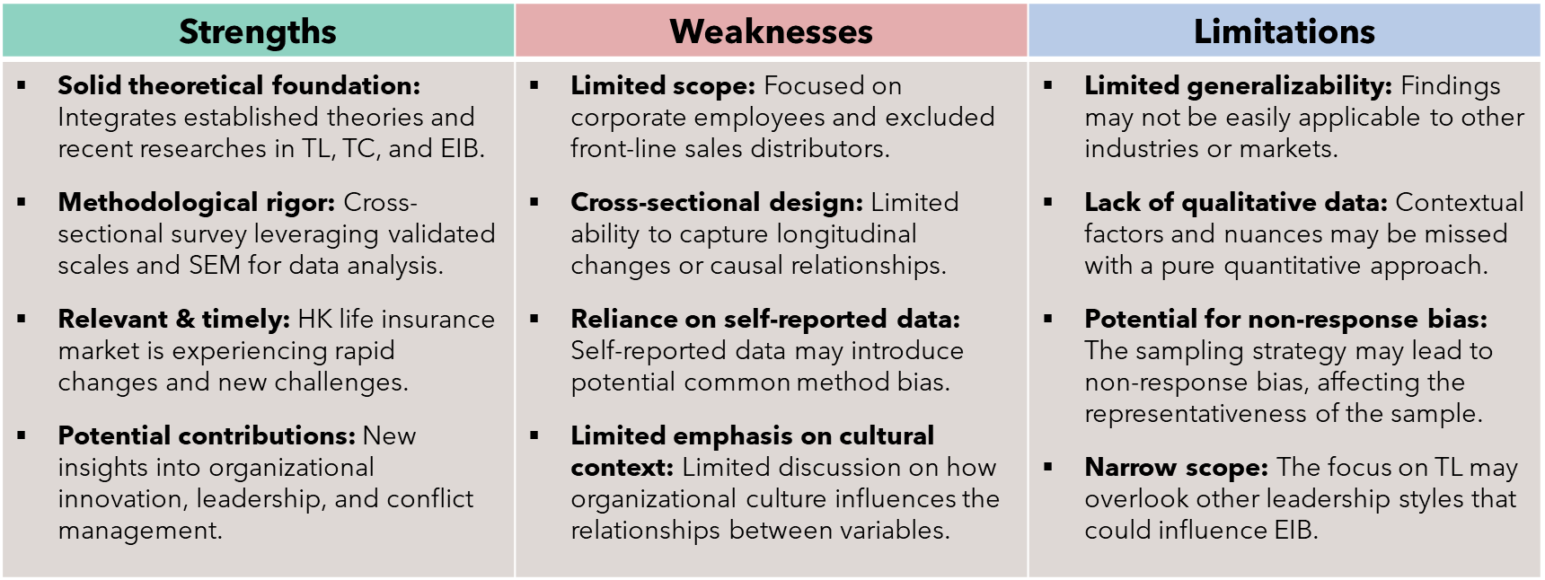
3. Evaluation of research proposal
Strengths, Weaknesses, and Limitations

Slide 11
Table of content
Summary of research proposal
Evaluation of research proposal
Alternative approaches & considerations
Expected findings & contributions
References

Slide 12

4. Alternative approaches & considerations

Slide 13
Table of content
Summary of research proposal
Evaluation of research proposal
Alternative approaches & considerations
Expected findings & contributions
References

Slide 14


5. Expected findings & contributions

Slide 15
Table of content
Summary of research proposal
Evaluation of research proposal
Alternative approaches & considerations
Expected findings & contributions
References

Slide 16

References (1/3)

Slide 17

References (2/3)

Slide 18

References (3/3)

Slide 19
Thank you

