Slide 1
PSYCHOLOGY IN HEALTH AND SOCIAL CARE
Module Number : LCHS 4010 (LON)
Assignment Number : ASSIGNMENT 1
Student Name : IMELDA LOBRIO RESURRECCION
Student ID : 2508294
Lecturer : PEACE UKACHUKWU
I confirm that I have used AI tools to source images and/or for proofreading this work CO-PILOT on 10/07/2026). I confirmed that I have not presented any AI generated materials as my own work.

Slide 2

INTRODUCTION(DFE,2023)
As a Trainee Early Years Support Worker, the role is to support young children learning, development, and wellbeing.
In a Children’s Centre, responsibilities include supporting children aged 0–5 in their social, emotional, and developmental growth.
Assisting with activities that promote cognitive, physical, and social skills.
Provide emotional and physical care, ensuring children feel safe, secure, and valued, and promoting health and wellbeing
This Photo by Unknown Author is licensed under CC BY-NC-ND

Slide 3
ISAAC’S CASE
Mum has post-natal depression
Has had disordered childcare setting over the past two years.
He is quiet and tends to keep to himself, shows slower progress in developing language skills, and finds it difficult to take part in group activities.
He struggles to settle to sleep and often seeks constant closeness or reassurances.

Slide 4
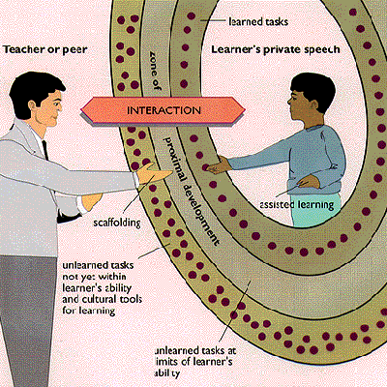
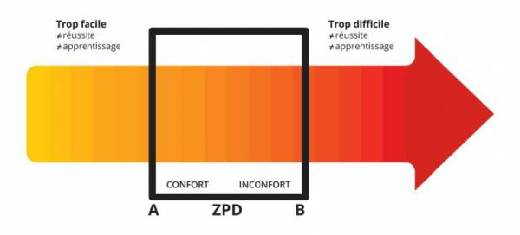
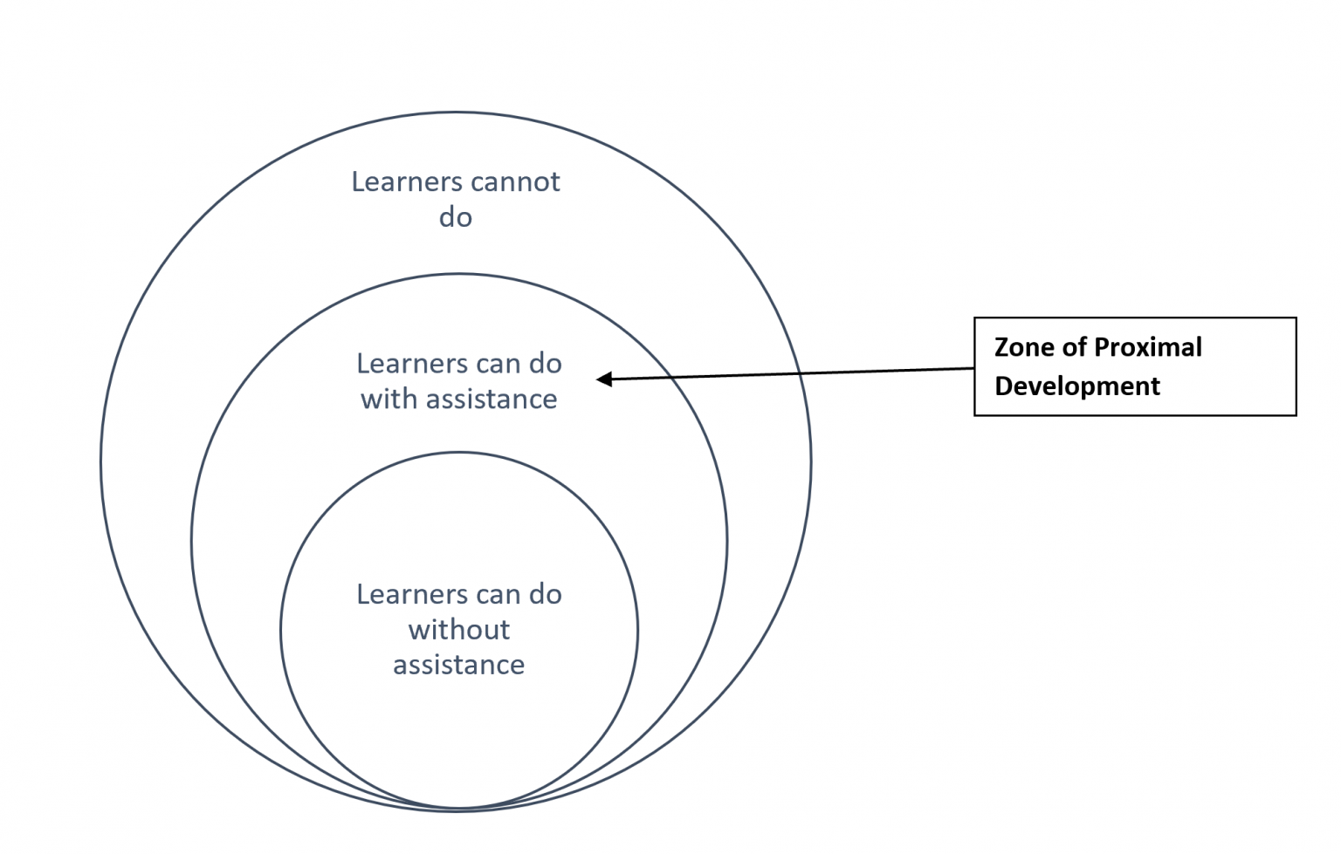
VYGOTZSKY KEY THEORY OF DEVELOPMENT(Vygotsky, 1978)
VYGOTZSKY BELIEVED THAT CHILDREN LEARN AND DEVELOP MAINLY THROUGH SOCIAL INTERACTION. This means children grow by talking, watching, and working with others, especially adults or more skilled peers.
ZPD-Zone of Proximal Development is the gap between what a child can do alone and what they can do with help(Mcleod, 2024)
MKO ( More Knowledge Other)-children develop because people around them teach, guide, and support them. Social interaction builds thinking skills.
This Photo by Unknown Author is licensed under CC BY-SA-NC
This Photo by Unknown Author is licensed under CC BY-SA
This Photo by Unknown Author is licensed under CC BY-NC-ND

Slide 5
Why this theory relates to Isaac’s situation
Isaac’s learning is affected by his Zone of Proximal Development (ZPD), which means a difference between what he can do alone and with help from others. Isaac’s emotional reactions like getting upset, pulling away, or becoming clingy and his delay in language make it hard for adults to see what he can really do. This means they might not give the right level of help at the right time.

Slide 6
STRATEGIES AND INTERVENTIONS TO HELP ISAAC
Use
Use consistent routines so Isaac knows what to expect.
Provide
Provide visual timetables to reduce anxiety and support transitions.
Use
Use familiar cultural tools (songs, stories, objects) to help him connect learning to real life.

Slide 7
BIOLOGICAL AND ENVIRONMENTAL FACTORS
Nature (biological factors) in Isaac’s development:
Isaac’s age determines his cognitive readiness for certain tasks.
His biological attention span may limit how long he can stay focused.
Any developmental delays or strengths influence his ZPD.
His sensory or motor abilities affect how he engages with learning tasks.
Nurture (social/cultural factors) in Isaac’s development:
Scaffolding supports him until he can perform tasks independently.
Isaac’s teacher or parent acts as the MKO, guiding him tasks he cannot do alone.
Language used during instruction helps him organize thought and develop reasoning. Burkholder, E.O. and Peláez, M. (2000).

Slide 8

STRENGTH OF VYGOTZSKY THEORY
Group work
Peer learning
Guided participation
Scaffolding
His theory acknowledges that children grow within cultural experiences, not in isolation. This is a strength because it explains why children in different societies develop different skills and behaviors (Daniels, H. (2008).

Slide 9
WEAKNESSES OF VYGOTZSKY THEORY
Too much focus on social interaction. This is a weakness because he did not explain well about how children learn on their own pace.
Note enough attention to Biology like brain growth, genetics, or delays. Therefore his theory cannot fully explain children with developmental or learning difficulties.
Moreover If a child does not have good support at home or school, the theory doesn’t work well.

Slide 10
CONCLUSION
Vygotsky’s theory helps explain Isaac’s learning because it shows that children develop best when they get support from adults or more skilled peers. His emotional reactions and language delay can make learning harder, but with calm guidance, clear communication, and the right level of help, Isaac can make good progress. Overall, Isaac needs a supportive environment where adults understand his needs and help him grow at his own pace.

Slide 11
REFERENCES
Department for Education( 2023) gov UK early years practitioner. Available at: https://www.gov.uk/government/publications/early-years-foundation-stage-framework--2 (Accessed: 11 July 2026
Vygotsky, L.S. 1978, Mind in society: The development of higher psychological processes, Harvard University Press, Cambridge, MA.(Accessed:11 July 2026)
NHS (2023) Helping your child to talk. Available at: https://www.nhs.uk/conditions/baby/communication-and-language/helping-your-child-to-talk/ ( Accessed: 11 July 2026).
McLeod, S. (2024) Zone of Proximal Development (ZPD). Available at: https://www.simplypsychology.org/zone-of-proximal-development.html (Accessed 11 July 2026).
Department for Education (DFE) (2023) Early Years Foundation Stage (EYFS) Framework. Available at: https://www.gov.uk/government/publications/early-years-foundation-stage-framework--2 (Accessed: 11 July 2026).

Slide 12
Public Health England (2020) Best Start in Life: Improving early language development.Available at:https://www.gov.uk/government/publications/best-start-in-life-improving-early-language-development ( Accessed: 11 July 2026).
Burkholder, E.O. and Peláez, M. (2000) ‘A behavioural interpretation of Vygotsky’s theory of thought, language, and culture’, Behavioral Development Bulletin, 9(1), pp. 7–9.
Daniels, H. (2008) Vygotsky and Research. London: Routledge.

