Slide 1
Strategic Management in Policing Module
Wythnos 5
Trosolwg Aseiniad
Week 5:
Assignment Overview

Slide 2

Week 5 – Assignment Overview
By the end of the session students will be able to:
Aware of submission deadline and associated matters
Able to read the assignment and identify key words
Understand the requirements of the assignment – its structure and contents
Introduced to software that may assist in compiling the assessment.

Slide 3

Submission date
Submission deadline:
23:59hrs
Tuesday 30th April 2024
Pass mark 50%
***Turnitin is now open***
Notes:
Further details can be found within the assignment booklet which will be available on Moodle.
You have 8 weeks today to submission

Slide 4

General overview
Submission deadline is : 23:59hrs on Tuesday 30th April 2024
5,000 words (+/- 10% - MAXIMUM is 5,500 words)
All written assessments, where practical and possible, must be submitted via Turnitin unless otherwise instructed (Please DO NOT put this assessment specification into Turnitin or it will match many similarities with other students’ submissions.) Turnitin portal is Open now.
Late submission of the assessment will result in a late penalty mark. Penalties for late submission: Up to one week late, maximum mark of 50%. Over one week late, 0%.
Reminder regarding honesty, plagiarism, collusion etc

Slide 5

Understanding the assignment
Directive word
Topic
Limitations
Notes:
Three key things to identify before you begin
Directive word – what do you think that is?
Topic – or subject area
Limitations – anything that restricts you?
And lets break the actual assignment down into 3 separate parts

Slide 6
The Assignment brief - 2024
Students are required to choose ONE task from the following two options:
1a. Write a 3,500-word report on the development of a strategic plan for a specialist area of policing. Students will describe how theories of strategic management relate to the development of their plan and will ensure that the report is underpinned with academic theory and sources.
1b. To support the strategic plan, design an infographic that outlines the key messages of the plan, which must be supported by academic sources. This will be an equivalent of 1,500 words.
OR
2. Write a 5000-word report on the development of a strategic plan for a specialist area of policing. Students will describe how theories of strategic management relate to the development of their plan and will ensure that the report is underpinned with academic theory and sources.

Slide 7
Breakdown the assignment
1a. Write a 3,500-word report on the development of a strategic plan for a specialist area of policing. Students will describe how theories of strategic management relate to the development of their plan and will ensure that the report is underpinned with academic theory and sources.
1b. To support the strategic plan, design an infographic that outlines the key messages of the plan, which must be supported by academic sources. This will be an equivalent of 1,500 words.
Notes:
Firstly read the assignment carefully. If you are unsure of any words look them up in a dictionary – translate the questions into words that will make it easier for you to understand.
So How many components are there that you need to cover?
Answer - Option 1 – two components = Report & infographic
So lets identify the 3 key areas – directive word, topic and limitations
What are the directive words here? Part 1a - Answer – write, describe, ensure
Part 1b – design , outlines
What is/are the topic area – Answer: strategic planning, strategic management
What are the limitations – Answer – specialist area of policing, key messages and word counts

Slide 8
2. Breakdown the assignment
2. Write a 5000-word report on the development of a strategic plan for a specialist area of policing. Students will describe how theories of strategic management relate to the development of their plan and will ensure that the report is underpinned with academic theory and sources. ​
Notes:
Again lets look for the 3 key areas
Directive word/s - write, describe, ensure
Topic – strategic planning, strategic management
Limitations – word count and one specialist area of policing

Slide 9
Read the assignment brief for ALL instructions
Paragraph 5
As students explore central issues of strategic management in policing, and within their own specialist areas, they are required to critically assess and evaluate the current position and key theories and concepts and apply these to their report.
This assignment is designed for students to engage with the existing literature covered during the lectures, together with their own research and professional practice in constructing the report.
Option 1 above will further offer an opportunity of creativity and communication by designing an infographic that will summarise and highlight key messages within their strategic plan.
Notes:
Don't forget to read ALL instructions of the assignment brief.
Are there any other relevant instructions for you??
In Paragraph 5 – there is the following instruction which I have highlighted in bold so that you are aware of its significance to your report
As students explore central issues of strategic management in policing, and within their own specialist areas, they are required to critically assess and evaluate the current position and key theories and concepts and apply these to their report.
So within this paragraph there are specific directive words that you need to consider - what are they?
Answer – Critically assess and evaluate

Slide 10

Directive words – what do they mean for your assignment?
Describe
To provide a detailed explanation as to how and why something happens
Outlines
To convey the main points placing emphasis on global structures and interrelationships rather than minute detail'
Notes:
What does 'DESCRIBE' mean?
Answer – to give a detailed account of in words
Academically – for assignment purposes it means - ' to provide a detailed explanation as to how and why something happens'
What does 'OUTLINE' mean?
Answer: a general description or plan showing the essential features of something but not the detail
Academically – for assignment purposes it means to put forward the main points placing emphasis on global concepts/theories and structures rather than just concentrating on the smaller details

Slide 11
Directive words – what do they mean?
Assess
Weigh up to what extent something is true. Persuade your reader of your argument by using sources but point out any flaws/counter-arguments. Conclude by stating clearly your agreement with the original proposition
Evaluate
To give your verdict as to what extent a statement or finding is true or what extent you agree with them. Provide evidence taken from sources.
Notes:
What do we mean by 'ASSESS'?
Answer: estimate the nature, ability or quality of something
Academically - Weigh up to what extent something is true. Persuade your reader of your argument by using sources but point out any flaws/counter-arguments. Conclude by stating clearly your agreement with the original proposition
What do we mean by 'EVALUATE'?
Answer : to judge or determine the value or significance of something or its value
Academically - To give your verdict as to what extent a statement or finding is true or what extent you agree with them. Provide evidence taken from sources.

Slide 12
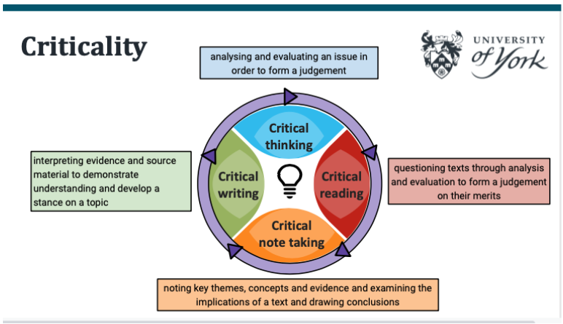
Directive words – what do they mean?
Critically
Provide evidence taken from sources which both agree and disagree/contradict an argument . Come to a final conclusion, basing your decision on what you judge to be the most important factors, justify how you have made your choice.
Notes:
What do you understand by the word 'CRITICALLY'?
Answer :showing you have thought seriously about something, considering what is good and what is bad about it:
Academically : Being critical in your writing means engaging in academic debates and research happening in your subject area.
from sources which both agree and disagree/contradict an argument . Come to a final conclusion, basing your decision on what you judge to be the most important factors, justify how you have made your choice

Slide 13
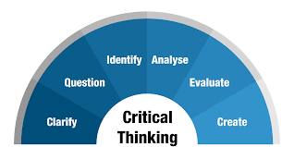
Critical thinking…
To think critically is to examine ideas, evaluate them against what you already know, and make decisions about their merit. The aim of critical thinking is to maintain an ‘objective’ position. When you think critically, you weigh up all sides of an argument by evaluating its strengths and weaknesses’
(Open University, 2018)
Notes:
Its really mportant to demonstrate critical thinking and writing within your assignment – look back to the assignment instructions – it ask syou to CRITICALLY assess and evaluate.

Slide 14

What is a Report?
Academic paper
Objectively written and focused
Written in 3rd person
Critical thought/analysis on a subject/event
Clear lines of argument
Introduces different perspectives as well as your own
Refers to strategic management theories/models
Notes:
Although referred to as a ‘report’ it is still an academic paper
Written objectively , focus on the topic and keep to the point
Most academic assignments are written in the 3rd person – including this one. Reflective reports are written in the 1st person like your previous assignment as you referred to your views, thoughts, experiences etc. But for this one write in the 3rd person
Requirements to critically assess and evaluate different aspects of the subject
And evidence a clear line of argument using sources to support or otherwise those arguments/views
Introduce different perspectives not only your own

Slide 15
Essential stages of writing your assignment
1. Understanding the assignment brief
2. Gathering and selecting information
3. Organising your material
4.Analysing your material
5. Writing your report
Notes:
STEP 1 - This is the most important stage. You need to be confident that you understand the requirements of the assignment brief – if in doubt ask/drop me an email.
We've gone through this already in quite a bit of detail.
STEP 2 – once you’re clear about the requirements of the assignment, Make some decisions around a) the specialist area of policing that you wish to refer to.
Previous papers choose areas such as a schools programme, offender management,
b) the theories and concepts of strategic management and planning that you wish to refer to
. Then spend a bit of time researching them. Read around them and get some good balanced views around them – as you read and gather information make sure that you assess its relevance to your report so that you can then highlight what you may use or what you will discard very early on. Don’t waste time reading something if its not going to be of any use to you. If need be keep referring back to your assignment brief to keep you on track and to help you decide if it is relevant.
STEP 3 – once you’ve finished doing your information gathering and decided what you want to keep and include, organise the information into groups so that points that are related are in the same group which will help you then to know which section of your writing they will appear in OR in what sequence so that your report is structured and easy to follow. Sometime its good to have some headings here to help you along.
Choose an order for your material that is logical and easy to follow
STAGE 4 – Before you start on your draft – take some time and make notes on the points you’ll make using the facts and evidence/quotations you have gathered. What conclusions can be drawn from the material, do any pieces of information conflict with one another?
NB – don’t just present the information you’ve gathered – it must relate to the problem or issue in your assignment brief i.e. strategic planning in a specific context

Slide 16

Step 5 – Writing your report
Notes:
Choosing a structure to your report is down to your discretion – I will show you two structures there are others that you could use or you could develop your own

Slide 17
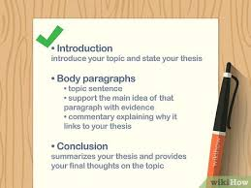
Simple report structure
1. Introduction
2. Main body
3. Conclusion
Introduce main idea of paragraph
Explain and expand the idea, define any key terms
Present relevant evidence to support your point
Comment on each piece of evidence
Conclude by showing relevance to report or link to next paragraph
Direct and precise
Avoid waffle
Make points clearly and concisely
Structure your paragraphs to help you
Notes:
STEP 5 – WRITING YOUR REPORT
Easiest structure is within 3 steps – introduction, main body and conclusion
Some people like to work out their word count in advance to give them an idea of where most of their word count will lie and to give themselves a structure around that.
Aim for a writing style that is clear and precise
Avoid waffle and make points clearly and concisely
Structure your paragraphs if it helps you
Middle box gives some guidance on how to structure paragraphs
I am happy for you to use headings if it will help you structure your report
NB – these headings are NOT included in your word count

Slide 18
Academic Report Structure
Title page
Contents page
Executive summary
Introduction
Main findings
Conclusions
Recommendations
References/Bibliography
Appendicies
Notes:
There are 9 sections to this structure

Slide 19
Report structure breakdown
Executive Summary – this sets out for the reader the essence of the report – in other words the key points of the report. This report is 5000 words and therefore consider the audience and for those who just want an overview of the main elements the executive summary should be able to capture the key elements.
Introduction – This is where you set the context of the assignment. You may want to consider some of the broader literature in relation to strategy and strategic management and the rationale for the development of a strategic plan for your chosen policing area. ​
Notes:
Students may use any format their wish in setting out their report, but as a guide the following may provide a broad structure for their submission.
Title Page
Contents Page
Executive Summary – this sets out for the reader the essence of the report – in other words the key points of the report. This report is 5000 words and therefore consider the audience and for those who just want an overview of the main elements the executive summary should be able to capture the key elements.
Introduction – This is where you set the context of the assignment. You may want to consider some of the broader literature in relation to strategy and strategic management and the rationale for the development of a strategic plan for your organisation.

Slide 20
Report structure breakdown
  Main findings - (This is the main body of the report and sets out what, when & how you propose to implement your plan). ​
    this is where you would cover the detail – in other words the components of the strategic plan what approach would you take and how is that support by the theory. What elements would deem necessary in order to formulate a coherent strategic plan​
    This is your assignment – make it your own.
Conclusions – draw together everything you’ve found and discussed and highlight any KEY matters and how it applies to the policing area of your choice. ​
Notes:
Main findings - (This is the main body of the report and sets out what, when & how you propose to implement your plan).
this is where you would cover the detail – in other words the components of the strategic plan what approach would you take and how is that support by the theory. What elements would deem necessary in order to formulate a coherent strategic plan
remember week make it your own.
Conclusions – draw together everything you’ve and set out what you have found in the literature and how it applies to the organisation of your choice.

Slide 21
Final bits....
Recommendations – simply suggest a set of recommendation based on the work you have done what you would recommend in terms of action based on the work that you have done. E.g. How would you go about delivering your approach.
  References – see below – Harvard referencing a must. ​
  Appendices – this does not count towards your word count – but must be set out properly and must be relevant to the content and not a substitute for material you can’t fit into the main body of the report. ​
Notes:
Recommendations – simply set of recommendation setting out what based on the work you have done what you would recommend in terms of action. How would you go about delivering your approach.
References – see below – Harvard referencing a must.
Appendices – this does not count towards your word count – but must be set out properly and must be relevant to the content and not a substitute for material you can’t fit into the main body of the report.

Slide 22
Content of your report – some ideas
What is strategic management
What is strategy
What is strategic planning
What theories/concepts underpin
What models can be used to assist
5P's approach
Aims and objectives
Mission goal and values
Strategy & strategic planning
Strategic options
Strategic analysis
Environmental analysis
SWOT/PESTEL
Performance management
Managing change

Slide 23

Presentation of your work
Work should be presented in a professional manner. Using Arial font size 12 and double spacing your work will mean that it is easier to proof-read prior to formal submission.
Harvard referencing system – a must – Make sure you use the guidance on Moodle and reference according to Harvard referencing principles.
Use the marking rubric – it’s there to help you cross check!

Slide 24
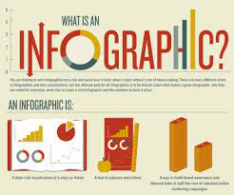

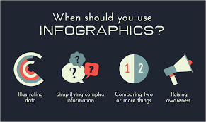
Infographic
A visual representation of information or data, e.g. as a chart or diagram.
Notes:
What are infographics?
A visual representation of information or data e.g a chart or diagram

Slide 25
3 Types of infographics
Statistical. One of the most popular infographic templates is one based on data and numbers. ...
Informational. This type of infographic is equally as popular however, instead of using numbers, it implements text-based information. ...
Process. Infographics that display a process show points in a linear order. They break down a task into a series of easy-to-follow steps
Visual
Informational
Scannable
Notes:
There are three successful types of infographics you can create, based on the kind of information you want to share: (source informaticsinc.com)
1. Statistical
One of the most popular infographic templates is one based on data and numbers. All infographics should have a compelling story, useful data for support, and visually appealing illustrations to emphasize the content. A statistical infographic will use large bold text to illustrate the data in an order that makes the most sense to the storyline. Data can be boring to read but when displayed in a creative way your audience will pay attention to the numbers!
2. Informational
This type of infographic is equally as popular however, instead of using numbers, it implements text-based information. Because it is focused on text, it covers a broad range of other templates. This could include brochures, instructional guidelines, even short presentations. The best way to incorporate text with any template is to use lists. Consumers like bullet points, numbers, and easy ways to read short text fast. When creating your infographic, think carefully about the direction your consumer is reading and create a storyline that makes the most sense. All parts of your content will be read and understood by your consumer once created properly.
3. Process
Infographics that display a process show points in a linear order. They break down a task into a series of easy-to-follow steps. The goal of this kind of graphic is to turn complex information of any sort into easily understood concepts. The key to a successful process infographic is being able to clearly label directions so a consumer can easily follow all steps. Using icons and numerical lists help lead the viewer through each of these steps. After reading, a consumer should feel prepared to complete the task included.
Why People Like Infographics
Visual
Informational
Scannable
We are visual people in a fast-paced world, making infographics the perfect way to consume large amounts of information quickly and efficiently. Since numbers can be mind-numbingly boring, infographics find a way to share statistics in a fun way that is easy to scan and digest in no time at all.

Slide 26
Tips for building infographics
Define your purpose
Know your audience
Break up your content
Typography matters
Tell a story
Notes:
Tips for building your infographic
Creating a strong and effective infographic requires careful planning and design to effectively convey your information. Here are five tips from the Informatics design team for creating a compelling infographic:
1. Define Your Purpose
Clearly define the purpose of your infographic before you ever put pen to paper. Are you trying to explain a process, showcase data trends, or compare different aspects of your business? Understanding your objective will ease the design process.
2. Know Your Audience
Always tailor your infographic to your target audience's preferences and level of understanding. Consider their interests, knowledge level, and the message you want to convey—how can you synthesize that information into an effective targeted piece?
3. Break Up Your Content
The most successful infographics simplify complex information. Break your content into easily digestible chunks, and use graphics such as charts, graphs, and icons to make it visually engaging. When planning your entire piece, design a clear and logical layout that guides the viewer's eye through the infographic.
4. Typography Matters
Choose easy-to-read fonts that complement your design and maintain consistency throughout the infographic. Use different font sizes, weights, and styles to emphasize key points and maintain a visual hierarchy.
5. Tell a Story
The best infographics bring together data, design, and content to tell an emotional story. Tell yours by organizing it in a narrative flow. Start with an attention-grabbing head, introduce the problem, explain the solution(s) and end with a strong call to action.

Slide 27
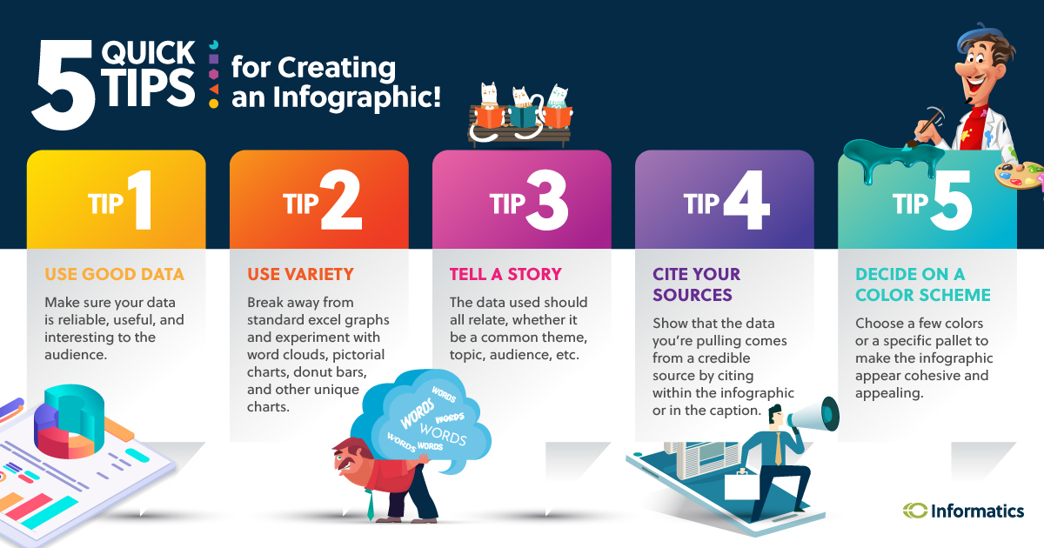
Notes:
1. Use Good Data
Don’t just make an infographic for the purpose of making one. Be sure that you have useful, interesting data to provide to your specific audience. Gather reliable statistics and facts that somehow relate to one another.
2. Use Variety
When laying out your infographic, employ a variety of information, from percentages and ratios to word clouds and bar graphs. This will keep your infographic interesting and show that it is more than just a series of Excel graphs.
3. Tell a Story
Your infographic should tell a story. As mentioned in Tip #1, the stats and facts should relate to one another in some interesting way. If your data is random and it is difficult to determine the connection, your infographic has no purpose other than being a dumping ground for random statistics. Know what your story is before you begin.
4. Cite Your Sources
The data you are using is most likely not your own. Thus, it is vital that you cite your sources and give credit where credit is due. This will let your viewers know that both you and your infographic can be trusted, as well as providing them with a source to gather more information on a specific topic if they would like.
5. Decide on a Color Scheme
Last but not least, decide on a color scheme that makes sense and doesn’t overwhelm. Do not begin creating your infographic without knowing the colors that you will be using. Determine the number and types of colors so that you may use them appropriately.

Slide 28
Useful websites for infographic designing
What is an Infographic? Examples, Templates, Design Tips (venngage.com)
https://youtu.be/VoEAxhhOV64
https://youtu.be/WkSYjZRgtqI
https://youtu.be/W1v3ILOnfGs
Link to Canva – free soft ware – create an account
Login to your Canva account

Slide 29
Submission date
Submission deadline:
23:59hrs
Tuesday 30th April 2024
Pass mark 50%
***Turnitin is now open***
Notes:
Just a reminder
I will send an email regarding a cut off date for drafts once I know what I am working over Easter
Turniti draft submission portal is open for you to check similarity scores
You have 8 weeks to submission – so plenty of time

Slide 30
Top tips
Choose a policing area that you are familiar with
Think about the approach you would adopt to the development of a strategic plan for the policing area – what elements do you think are critical – think through the materials and read around those areas to develop and informed view of what you would include and how you would approach the key elements.
Use good sources for the 'critical' element of your writing
Plan well, read widely, take notes, organise your notes.
Choose an options that meets your strengths as a learner.

Slide 31

Examples
Examples of previous submissions will be released on Moodle – BUT have a go yourself first!!

Slide 32

Worst case scenario
There is NO worst case scenario
Speak with me early

Slide 33
Extenuating Circumstances (EC’s)
Useful information:
Student’s Union - https://www.uwtsdunion.co.uk/extenuating-circumstances
Academic Handbook
https://www.uwtsd.ac.uk/academic-office/appendices-and-forms/

Slide 34

Questions/concerns?

