Slide 1
Module Name : Electronics I
Module Code : ACDB5002
Lecture : 6
Topic : Single, Split and Multi- rails
Power supply
Lecture By,
Mrs. Jenifer Prince Devaraj,
Lecturer - Embedded Electronics,
Faculty of Applied Computing,
UWTSD
Email:j.prince-devaraj@uwtsd.ac.uk

Slide 2
Power Supply Rails
Power Supply Rails
The power supply units which are used in PC converts the energy that comes from the socket (alternating current) into direct current that the PC can use.
PSU can use rails to operate different components by having different voltages.
Example Voltages can be +12V, +5V, +3.3 V etc…

Slide 3
Power Supply Rails
Voltage Rails
A voltage rail is a supply of voltage in varying amounts, used by different system components depending on their voltage requirements.
For example,
    a PCI network card will likely draw power from the +5 V rail.
    the motors for the CPU fans will draw power from the +12 V rail.
Simply, the voltage rails are the levels of voltage available for use by any system component.

Slide 4
Power Supply Rails
Types of Power Supply Units
Single Rail PSU
Multi- Rail PSU
Split – Rail PSU

Slide 5
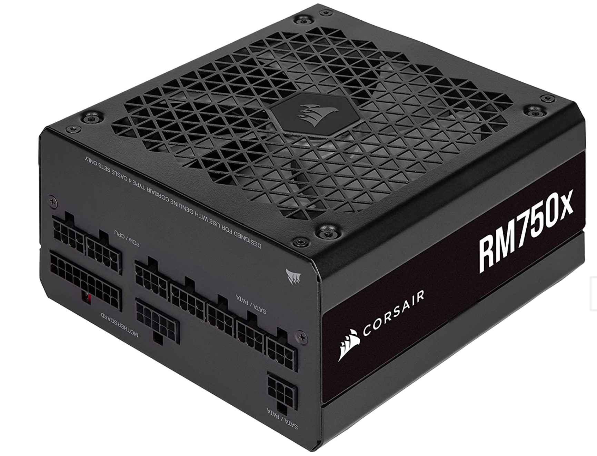
Power Supply Rails
Single Rail PSU
A single-rail PSU comes with a single voltage monitoring channel.
This prevents any form of power split in the middle.
Every power we have ever seen is a single-rail PSU.
Eg:Corsair’s RMx series

Slide 6
Power Supply Rails
Single Rail PSU
RMx series handles all its current output through a single circuit and has a strong OCP (Over Current Protection monitors the rail and shuts down the entire system in case a rail is overloaded.)
Example: Single PSUs with larger power ratings are commonly found in computers that have multiple graphics cards mainly for gaming / graphics processing.

Slide 7
Power Supply Rails
Single Rail PSU
The main advantage of a single rail + 12V power supply is
It can supply a higher current intensity (Amps), that is required to service modern graphics cards.
For example, an NVIDIA RTX 3090 requires 40A on the + 12V rail.
If the source is multi rail it is likely to use several cables connected to different rails of the source to reach the same current value.

Slide 8
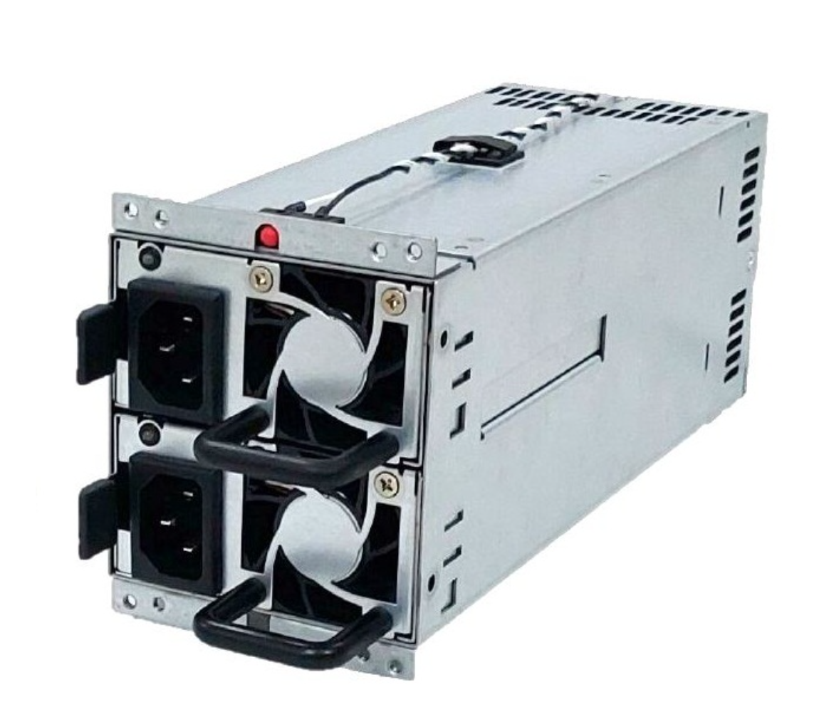
Power Supply Rails
Multi Rail PSU
A multi-rail PSU have multiple +12V rails for different connectors.
For example, each PC connector that goes to the GPU has a separate rail/trace, the CPU power cable has a trace, the 24-pin motherboard has a separate rail.
Multi-rail power supplies are used in workstations and server hubs.
Example :RA2-G700VP

Slide 9
Power Supply Rails
Multi Rail PSU
The load is distributed along multiple rails makes it safer and is preferable since it can identify a localized issue and shut down the PSU faster.
The advantage of multi-rail sources is that they divide the load.
This allows overloads to be avoided more easily.
Each of the multiple rails has its own independent safety mechanism (OCP)

Slide 10
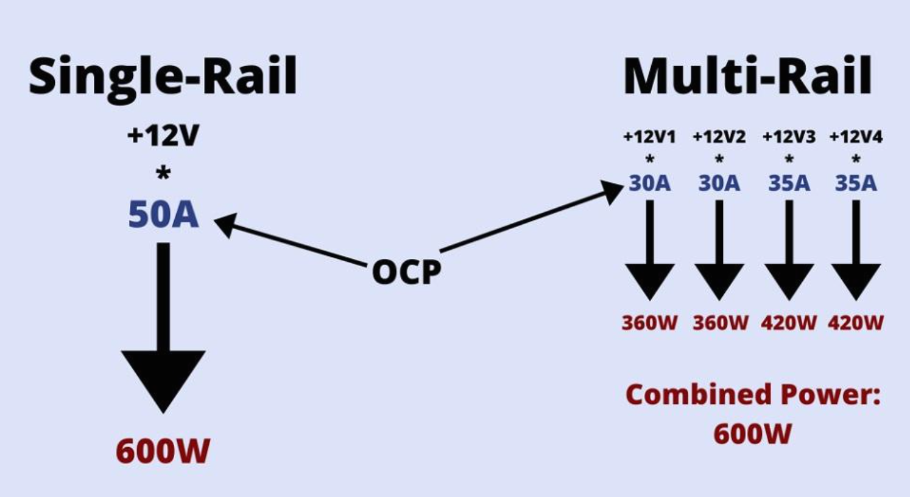
Power Supply Rails
Single Vs Multi Rail PSU
The single rail model supplies 50 amps of current, which makes it capable of delivering these 600 watts with this single rail.
Multi Rail have a power supply with several rails, two of them that supply 30 amps (360W) and another two that can deliver up to 35 amps (420W), delivering a combined power of 600 watts.

Slide 11
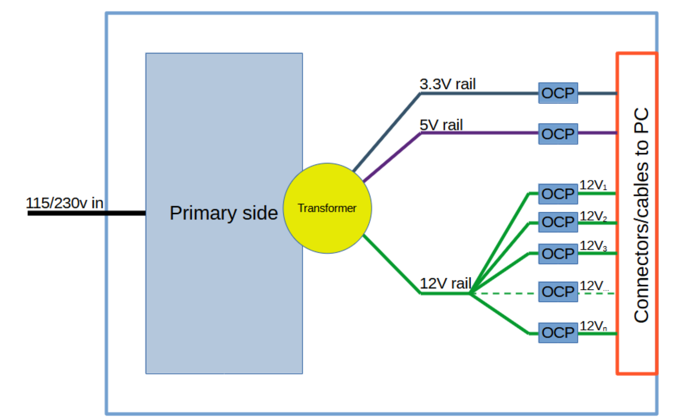
Power Supply Rails
Single Vs Multi Rail PSU
Features | Single Rail PSU | Multi-Rail PSU
+12V Power Delivery | All power flows through one rail. | Power is distributed across multiple rails.
Overcurrent Protection | OCP applies to the entire +12V rail. | Each rail has its own OCP.
Safety | Less safe if a short circuit occurs, as high current can flow unchecked. | Safer, as OCP limits current per rail.
Simplicity | Easier to manage and set up, no need to balance loads. | Requires balancing load across rails.
High-Power GPUs | Suitable for GPUs needing very high current. | May require using multiple connectors from separate rails.
Cost | Typically less expensive. | Can be more expensive due to added circuitry.

Slide 12
Power Supply Rails
Exercise 1
Design a multi-output regulated power supply that provides three independent DC voltage outputs: +12V, +8V, and +5V. The supply should use a single AC input source, step it down using a transformer, and convert it to DC using a bridge rectifier. Include voltage regulation using appropriate linear regulators (7812, 7808, and 7805) and ensure proper filtering and stability with capacitors and load resistors.

Slide 13
Power Supply Rails
Split Rail PSU
A split-rail power supply is a circuit that provides positive and negative DC voltage rails from a single AC transformer, and step-down voltage regulators.
  Example : Headphone amplifiers usually require positive and negative voltages.
Both voltages are generated from a single input voltage with an all-integrated split-rail converter.

Slide 14
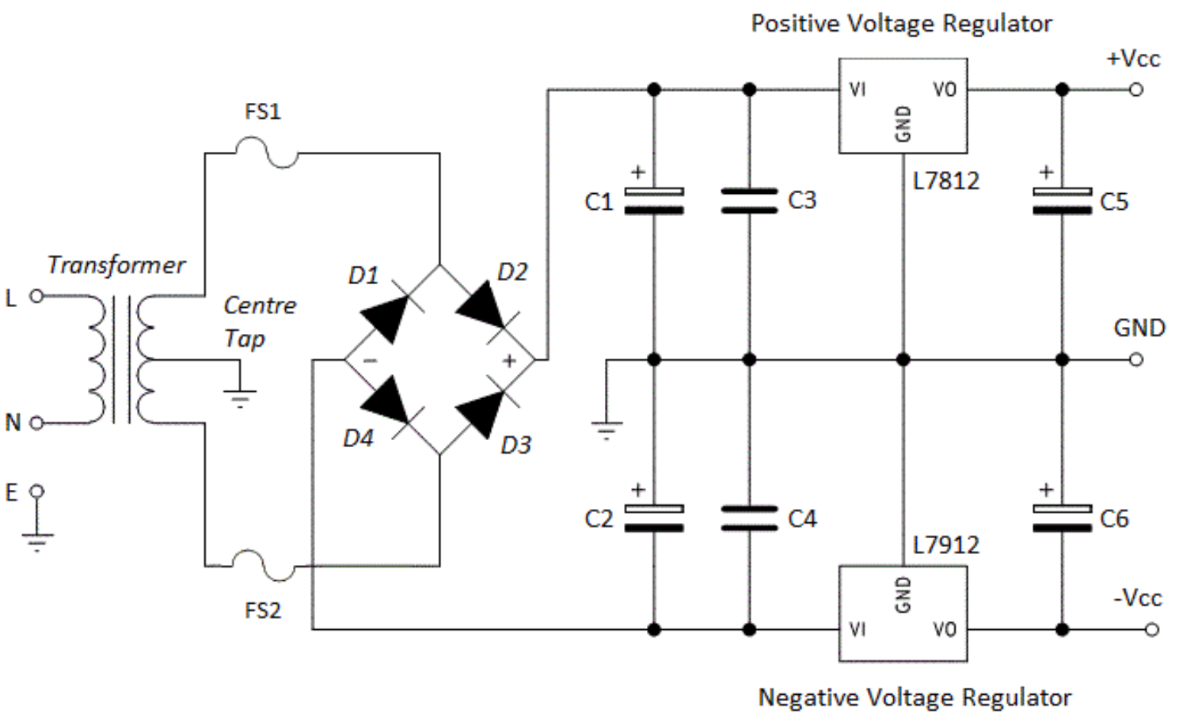
Power Supply Rails
Split Rail PSU
Building a split-rail power supply is very simple and requires a transformer with a centre tap on the secondary side.
Dual power supply rails are very useful when working with op amps as this type of design provides greater stability.
The expected voltage has both polarities such as ±5 V, ±12 V, and ±15 V designs.

Slide 15
Power Supply Rails
Exercise 2
Design a split power supply circuit capable of providing both +5V and -5V DC outputs using a single AC input source. The circuit should include a step-down transformer, a bridge rectifier, filtering capacitors, and voltage regulators that produce +5 V and – 5 V. Ensure proper decoupling and load stabilization with suitable components.

Slide 16
Power Supply Rails
References
[1] P. Horowitz and W. Hill, The Art of Electronics, 3rd ed. Cambridge, UK: Cambridge University Press, 2015.
[2] Tech4Gamers, “Single Rail vs Multi Rail PSU: Which One to Choose?,” Tech4Gamers, Jan. 13, 2023. [Online]. Available: https://tech4gamers.com/single-rail-vs-multi-rail-psu/.
[3] MSI, “5 Things to Pay Attention to When Choosing a Power Supply,” MSI Blog. [Online]. Available:https://www.msi.com/blog/5-things-to-pay-attention-to-when-choosing-a-power-supply.
[4] "High current dual power supply," Electronics Stack Exchange. [Online]. Available: https://electronics.stackexchange.com/questions/389772/high-current-dual-power-supply.
[5] "An Attempt at Explaining Single and Multi-Rail in Power Supplies," Cultists Network. [Online]. Available:https://cultists.network/11658/an-attempt-at-explaining-single-and-multi-rail-in-power-supplies/.

Slide 17
Thank You

