Slide 1
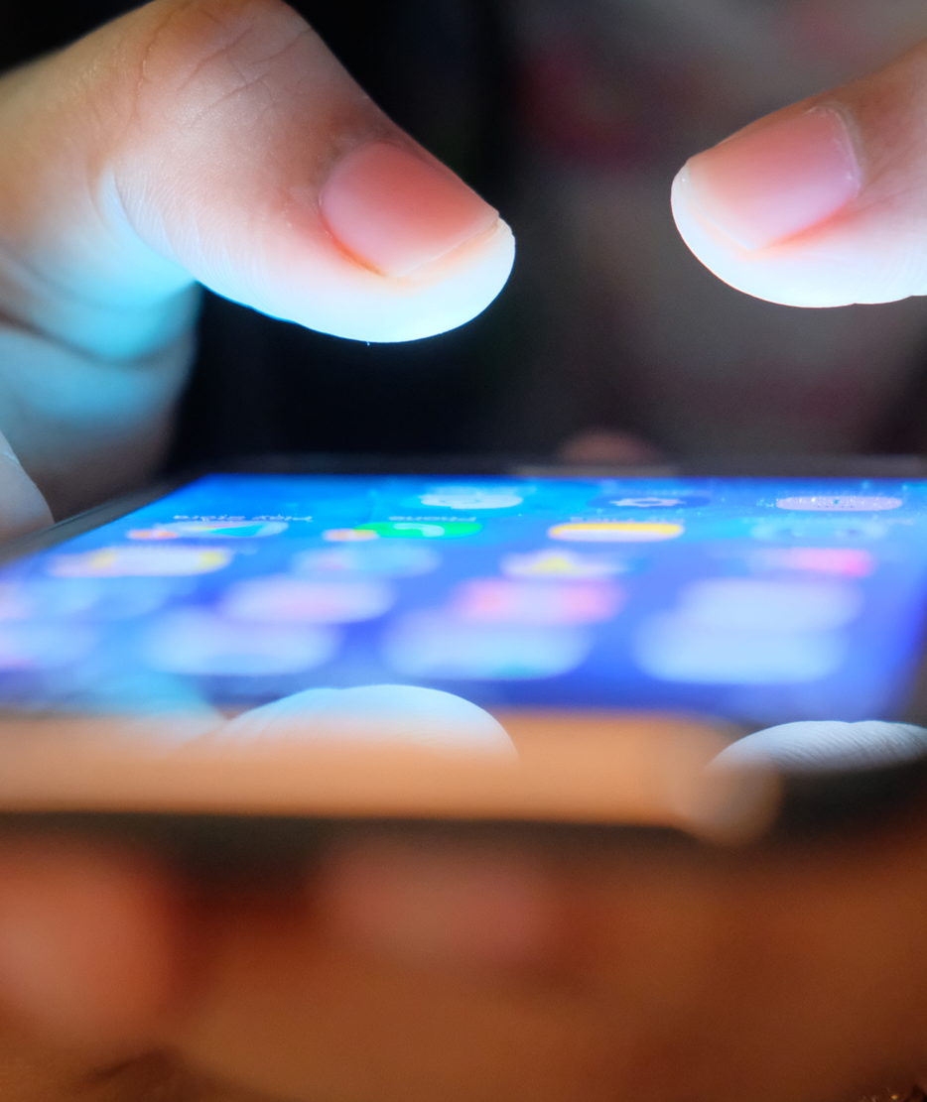
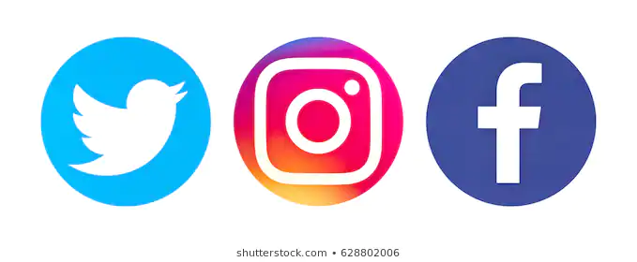
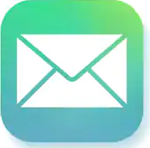

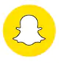

Cyberbullying- delete it!
5.43 million young
people in the UK have
been the victims of Cyberbullying!
(Ackroyd, 2019)
Shutterstock, 2020
Shutterstock, 2020
Shutterstock, 2020
Shutterstock, 2020
Shutterstock, 2020
Shutterstock,2020
(The National News, 2020)
Shutterstock, 2020
Make the most of what you post!

Slide 2
Reference List
Ackroyd, B., 2019. Compare The Best Mobile Phone Deals And Save £ At Tigermobiles.Com. [online] TigerMobiles.com. Available at: https://www.tigermobiles.com/faq/cyberbullying-statistics/ [Accessed 27 November 2020].
Bates, B., 2019. Learning Theories Simplified. 2nd ed. London: SAGE Publications, p.52.
Bates, B., 2019. Learning Theories Simplified. 2nd ed. London: Sage publ., p.188.
Bates, B., 2019. Learning Theories Simplified. 2nd ed. London: Sage publ., p.194.
KiVa Program. 2021. Kiva Is An Anti-Bullying Programme | Kiva Antibullying Program | Just Another Kiva Koulu Site. [online] Available at: <https://www.kivaprogram.net/> [Accessed 17 January 2021].
Ons.gov.uk. 2021. Online Bullying In England And Wales - Office For National Statistics. [online] Available at: https://www.ons.gov.uk/peoplepopulationandcommunity/crimeandjustice/bulletins/onlinebullyinginenglandandwales/yearendingmarch2020 [Accessed 16 January 2021].
Shutterstock, 2020 Email Logo. [image] Available at: https://www.shutterstock.com/search/email [Accessed 24 November 2020].
Shutterstock, 2020. Facebook Logo. [image] Available at: https://www.shutterstock.com/search/facebook [Accessed 24 November 2020].
Shutterstock, 2020 Instagram Logo. [image] Available at: https://www.shutterstock.com/search/Instagram [Accessed 24 November 2020].
Shutterstock, 2020 Snapchat Logo. [image] Available at https://www.shutterstock.com/search/snapchat [Accessed 24 November 2020].
Shutterstock, 2020 Text Logo. [image] Available at: https://www.shutterstock.com/search/text [Accessed 24 November 2020].
Shutterstock, 2020 Twitter Logo. [image] Available at: https://www.shutterstock.com/search/twitter [Accessed 24 November 2020].
Shutterstock, 2020 Tiktok Logo. [image] Available at: https://www.shutterstock.com/search/tiktok [Accessed 24 November 2020].
The National News, 2020. Mobile Phone. [image] Available at: https://www.thenationalnews.com/opinion/comment/mobile-phones-are-killing-our-attention-spans-and-ruining-public-discourse-1.872749 [Accessed 24 November 2020].
Unicef UK. 2021. UN Convention On The Rights Of The Child (UNCRC) - Unicef UK. [online] Available at: <https://www.unicef.org.uk/what-we-do/un-convention-child-rights/> [Accessed 17 January 2021].

