Slide 1
AHHI6013
Week 2
Power, Punishment, Panopticism:
Prison and the Birth of Disciplinary Society
Lecture 2: benthamite conceptions of power/punishment
Alexander Scott
alexander.scott@uwtsd.ac.uk

Slide 2

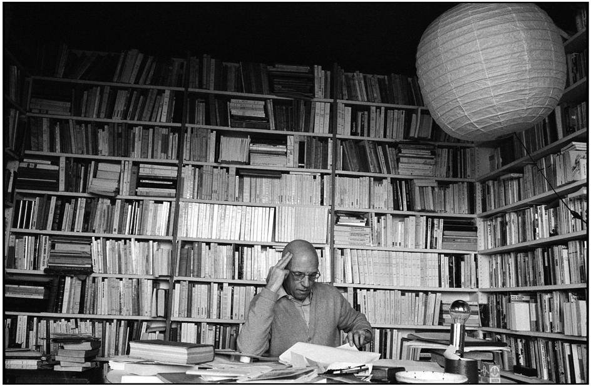
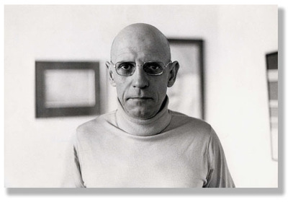
Michel Foucault (1926–1984)
Lecture reading:
Michel Foucault, Discipline and Punish: The Birth of the Prison (London: Penguin, 1977 [French 1975]), pp. 195–209, 293–296, 307-308.
Full copy of book, available here: https://monoskop.org/images/4/43/Foucault_Michel_Discipline_and_Punish_The_Birth_of_the_Prison_1977_1995.pdf.
Jeremy Bentham, Panopticon; Or the Inspection-House (1787) extracts: Preface, Letter I, Letter II, Letter IV, Letter V, Letter VI, Letter XXI.
Samuel Bentham, Panopticon illustrations (1787)
N Harou Romain, Plan for Penitentiary illustration (1840

Slide 3
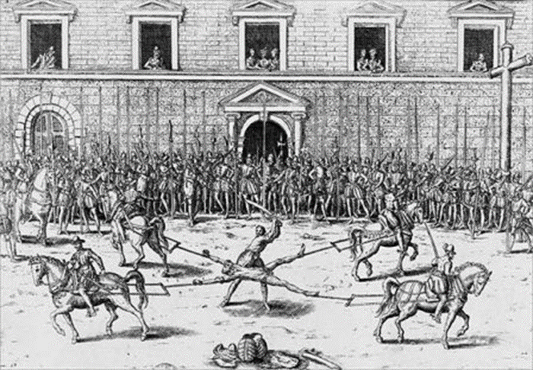
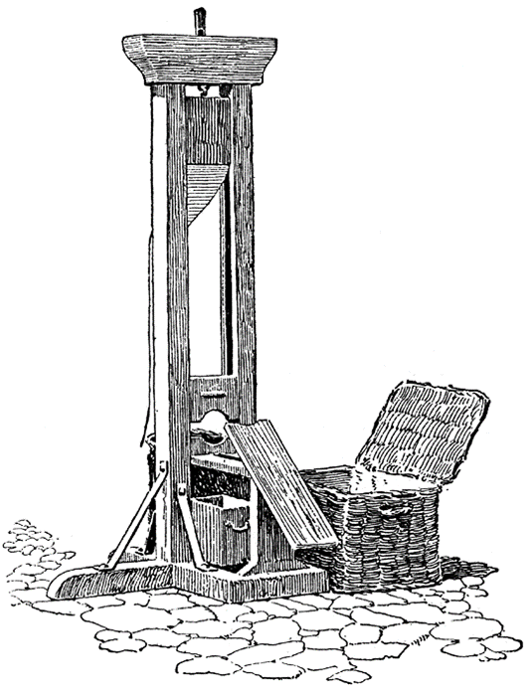
Discipline and punish
Foucault argues against the notion that late-18th-/early-19th-century shifts in how crime was conceptualised and punishment administered resulted from Enlightened Humanism so much as they aimed at a better economy of punishment – and by extension a better economy of power.
Thus it was less torture per se that was a problem for prison and social reformers, and more its inefficiencies. Because even “in the ‘excesses’ of torture, a whole economy of power is invested” (p. 35), prison reform therefore involved the creation and exercise of new economies of punishment and new regimes of power.

Slide 4


Discipline and punish
Foucault’s primary intellectual concern was the symbiosis of knowledge/power. In Discipline and Punish, he paid particular attention to what he perceived as the intimate relationship between human sciences – sociology, criminology, psychology, psychoanalysis – and systems of punishment/power.
The implications of this were not deemed as exclusively limited to ‘the birth of the prison.’ Rather, Foucault sought to map the disciplinary regimes of the modern prison onto society as a whole. The key to Foucault’s analytical ‘leap’ is the ideal prison designed by Jeremy Bentham in 1787: the Panopticon (see Friday class).

Slide 5
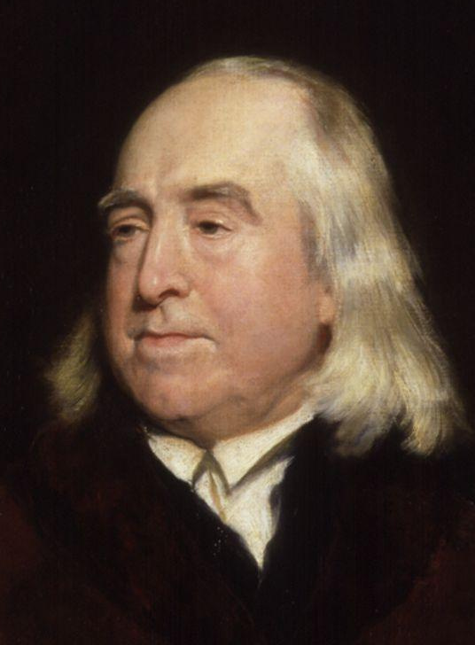
Jeremy Bentham (1748–1832)
b. 1748, London; d. 1832, London
Philosopher, legal scholar, social reformer
Product of Age of Enlightenment – influence of French philosophes plus Joseph Priestley, John Locke and David Hume; close friend of James Mill – father of John Stuart Mill, a key follower of Bentham’s thought
Context of American and French Revolutions
Context of Industrial Revolution’s onset – era of technological change
Jeremy Bentham, by Henry William Pickersgill (pre 1875)

Slide 6
Jeremy Bentham (1748–1832)
Campaigned for codification of common law
Animal Rights campaigner
Believed in gender equality
Argued for decriminalisation of homosexuality (‘pederasty’ – see Offences Against One’s Self, 1785)
Influence on est. of University College London, 1826 (its ‘spiritual founder’) – open access to all the first in England to admit all males regardless of race, creed or political belief (first to admit women on equal terms, 1878)

Slide 7
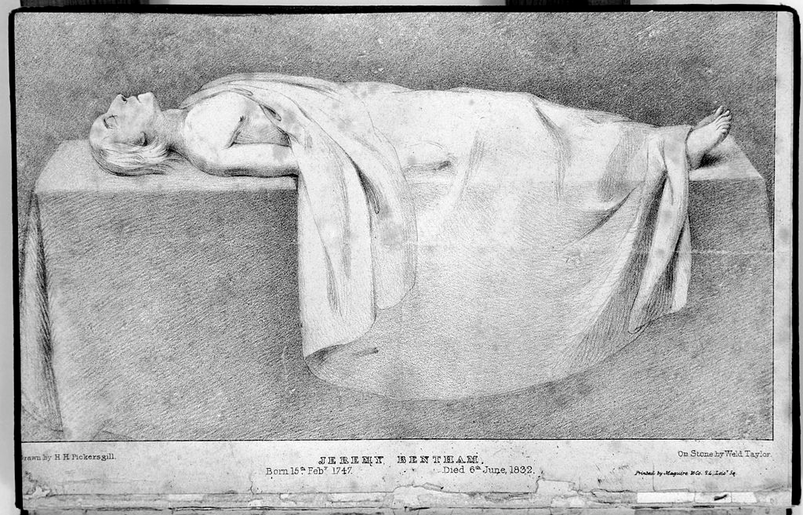
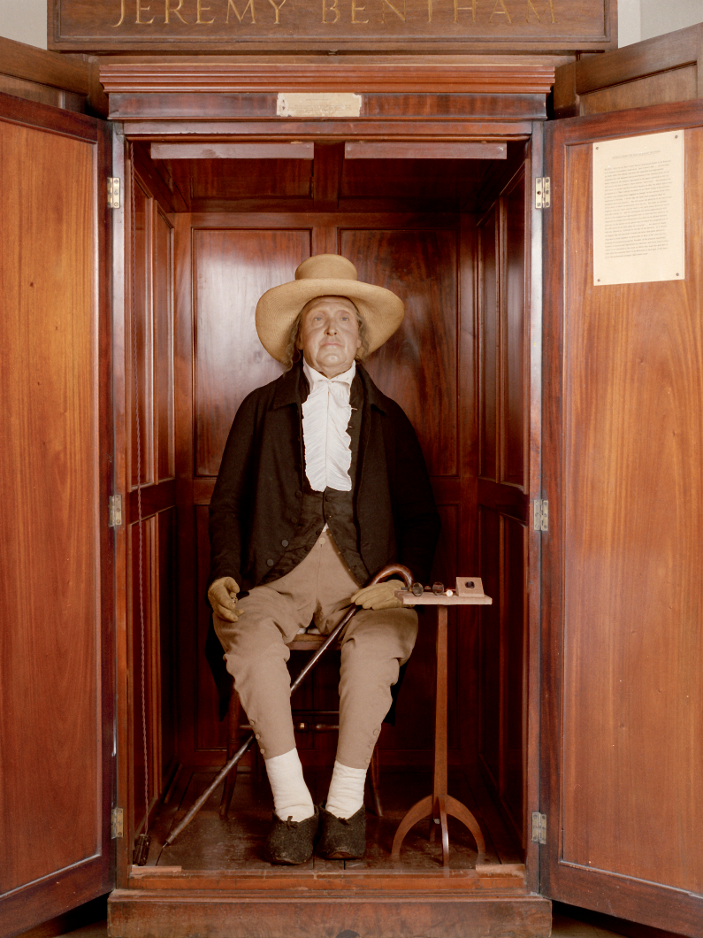
Jeremy Bentham (1748–1832)
Bentham dedicated his body to science – public dissection
Skeleton and skull used in creation of the “auto-icon” – preserved cadaver using mummification and taxidermy methods (since replaced with wax moulds, through retaining some of Bentham’s hair)
Auto-icon still on public display at UCL (pictured) – original skull in its archaeological collection
‘The Mortal Remains of Jeremy Bentham, laid out for public dissection,’ HH Pickersgill (1832)

Slide 8
Utilitarianism
Founder of modern social-moral-political philosophy of Utilitarianism: emphasis on utility, usefulness
Ethical dimension: based on Bentham’s “fundamental axiom” that “it is the greatest happiness of the greatest number that is the measure of right and wrong” (from A Fragment on Government, 1776)
Attempted to devise mathematical formulae to quantify and define such happiness
Belief in psychological egoism – that human nature is defined by self-interest

Slide 9
Utilitarianism
“Nature has placed mankind under the governance of two sovereign masters, pain and pleasure. It is for them alone to point out what we ought to do, as well as to determine what we shall do. On the one hand the standard of right and wrong, on the other the chain of causes and effects, are fastened to their throne. They govern us in all we do, in all we say, in all we think.”
(from The Principles of Morals and Legislation, 1789)

Slide 10
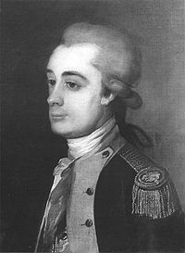
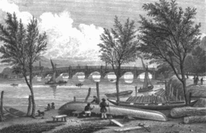
Panopticon
In 1786 and 1787, Bentham travelled to Krichev in White Russia (modern Belarus) to visit his brother, Samuel, who was managing various industrial and other projects for Prince Potemkin
Mechanical engineer and naval architect credited with numerous innovations, particularly related to naval architecture (Portsmouth docks) and weaponry (Arrow sloop)
Panopticon; Or the Inspection-House (1787) arose out of the Benthams’ visit to Russia – originally as letters to from Jeremy to their father
Vauxhall Bridge, designed by Samuel Bentham
Samuel Bentham, as
Inspector General of Naval Works
(1757–1831)

Slide 11
Panopticon
Jeremy Bentham, Panopticon; Or the Inspection-House (1787) extracts: Preface, Letter I, Letter II, Letter IV, Letter V, Letter VI, Letter XXI.
What are the key features of the Panopticon according to Bentham? What are its main utilities? How is it deemed advantageous over other possible methods of imprisonment or detention?
What would you describe as the key goals of Bentham’s Panopticon, and how does are these desired outcomes supposed to be achieved?

Slide 12
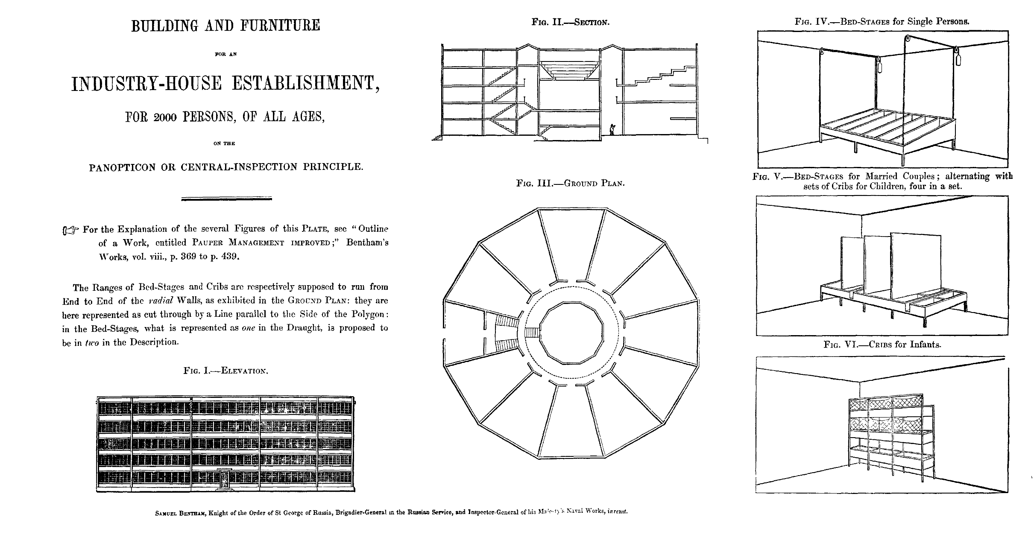
Panopticon: Samuel Bentham, Panopticon illustrations (1787)

Slide 13
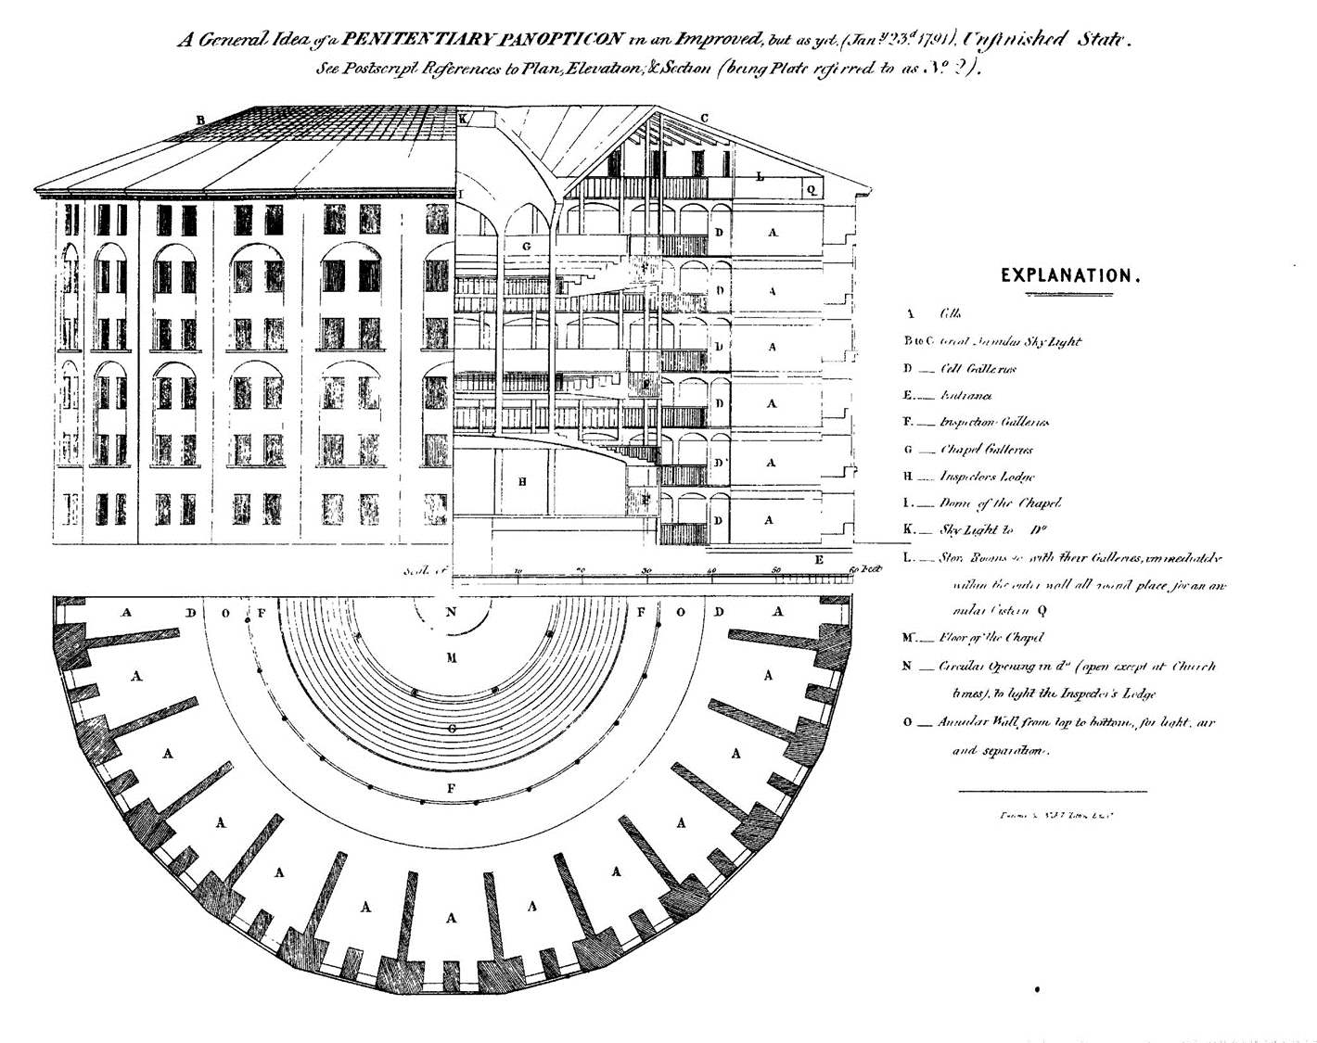
Panopticon: Samuel Bentham, Panopticon illustrations (1787)

Slide 14
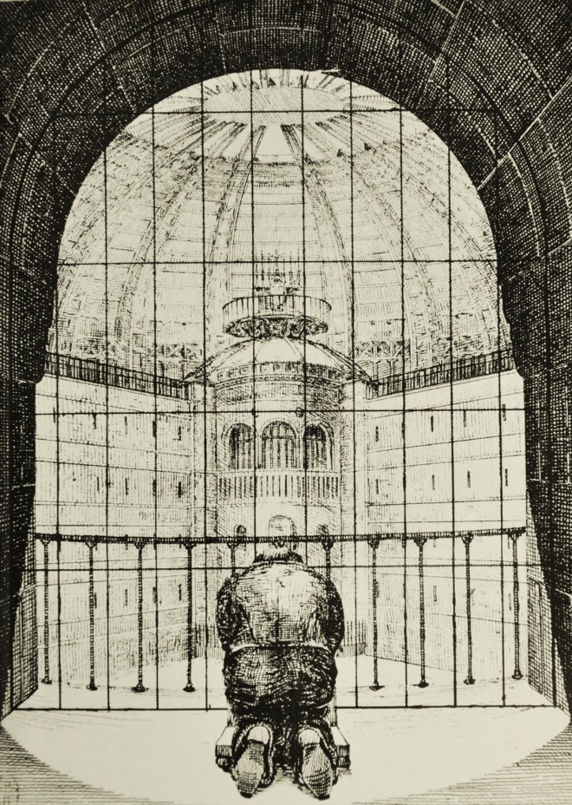
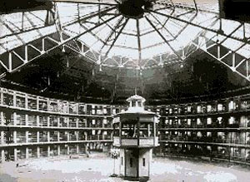
Panopticon
The Benthams’ plans for a prison built on panoptic principles went unfulfilled in their lifetime – abortive plans for a National Penitentiary
However, features of their proposed design were embraced and incorporated (though not replicated wholesale) by architects of numerous prisons across the world
N Harou Romain, Plan for Penitentiary illustration (1840)

Slide 15
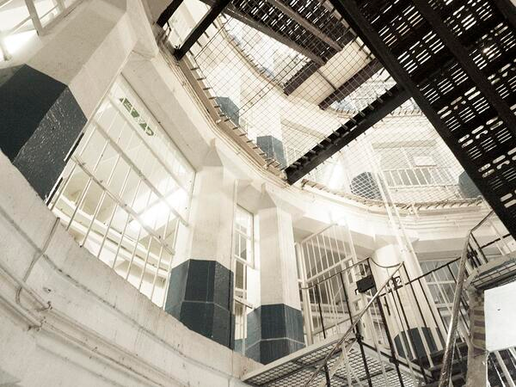
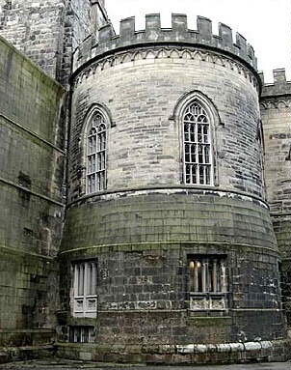
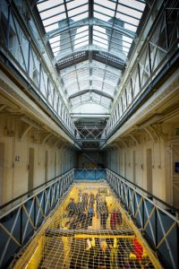
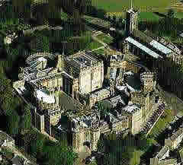
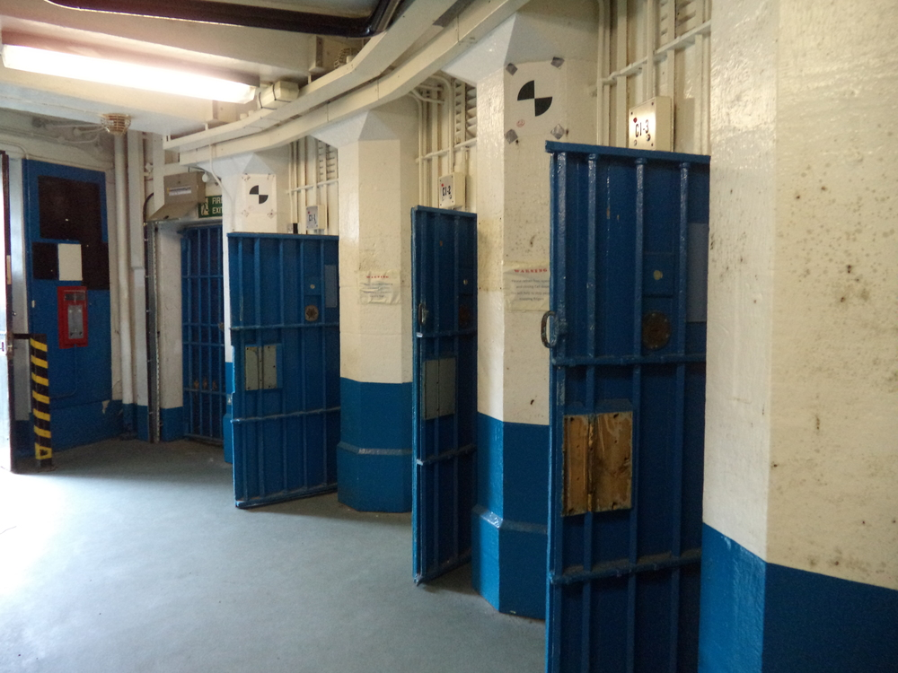
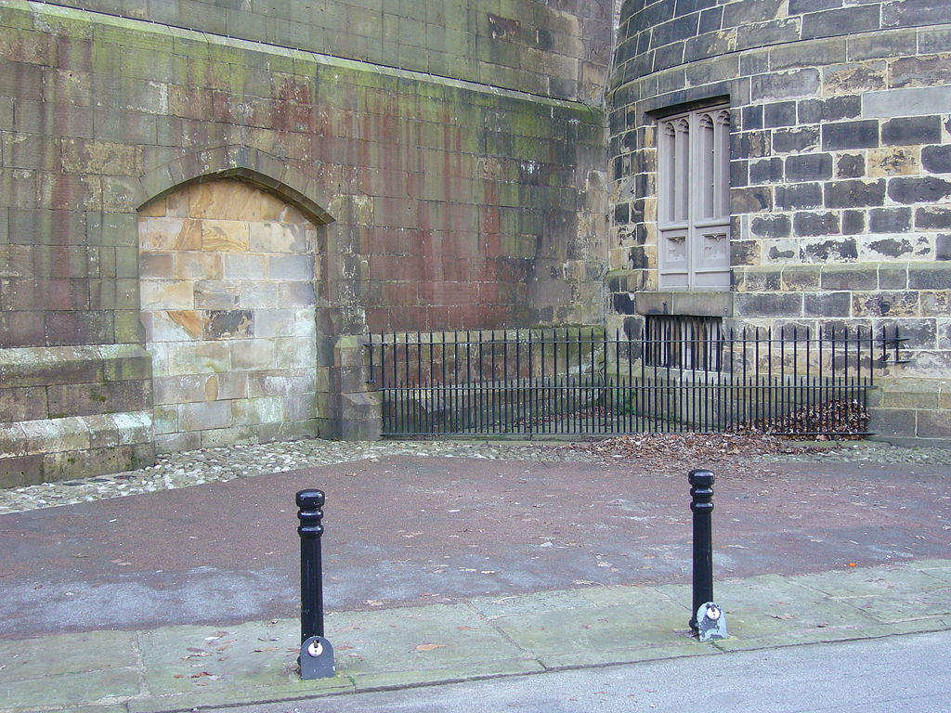
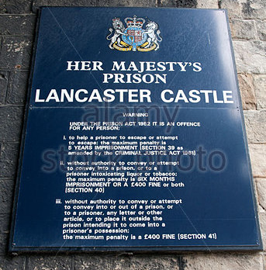
Panoptic design principles at HM Prison, Lancaster Castle
(earliest origins 11th century, prison decommissioned 2011)
A-Wing, renovated in the 1820s, incorporates a panopticon, a glass atrium and 18 cells over each of 3 floors.
"Hanging Corner" – the site of public executions until 1865

Slide 16

Panopticism and disciplinary society
But Foucault does not see the importance of Bentham’s ideas as being limited to prison architecture, and instead thinks they offer profound insights into the modern world
Why does Foucault place such importance on Bentham's panopticon? What arguments is he trying to express?
What do you understand by Foucault’s key phrases:
  a) Panopticism;
  b) Disciplinary society;
  c) The carceral;
  d) “Economy of punishment”?
What different connotations do you associate with ‘discipline,’ what significances might you draw from them?
Foucault, Discipline and Punish, pp. 195–209, 293–296, 307-308

Slide 17
Panopticism and disciplinary society
Foucault suggests panopticism is a key attribute of modern, ‘disciplinary’ society – in which a whole series of institutions are linked with one another. How might these ideas relate to analyses of, say, museums and schools?
    In groups, use the collection of primary sources made available to you to formulate answers to the above question. Also think about the following:
      What insights might the sources afford onto ‘panopticism’ or ‘disciplinary society’?
      What different connotations do you associate with ‘discipline,’ what significances might you draw from them?
      Do the sources affirm Foucault’s ideas?
      Might Foucault’s ideas have resonances today, and if so how?
      What counter-arguments might one formulate in response to Foucault’s ideas?
Foucault, Discipline and Punish, pp. 195–209, 293–296, 307-308

Slide 18
Panopticism and disciplinary society
“In organizing ‘cells’, ‘places’ and ‘ranks,’ the disciplines create complex spaces that are at once architectural, functional and hierarchical. It is spaces that provide fixed positions and permit circulation; they carve out individual segments and establish operational links; they mark places and indicate values; they guarantee the obedience of individuals, but also a better economy of time and gesture. They are mixed spaces: real because they govern the disposition of buildings, rooms, furniture, but also ideal, because they are projected over this arrangement of characterizations, assessments, hierarchies. The first of the great operations of discipline is, therefore, the constitution of ‘tableaux vivants’ [a silent and motionless group of people arranged to represent a scene or incident], which transform the confused, useless or dangerous multitudes into ordered multiplicities.”
Note: Foucault later elaborated the idea of ‘mixed space’ in an essay on ‘other spaces’ or what he called heterotopias – buildings and institutions that combine physical space and idealised, metaphysical (utopic) elements.
Foucault, Discipline and Punish, p. 148

Slide 19
Panopticism and disciplinary society
“The drawing up of ‘tables’ was one of the great problems of the scientific, political and economic technology of the 18th century: how one was to arrange botanical and zoological gardens, and construct at the same time rational classifications of living beings; how one was to observe, supervise, regularize the circulation of commodities and money and thus build up an economic table that might serve as the principle of the increase of wealth; how one was to inspect men, observe their presence and absence and constitute a general and permanent register of the armed forces; how one was to distribute patients, separate them from one another, divide up the hospital space and make a systematic classification of diseases: these were all twin operations in which the two elements – distribution and analysis, supervision and intelligibility — are inextricably bound up. In the 18th century, the table was both a technique of power and a procedure of knowledge. It was a question of organizing the multiple, of providing oneself with an instrument to cover it and to master it; it was a question of imposing upon it an ‘order’ … Tactics, the spatial ordering of men; taxonomy, the disciplinary space of natural beings; the economic table, the regulated movement of wealth.”
Foucault, Discipline and Punish, pp. 148–149

Slide 20
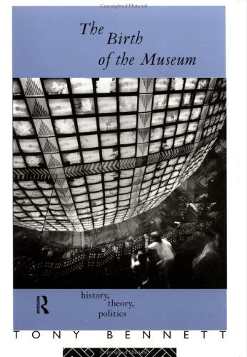
Panopticism and disciplinary society
See Tony Bennett’s work for a concerted attempt to apply Foucauldian ideas to an interpretation
Foucault, Discipline and Punish, pp. 195–209, 293–296, 307-308

Slide 21
Panopticism and disciplinary society
“The public execution was the logical culmination of a procedure governed by the Inquisition. [Just as] the practice of placing individuals under ‘observation’ is a natural extension of a justice imbued with disciplinary methods and examination procedures. Is it surprising that the cellular prison, with its regular chronologies, forced labour, its authorities of surveillance and registration, its experts in normality, who continue and multiply the functions of the judge, should have become the modern instrument of penality [societal system of investigation and punishment]? Is it surprising that prisons resemble factories, schools, barracks, hospitals, which all resemble prisons?”
Foucault, Discipline and Punish, pp. 227–228

Slide 22
Panopticism and disciplinary society
Essay question:
Michel Foucault posited that “prisons resemble factories, schools, barracks [and] hospitals, which all resemble prisons.” What does this quotation tell us about Foucault’s conception of ‘disciplinary society,’ and how persuasive do you find his ideas?
Foucault, Discipline and Punish, pp. 195–209, 293–296, 307-308

