Slide 1
DS3 Digital Skills Portfolio & Reflection
Volodymyr Baraban
Student ID: 2538090
Digital Skills Module

Slide 2
  INTRODUCE
  Hello, this is my Digital Skills portfolio.
  In this portfolio, I included five examples of my work:
  Excel (Stock Levels Table and Chart)
  Word (My Digital Life – University Student Portal)
  PowerPoint (Quarterly Business Update)
  File Organisation (OneDrive – AS and DS Folders)
  Responsible Use of AI (Clarity in Writing Activity)
I chose these examples because they show different digital skills and my progress during the module.

Slide 3
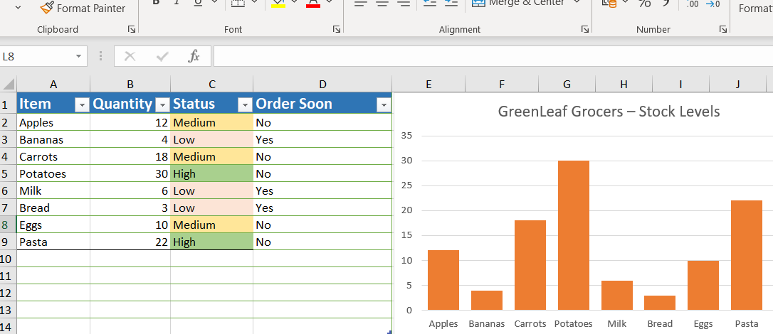
GreenLeaf Grocers – Excel Stock Management Table and Chart
This Excel table shows GreenLeaf Grocers' product inventory levels:
Availability (whether the item is in stock)
Quantity (how many items are available)
Stock level (Low, Medium or High)
Order Soon (reorder needed)
Skills Used:
Entering and organising data
Using colour coding
Creating charts
Comparing stock levels
Identifying items to reorder
Through practice and teacher support, I learned how to organise data, use formulas and create charts in Excel.

Slide 4
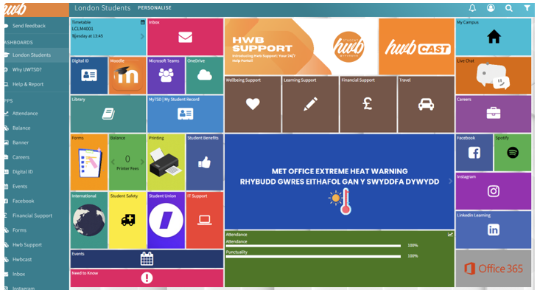
WORD DOCUMENT – UNIVERSITY DIGITAL SERVICES
This document shows the digital tools I use for my studies:
University portal (access to university services)
Moodle (course materials and assignments)
OneDrive (saving and organising files)
Microsoft Teams (communication and online meetings)
Skills Used:
Formatting text
Using headings
Using bullet points
Inserting images/screenshots
Organising information
Writing short explanations
I learned how to format text, use headings and bullet points, insert screenshots, and organise information clearly in Word.

Slide 5
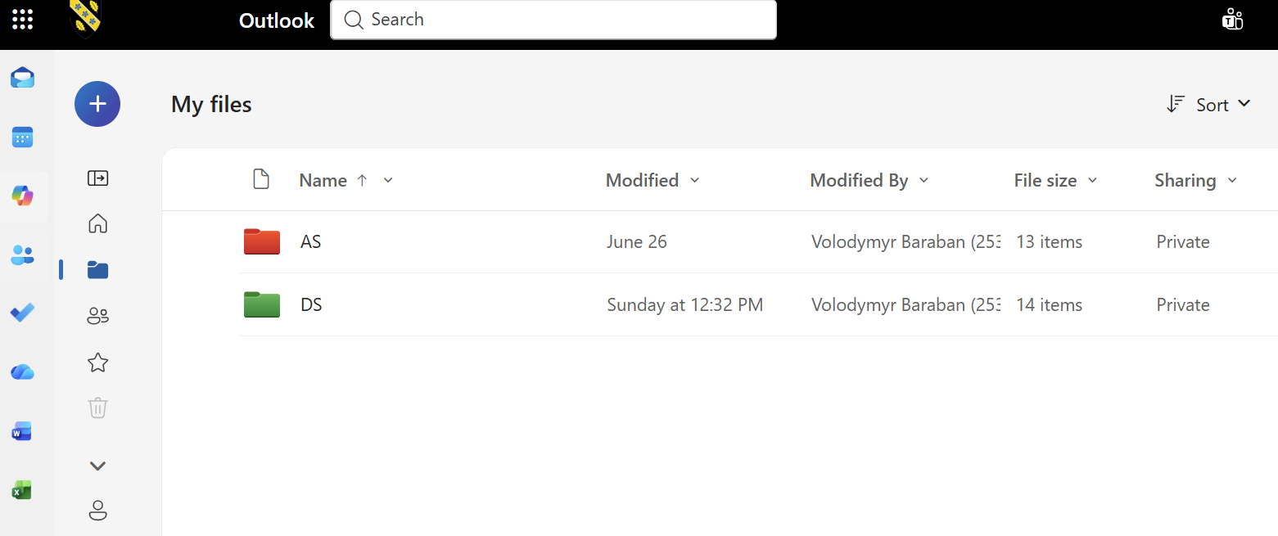
OneDrive – Organising AS and DS Study Files
This screenshot shows how I organise my university files in OneDrive by creating separate AS and DS folders, naming them clearly, and saving files in the correct place.
Skills Used:
Creating folders
Naming folders clearly
Organising files by subject
Saving files in the correct place
Moving files between folders
Using OneDrive for file management
I learned these skills through teamwork and working with my classmates.

Slide 6
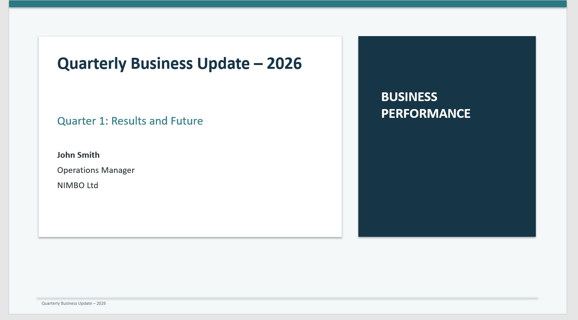
PowerPoint – NIMBO Ltd Quarterly Business Update
This presentation shows a quarterly business update for NIMBO Ltd, including Quarter 1 results and future plans
Skills Used:
Creating slides
Using titles and headings
Using bullet points
Choosing a clear layout
Inserting images and charts
Organising information
Using consistent formatting
I learned these skills through practice, teacher support and working on different PowerPoint tasks.

Slide 7
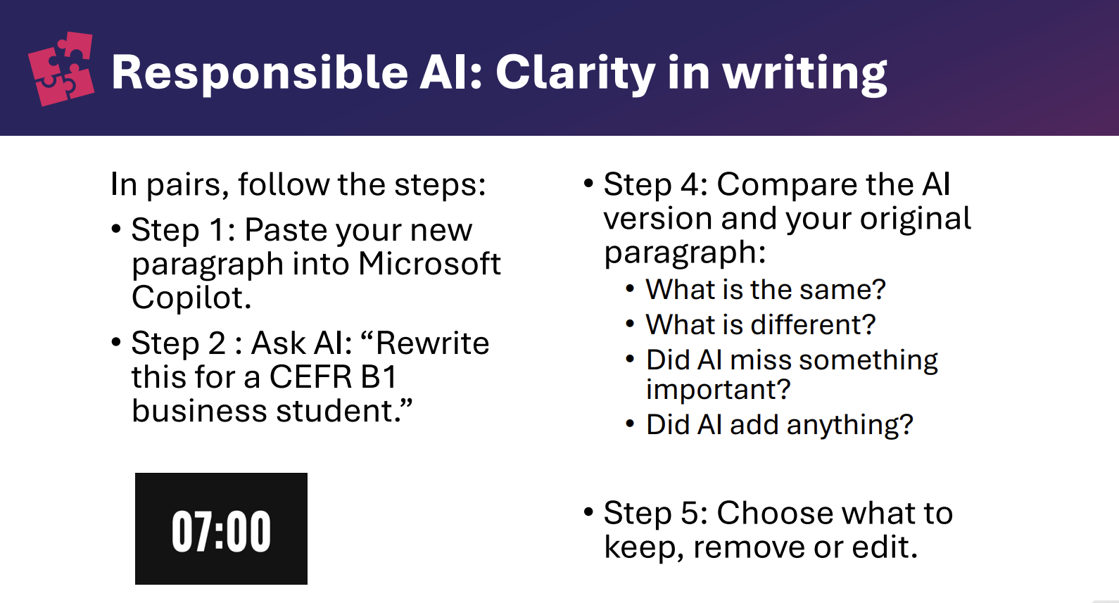
Responsible AI – Comparing, Checking and Editing
This slide shows how I used Microsoft Copilot to improve the clarity of my writing. I compared the AI version with my original paragraph, checked what was changed, what was missing, and what was added. Then I decided what to keep, remove or edit.
Skills Used:
Using AI responsibly
Editing and improving writing
Making decisions about content
Comparing texts
Critical thinking
I learned to use AI as a support tool, check its output carefully, compare it with my own work, and make my own final decisions.

Slide 8
References and Learning Resources
Microsoft (n.d.) PowerPoint help & learning. Available at: https://support.microsoft.com/en-us/powerpoint (Accessed: 13 August 2026)
CreativePro (n.d.) PowerPoint: Tips for Creating Better Tables. YouTube. Available at: https://www.youtube.com/watch?v=jeY3tn2Metc (Accessed: 13 August 2026).
ThinkOutsideTheSlide.com (n.d.) Create a graph in PowerPoint using data and formulas from Excel for increased functionality. YouTube. Available at: https://www.youtube.com/@ThinkOutsideTheSlide/videos (Accessed: 13 August 2026).
Pach, A. (n.d.) Charts in PowerPoint – 4 Good Practices To Follow: PPT Chart Tricks. YouTube. Available at: https://www.youtube.com/@andrewppt/videos (Accessed: 13 August 2026).

