Slide 1

Digital Skill And Research Methods
Module code : LCH4002
Module leader : Amitave Banik
Student Name : Chanthy Khuon
Student ID : 212753
Research Topic : Use of Digital Communication, Collaboration and Participation.

Slide 2
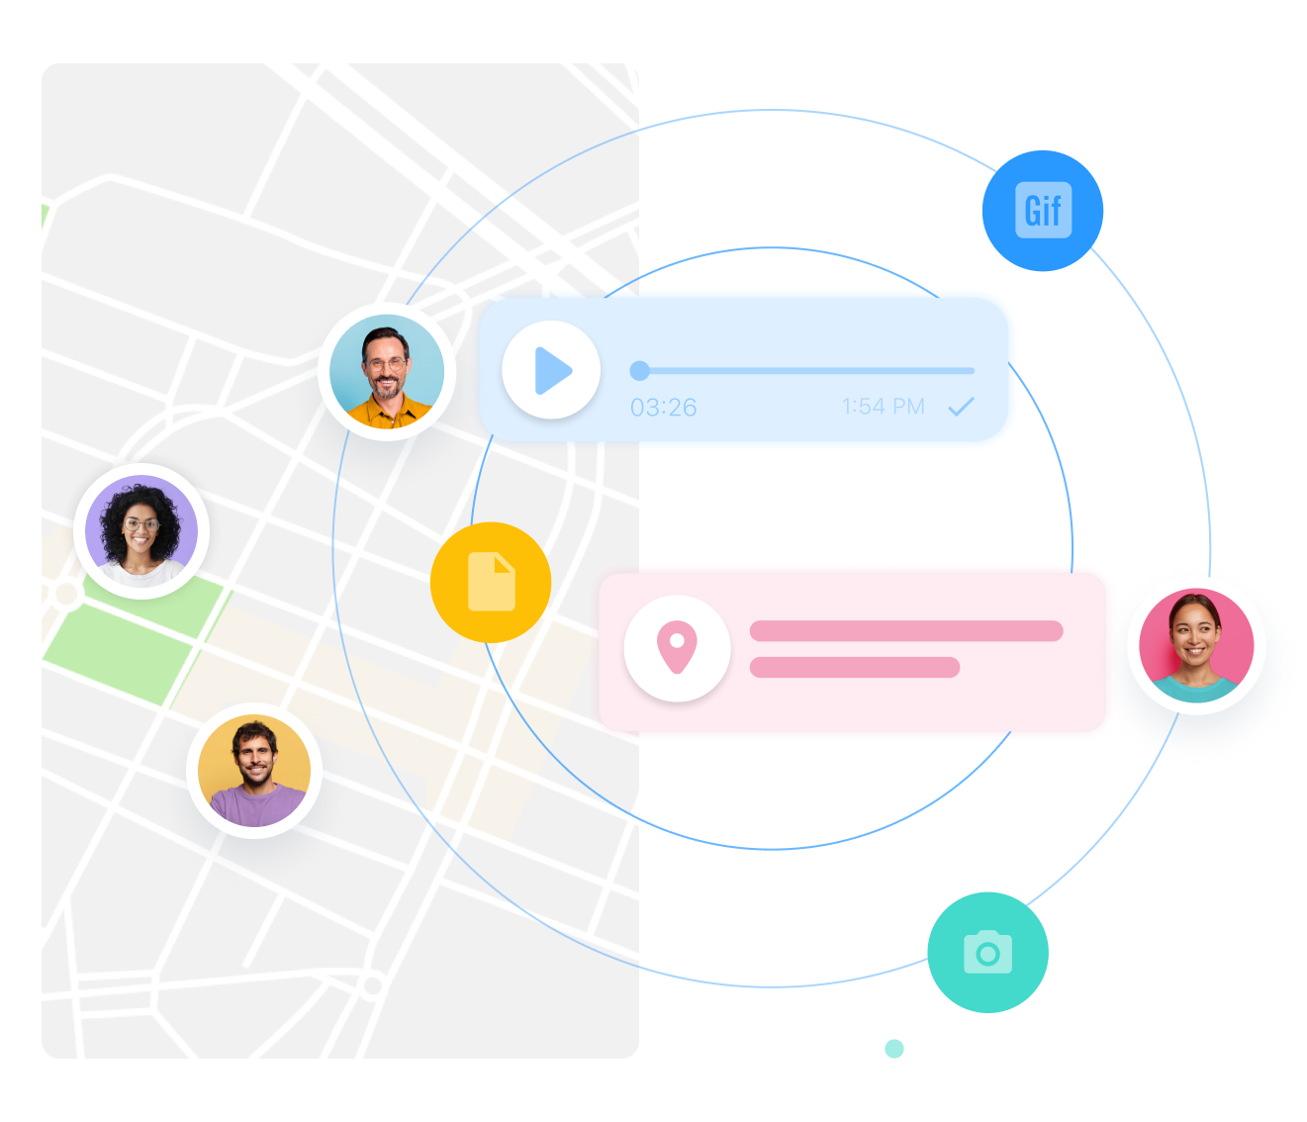
Use of Digital Communication, Collaboration And Participation
What is digital Communication?
What is digital collaboration?
What is digital participation?
Communication in text-based forums , online , video, audio, building network through social media.
To share the images, videos, audio…etc...
Know how online networks can help me keep up-to-date on professional issues.

Slide 3
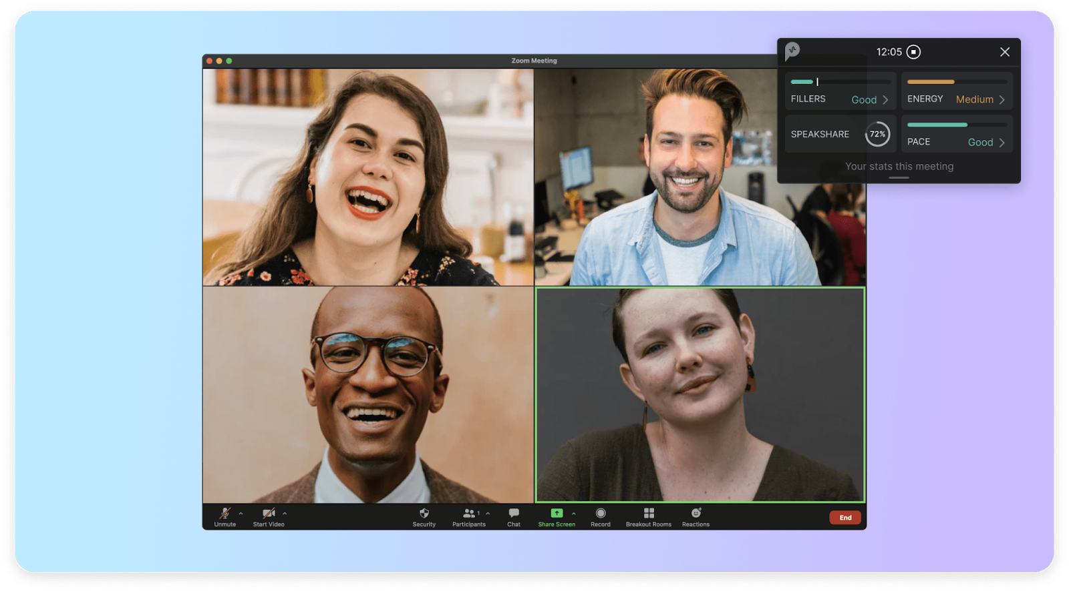
Use of Digital Communication, Collaboration And Participation
Able to build beneficial relationships with people in virtual care environments.
Able to choose an appropriate network for the professional needs.
Share the digital materials you have created with others.
Build an online community.
Understand how digital content and interactions can influence a person’s behavior.
The better way of life living in digital world.
Saving Time-consuming and expenses.

Slide 4
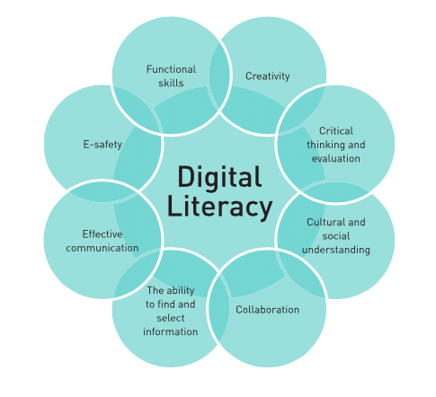
Digital Skills And Research Methods
Module Code : LCHS4002
Module Leader: Amitave Banik
Student Name : Joyce Heidinger
Student ID : 2133752
Research Topic : Use of Digital Literacy For Employee Well-being And Their Professional Career Development(Teaching, E-learning And Self-development)”

Slide 5
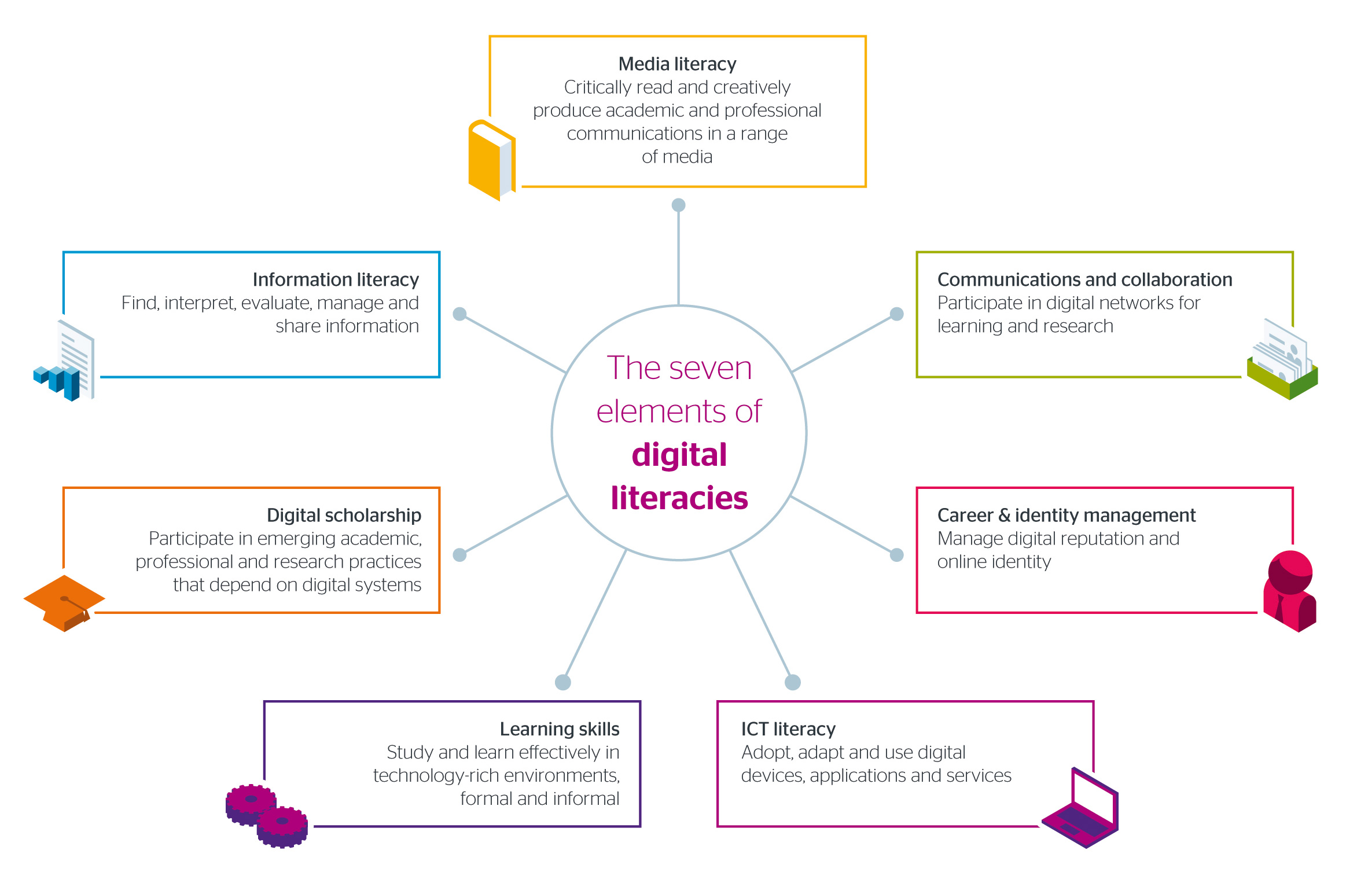
What Is The Digital Literacy ?
Digital literacy generally refers to the information technology skills needed for the twenty-first century.
A digitally literate individual is one with the requisite competencies to find, evaluate, utilize, share and create content using information technologies and the Internet.
Basic digital skills include having the ability to: use everyday ICT software, such as Microsoft Word and Excel; process digital information and content; communicate digitally; and learn new digital skills.
This Photo by Unknown Author is licensed under CC BY-NC-ND

Slide 6

Use of Digital Literacy For Employee Well-being And Their Professional Career Development(Teaching, E-learning And Self-development)”
Important because of growing use of technology in healthcare such as electronic notes and equipment
You will struggle less with digital tasks and will have positive attitude towards new technology in healthcare
According to hospitals record observations using an iPad
Common programmers such as Microsoft Excel, word and PowerPoint are used a lot in the hospital. Also, responding to e-mails to communicate.
You will have more skills for the workplace
r

Slide 7

Use of Digital Literacy For Employee Well-being And Their Professional Career Development(Teaching, E-learning And Self-development)”
Better outcomes for patients – digital tools have the potential to improve services for those receiving care.
Better experiences for staff – the working lives of nurses and midwives could be improved by technology, enabling people to feel increased empowerment and satisfaction in their roles.
More efficient ways of working – care could be delivered more efficiently, and a digitally enabled health service could release time for clinicians and healthcare workers to devote to the people and populations who require their services.

Slide 8

Digital Skill And Research Methods
Module code : LCH4002
Module leader : Amitave Banik
Student Name : Justina Kuffour
Student ID : 2131286
Research Topic : Use of technology during the Covid-19 pandemic.

Slide 9
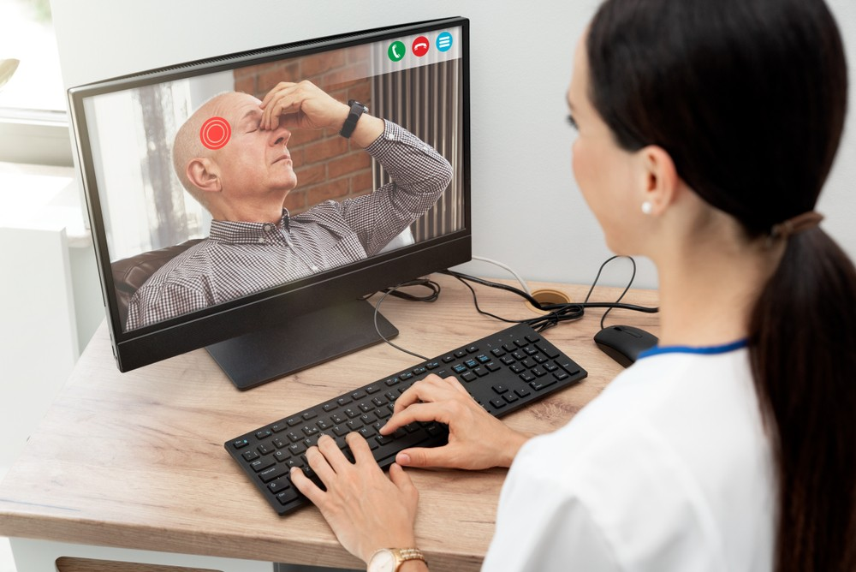
Use of Technology During The Covid-19 Pandemic
Telephone and video consultations
Electronic processes
Online applications for timesheets
Producing staff rota

Slide 10
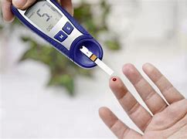
Use of Technology During The Covid-19 Pandemic
Diabetic technology –allows for a patient’s glucose reading by a wearable device.
WhatsApp – for sharing information among health and social care teams.
Electronic prescribing service
Ordering prescriptions

Slide 11

Use of Technology During The Covid-19 Pandemic
Artificial intelligence e.g. Chatbots
Virtual reality(VR) & augmented reality(AR) –for delivering staff training
Wider use of NHS websites and NHS 111 online

Slide 12

Digital Skill And Research Methods
Module Code : LCH4002
Module Leader : Amitave Banik
Student Name : Yetunde Akinyemi
Student ID : 2133596
Research Topic : The Relevance of Technical Proficiency for Data and |Information handling.

Slide 13

The Relevance of Technical Proficiency For Data And Information Handling
It is to determine the nature and completely of data analysis data.
Giving appropriate information technology reference.
Able to take change of my experiences by being well informed reading , investigate also and double check.
By developing the right mind set as follows intellectually curios end up .
Strongly motivated and determined to successes.

Slide 14
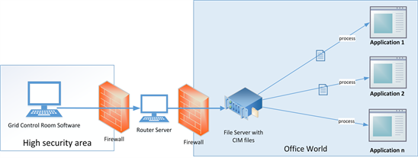
The Relevance of Technical Proficiency For Data And Information Handling
Help with ability to prepare date for effective analysis.
Able to align the right technique solutions to relevant problems
Help to translate data into result that work for business or organizations.
To reduce or mitigate or risk of data laws.
It reduces time spend on tasks.
To make informed technical decision.
It reduces risk of reputational risk as a result of data mishandling
It is safe spending
It reduces cost of production.

Slide 15

Digital Skill And Research Methods
Module Code : LCHS 4002
Module Leader : AMITAVA BANIK
Student Name : LAZIA NABBANJA
Student ID : 2133640
Research Topic : Use of Contemporary Technology In Healthcare ( Administrative, Care Support And Diagnostic).

Slide 16

Contemporary Technology In Healthcare For Administrative Support
Helps in keeping medical records of patients and thus information is available readily.
Managing privacy and portability of patient data
(O'Cathail et al., 2020).
Additionally, health informatics improves healthcare management by increasing accessibility to crucial clinical information.

Slide 17

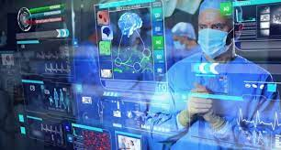
Contemporary Technology In Healthcare For Supportive Care
Enhanced ,easier care integration and increased practice effectiveness is also help in data management throughout time.
Technological tools like analytics and scanning systems make it easier to provide healthcare help. Utilizing contemporary technological tools makes it easier to provide healthcare help.
Significant prospects for enhancing and revolutionizing healthcare are presented by health information technology (Eccleston et al., 2020). This includes lowering interpersonal error rates, improving treatment benefits, enabling patient care, increasing practice effectiveness, and monitoring dataset

Slide 18
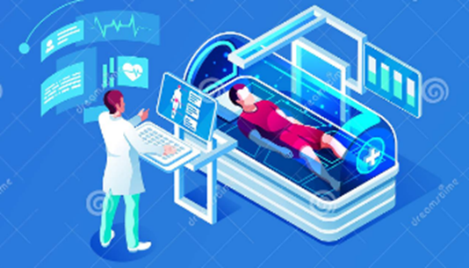
Contemporary Technology In Healthcare For Diagnostic Support
Information technology (IT) helps in acquiring patients' data like medical history.
Helps in evaluating test results of the diagnosis thereby raising workflow in the clinical aspects.
The capture of patient data, such as the patient history and findings of diagnostic tests (Lu et al., 2020). This informs the clinical diagnosis, is one area where healthcare IT plays a crucial role in the clinical diagnosis. influencing a clinician's outcome and productivity during the treatment process.

Slide 19
References :
Chian‐Son Yu Publish (2005) Causes influencing the effectiveness of the post-implementation ERP system, Industry management+ Data system Causes influencing the effectiveness of the post‐implementation ERP system | Emerald Insight P105,115-132
Digital communication | Digital skills | Royal College of Nursing (rcn.org.uk)
Eccleston, C., Blyth, F.M., Dear, B.F., Fisher, E.A., Keefe, F.J., Lynch, M.E., Palermo, T.M., Reid, M.C. and de C Williams, A.C., 2020. Managing patients with chronic pain during the COVID-19 outbreak considerations for the rapid introduction of remotely supported (eHealth) pain management services. Pain, 161(5), p.889.
Education, 7 (2). pp. 131-138
Employment, London.
Hillage, J. and Pollard, E. (1998) Employability: Developing a Framework for Policy Analysis. Department for Education.
How Digital Collaboration in the Workplace Improves Workflows? (bit.ai)
https://www.microsoft.com/en-us/digital-literacy [Accessed 24 July 2022].
https://www.rcn.org.uk/professional-development/publications/PUB-006129 [Accessed 4 August 2022].
http://usj.sagepub.com/cgi/content/refs/42/2/191

Slide 20
Introduction to Communication, collaboration and participation – Digital Capability Toolkit (derby.ac.uk)
Kawalek. Pand Wood-Harper T. (2000) User participation in ES implementation.
Lu, L., Zhang, J., Xie, Y., Gao, F., Xu, S., Wu, X. and Ye, Z., 2020. Wearable health devices in health care: narrative systematic review. JMIR mHealth and uHealth, 8(11), p.e18907.
Lee Harvey (2001) Defining and Measuring Employability, Quality in Higher Education, 7:2, 97-109
McQuaid et al (2005) Introducing Employability, Urban Studies, Vol. 42, No. 2, 191–195, February 2005
Morley, Louise (2001) Producing New Workers: Quality, equality and employability in higher education. Quality in Higher.
Nancy H. Bancroft, (1996) Implementing SAP R/3 How to introduce a large system into a large organization P 50
O'Cathail, M., Sivanandan, M.A., Diver, C., Patel, P. and Christian, J., 2020. The use of patient-facing teleconsultations in the national health service: scoping review. JMIR medical informatics, 8(3), p.e15380.
The Queen’s University of Belfast
User Participation in Enterprise System Implementation: A Multiview Analysis | Research Explorer | The University of Manchester p 33 (1), 13-22.
www.westernsydney.edu.au/studysmart/home/study_skills_guides/digital_literacy/what_is_digital_literacy [Accessed 24 July 2022].

