Slide 1
Introduction to
Project Management
Part 2

Slide 2
Project Sponsorship
Project Sponsorship involves moving from Business Strategy & Leadership to Management.
Project sponsorship is linked very strongly with principles of leadership, and is improved by awareness of different leadership theories, styles, models, etc.
Project sponsorship is also closely connected with delegating responsibility and related techniques.
Having a basic understanding of different personalities and motivational issues is also helpful for interpreting and performing the project sponsorship role effectively and successfully.
Project sponsorship is quite different to project management. The role of a project sponsor is different to the role of a project manager.
However project sponsorship and project management are linked crucially together, and are mutually dependent roles. Both roles are necessary for any large organizational project to be properly conceived and successfully completed.
In a very small organization the two roles may effectively be held by the same person, for example where an owner-manager /director of a small company instigates and then manages a project. Accordingly, in small-scale situations the roles of project sponsor and project manager effectively combine into one role which comprise all duties.
Note: The differences between the two are covered in a different section of the module. For more information please click-here.
(3)

Slide 3
Product life-cycle management PLM
In industry, product lifecycle management (PLM) is the process of managing the entire lifecycle of a product from its conception, through design and manufacture, to service and disposal.^{[1]} PLM integrates people, data, processes and business systems and provides a product information backbone for companies and their extended enterprise.^{[2]}
The inspiration for the burgeoning business process now known as PLM came from American Motors Corporation (AMC).^{[3]} The automaker was looking for a way to speed up its product development process to compete better against its larger competitors in 1985...
The first part in its quest for faster product development was computer-aided design (CAD) software system that make engineers more productive.^{[4]}
The second part in this effort was the new communication system that allowed conflicts to be resolved faster, as well as reducing costly engineering changes because all drawings and documents were in a central database.^{[4]}
The product data management was so effective that after AMC was purchased by Chrysler, the system was expanded throughout the enterprise connecting everyone involved in designing and building products.^{[4]} While an early adopter of PLM technology, Chrysler was able to become the auto industry's lowest-cost producer, recording development costs that were half of the industry average by the mid-1990s.^{[4]}
Ref: http://en.wikipedia.org/wiki/Product_lifecycle_management#Bottom.E2.80.93up_design

Slide 4
Product life-cycle management PLM
Product lifecycle management (PLM) should be distinguished from 'product life cycle management (marketing)' (PLCM). PLM describes the engineering aspect of a product, from managing descriptions and properties of a product through its development and useful life; whereas, PLCM refers to the commercial management of life of a product in the business market with respect to costs and sales measures.
Product lifecycle management can be considered one of the four cornerstones of a manufacturing corporation's information technology structure.^{[6]}
All companies need to manage communications and information with their customers (CRM-customer relationship management), their suppliers and fulfillment (SCM-supply chain), their resources within the enterprise (ERP-enterprise resource planning) and their product planning and development (PLM).
For more information please click-here.
Ref: http://en.wikipedia.org/wiki/Product_lifecycle_management#Bottom.E2.80.93up_design

Slide 5
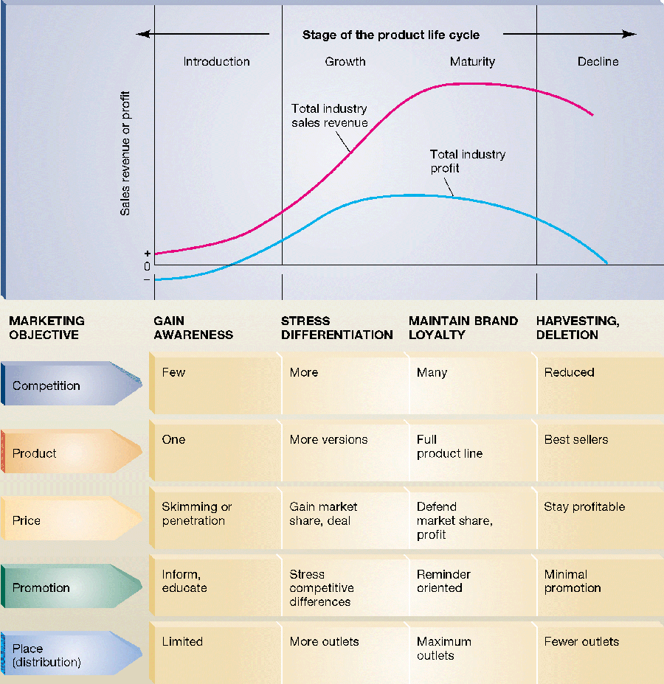
Click here:

Slide 6
Product Mife-cycle Management PLM
PLM image: http://bit.ly/1778hsL
PLM Software: http://www.plm.automation.siemens.com/en_gb/plm/

Slide 7
Project Plan & Resources
A project must be properly planned out before starting, otherwise it may fail for lack of resource e.g. time and/or money.
The engineering industry is highly competitive and in most companies it is the accountants who have the final say on whether a project proceeds.
A highly innovative product may seem like a good idea to a design engineer but if the business runs out of money during the development process, then it will never come to market and all be lost.

Slide 8
Lines of communication
Good communication is a key aspect of a successful project.
In a business context, communication will be both internal and external to an engineering company.
In industry, a project team will consist of a leader and people with specific knowledge in, for example, mechanical, manufacturing and electrical engineering.
Lines of communication between the team members will be informal and, depending on the organisational structure of the company, there be links up, down and across the organisation.
The team leader will report to a senior manager or director, and team members will communicate with staff in other departments, such as workshops, quality assurance and testing.

Slide 9
Type of project
Before you can draw up any specification you need to decide what type of project you intend to undertake e.g.
  Designing or modifying a project - this could be a physical product or software
  Testing an electrical, electronic or mechanical product or system
  Designing or modifying a plant layout such as an assembly line
  Producing a complex maintenance procedure for a product or system
  Designing a production method for a product or system, such as automated assembly or CNC manufacturing
  Auditing and making proposals relating to quality assurance or health and safety in an industrial situation
  Making a business improvement proposal
  Mathematical modelling an engineering function, such as undertaking a stress analysis or electronic circuit design.
When preparing a project proposal for a product or system that you are going to design, make or test, you must think about and present information on both the technical and the operational aspects of the project.
The technical aspects involve considerations about the product’s (or system’s) parameters of performance, physical dimensions, mass, reliability and conformance with standards. Essentially you need to provide information that helps define the way the project will be expected to perform in service.
The operational aspects involve considerations about the procedures that will progress the project, such as access to human and physical resources, controlling the budget, progress monitoring and reporting, and schedules and timescales.

Slide 10
Research
Once an initial concept has been identified, you need to research the chosen topic in depth. The idea here is to draw together enough information to be able to make an informed decision about what should be written into the project’s specification.
Suppose you come up with the concept of a solar-powered charger for notebook computers. This seems like a good idea, but there are several obvious questions that need to be addressed.
  What type of people use notebooks in situations where there is no electricity supply?
  What is the power consumption of a notebook?
  How much energy do voltaic panels generate?
  How would the power be stored and regulated?
  Is a clockwork (wind-up) device a better option?
  What are the marketing costs likely to be?
These questions need to be answered through research.
Before starting on any type of research exercise, you must plan what you want to find out, what questions you need to answer.

Slide 11
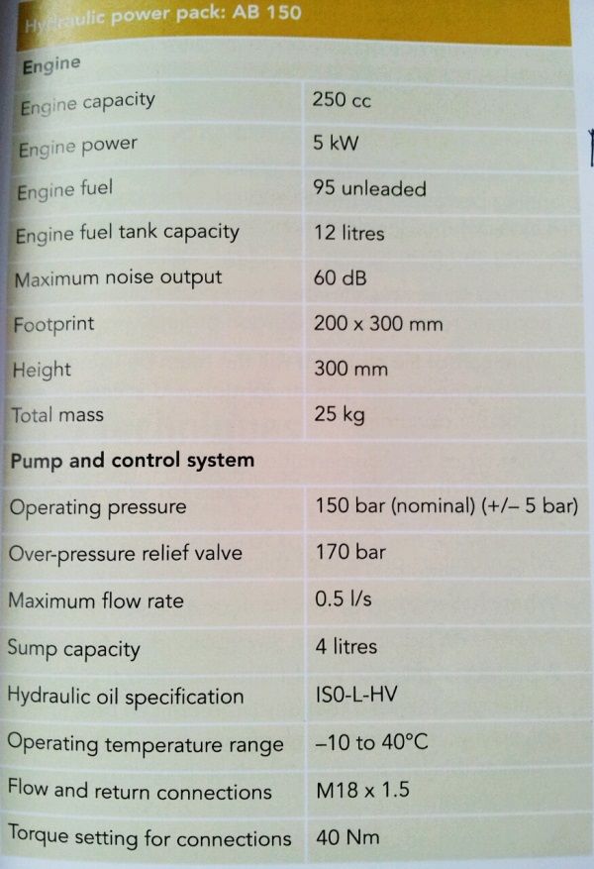
Specificaton for a Hydraulic pack:
The Spec relates to a portable hydraulic power pack that can be used on construction sites.
An air-cooled petrol engine is coupled to a hydraulic pump and control system - and the power tools are connected to the pack by flexible hoses.

Slide 12
Comparison methods
When the project development department of a company comes up with new ideas for new products, these are judged to see whether they are flexible. Are the proposals technically and financially viable?
Once the project has been approved, the next step is to write a specification and to produce detailed and costed design proposals. The decision about which proposal to develop further will be influenced by the result of a comparison technique such as an evaluation matrix.
Each possible solution is evaluated against a list of selection criteria and numerical sources, or a plus/minus scoring system, can be assigned to each criterion. Each design proposal ends up with an overall score and the one with the best score is chosen for development. The selection criteria will consider aspects such as:
  Manufacturing process – for example, machining from solid versus fabrication
  Resources – raw materials, components, labour, finance
  Processing compatibility – for example, how many units of a manufactured product are required over a given time scale.
  Fitness for purpose – for example, will the finished product meet the requirements of the design brief?

Slide 13
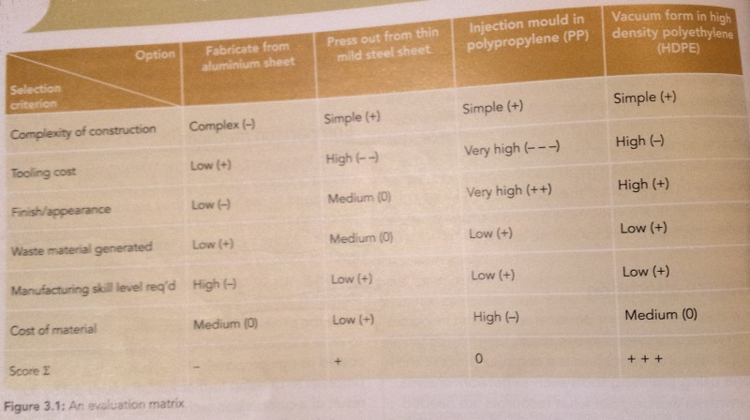
Evaluation Matrix
This Evaluation Method is based on the ‘Pugh decision making model.’

Slide 14
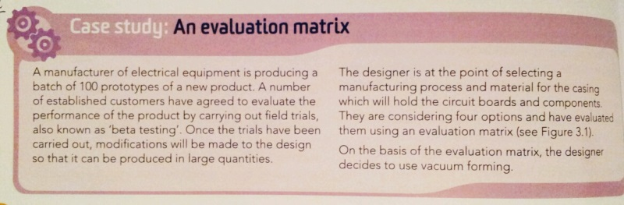
Case-study: Evaluation matrix

Slide 15
Evaluation Matrix & decision making
For information on ‘Weighted Ranking’ decision making please click-here.
For information on ‘Decision making software’ decision making please click-here.

Slide 16
Cost Benefit Analysis CBA
Overview of Cost Benefit Analysis.
Illustration of Cost Benefit Analysis.

Slide 17
Project Aim & Objectives
A project will have an aim and several objectives. An aim is a general statement of intent. To achieve this aim, you should be able to write down a set of objectives, also often referred to as goals. These are activities that have prescribed and measurable outcomes.
Your overall aim at the moment is to achieve your qualifications. This will improve your career prospects. You may not be to sure whether you want to go in the future, but at this moment there is a definite aim in your life – to better yourself.
An aim is a general statement of intent. In this case it might be: (I want to pass the course and to improve my employment prospects). To achieve this aim, you should be able to write down a set of objectives, also often referred to as goals. These are activities that have prescribed and measurable outcomes.
You should identify your objectives and put together a plan for how these might be achieved.

Slide 18
2. Plan and monitor a project
Many factors contribute to the cost of running a project, but the two biggest contributors are the cost of labour and materials.
It is important that peoples’ time and skills are used in the most effective way and that materials are available when needed. To make this happen businesses use scientific planning and monitoring techniques.
A project will have an aim and several objectives. An aim is a general statement of intent. To achieve this aim, you should be able to write down a set of objectives, also often referred to as goals. These are activities that have prescribed and measurable outcomes.
Let’s take a business example. Suppose the aim of a start-up electronics business is to capture 20% of the available market share for a particular type of hand-held barcode scanner. Some of the company’s objectives would be:
  A new model to marketed within 9 months
  First year turnover to be £600,000
  A second model to be marketed 12 months after the first one
  Product reliability to be better than 95%
  Return on investment to be achieved by year 4 of trading
  A 10% market share by year 2 of trading, and 20% by year 6
Once you have established aims and objectives for any project, you can then start the detailed planning.

Slide 19
Setting and monitoring targets
If a project is to have a successful outcome, it is crucial to set achievable targets. There are two overall targets which must be set:
The production of a solution that meets the requirements of the project’s specification.
A schedule for achieving the solution within the given time frame.
Within the overall targets, there should be staging and review points so that you can monitor progress and make modifications to the project plan.

Slide 20
Timescales & Planning Tools
Producing an end result within a given timescale is a key element for the success of a project.
Along the way there will be review points, also called staging points.
  For example, if you are designing and manufacturing a product, break the production down into clearly identifiable steps which you can check off as you go along.
  Timescales for individual elements of the project are best set by using planning tools.

Slide 21
Critical path:
Within a network diagram there will be the critical path.
This is the path that links the activities that have the greatest expected time – in other words, the critical path allows the project manager to identify those activities that have the greatest effect on the overall project time.
By devoting extra resources to these activities so that they are completed more rapidly a project manager would be able to reduce the overall time taken for the project.

Slide 22
PRINCE 2
PRINCE2 (an acronym for Projects in Controlled Environments, version 2) is a project management methodology. It was developed by the UK government agency Office of Government Commerce (OGC) and is used extensively within the UK government as the de facto project management standard for its public projects. The methodology encompasses the management, control and organisation of a project. PRINCE2 is also used to refer to the training and accreditation of authorised practitioners of the methodology who must undertake accredited qualifications to obtain certification.
For more information please click here, and here.

Slide 23
Project Management
Student Activites

Slide 24
Activity:
Choose an on-line solution below and Create a Gannt chart for a Project (e.g. An Assignment):
  TeamGannt – Video intro.
  SmartSheet – Video intro.
  TomsPlanner – Video intro.
  Zoho
  Gantter (integrates with Google Drive)
  Ganttic + Video overview.
  Creatly Online Chart tool + Video overview.
Add a new software skill to your CV.

Slide 25
Activity:
Using available resources summarise in one page of A4 the main steps involved in ‘Project Management’.

Slide 26
Activity:
In pairs think of a new electric device or enhance an existing one
Prepare a resource plan to develop your product which should include details of:
  Materials and components to be bought or borrowed.
  Tools and test equipment.
  Specialised technical help that you might need.
  Access to IT equipment and software packages.

Slide 27
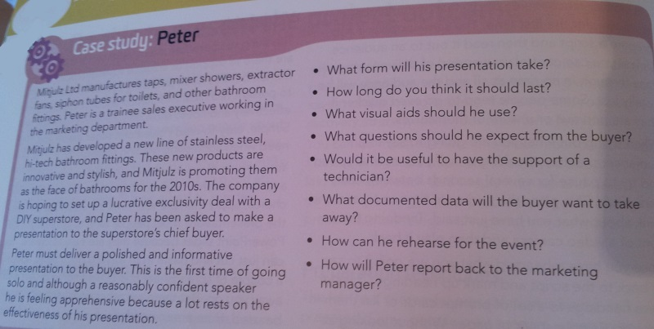
Activity: Presentation

Slide 28
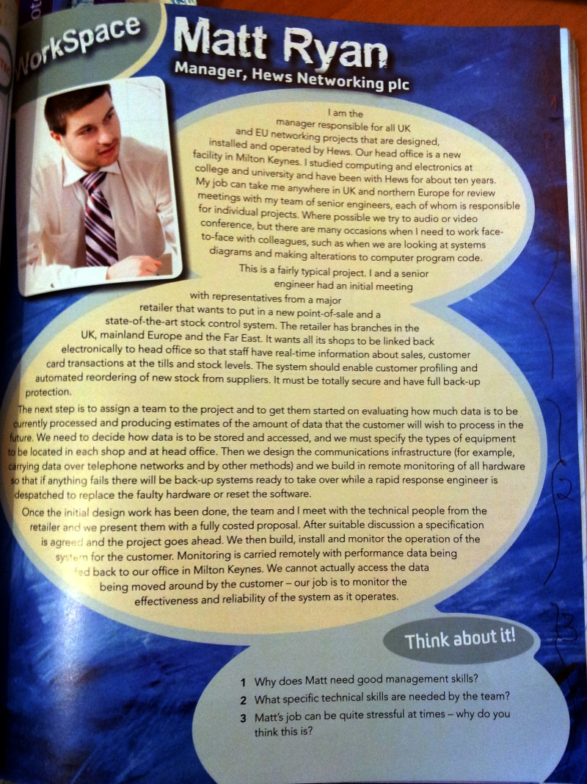
Activity: Handout

Slide 29
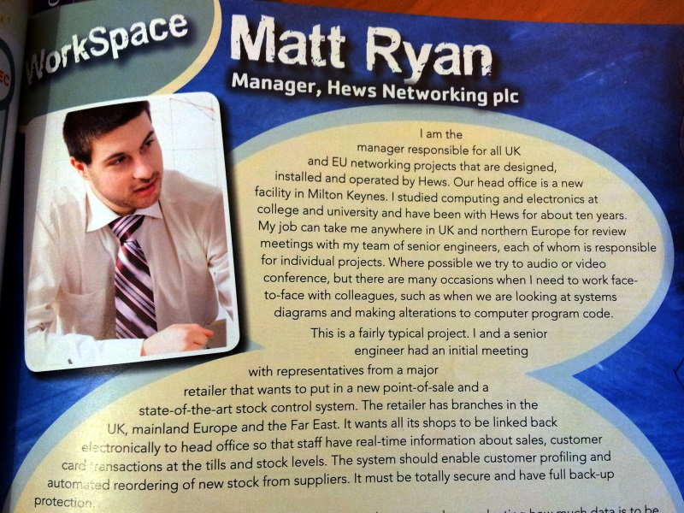

Slide 30
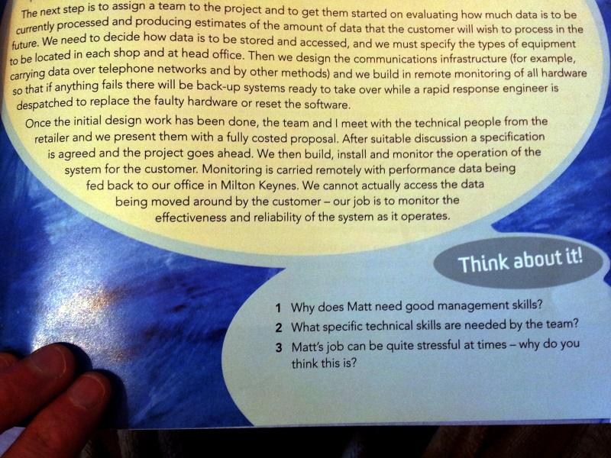

Slide 32
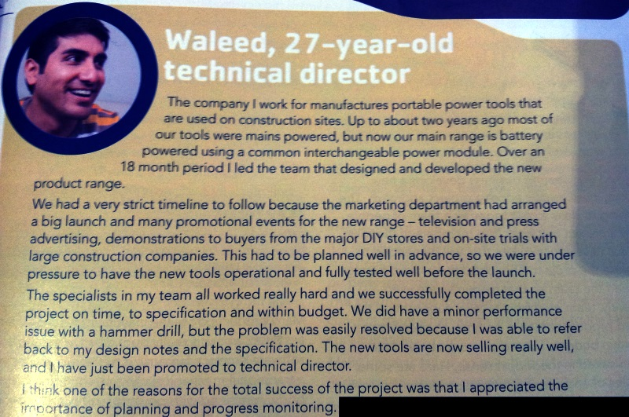
Case example:
(1)

Slide 33
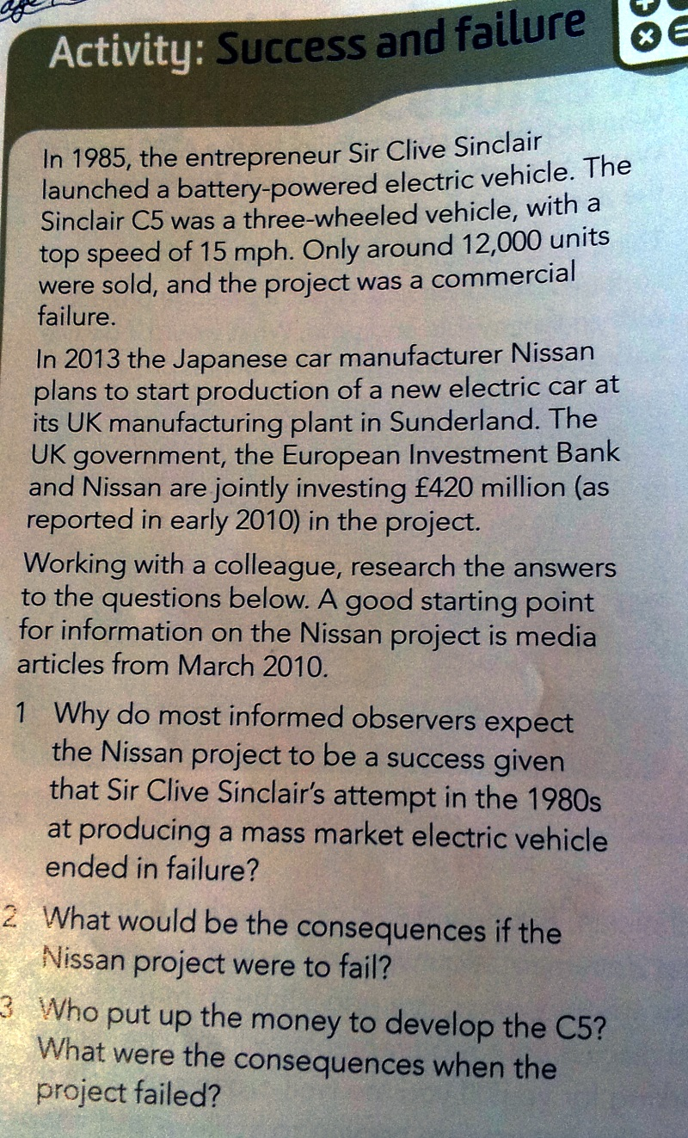
Activity:

