Slide 1
GIS – Geographic INFORMATION SYSTEMs
Presentation by Aidan Swan

Slide 2
Key areas
What is GIS ?
How it works
Examples of GIS
Implications & applications In the built environment
How GIS is used in the construction of dams ( My research proposal)

Slide 3
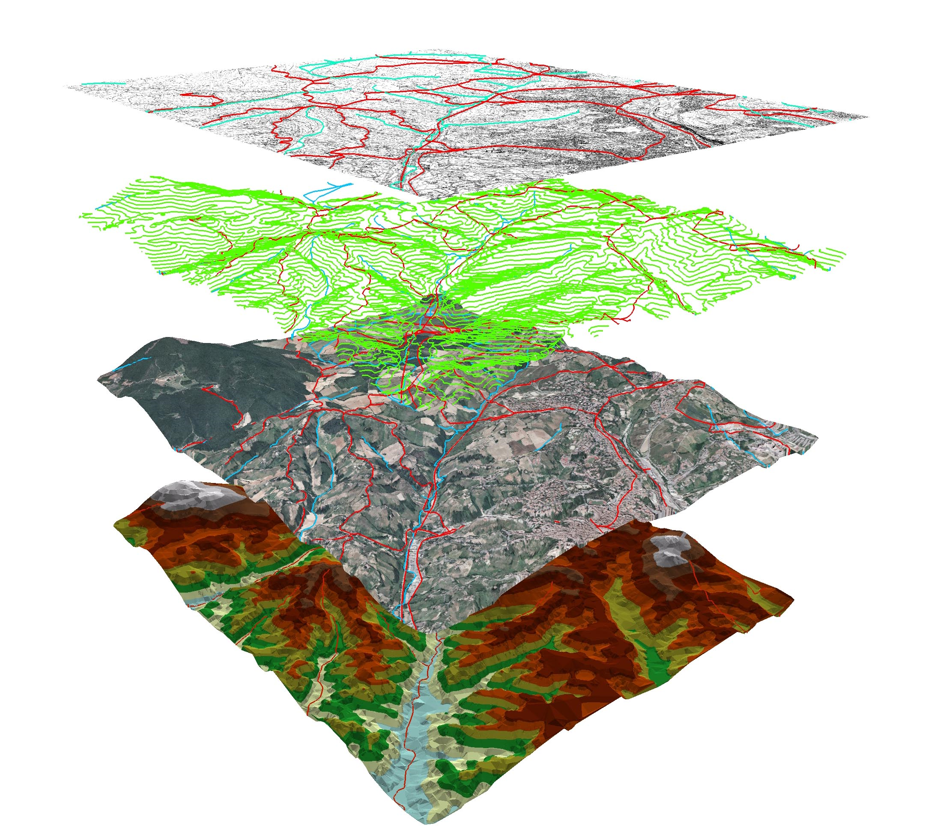
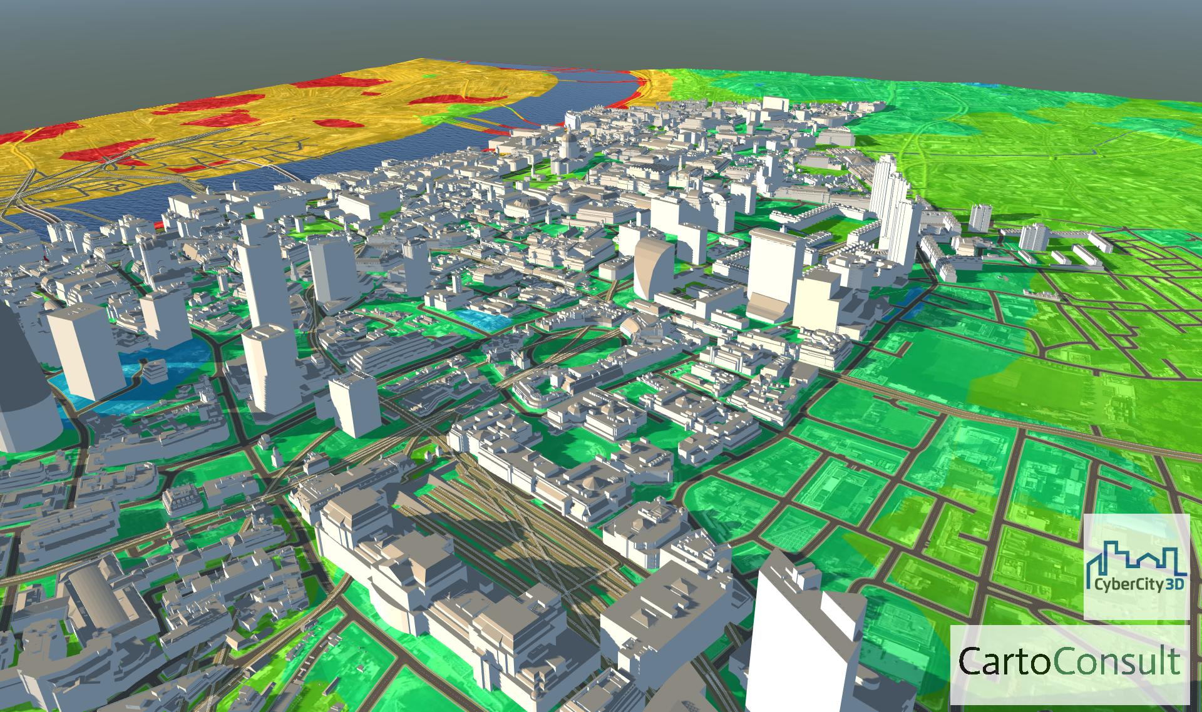
What is GIS ?
Example 1. GIS 3D mapping (Syntec x 2017)
Example 2. GIS 3D city (Spatial data 2017)

Slide 4

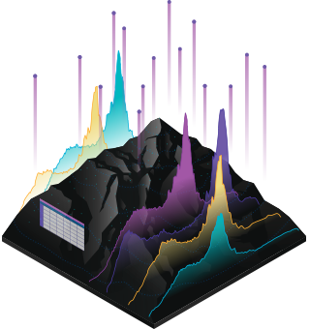
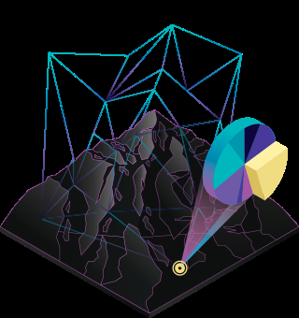

How GIS works
Maps
Data
Analysis
Hardware
Reference. Esri (2018)

Slide 5
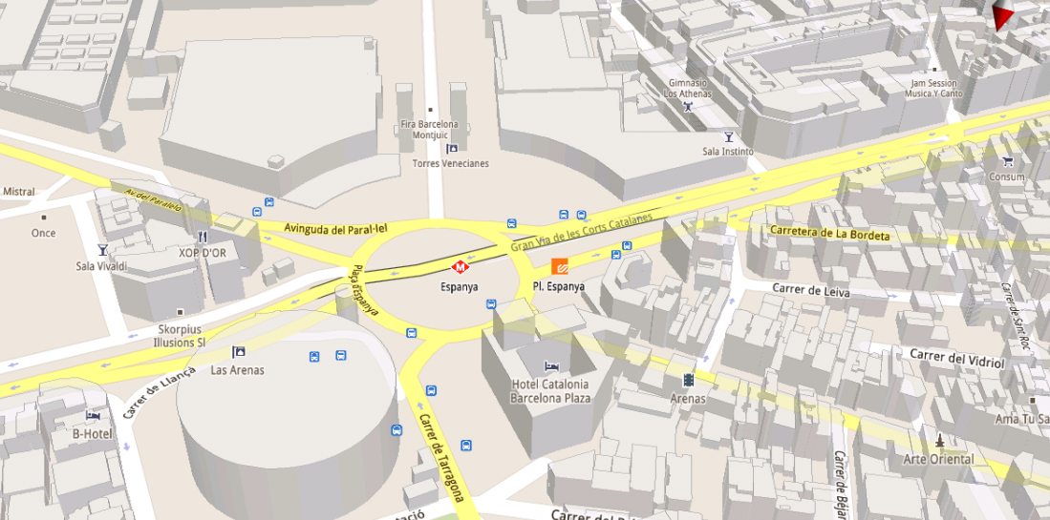
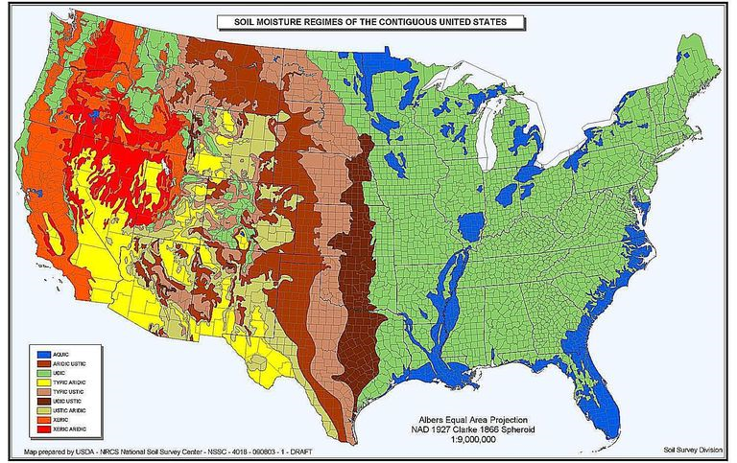
Examples of GIS
GIS google maps. Smos (2018)
GIS mapping
Soil mapping
EIA (Environmental impact analysis)
Soil mapping. Smos (2018)

Slide 6
GIS implications & applications to the built environment
Planning
Storage
Cost

Slide 7

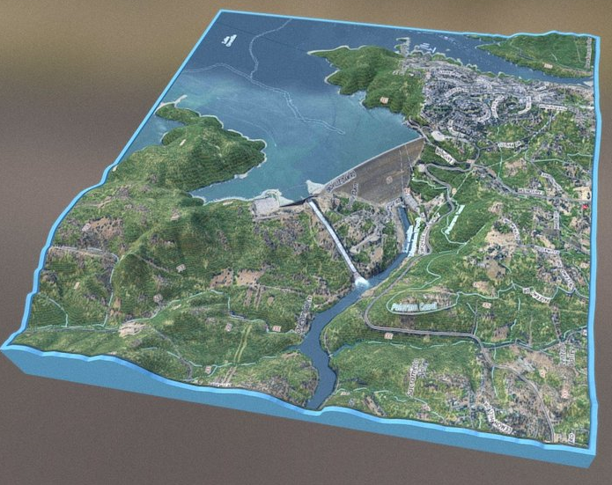
How GIS is used in the construction of dams (research proposal)
Mapping potential sites for dams e.g. soil strata
How the dams construction will effect the environment
planning and cost efficiency
3D GIS dam design (Thematic group 2018)

Slide 8
ANY QUESTIONS ?

Slide 9
REFERECES
Esri (2017) GIS Available at: https://www.esri.com/en-us/home Accessed on 10/03/2018
Smos (2018) GIS forms of mapping Available at: http://www.esa.int/Our_Activities/Observing_the_Earth/SMOS/SMOS_maps_Europe_s_dry_autumn_soils Accessed on 8/03/2018
Spatial Data (2017) GIS 3D city available at: http://spatialdc.com/portfolio-items/city-of-greensboro-gis-feature-update-2014/ Accessed on: 5/03/2018
Syntec x (2017) GIS 3D mapping, available at: http://syntecx.com/gis-services/ Accessed on: 10/03/2018
Themtic group (2018) available at: https://thewaternetwork.com/_/geographic-information-systems-gis/article-FfV/interactive-3d-model-of-oroville-dam-before-spillway-0Hmjm9e8TtwkZDw8z8ujiQ Accessed on: 05/05/2018

