Slide 1

Eastern Fusion
Kirsty
Ripara
Saleema
Romi
Notes:
Good morning we are kirsty, ripara, saleema and romi . Our business proposal is for a food truck called eastern fusion. Where we will sell eastern street food at festivals and events.

Slide 2

Notes:
Eastern fusion is an equal partnership, meaning we have all put forward the same amount of money and we are equally liable for any debt Cousins (2014). we chose a partnership so that we all have equal responsibility and liability of the business.

Slide 3
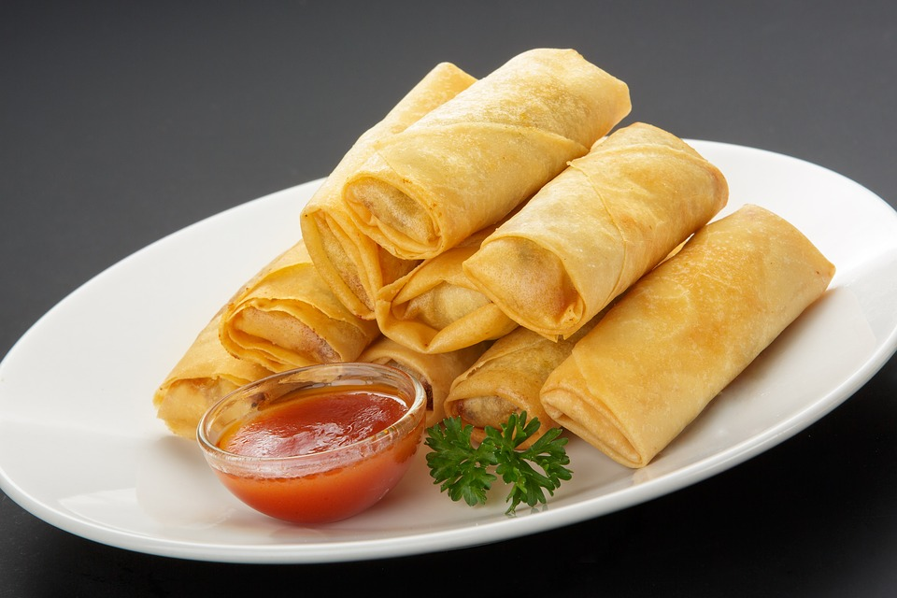
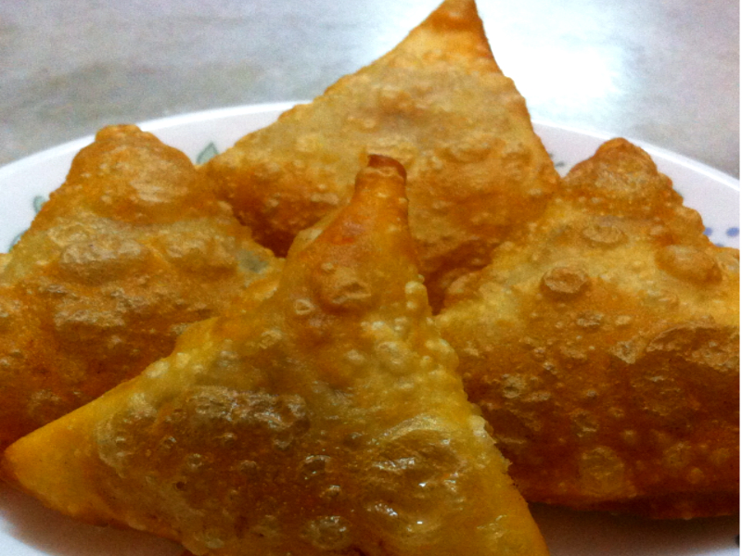


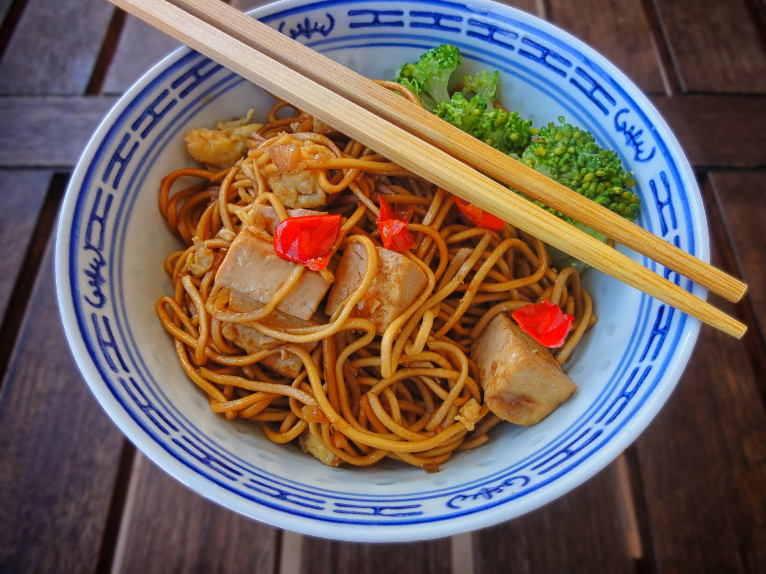
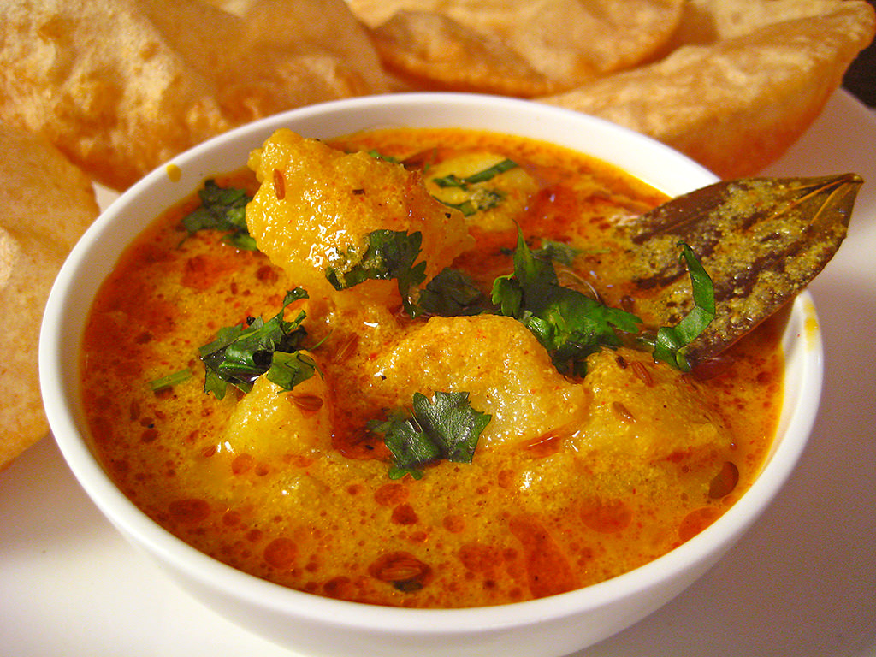
Mission statement
Eastern fusion is commented to bringing our customers quality halal eastern street foods at a great price.
We aim to bring our customers a taste of the east with a difference.

Slide 4
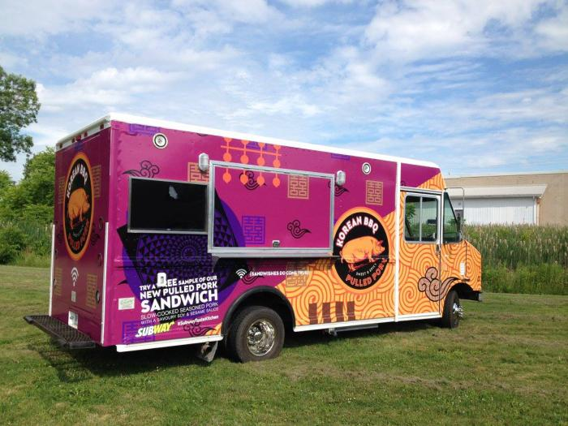
WHO WE ARE
WE AS PARTNER’S DEVELOPED THE IDEA OF STARTING A FOOD TRUCK BUSINESS, AFTER DISCOVERING A PASSION TO BE OUR OWN BOSS AND SERVE A GREAT TASTING EASTERN HALAL STREET FOOD AT HIGH QUALITY, CONVENIENT MEALS TO FAMILIES AND THE GENERAL PUBLIC AT GREAT VALUE PRICE.
DEVELOPED A MENU AND ROUTE
DEVELOPED A MENU AND ROUTE
DEVELOPED A BUSINESS PLAN
RESEARCHED THE MARKET

Slide 5


WHAT WE DO AS A COMPANY
OUR COMPANY IS A MANUFACTURER OF FOOD PRODUCTS. WE OPERATE VIA A MOBILE FOOD TRUCK, SERVICING THE GENERAL PUBLIC, WITH A FOCUS ON THOSE WHO ARE SEEKING GOOD EASTERN FOOD, FAIR PRICES FOR MONEY, AND A RAPID FAST DELIVERY
Notes:
It‘s important to tell your customers what u do as a company.

Slide 6


Physical resources
Mobile catering van
Website

Slide 7


Financial resources
Financial resources
£10,000 from each partner
£40,000 start up pot
From savings
Loans from family
£10,000 from each partner
£40,000 start up pot
From savings
Loans form family

Slide 8



Target audience
Families
Students
Notes:
our target audience will be families and students depending on what sort of festivals we attended for example if it’s family orientated than the prices will be adjusted accordingly. According to Fat Guy media, [2017] it is important to choose a target audience to market your product.

Slide 9

Pricing
Main menu set price
Family meal deal
Student discount
Pricing will be dependent on the type of event.
Notes:
We have looked at the different pricing structures cost leadership and differentiation. According to the University of Cambridge (2018) cost leadership is when a business will try and under cut others in the same sector to become the lowest cost the downside of this is the business may lose money if they are not careful to take advantage of all the ways they can cut costs.
The University of Cambridge (2018) suggests that businesses using differentiation pricing strive for uniqueness within their sector. They will set their prices at a premium.
We have chosen to skim both strategies, during our first few months we will be keeping the cost to the customer as low as possible until we have made a name for ourselves. We will then slowly increase our prices as our brand grows.

Slide 10
Start up costs
Second hand catering van £9,000
Renovate and branding £1,000
Licensing
Food hygiene
Insurance
NCASS membership From £25/month
Notes:
Second hand vans on eBay from £4,000 fully operational vans from £7,500 https://www.ebay.co.uk/itm/12ft-burger-van-Ready-To-Trade-with-Honda-Generator/153201911888?hash=item23ab8ba850:g:010AAOSwBNdbqO5O:rk:13:pf:0
https://www.ncass.org.uk/mobile-catering-home/content/mobile-catering-insurance

Slide 11


MARKETING STRATEGIES FOR EASTERN FUSION
FREE SAMPLES [FOR PEOPLE PASSING BY]
USE SOCIAL MEDIA [ FACEBOOK, TWITTER, INSTAGRAM] PUT UP PICTURES AND VIDEOS.
ALSO TO PROMOTE AND TO INFORM CUSTOMERS OF WHERE OUR TRUCK WILL BE LOCATED
BRANDING [ A TOOL TO USE BOLT GRAPHICS]
FOOD TRUCK EVENTS
DAILY SPECIALS, AND PROMOTIONS
Notes:
(Ripara) According to breeze people 2018. Giving away free samples is one of the most effective way to boost sales and drive awareness of our products. This will help as were new to the market at events and festivals. Ecommerce in 2019 (2018) suggest the importance of social media for for a successful marketing campaign for small businesses. A strong social media presence help small business target their audience effectively through facebook, instagram and twitter.

Slide 12
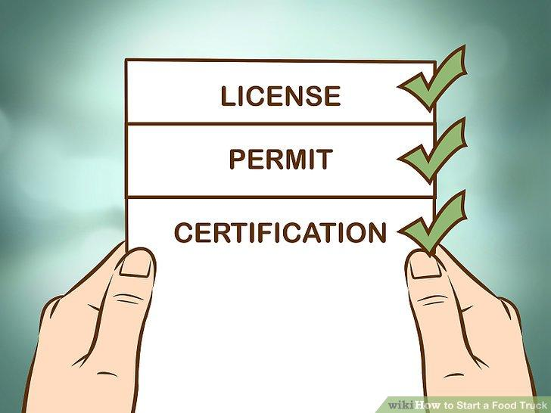
LICENSES & PERMITS
BUSINESS REGISTRATION-APPLY ONLINE AT WWW.GOV.UK AND STREET TRADING LICENCE
SELLER’S PERMIT
FOOD HANDLER CERTIFICATE - NCASS
Notes:
We will need to apply for a street trading licence can be done by visiting online site www.gov.uk-business-and-self-employed website. According to paymentsense [2018.] the business will have to join the national market traders federation (NMTF) which provides liability protection of upto £10 million for small business across EU. The food handling certificate and other requirement will be taken care of by NCASS which is included in the membership.

Slide 13

LEGAL REQUIREMENTS
PROOF OF OWNERSHIP, PROPER IDENTIFICATION, AND VEHICLE LICENSE
RECORDS OF INVENTORY
PROPER STORAGE FOR FOOD, EQUIPMENT, AND SUPPLIES
INSPECTION REPORTS
RENEWAL PERMIT
Notes:
These are the legal requirements needed in any food truck business according to mobile cuisine (2017) .

Slide 14

All owners working on food truck
Kirsty - Operations and finance manager
Ripara - Mareting manager
Romi - Human resources
Saleema - Training
Notes:
Every staff member will have an level 2 hygiene qualifications and management skills we treat all our staff members equally and all team member treat each other with respect. Mobile cuisine (2017) all team staff members have each job so we get our tasks done quckily and each of us wil have mangerment skills or can training towards it,

Slide 15
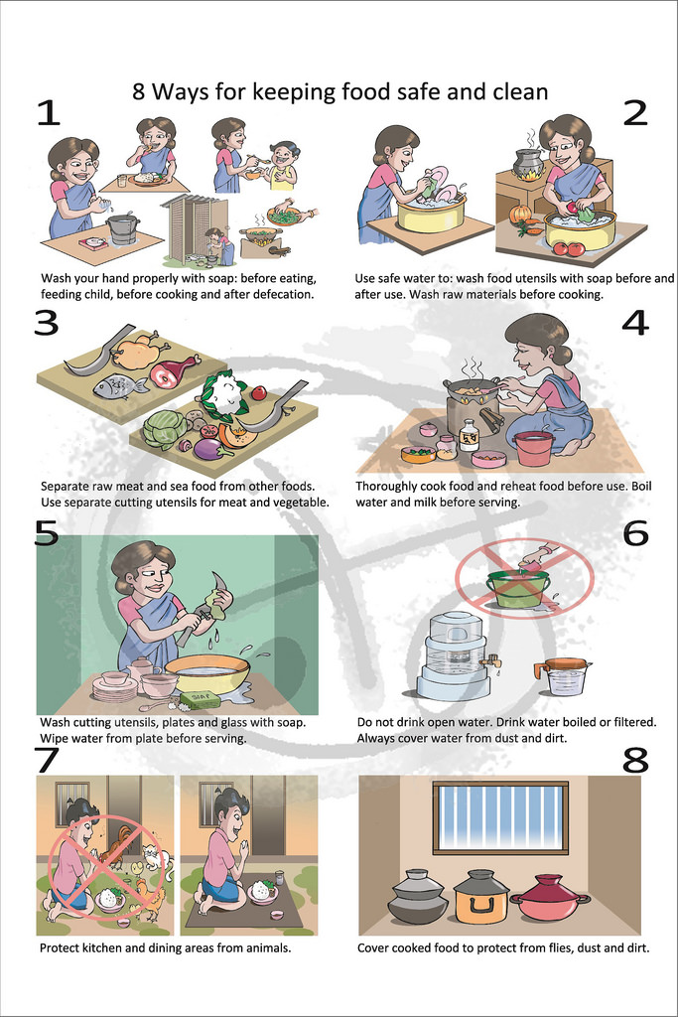
Food hygiene
Health and safety
HACCP
risk assessments
food poisoning
cleaning
refuse
pest control
Notes:
Hygiene courses cover all practices that you'd want staff to be aware of. A typical level 2 course (ideal for food handlers) will cover health & safety in the workplace, HACCP, risk assessments, food poisoning, cleaning, refuse, pest control and personal hygiene amongst other subjects.
A level 1 hygiene training course (for part time or temporary staff) course will cover more basic aspects of food hygiene, such as pest control, food storage, waste disposal, personal hygiene and temperature control.
Courses for supervisors, managers and business owners (level 3 food hygiene) typically develop extensive knowledge of the principles of food hygiene so that they are equipped to practice food hygiene and ensure its maintenance throughout the rest of the business.
https://www.ncass.org.uk/mobile-catering-home/content/get-legal/law-pages/training-requirements-for-mobile-caterers

Slide 16


Leadership duties
Planning
Support
Growing employees
Notes:
Top 3 Critical Leadership Duties For A Food Truck Owner
Planning
Support
Growing employees
To ensure your business maximizes its potential.
https://mobile-cuisine.com/business/leadership-duties-the-most-critical-for-food-truck-owners/

Slide 17
Weaknesses
Seasonal
Lots of competition
Price wars
Limited space
Limited funds
Higher purchase prices
Weather dependent
Strengths
Catering experience
Family friendly
Multicultural food
Affordable food
Fresh ingredients
Notes:
These are our strengths and weaknesses of the proposal of our businesses according to mobile cuisine (2018) its important part of planning our food truck’s future and also our current market position. Also by doing a opportunities and threats section it identifies the effects and challenges down the road and lets the businesses focus on the goals.

Slide 18
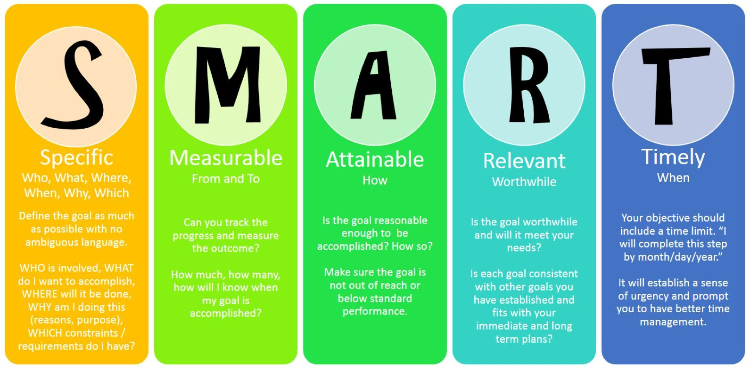
Action plan
By February 2019 we will
Have all licenses and permits
Have applied for all local festivals
Have our menu all planned out
Have decided on uniform design
Have website up and running
By the 1st of july 2019 we will
Have all staff hygiene trained
Have our food truck operational and fully stocked
have a rota in place so all paterners know when they will be working

Slide 19
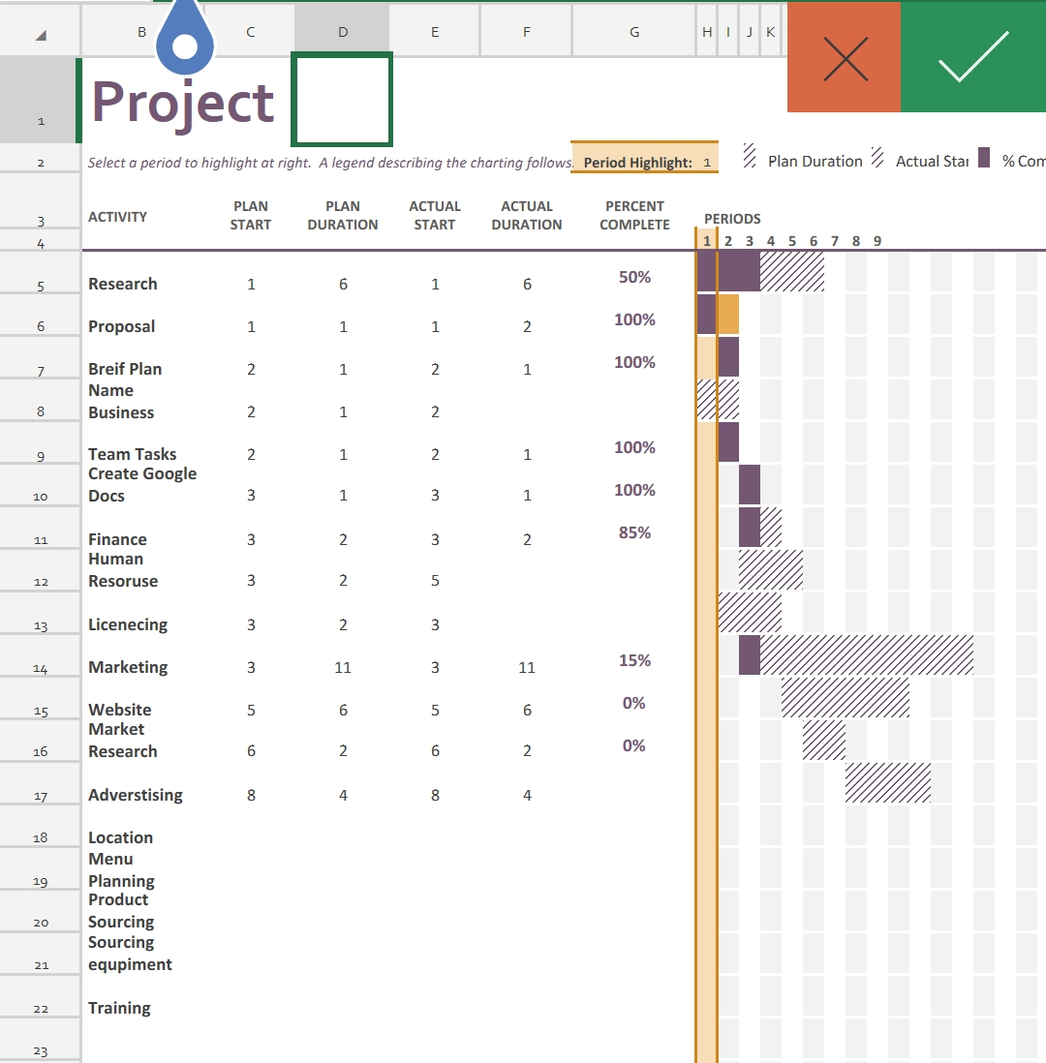
GANTT CHART
Notes:
The gantt chart shows the start of our progress https://www.mindtools.com/pages/article/newPPM_03.htm

Slide 20
References
Cousins, G. (2014) ‘How to Set Up a Partnership or Company With Equal Partners’ [online], https://www.business-lawfirm.co.uk/blog/how-to-set-up-a-partnership-or-company-with-equal-partners.aspx. (accessed 29/10/2018).
Fat guy media. (2017) ‘what is a target audience, and why is it so important’ [online] https://fatguymedia.com/inbound-marketing/target-audience. (accessed 30/10/2018)
FLIP. (2018) ‘How Food Trucks Can Plan Ahead for the Winter Season’ [online]
https://www.fliprogram.com/blog/how-food-trucks-can-plan-ahead-for-winter. (accessed 1/11/2018)
Food business registration-gov UK. (2018) ‘registration of food business’ [online] https://www.gov.uk>business-and-self-employed. (accessed 30/10/2018)
Mobile cuisine. (2018) ‘Leadership Duties: The Most Critical For Food Truck Owners’. [online]https://mobile-cuisine.com/business/leadership-duties-the-most-critical-for-food-truck-owners/. (accessed 3/11/2018)

Slide 21
Mobile cuisine. (2018) ‘Make Sure To Focus On Your Food Truck Capabilities’. [online] https://mobile-cuisine.com/growth/focus-on-your-food-truck-capabilities/. (accessed 1/11/2018)
Mobile cuisine. (2018) ‘The Complete Human Resources Guide for Food Trucks’ [online]
https://mobile-cuisine.com/human-resources/human-resources-food-truck. (accessed 1/11/2018)
NCASS. (2018) ‘Training for Mobile Caterers’. [online] https://www.ncass.org.uk/mobile-catering-home/content/get-legal/law-pages/training-requirements-for-mobile-caterers. (accessed 03/11/2018)
Paymentsense. (2018) ‘how to be a vendor at festivals.’ [online] https://paymentsense.co.uk/blog/how-to-be-a-vendor-at-festivals.uk. (accessed 30/10/2018)
Reed, W (2017) ‘What Food Hygiene Qualifications do I need to work in a kitchen?’. [online] https://jobs.morningadvertiser.co.uk/article/what-food-hygiene-qualifications-do-i-need-to-work-in-a-kitchen-/. (accessed 31/10/2018)
University of Cambridge. (2018) ‘ Porter’s Generic Competitive Strategies’. [online] https://www.ifm.eng.cam.ac.uk/research/dstools/porters-generic-competitive-strategies/. (accessed 31/10/2018)

