Slide 1

Advanced Cybersecurity ACCB 6000
Portfolio – Report
BSc - Applied Computing
Saidi Segirinya (2320521)
University of wales trinity saint david (UWTSD) – Institute of Inner-city LEArning (IICL) birmingham
Lecturer: Dr Md Shantanu Islam
17/03/2026

Slide 2
1. Introduction
The purpose of this Portfolio deliverable was:
To verify that the preconfigured virtual machines, Swansea Domain Controller (S‑DC) and London location (a Domain member of Swansea.acca) (L‑CD), match the expected network topology.
To confirm connectivity between Swansea and London networks before beginning weekly security tasks.
To document the initial network state as required for submission.

Slide 3
2. System Overview
The topography of the system includes the following virtual machines (VMs) involved in the testing process:
S_DC — Windows Server 2022 (Domain Controller) with an IP Address of 192.168.1.1/24
L_CD — Debian Server (Domain Member, DHCP Relay) with an IP Address of 192.168.2.1/24
Client S1 — Windows Client with an IP Address of 192.168.1.10
Client L1 — Debian Client with an IP Address of 192.168.2.10
(Appendix A virtual machines (VMs) screenshot follows in the next slide)

Slide 4
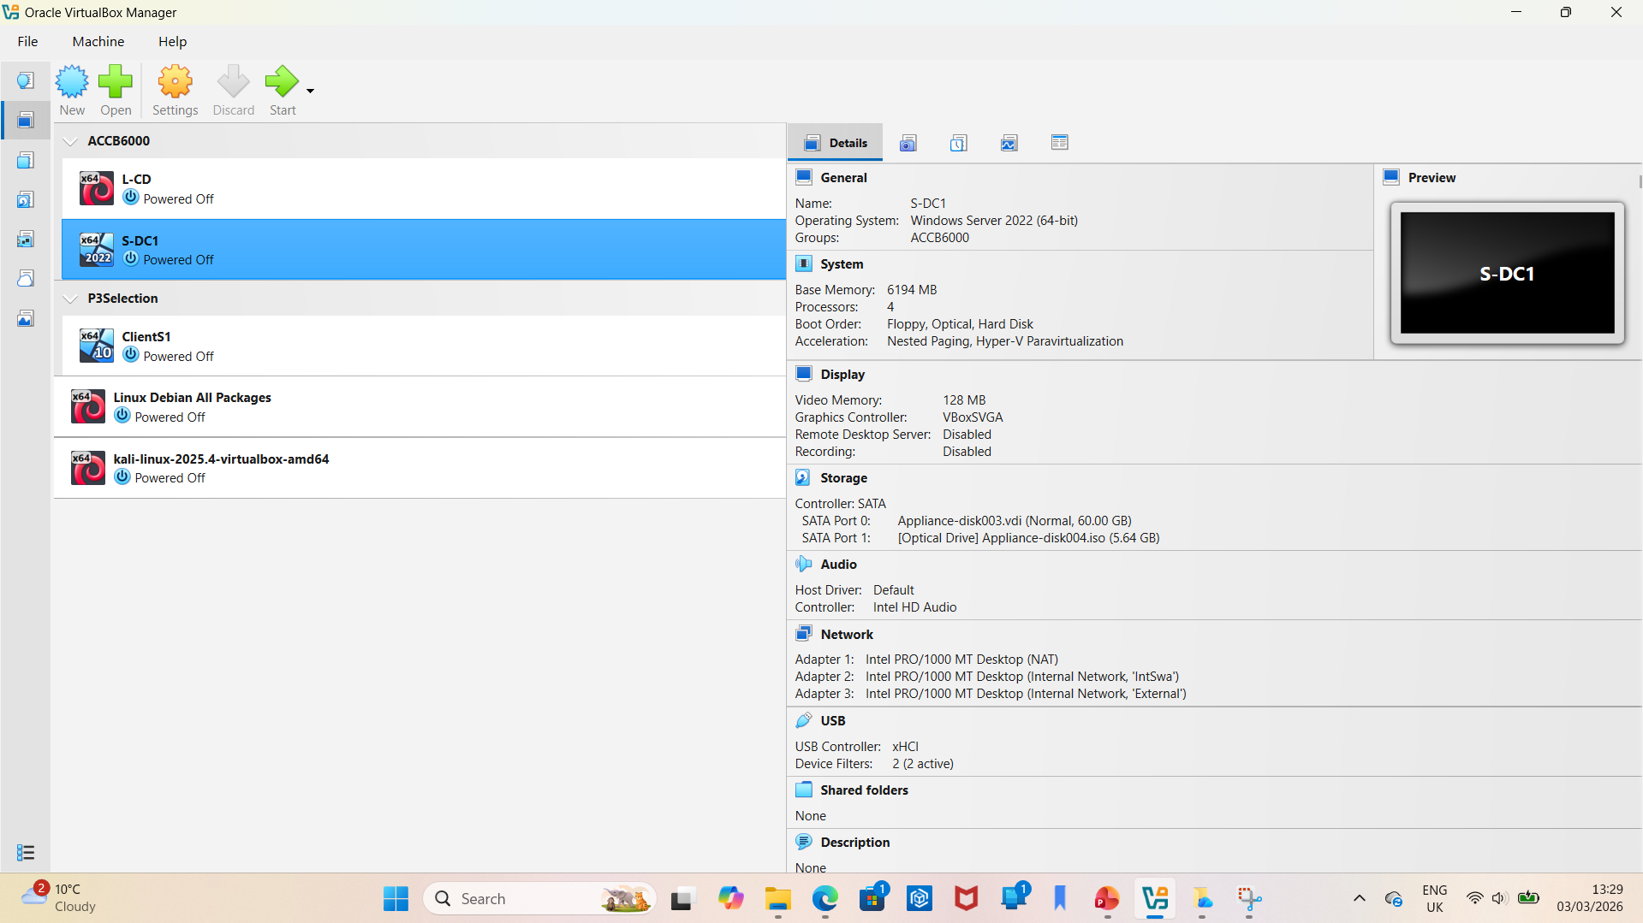
Virtual Machines Installed and Running

Slide 5
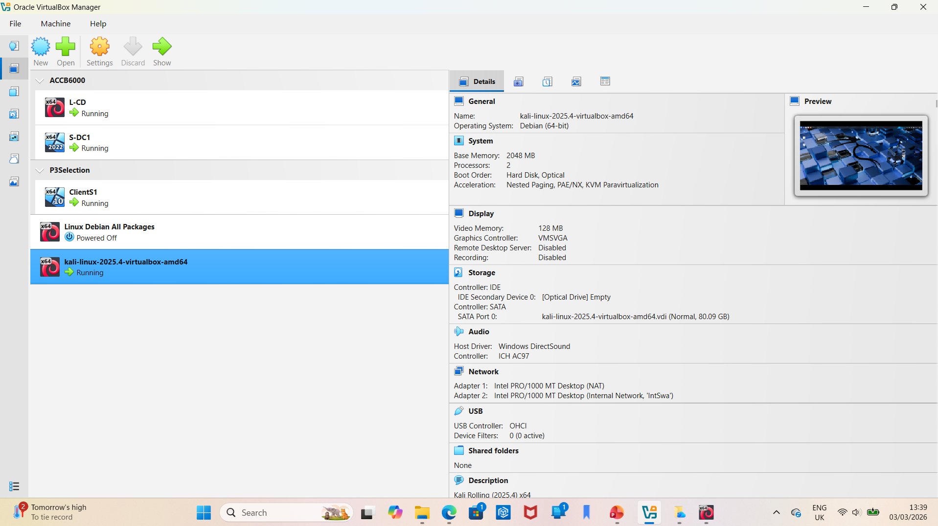
Virtual Machines Installed and Running

Slide 6
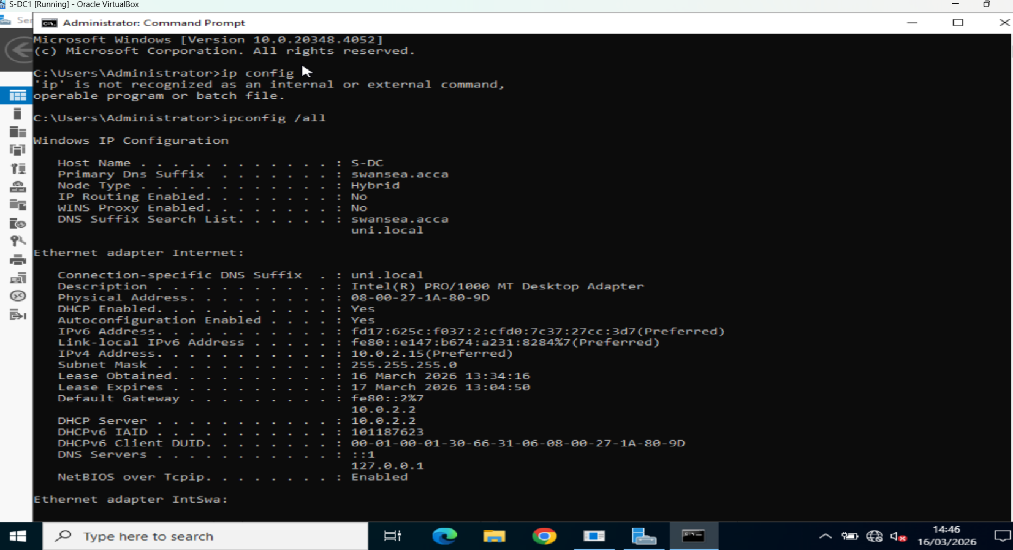
3. Network Test Results – S-DC
3.1 IPCONFIG /ALL Summary

Slide 7

3. Network Test Results – S-DC
3.2 Connectivity Tests
(Appendix B screenshots follow in the next slides)
Command | Expected Result | Actual Result | Status
ping 192.168.1.10 | Success | Success
ping 192.168.2.1 | Success | Success
ping 192.168.2.10 | Success | Success

Slide 8
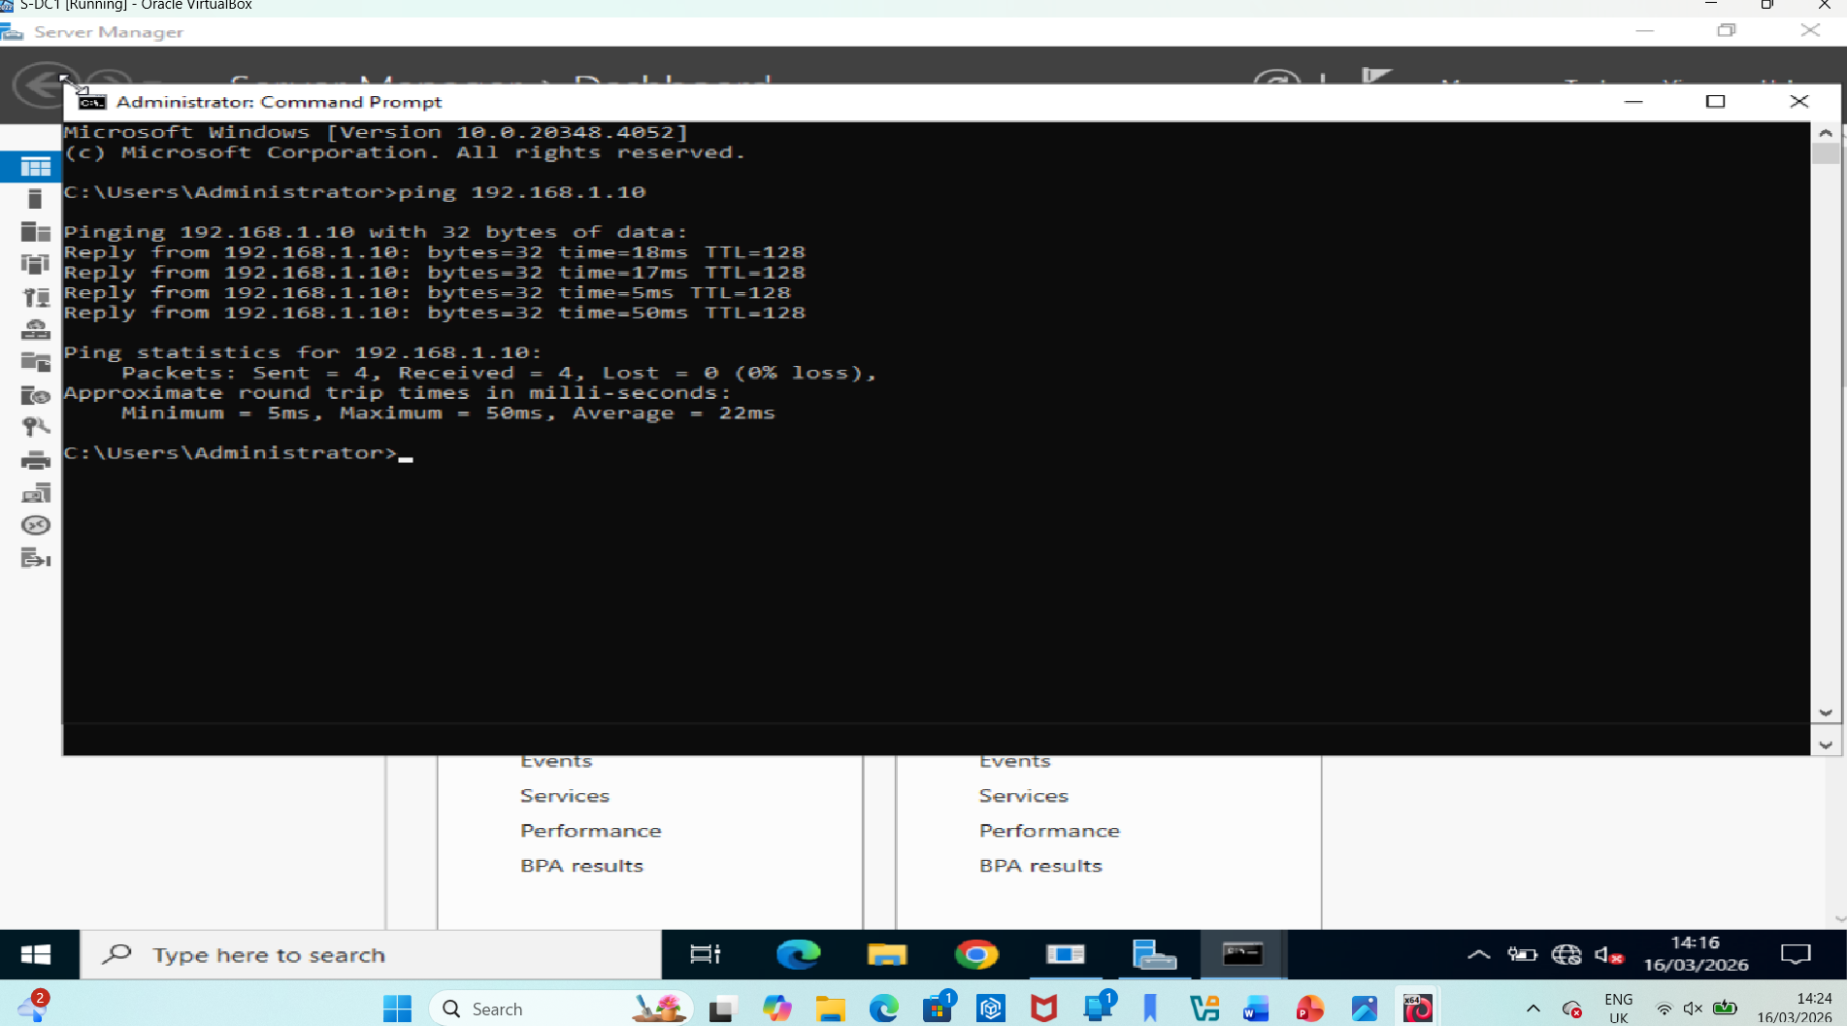
Screenshot for ping 192.168.1.10

Slide 9
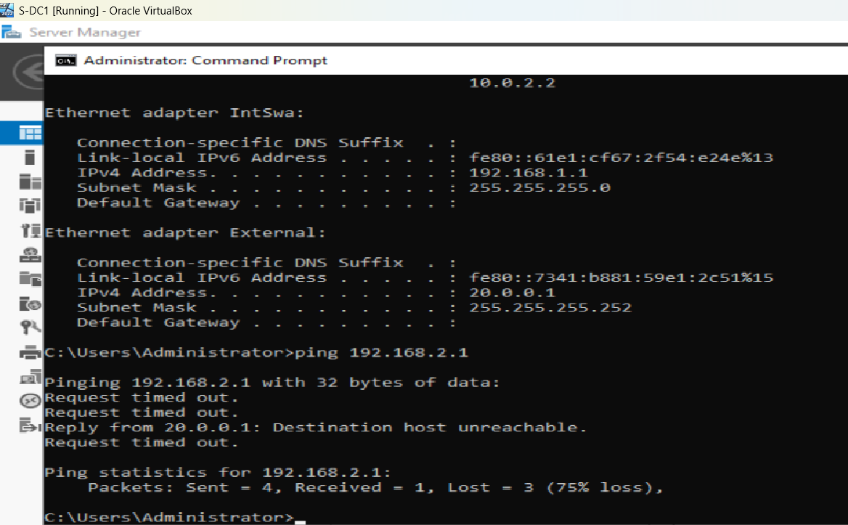
Screenshot for ping 192.168.2.1

Slide 10
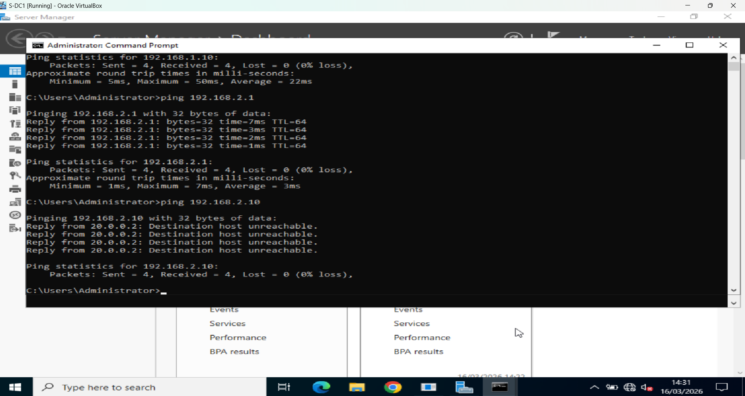
Screenshot for ping sweep 192.168.2.10

Slide 11
4. Network Test Results – L-CD
4.1 IP Address Summary
Expected IP: [192.168.2.1/24]
Actual IP: [Insert]
4.2 Connectivity Tests
(Appendix B screenshots follow in the next slides)
Command | Expected Result | Actual Result | Status
ping 192.168.1.10 | Success | Success
ping 192.168.2.1 | Success | Success
ping 192.168.2.10 | Success | Success

Slide 12
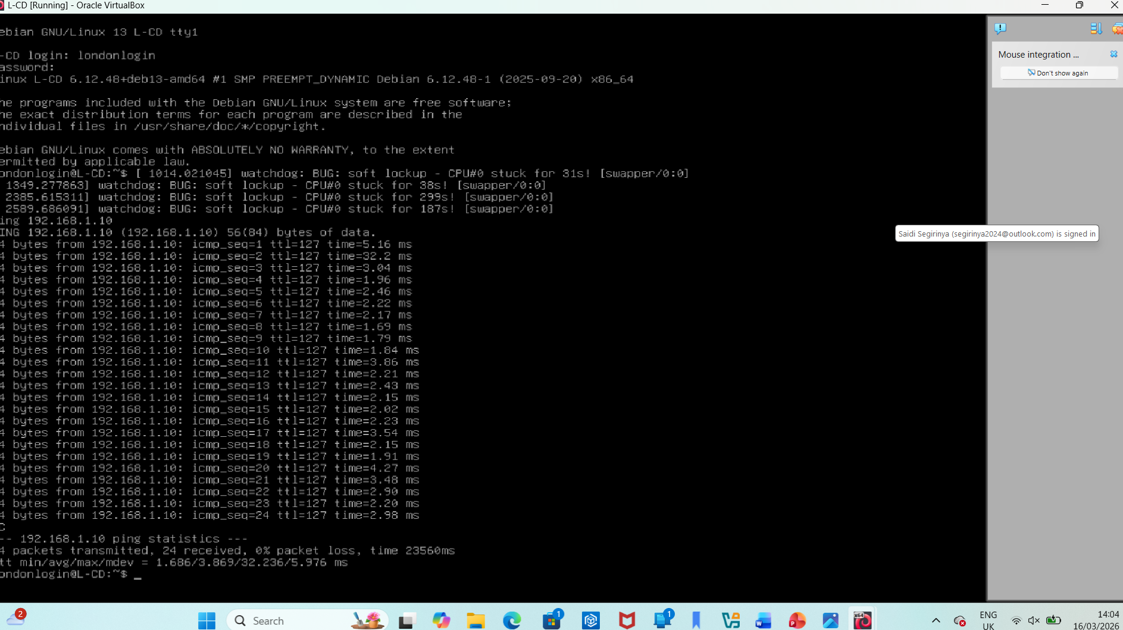
Screenshot for ping 192.168.1.10

Slide 13
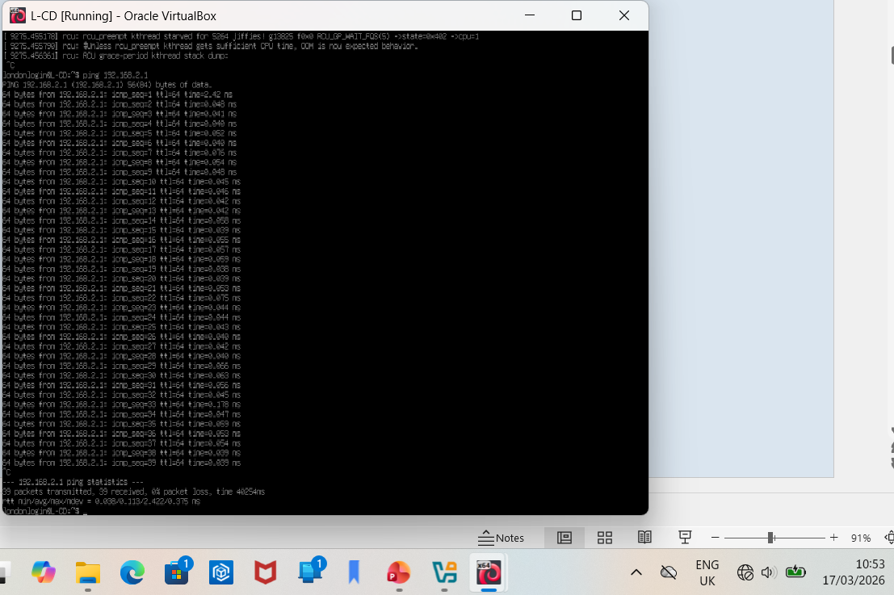
Screenshot for ping 192.168.2.1

Slide 14
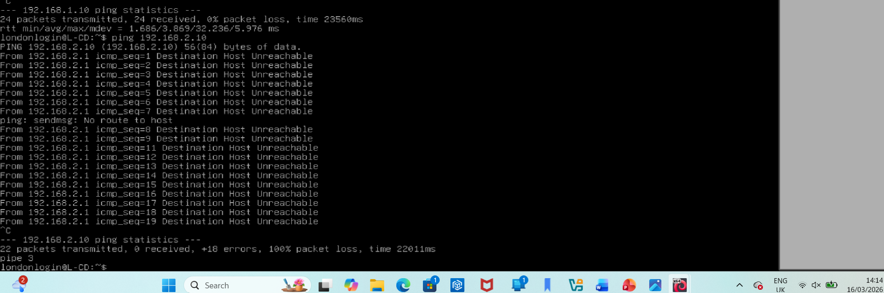
Screenshot for ping 192.168.2.10

Slide 15
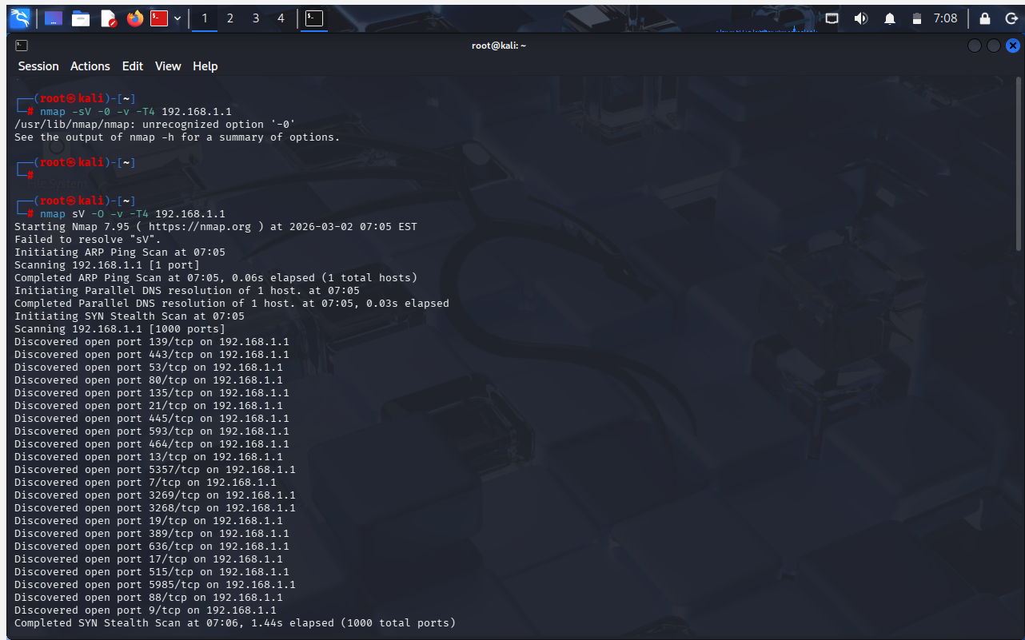
Information Gathering (Reconnaissance)
Nmap Scanning Results
192.168.1.1 (S‑DC – Windows Server 2022):
  Open ports: 21 (FTP), 80 (HTTP), 443 (HTTPS), 445 (SMB), 389/636 (LDAP), 88 (Kerberos), 135/593 (RPC), 3268/3269 (Global Catalog), 5985 (WinRM), legacy ports (7, 9, 13, 19)
  Services: IIS 10.0, Microsoft FTP Service, Active Directory, SMB
  OS detection: Windows Server 2022
192.168.1.10 (ClientS1 – Windows 10):
Open ports: 135, 139, 445, 5357
Services: RPC, NetBIOS, SMB, WSDAPI
1

Slide 16
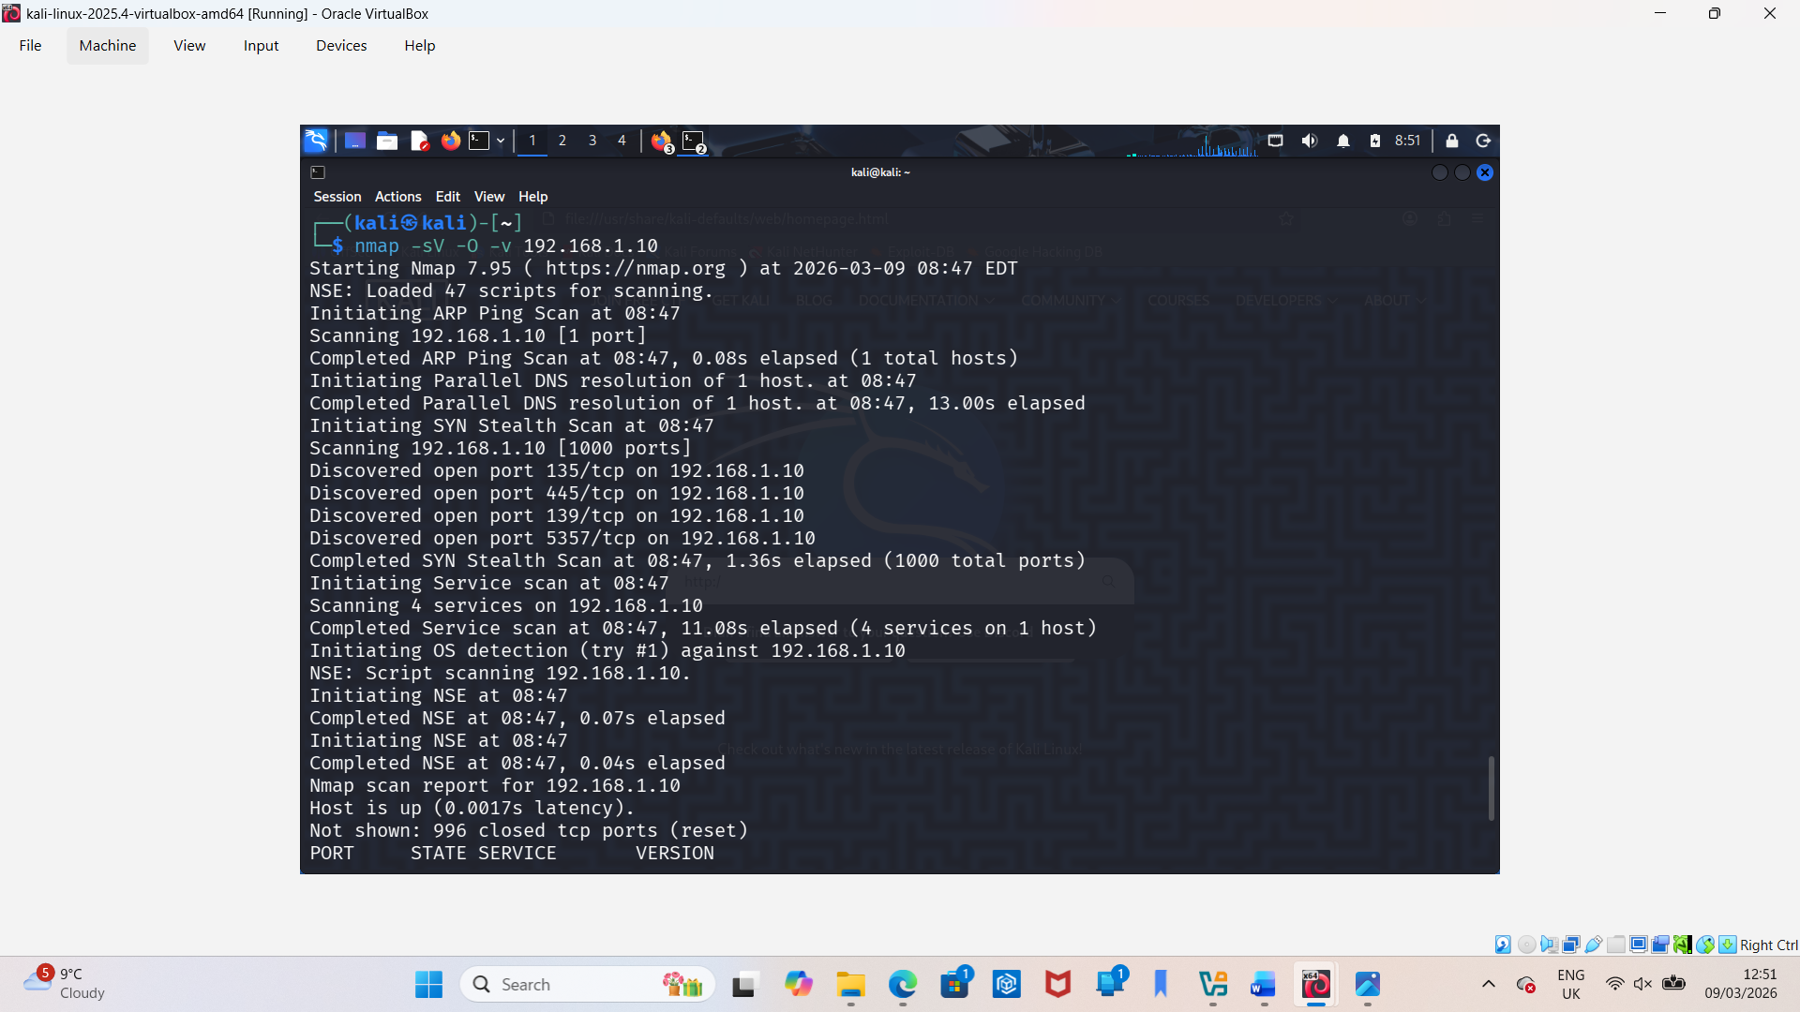
nmap -sV -O –v 192.168.1.10.png

Slide 17
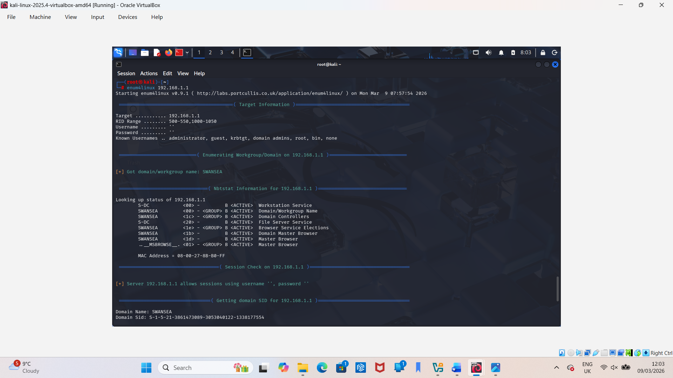
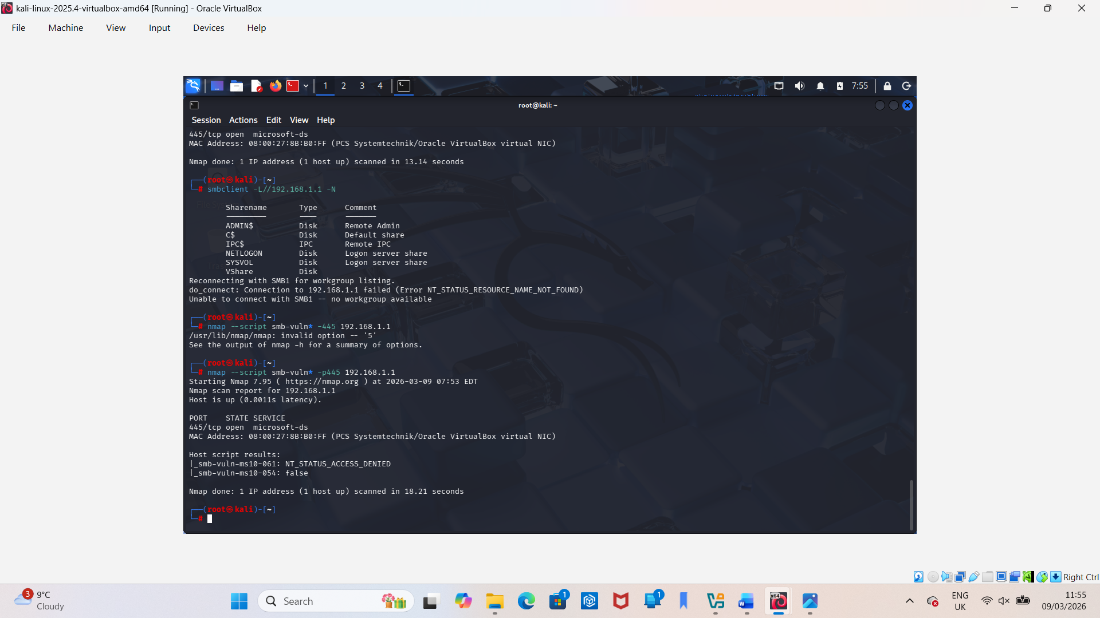
Vulnerabilities

Slide 18
Exploitation & Post‑Exploitation

Slide 19
The above screenshots show:
Exploiting FTP write access
Extracting files
Enumerating SMB shares
Gathering domain information
Mapping the network for lateral movement

Slide 20
Security Measures Implemented
Preventive Measures
Disabled anonymous FTP login
Restricted FTP directory permissions
Disabled legacy services (Echo, Discard, Daytime, Chargen)
Hardened IIS configuration (removed default pages, disabled unnecessary modules)
Restricted SMB access to authenticated users only
Applied firewall rules to limit exposed ports
Enabled logging and monitoring for FTP, SMB, and IIS
Implemented network segmentation to isolate critical services

