Slide 1
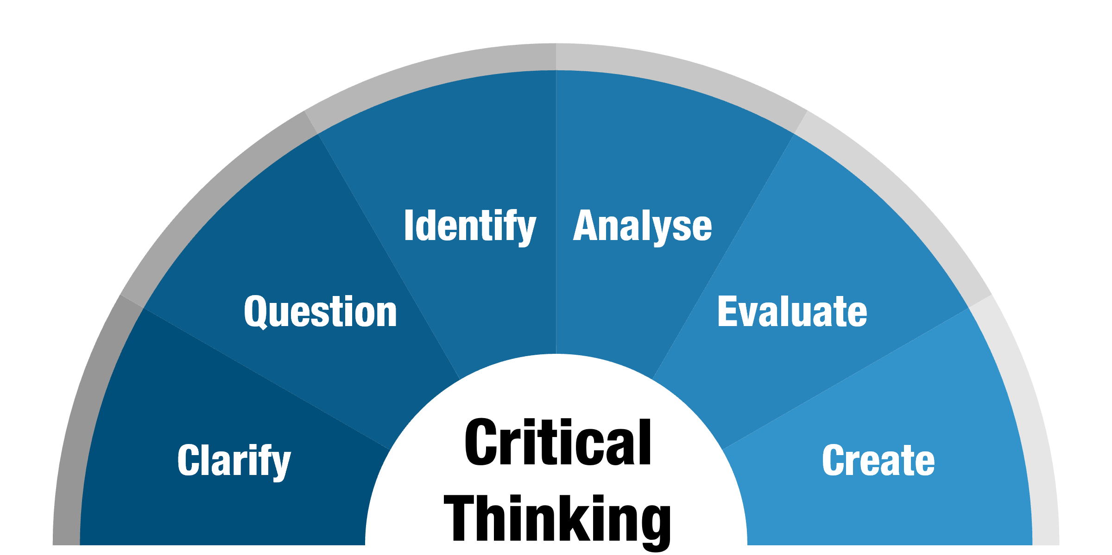

Brooklyn Smith ,221690
ECGE4005P
Critical Thinking
and the qualities that influence the development of critical thinking.
Open mindedness
Being opened minded can have many benefits, one being achieving personal growth, being open to new ideas and exploring more opportunities will make you a more vibrant individual which can support you in being a stronger person. Personal growth has a sizeable part to play in critical thinking which all stems from open mindedness.
To critically think you must be able to consider other people’s viewpoints and be receptive to others’ ideas. People may find it hard to be open minded when they are passionate about something which may result in poor development of critically thinking.
Individuals who are not so receptive to new ideas are the opposite to being open minded, this means they only consider their own viewpoints. According to research (Dwyer. C. April 2019) states this can result in these individuals being less able to tolerate cognitive inconsistencies which may lead to them finding it more difficult to critically think and be more dogmatic.
In many cases some people may find ideas and suggestions simple or foolish, however having the quality of being open minded can give you the skill to brainstorm on this and can deliver a foundation for a stronger and greater idea where you can expand and go into more detail.
Dwyer C. (April 2019) says Brainstorming is a great technique to support your critical thinking which allows you to write alongside talking about all your ideas, expanding on them once you have got everything written down. Brainstorming links and supports communication when you’re critically thinking as you can pair up or get into groups to share all ideas, thoughts which supports your communication to be able to form connections expanding on your ideas making them more academically stronger.
What is critical thinking?
Critical thinking is the process of looking over an issue or situation and being able to question, analyse, interpret, evaluate, and make a judgement about the information.
According to the Monash University website they quote
'’The Term ‘critical comes from the Greek word Kritikos meaning ‘’able to judge or discern’’.
(Monash University,2022)
Source: (Monash University,2022)
Communication
Being a good communicator is having the ability to engage in a conversation with people and make sure it is consistent and offers value. Good communicators will be able to get their point across clearly but also will be able to get the other person to understand the information effectively and easily.
To be able to critically think you must be a good communicator. To be able to see something from a different perspective you must be able to communicate efficiently whilst allowing yourself to accept other individuals’ viewpoints. Adults who can examine the process of how other people think are more than likely to be better communicators and according to Miller, B. (September 2022) this type of analysis is very important when it comes to critical thinking.
However, individuals that find communicating more difficult more than likely will find critically thinking harder as they are unable to problem solve or consider other perspectives which are another two important qualities needed when critically thinking.
Note Taking
From research, (Austin Community college n.d) states that note taking can help you decide and highlight the key ideas of the information you see or hear. Being organized and taking notes will make it easier for you to link information and gives you the correct accurate information you need. (Austin Community College. N.d) also informs me that the benefits of effective note taking keeps you involved in your research and assignments, It allows you to reflect on what to include within your assignment and taking notes makes studying easier to understand after a lecture. Similarly, Rickards, Fajen and Sullivan (1997: 508) agrees note taking has a positive impact on students’ recollection of lectures information compared to students who do not take any notes and therefore do not remember the whole text and information they have previously heard or read which may affect their process of critical thinking and ability to transfer work into their own words.
Source: (Conceptboard , June 2021)

Slide 2
References
Austin Community College District. Benefits of Note Taking?. Available at: https://www.austincc.edu/about-acc
(Accessed 21/09/2022)
Monash University. (May 2022) What is critical Thinking. Available at: https://www.monash.edu/learnhq/enhance-your-thinking/critical-thinking/what-is-critical-thinking
(Accessed 20/09/2022)
By Kerry Cherry. (Updated February 17,2022) How to be Open minded. Available at: https://www.verywellmind.com/be-more-open-minded-4690673. (Accessed 21/09/2022)
Rickards, Fajen and Sullivan (january 2009). The Effect of note-taking on university students’ Listening comprehension of lectures. Available at: https://files.eric.ed.gov/fulltext/ED570171.pdf. (Accessed 21/09/2022)
Miller, B. (September 2022) what is the connection between communication and critical thinking? Available at: https://www.languagehumanities.org/what-is-the-connection-between-communication-and-critical-thinking.htm (Accessed: 22/09/2022)
Indeed Editorial Team. (November 202) (updated August 2022). What is Effective Communication?. Available at: https://www.indeed.com/career-advice/career-development/effective-communication (Accessed 21/09/2022).
Dwyer C. (April 2019) Open mindedness and scepticism in critical Thinking. Available at: https://www.psychologytoday.com/us/blog/thoughts-thinking/201904/open-mindedness-and-skepticism-in-critical-thinking (Accessed 25/09/2022).
New York University ( N.D). Brainstorming. Available at: https://www.nyu.edu/faculty/teach (Accessed 25/09/2022)
Conceptboard (June 2021) 15 brainstorming techniques with free templates for 2021. Available at: https://conceptboard.com/blog/brainstorming-techniques-templates/ (Accessed 27/09/2022).

