Slide 1

Module: Community Care and Management of Long-Term Conditions
Module Code: LCHS7003
Assessment 2
Student name: Esther Iyamu
Student ID: 2213124
Lecturer’s name: Dr Mohammad Khan
Deadline: 10th December 2025, 14:00 (2 PM)
Title: Presentation on Depression
Acknowledgement
I confirm that I have not used any AI tools in the research and creation of this assignment. I confirm that I have not presented any AI-generated materials as my work. I confirm I have copies of my drafts, notes, and other resources I used, which I may be asked to provide in evidence.

Slide 2
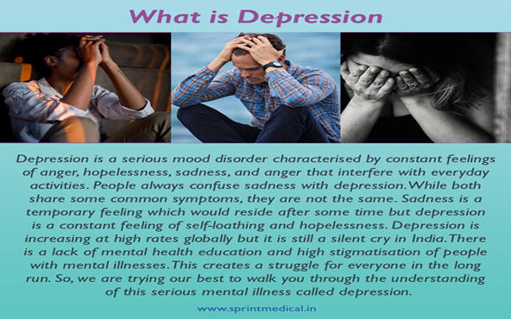

What is Depression
Depression is a persistent low mood accompanied by a loss of interest or pleasure that lasts for weeks or months, impacting emotions, thoughts, physical health, and behaviour. Its severity ranges from mild to severe (NICE, 2025).
Depression in older adults is often linked to chronic illness, showing it's more than just a mood disorder. Recognising this connection is essential for effective care and support (Oude Voshaar, 2023).

Slide 3
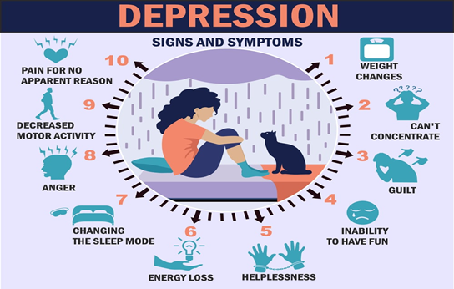

Signs and Symptoms of Depression
Feelings of sadness, restlessness, or irritability
Struggles with guilt, worthlessness, and self-doubt
Emotional numbness and isolation
Reduced joy in previously enjoyable activities
Frustration over minor issues
Lack of self-confidence and feelings of hopelessness
Feeling constant fatigue (Mind, 2025).

Slide 4
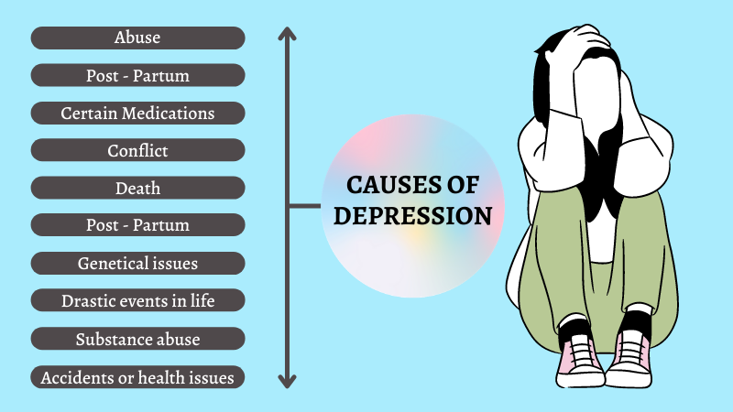
Causes of Depression
Stressful life events (bereavement, divorce, illness, job loss)
Social and economic circumstances
Personality traits
Family history
Loneliness and isolation
Substance abuse (alcohol and drugs)
Physical illnesses (heart disease, cancer) (NHS, 2023).
(Psychiatrist in Rohini, 2021).

Slide 5
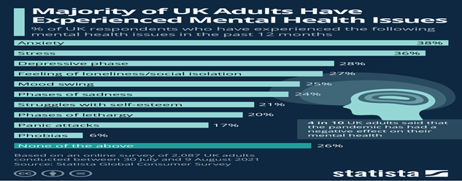
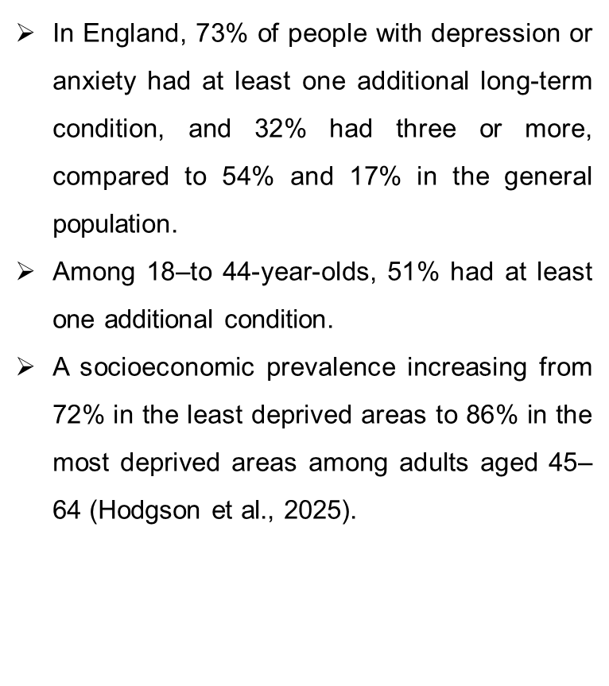

Prevalence in the United Kingdom (UK)

Slide 6
Prevalence Worldwide
An estimated 4% of the general population experiences depression. Globally, about 5.7% of adults are affected, with 4.6% of men and 6.9% of women affected (WHO, 2025).
Also, 5.9% of adults aged 70 and older suffer from depression, totalling around 332 million people worldwide (WHO, 2025).
Depression is 1.5 times more common in women than in men, and 10% of pregnant women and new mothers experience it.
In 2021, around 727,000 people died by suicide, making it the third leading cause of death for those aged 15 to 29 (WHO, 2025).

Slide 7
Economic burden of depression
Mental health problems cost the UK economy at least £117.9 billion per year, 23% of £117.9 billion = £27.1 billion per year attributable to depression (Mcdaid, D and A-la,2022).
In 2022, the total cost of mental ill health in England reached £300 billion, of which £60 billion for Health and care costs, which includes care provided by public services and family and friends (Cardoso and McHayle 2025).
Economic costs: £110 billion lost due to mental ill health. (Cardoso and McHayle 2025).
The annual cost of depression in the UK is approximately £7.5 billion. Mental ill-health costs the UK economy at least £118 billion annually, which is 5% of Gross Domestic Product (GDP)
(NHS, 2025).

Slide 8
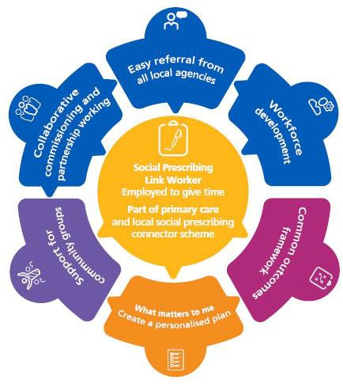
Social Prescribing model
Social burden of Depression
Depression is a significant health, social, and economic issue affecting millions in the UK (Office for National Statistics, 2022).
Financial hardship often correlates with depression, as 24% of adults struggle to pay energy bills (Office for National Statistics, 2022).
Debt and care are common among those with depression, with 1 in 6 adults experiencing severe cases (Office for National Statistics, 2022).
The social prescribing model links adults with depression to non-medical support for practical issues, including help with rent arrears, unpaid bills, debt counselling, welfare benefits advice, and housing support (Office for Health Improvement and Disparities, 2022).
(NHS England, n.d).

Slide 9
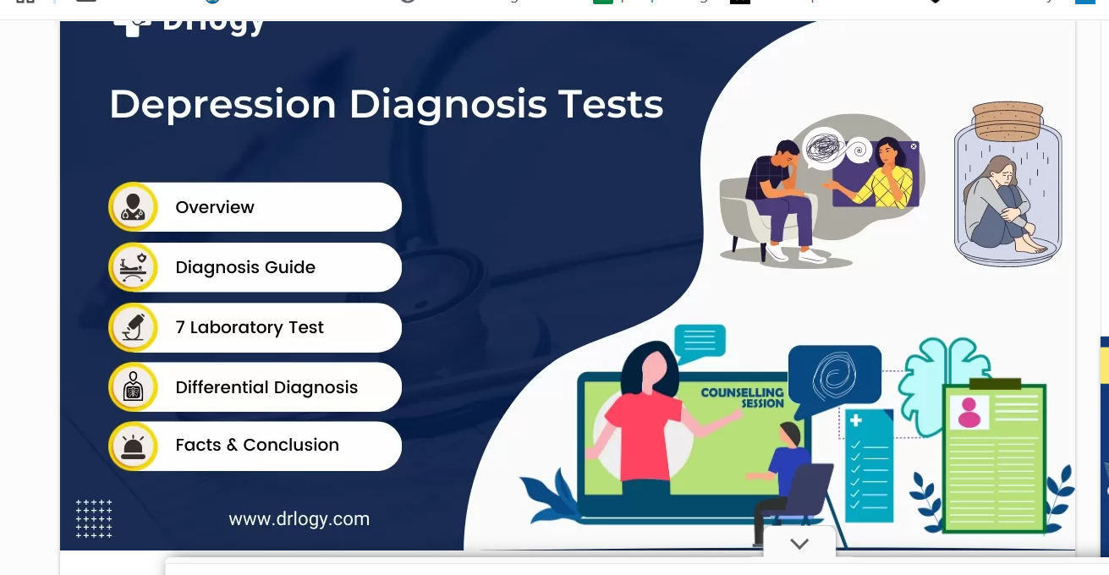
Diagnosis and Initial Assessment of Depression
Diagnosis
Utilised a validated depression questionnaire, PHQ-9 (Patient Health Questionnaire-9), to identify Possible Depression to evaluate and monitor the severity and duration of depressive symptoms, such as low mood, persistent distress, loss of interest/pleasure, sleep disturbance, appetite/weight change (NICE, 2025).
Initial Assessment
Medical professionals should consider risk factors such as suicide or self-harm, chronic physical health conditions, medication and a history of domestic violence (NICE, 2025).
Urgent referral if high risk and ensure safety-netting
Communication Considerations if the individual’s language is complex.
Clinical Knowledge Summary (CKS) emphasises shared decision-making and using tools (questionnaires) not just to screen, but also to monitor treatment response (NICE, 2025).
(Drlogy, 2025)

Slide 10
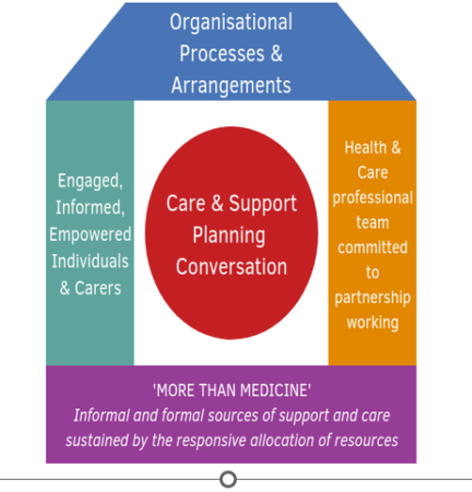
The House of Care model for managing depression
The House of Care framework promotes person-centred collaborative care and support planning across various health systems, including professionals such as occupational therapy (Hendry, 2021).
Community supports such as social prescribing enhance self-management and improve clinical outcomes (Hendry, 2021).
House of Care model for depression
The House of Care model focuses on individual priorities in managing depression.
Collaborate to develop a care plan addressing physical, psychological, and social needs.
Applying the House of Care Model to Depression Care
Putting the person in charge of a shared care plan
Supporting self-management (psychological, behavioural, lifestyle)
Psychoeducation- an approach that teaches people about mental health conditions, symptoms, treatments, and coping skills to empower them to manage their well-being and reduce relapse.
Working as a coordinated multidisciplinary team
(Alliance, 2025).

Slide 11
Management of long-term conditions
Improving Outcomes for Adults with Long-Term Depression
Conduct early and accurate assessments of depressive symptoms and individual needs.
Develop a personalised care plan that respects the patient's choices and wishes.
Ensure access to evidence-based psychological therapies.
Involve partners or family when relevant (e.g., in behavioural couples therapy).
Implement stepped or matched care to prevent under-treatment or over-treatment.
Monitor ongoing for signs of relapse and potential side effects of medication.
Coordinate care between primary and secondary healthcare services (NICE, 2022).
The National Institute for Health and Care Excellence provides a UK framework for managing depression in adults with long-term conditions.
Person-Centred Care
Treat the individual with compassion, respect, and dignity to reduce stigma.
Provide clear, tailored information and involve patients in decisions.
Early Recognition and Assessment
Stay alert for depression in people with chronic physical illness
Evaluate symptoms, lifestyle, and social stressors (NICE, 2022).
Collaborative Care (Key for Long-Term Conditions)
Coordinated care between GP, mental health services, and physical health teams.
(NICE, 2022).
Notes:
11

Slide 12



Treatment Option for Depression in the United Kingdom
Talking Therapy
Antidepressant Drugs
Physical activity
(Pattemore, 2022).
Talking therapy allows patients to discuss their thoughts and feelings with a trained professional.
It helps individuals understand their emotions, identify unhelpful patterns, and explore the origins of negative thoughts, enabling them to change those thoughts and feel better (NHS, 2025)
Physical activity effectively manages depression and anxiety symptoms, especially with higher intensity and shorter interventions.
Exercise produces greater improvements in mood. (Singh et al., 2023).
Gatta, 2024).
Relieve depression symptoms.
They can help those with moderate to severe depression
It requires a doctor's prescription (NHS, 2023).

Slide 13
Comorbidities that can accompany Depression as a long-term condition
Depression frequently co-occurs with long-term disabling conditions:
Stroke
CVD
Diabetes
Eye disease
Dementia
May increase the risk of future physical health issues, especially stroke, cardiovascular disease, and diabetes.
(Singh et al., 2023).
About 40% of individuals with depression and anxiety also have a long-term condition (LTC) such as cardiovascular disease or diabetes (NHS,n.d).
Around 30% of those with an LTC and 70% of those with medically unexplained symptoms face mental health issues.
Increased costs for the NHS have led to poorer health outcomes. (NHS, n.d.)).

Slide 14
How to prevent depression
Prevention Strategy
Lifestyle changes
Quality leisure time and meaningful socialisation involve engaging in hobbies and maintaining social connections.
Promoting mental health involves supporting psychological well-being, managing stress, building resilience, and fostering a healthy social environment to prevent mental health issues.
Early support and intervention are more effective when addressing warning signs and stress before a disorder fully develops.
(Gaspar de Matos, Sarmento and Marques, 2023, p. n.p)
Lifestyle changes can improve depression in adults by:
Regular physical activity, such as walking
Reducing alcohol intake
Stopping smoking – smoking is linked with poorer mental health
Healthy eating
(NHS, 2023)

Slide 15
Evaluate the skills, values, and behaviours required for co-productive care for a person experiencing depression.
Depression Care Skills required
Shared decision-making
Holistic and Collaborative Care
Assess social, physical, psychological, and cultural factors
Create collaborative care plans for complex needs
Coordinate with GPs, mental health teams, and social care
Support advanced statements for severe depression.
Critical point:
Effective collaboration relies on system resources and inter-agency communication, which may not always be achievable.
(NICE, 2022).
Key Values and Behaviours for Co-Production in Depression Care
Transparency and Honesty (Balanced Information)
Value: Respect for autonomy
Behaviour: Provide clear, balanced information on all treatment options (psychological, medication, self-help), including risks/benefits
Critical evaluation
Adults want detailed information, which exposes a system weakness: many services do not routinely provide it.
Risk management can conflict with autonomy.
(Reynolds et al., 2023).

Slide 16
4. Social prescribing and community-based support--Connect people with activities, groups, and services in their community to address the practical, social, and emotional needs that impact their health and well-being
1. Shares decision-making- Supports decisions that align with their treatment needs.
2. Personalised Care and support planning-Value and respect patients, placing them at the centre of their care, and involve them in planning and managing their own health.
5. Supported self-management - Assist individuals with depression in managing their health through education on diet, exercise, emotional well-being, and pain management.
3. Enabling choice, including legal rights to choice-- Ensure that individuals have the right to make informed choices about the services they receive from the NHS.
6. Personal health budget and integrated personal budgets - Individuals with a personal health budget or their representative should play a key role in creating their care and support plan, determining who will be involved and agreeing on health and well-being outcomes with relevant professionals.
(NHS England, n.d).

Slide 17
Conclusion
This presentation covered the following key points regarding depression:
Definition, signs, symptoms, and causes
Prevalence in the UK and globally
Economic and social burden in the UK
How social prescribing connects adults with depression to community support
Diagnosis and initial assessment process
Management of long-term conditions: Treatment options in the UK
Importance of the house model framework
The link between depression and other diseases
Skills and values needed for quality service
Discussed a comprehensive model of personalised self-management

Slide 18
References
Armstrong, M. (2021) Majority of UK Adults Have Experienced Mental Health Issues. Available at: https://www.statista.com/chart/25645/uk-mental-health-issue-prevalence-gcs/?srsltid=AfmBOopeVTmIEvvQlTC5gvkuQakSosKjV-yw4BZ94FHOM1d3h1w1XWd8 (Accessed: 17 November 2025).
Alliance (2025) The House of Care Model. Available at: https://www.alliance-scotland.org.uk/past-work-and-projects/scotlands-house-of-care/the-house-of-care-model/ (Accessed: 1 December 2025).
Cardoso, F and McHayle, Z. (2025) The economic and social costs of mental ill health. Available at: https://www.centreformentalhealth.org.uk/publications/the-economic-and-social-costs-of-mental-ill-health/#:~:text=Frederico%20Cardoso%20and%20Zo%C3%AB%20McHayle,self%2Dfund%20mental%20health%20support. (Accessed November 16, 2025).
Coleman, K.J. et al. (2020) ‘A Roadmap for Institutionalizing Collaborative Care for Depression in a Large Integrated Healthcare System’, Journal of general internal medicine : JGIM, 35(Suppl 2), pp. 839–848. Available at: https://doi.org/10.1007/s11606-020-06102-8.
Drlogy (2025) Depression Test: 7 Best Diagnosis Ways to Assess Mental Health. Available at: https://www.drlogy.com/health/depression-test?srsltid=AfmBOopLG8dbgNUOY3vzoVi4k0ZPxMmnW-aJ5aj3U-xK2TSDgLnkX6j_(Accessed: 17 November 2025).
Edeisten, C. E. (2025). The NHS and Social Care Long Term Conditions Model. Available at:
https://www.researchgate.net/figure/The-NHS-and-Social-Care-Long-term-Conditions-Model-Department_fig1_277844174 (Accessed: 19 November 2025).
Notes:
18

Slide 19
References
Gatta, F. (2024) Depression Medications (Antidepressants). Available at: https://www.webmd.com/depression/depression-medications-antidepressants (Accessed: 20 November 2025).
Hodgson, K et al. (2025) Inequalities in health care for people with depression and/or anxiety. Available at: https://www.health.org.uk/reports-and-analysis/briefings/inequalities-in-health-care-for-people-with-depression-and/or#:~:text=the%20methods%20used.-,Most%20people%20with%20depression%20and/or%20anxiety%20have%20additional%20long,most%20deprived%2020%25%20of%20areas. (Accessed 16 November 2025).
Hendry, A. (2021) ‘House of Care: Enabling integrated care through collaborative care and support planning in different context and cultures’, International journal of integrated care, 21(S1), p. 352. Available at: https://doi.org/10.5334/ijic.ICIC20469..
Iacobucci, G. (2019) ‘NHS long-term plan: three new models of care that could be replicated across England’, BMJ : British Medical Journal (Online), 364.
Mind (2025) Depression Available at: https://www.mind.org.uk/information-support/types-of-mental-health-problems/depression/symptoms/#CommonSignsAndSymptomsOfDepression (Accessed: 15 November 2025).
McDaid and A-la, F. (2022) The economic case for investing in the prevention of mental health conditions in the UK (Summary) Available at: https://www.mentalhealth.org.uk/sites/default/files/2022-06/MHF-Investing-in-Prevention-Report-Summary.pdf?utm_source=chatgpt.com (Accessed: 28 November 2025).

Slide 20
References
NHS (2023) Overview - Depression- in Adults. Available at: https://www.nhs.uk/mental-health/conditions/depression-in-adults/overview/#:~:text=Living%20with%20depression,can%20also%20be%20very%20supportive (Accessed 28 November 2025).
NHS (2023) Causes - Depression in adults. Available at: https://www.nhs.uk/mental-health/conditions/depression-in-adults/causes/ (Accessed 15 November 2025).
NHS England (n.d) Social Prescribing. Available at: https://www.england.nhs.uk/personalisedcare/social-prescribing/#:~:text=What%20is%20social%20prescribing?,in%20our%20frequently%20asked%20questions. (Accessed: 5 December 2025).
NHS (2025) Cognitive behavioural therapy (CBT). Available at: https://www.nhs.uk/tests-and-treatments/cognitive-behavioural-therapy-cbt/#:~:text=After%20you%20have%20CBT,a%20different%20type%20of%20treatment. (Accessed, 20 November 2025).
NICE (2025) How should I assess a person with suspected depression? Available at: https://cks.nice.org.uk/topics/depression/diagnosis/assessment/ (Accessed: 17 November 2025).
NICE (2022) Depression in adults: treatment and management. Available at: https://www.nice.org.uk/guidance/ng222/chapter/Recommendations#principles-of-care (Accessed: 17 November 2025).
NICE (2022) Depression in adults: treatment and management. Available at: https://www.nice.org.uk/guidance/ng222 (Accessed: 1 December 2025).
NHS England (n.d) Comprehensive model of personalised care. Available at: https://www.england.nhs.uk/personalisedcare/comprehensive-model-of -personalised-care/ / (Accessed: 28 November 2025).

Slide 21
References
NICE (2025) Depression. Available at: https://cks.nice.org.uk/topics/depression/ (Accessed 15 November 2025). NICE (2025) How should I assess a person with suspected depression? Available at: https://cks.nice.org.uk/topics/depression/diagnosis/assessment/ (Accessed: 17 November 2025).
Offshore (2025) Depression: Recognising Symptoms And Seeking Help. Available at: https://www.offshorecheapmeds.com/blog/depression-symptoms-seeking-help/ (Accessed 15 November 2025).
Office for Health Improvement and Disparities (2022) Social prescribing: applying All Our Health. Available at: https://www.gov.uk/government/publications/social-prescribing-applying-all-our-health/social-prescribing-applying-all-our-health#:~:text=Social%20prescribing%20improves%20outcomes%20for,walking%2C%20singing%20or%20gardening%20groups.(Accessed: 29 November 2025).
Office for National Statistics (2022) Cost of living and depression in adults, Great Britain: 29 September to 23 October 2022. Available at: https://www.ons.gov.uk/peoplepopulationandcommunity/healthandsocialcare/mentalhealth/articles/costoflivinganddepressioninadultsgreatbritain/29septemberto23october2022. (Accessed: 29 November 2025).
Oude Voshaar, R.C. (2023) ‘The “discontinuity hypothesis” of depression in later life—clinical and research implications’, Age and ageing, 52(12). Available at: https://doi.org/10.1093/ageing/afad239

Slide 22
References
Pattemore, C. (2022) Talk Therapy May Improve Depression, Anxiety in People with Dementia. Available at: https://www.healthline.com/health-news/talk-therapy-may-improve-depression-anxiety-in-people-with-dementia (Accessed: 20 November 2025).
Psychiatrist in Rohini (2021) Understanding the Main Causes of Depression. Available at: https://www.psychiatristinrohini.in/blog/2021/02/09/understanding-the-main-causes-of-depression/ (Accessed: 15 November 2025).
Priory (2025) Prevalence and demographics. Available at: https://www.priorygroup.com/mental-health/depression-treatment/depression-statistics (Accessed:16 November 2025).
Senra, H. and McPherson, S. (2021) ‘Depression in disabling medical conditions - current perspectives’, International review of psychiatry (Abingdon, England), 33(3), pp. 312–325. Available at: https://doi.org/10.1080/09540261.2021.1887823.
Sprint Medical (2022) Depression - Symptoms, Causes and Treatment. Available at: https://sprintmedical.in/blog/depression-causes-symptoms-and-treatment (Accessed: 15 November).
Singh, B., Olds, T., Curtis, R., Dumuid, D., Virgara, R., Watson, A., Szeto, K., O’Connor, E., Ferguson, T., Eglitis, E., Miatke, A., Simpson, C.E.M. and Maher, C. (2023) ‘Effectiveness of physical activity interventions for improving depression, anxiety and distress: an overview of systematic reviews’, British journal of Sports Medicine.
WHO (2025). Depressive disorder (depression).Available at: https://www.who.int/news-room/fact-sheets/detail/depression#:~:text=Key%20facts,among%20women%20than%20among%20men.(Accessed: 16 November 2025).

