Slide 1
WAREHOUSE MANAGEMENT
Year 1
Health & Safety – Part 3

Slide 2
Lifting Operations and Lifting Equipment Regulations 1998 (LOLER) ...
In most cases, lifting equipment is also work equipment so the Provision and Use of Work Equipment Regulations (PUWER) will also apply (including inspection and maintenance).20 Apr 2015
Lifting Operations and Lifting Equipment Regulations 1998 (LOLER ...
www.hse.gov.uk/work-equipment-machinery/loler.htm

Slide 3
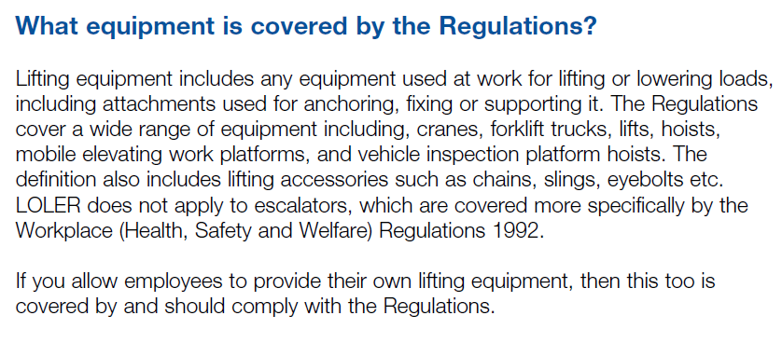

Slide 4
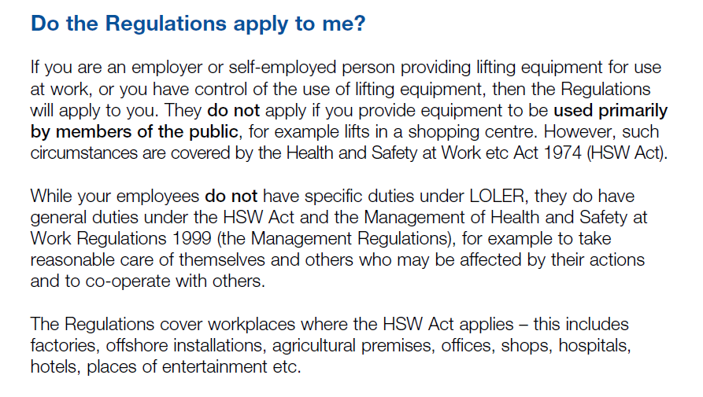

Slide 5
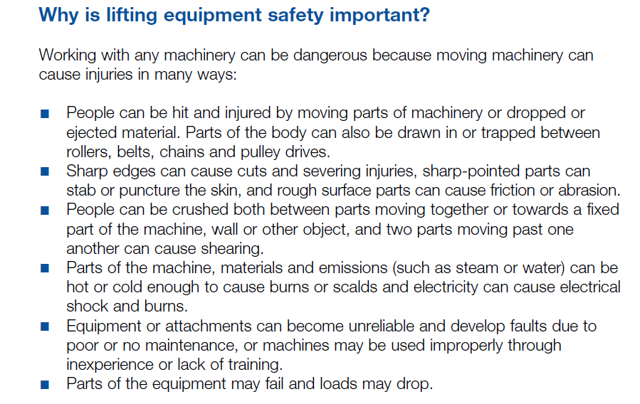

Slide 6
LOLER Inspections, LOLER Testing and Lifting Equipment Inspection
5 more rows
Loler testing | LOLER inspections | Lifting Equipment Inspection
Description | Inspection Frequency (months)
Other equipment for lifting persons | 6
Lifting accessories | 6
Motor vehicle lifts | 6
Cranes if used to lift people | 6

Slide 7
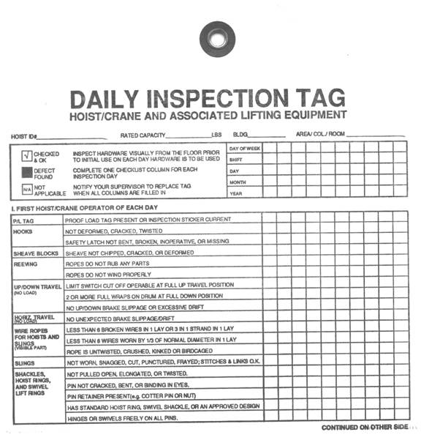

Slide 8
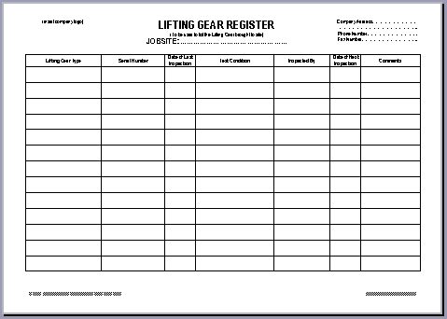

Slide 9
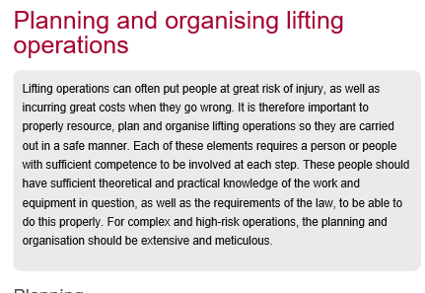
http://www.hse.gov.uk/work-equipment-machinery/planning-organising-lifting-operations.htm

Slide 10
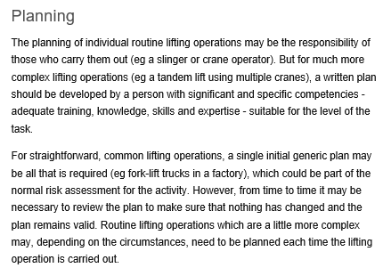

Slide 11
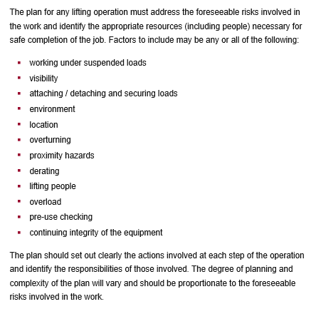

Slide 12
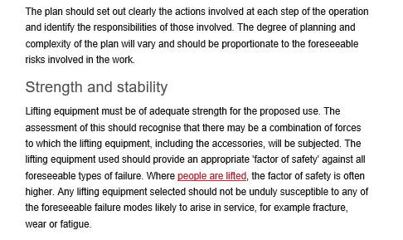

Slide 13
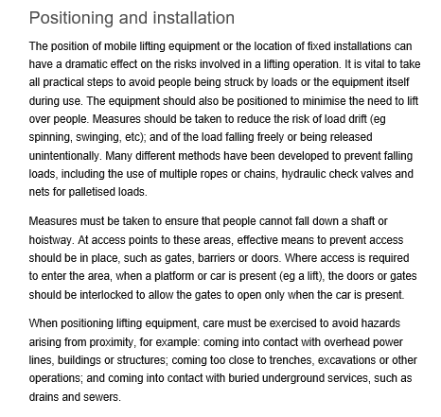

Slide 14
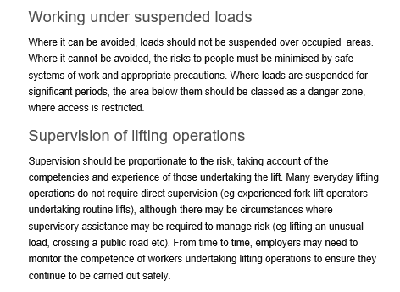

Slide 15
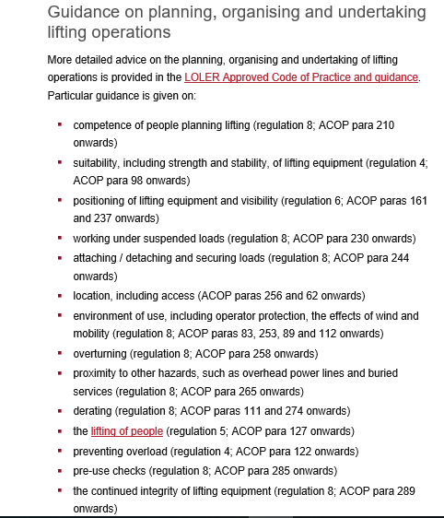

Slide 16
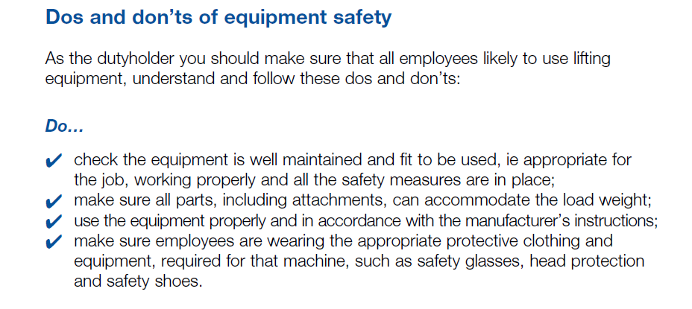

Slide 17
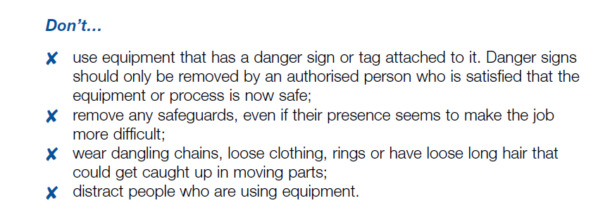

Slide 18
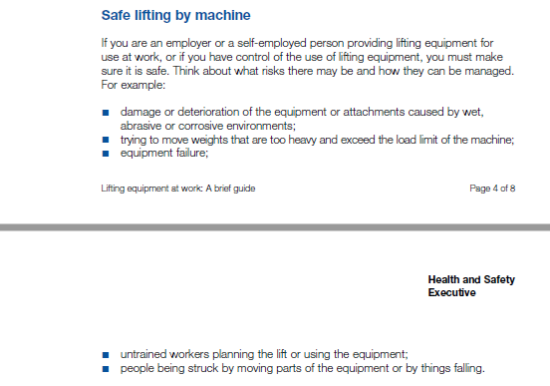

Slide 19
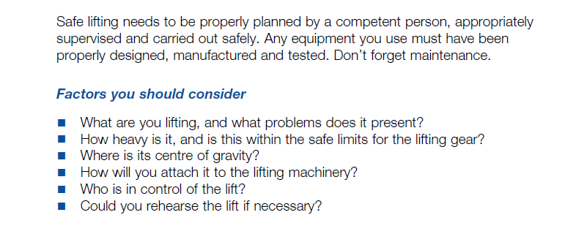

Slide 20
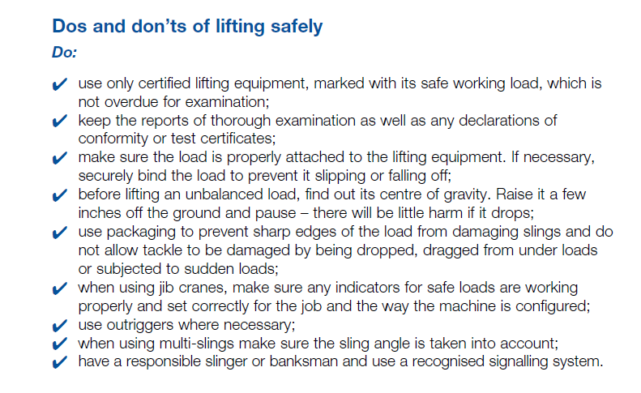

Slide 21
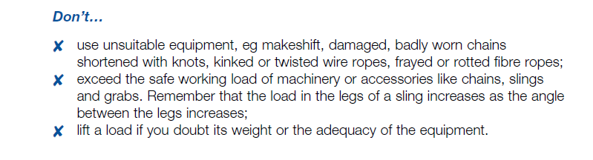

Slide 22
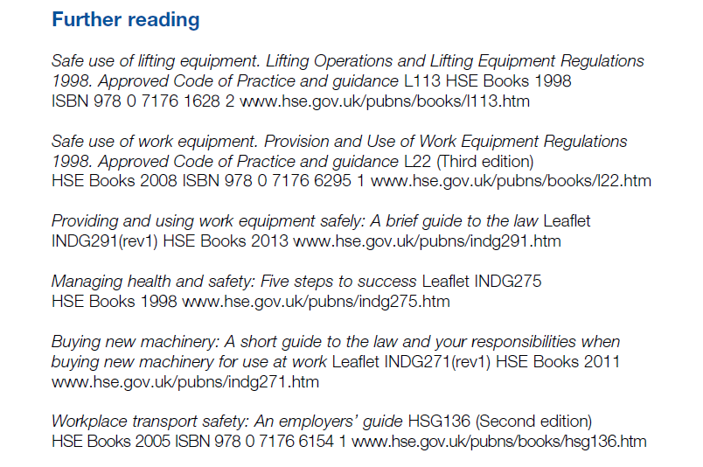

Slide 23
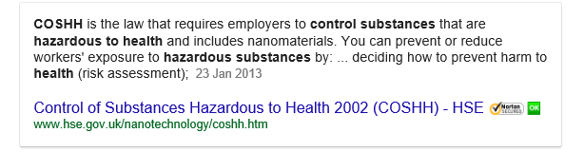
https://www.google.co.uk/?gfe_rd=cr&ei=JOjPWP7UEbGGgAbRzJOQCw&gws_rd=ssl#q=control%2Bof%2Bsubstances%2Bhazardous%2Bto%2Bhealth%2Bregulations%2B2002%26*&*&spf=384

Slide 24
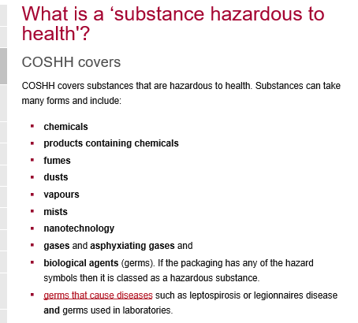

Slide 25
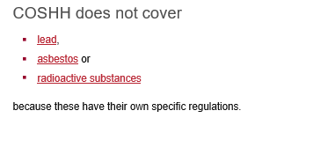

Slide 26
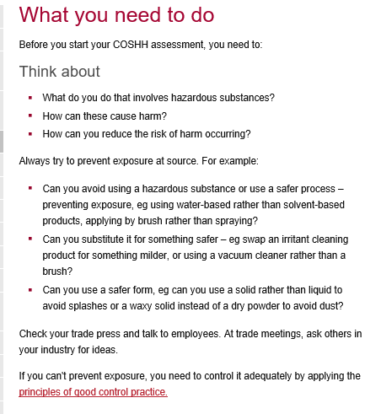

Slide 27
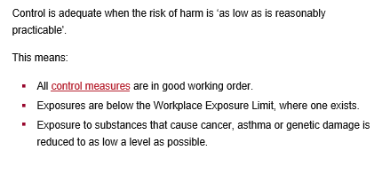

Slide 28
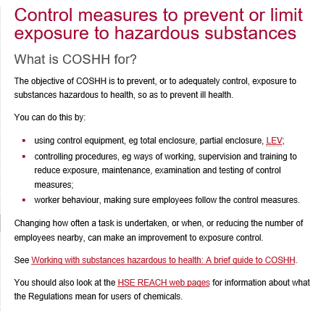

Slide 29
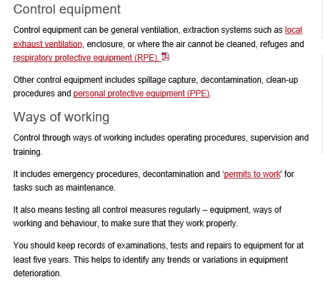

Slide 30
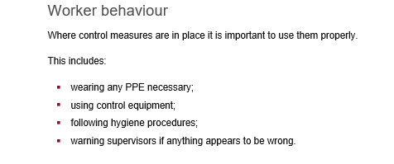

Slide 31
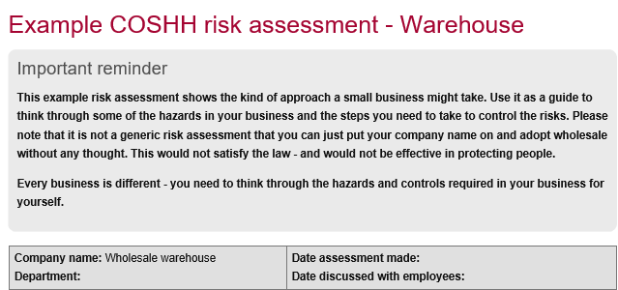

Slide 32
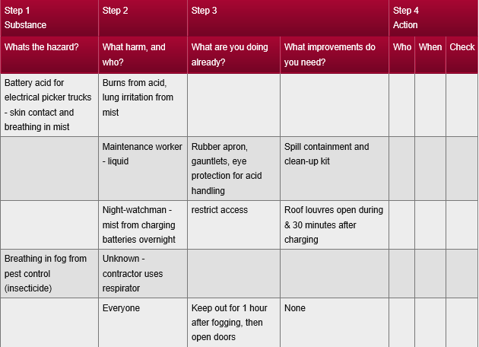

Slide 33
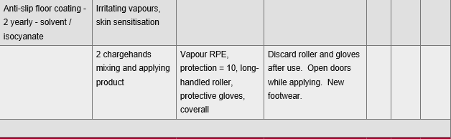

Slide 34
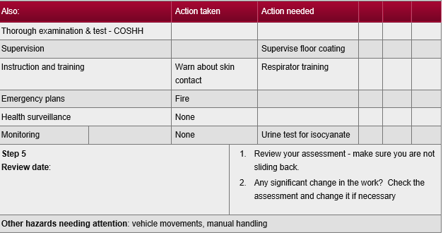

Slide 35
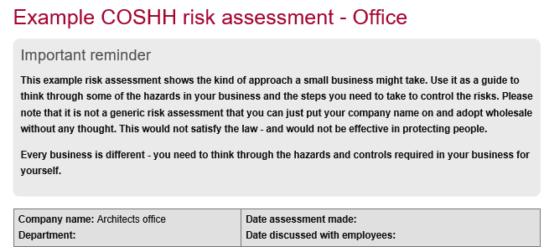

Slide 36
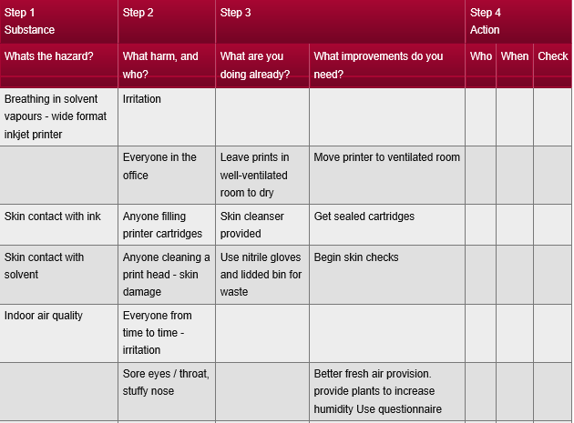

Slide 37
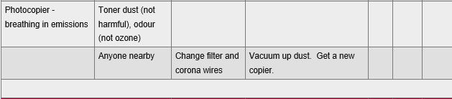

Slide 38
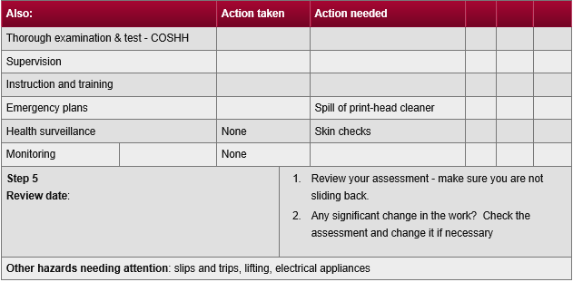

Slide 39
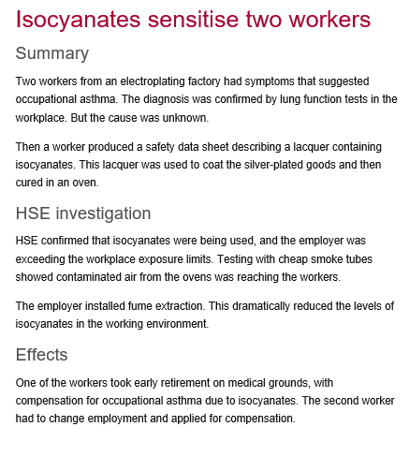

Slide 40
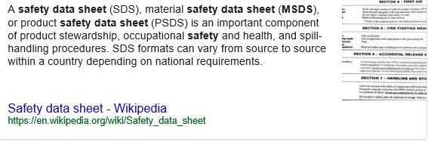

Slide 41


Slide 42
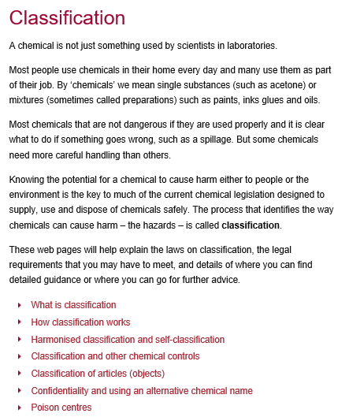

Slide 43


Slide 44
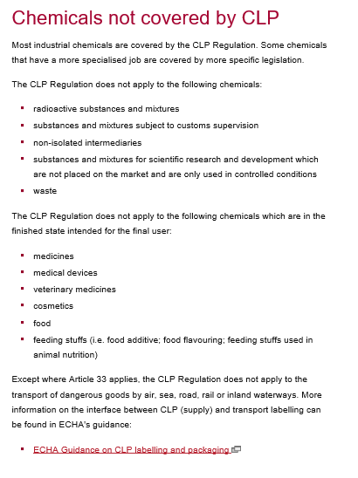

Slide 45
http://www.bp.com/content/dam/bp-marine/en/documents/Malaysia-DMA.pdf
http://www.premiereproducts.co.uk/Admin/Downloads/MSDS/MSDS%20-%20Liquid%20Bleach.pdf
http://www.rkiinstruments.com/pdf/msds/MSDS_49-8103RK_49-8104RK.pdf

Slide 46
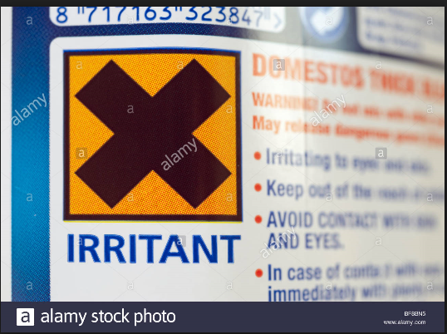

Slide 47
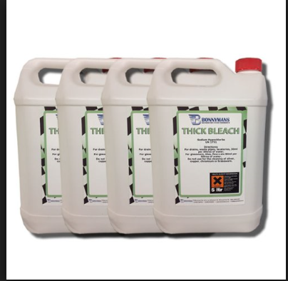

Slide 48


Slide 50


Slide 51
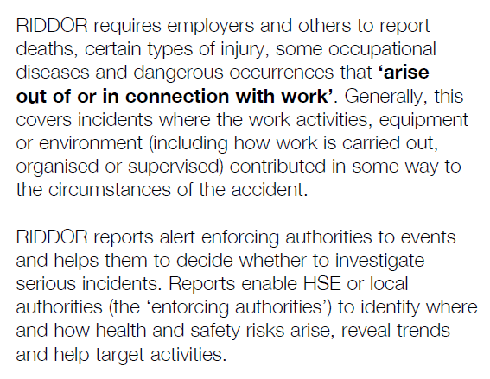

Slide 52
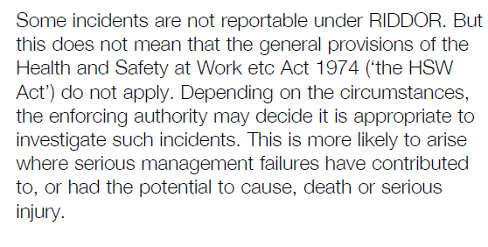

Slide 53
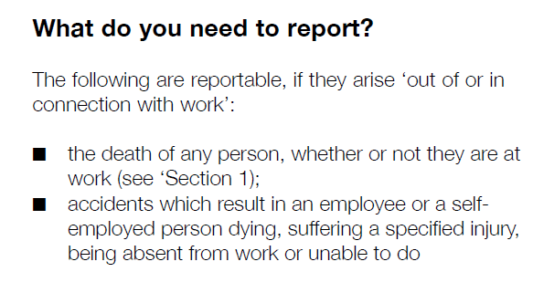
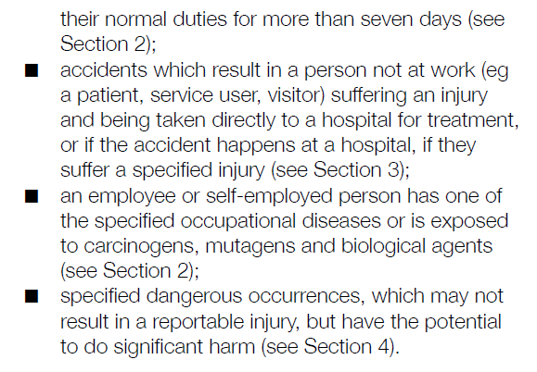

Slide 54
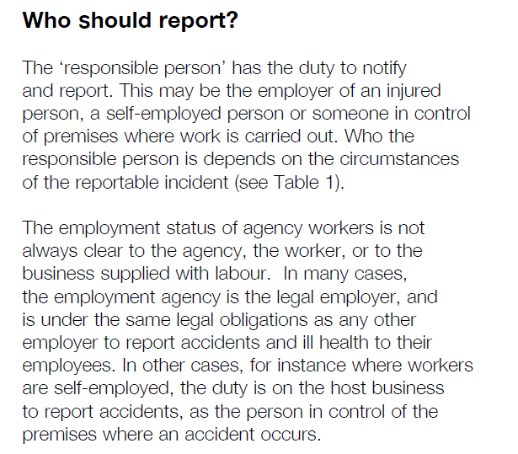

Slide 55
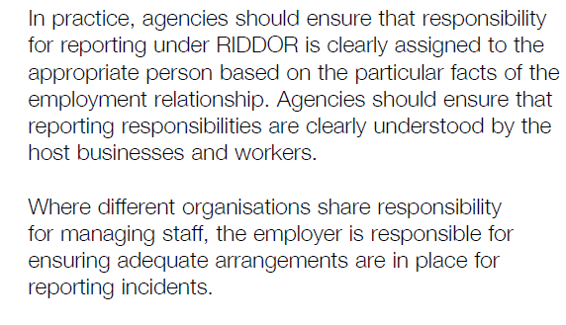

Slide 56
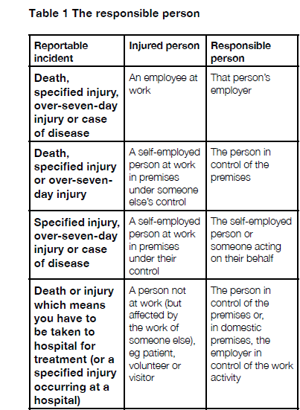

Slide 57
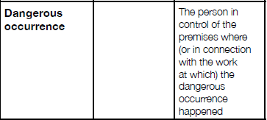

Slide 58
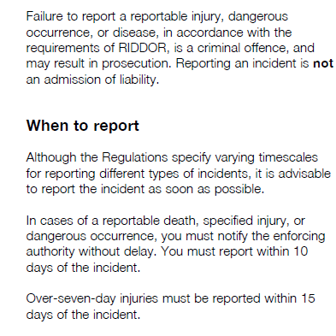

Slide 59


Slide 60


Slide 61


Slide 62


Slide 63


Slide 64


Slide 65


Slide 66


Slide 67


Slide 68


Slide 69


Slide 70


Slide 71


Slide 72


Slide 73


Slide 74


Slide 75


Slide 76


Slide 77


Slide 78


Slide 79



Slide 80

https://en.oxforddictionaries.com/definition/seroconvert

Slide 81

http://www.fork-lift-training.co.uk/training/forklift-training.html

Slide 82


Slide 83

http://www.hse.gov.uk/workplacetransport/lift-trucks/lift-truck-training.htm

Slide 84


Slide 85


Slide 86


Slide 87


Slide 88
http://www.hse.gov.uk/pUbns/priced/l121.pdf

Slide 89


Slide 90


Slide 91


Slide 92


Slide 93


Slide 94


Slide 95


Slide 96


Slide 97


Slide 98


Slide 99


Slide 100


Slide 101


Slide 102


Slide 103


Slide 104

http://www.mfs-fire-extinguishers.co.uk/types.htm

Slide 105


Slide 106


Slide 107


Slide 108
http://www.fireextinguisherguide.co.uk/foam-fire-extinguishers/

Slide 109
Lifting Operations Regulations
https://www.google.co.uk/webhp?sourceid=chrome-instant&ion=1&espv=2&ie=UTF-8#q=lifting+operations+regulations+uk&*
Control of Substances Hazardous to health
https://www.google.co.uk/webhp?sourceid=chrome-instant&ion=1&espv=2&ie=UTF-8#q=control+of+substances+hazardous+to+health+regulations+2002&*
RIDDOR
https://www.google.co.uk/webhp?sourceid=chrome-instant&ion=1&espv=2&ie=UTF-8#q=riddor+regulations&*
Forklift Truck
http://www.hse.gov.uk/workplacetransport/lift-trucks/
http://m.fork-lift-training.co.uk/
http://www.hse.gov.uk/workplacetransport/lift-trucks/lift-truck-training.htm
http://www.hse.gov.uk/pubns/books/l117.htm
http://www.hse.gov.uk/workplacetransport/index.htm
Ionising Radiation Regulations
https://www.google.co.uk/#q=ionising+radiations+regulations+1999&*
Fire Precautions (Workplace) Regulations 1997
https://www.google.co.uk/#q=fire+precautions+(workplace)+regulations+1997&*
https://www.healthandsafetygroup.com/guides/fralaw

Slide 110
Ionising Radiation Regulations
https://www.google.co.uk/#q=ionising+radiations+regulations+1999&*
Fire Precautions (Workplace) Regulations 1997
https://www.google.co.uk/#q=fire+precautions+(workplace)+regulations+1997&*
https://www.healthandsafetygroup.com/guides/fralaw

Slide 111

ANY QUESTIONS

