Slide 1

Business Plan
Name of the student :- Dimpal Soni
Student ID :- 1604495
Business name:- Cyber Restaurant

Slide 2
Introduction
Business plan is Cyber Restaurant which is the combination of restaurant and Cyber café.
In competitive environment, almost each person needs to connect and assess with the internet while food is the basic requirements of living.
From this perspective, we establish a shop which is mainly combine with two concepts to offers online socialize and dine in, gaming experience.

Slide 3
Key issues& Why it works
Key issues
Yet not the all areas are available in same place with restaurant and internet coverage in UK; thus it provides the competitive benefits to the organization to execute business in successful manner. Key issues of the business are
Market competition and business locations
Why it works
Cyber restaurant which offers consumers eat and drink food and beverage when they using internet through computers.
creation of the innovative and unique environment
It allow for flexible coffeehouse/dining/entertainment/gaming options making its attractive to several population

Slide 4
PEST
Political factors
economical factors
regulation related with the hygiene, wages and good quality need to be maintained
Raises in transportation costs in line with fuel pricing
High living standard rate
Social factors
Technological factors
Increase customers services and convinces
labour act and tax regulations also impact the organization performance
national minimum wage increase impacting wages and salary
Reform and changes of organization’s licensing acts in line with government policies
International and national economical downfalls economy means person with generally have less income for socializing
Higher inflation rate in UK also impact the performance of the Cyber restaurant
Attitude of the person towards eating and gaming
Health conscious market
Using social media and online ordering have increased consumers traffics
Organization can promote their goods and services through social media
Use of displays and kiosks can reduce costs of labour

Slide 5
Research and development
Consumer demographics
Products segments

Slide 6
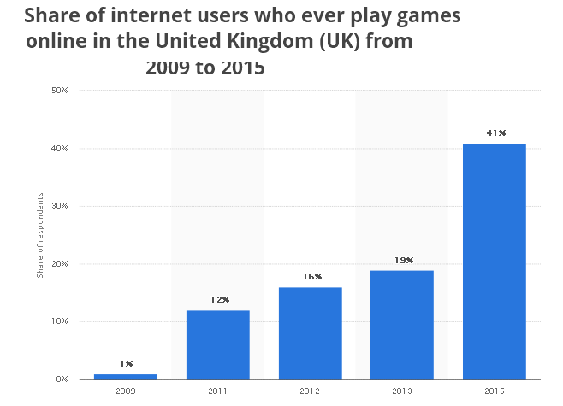
Market size, growth and trends
According to the market research, it is seen that 41% of internet users are playing game online in FY2015, as illustrated in give figure

Slide 7
Product description & marketing strategy
Product description
The Cyber restaurant offer computer for consumers to order themselves through menu from PCs. Mainly the organization offers herbal tea, green tea as well as soft drink in order to make sure that computer is not easily harm to any liquid.
  Provide menu at PCs for consumers order their F&B(food and beverage) through online system
  Internet café must have client computer, internet connection and server computer that control networking hardware and clients
  The organization offers bone marrow on toast with parsley salad, chorizo roll, chicken, AL pastor tacos, meat fruit etc
Marketing and promotional strategy
Cyber restaurant promotional and marketing strategy includes early bird package which start from each morning 8 pm until 12 pm, 4 hours of gaming and online services. In addition to this, organization uses face book, email and digital marketing techniques to promote their goods and services.

Slide 8
Background
Cyber restaurant is startup organization and owned by the five people under partnership agreements.
In order to execute the operations in better manner the organization hire total 25 staff’s members this includes the kitchen, chefs, staffs, waiters or coordinators ,waitresses.
Beside this the organization needs purchase 50 computers including DSL, webcam, and kitchen and internet connection.
Structure :-
Chief Executive officer
Chief Operation officer
Chief financial officer
Human resources manager
Marketing manager

Slide 9

Vision, mission & sources of funding
Vision
The vision of cyber restaurant is to become the leading restaurant café in UK with the commitment to fulfill consumer’s expectation and needs
Mission
The creation of the innovative and unique environment that differentiate cyber restaurants from restaurant café or internet café.
The formation of the environment that will bring the person with different backgrounds and interests together in common platform
To generate 7.5% profits on sales by year two
Funding sources
Bank loan, personal savings, share issues

Slide 10
SWOT
Strengths Better management skills high skills labour Access high quality of products and services | Weakness Inadequate employee training Not getting consistent supplies Relaying outdated point of scale system
Opportunities introducing more organic dishes Offering delivering services Offering better discounts for frequent clients | Threats market competitors Potential price raising of certain foods Operating costs are established to increase

Slide 11
Scale UP
sales forecast | Daily Customer
 | Cyber |  | Restaurant | Increase in %
Year 1 | 120 |  | 90 | 8%
Year 2 | 140 |  | 100 | 12.00%
Year 3 | 170 |  | 120 | 24.00%

Slide 12
Conclusion:-
From the above research on cyber and restaurant , I can say that how benefits the cyber in an restaurant to the people who can easily use the net also can be easy to download the apps and many more..

Slide 13
References
Wilson, A., Zeithaml, V. A., Bitner, M. J., & Gremler, D. D. (2012). Services marketing: Integrating customer focus across the firm. McGraw Hill.
Armstrong, G., Kotler, P., Harker, M., & Brennan, R. (2015).Marketing: an introduction. Pearson Education.
Kwok, L., & Yu, B. (2013). Spreading social media messages on Facebook: An analysis of restaurant business-to-consumer communications. Cornell Hospitality Quarterly, 54(1), 84-94.
Spiller, K. (2012). It tastes better because… consumer understandings of UK farmers’ market food. Appetite, 59(1), 100-107.
statista. (2017). statista. [online] Available at: http://www.statista.com [Accessed 6 Dec. 2017].
theguardian. (2017). theguardian. [online] Available at: https://www.theguardian.com/business/2017/jul/18/uk-inflation-figures-pound-brexit-city-food-prices [Accessed 8 Dec. 2017].

