Slide 1
Case Management:
The Tracks

Slide 2
Case Management includes:
Allocation to a track
Directions Questionnaire (DQ)
Case Management Directions
Set of steps within a timetable

Slide 3
Allocation to a Track
A defended claim will be allocated to one of four case management tracks:
the small claims track;
the fast track;
the intermediate track;
the multi-track.
Each has a different scope, timescale, features and applicable rules, although there are some similarities.
One very significant difference is whether, and if so, how much legal costs and disbursements, can be recovered between the parties in making or defending the claim.
One of the most important common factors in determining the appropriate case management track is the value of a claim, so that needs to be identified first

Slide 4
What is the ‘value’ of a claim?
r16.3: The statement of value should state the amount that the claimant reasonably expects to recover and aligns with some of the financial value thresholds applicable to different case management tracks.
The statement of value should have disregarded, under r16.3(6), any possibility:
  that the court may make an award of interest or costs
  that the court may make a finding of contributory negligence;
  that the defendant may make a counterclaim or that the defence may include a set-off; or
  that the defendant may (under s6 of the Social Security (Recovery of Benefits Act 1997)) be liable to deduct from the claimant’s damages (in a personal injury claim) certain recoverable welfare benefits, and to reimburse the Department for Work and Pensions for that sum.
The statement of value should state:
the amount of money claimed;
that the claimant expects to recover –
  not more than £10,000; or
  more than £10,000 but not more than £25,000; or
  more than £25,000 but not more than £100,000; or
  more than £100,000; OR
that the claimant cannot say how much is likely to be recovered.

Slide 5
Additional requirements
The statement of value provides a starting point, but it is not a complete answer. In addition to the matters disregarded for the statement of value, the court should also disregard, under r26.13(2):
any amount not in dispute;
Also, if multiple claimants have started a claim against the same defendant using the same claim form, and each claimant has a claim against the defendant separate from the other claimants, the court shall consider the claim of each claimant separately when it assesses financial value for the purposes of determining the appropriate case management track.

Slide 6
Scope of the Small Claims Track
The aim of the small claims track is to provide a streamlined, relatively quick, inexpensive procedure, and without substantial legal costs being recoverable between the parties.
Claims value: not more than £10,000
Should be possible for a litigant to conduct their own case without legal representation if they wish (PD 26, para 15(2)).
Save for some limited exceptions, many different types of claim could be dealt with in the small claims track. Under PD 15, para 15(3) these include:
  consumer disputes,
  accident claims,
  disputes about the ownership of goods,
  many disputes between a landlord and tenant

Slide 7
Claims which won’t be allocated to Small Claims Track
Claims involving a disputed allegation of dishonesty (PD 26, para 15(4)).
Claims by a tenant of residential premises against his landlord in respect of harassment or unlawful eviction (r26.12(2)); or a claim under the Renting Homes (Wales) Act 2016 by a contract holder of a dwelling against their landlord for a remedy in respect of harassment or unlawful eviction (r26.12(3)).
For other claims, the financial value is the most important factor : not more than £10,000 (r26.9(4))
Unless one of the exceptions in r26.9(1) applies, where a lower value applies for the threshold in respect of damages for personal injurty ( pain and suffering and loss of amenity).
Where any of these exceptions apply, the claim will fall beyond the scope of the small claims track and instead will fall within the scope of the fast track, the intermediate track or the multi-track, depending on the rules about the scope of those tracks.
Even where a claim is above the financial limits of the small claims track, the court still has a residual discretion to allocate the claim to the small claims track (PD 26, para 15(5)) although even if the court does so, it will not normally allow the hearing of the claim to be more than a day.

Slide 8
Scope of the Fast Track ( r 26.9 and PD26 para 16)
Under rr26.6(4) and (5), the fast track is the normal track for a claim which:
  is beyond the scope of the small claims track;
  has a value of not more than £25,000. Unless all parties consent, the court cannot order a claim worth over £25,000 to proceed in the fast track;
  the court considers the trial is likely to last for no longer than one day (five hours in court);
oral expert evidence at trial (if permitted by the court at all) will be limited to expert evidence in two expert fields; and
oral expert evidence at trial will be limited to one expert per party in relation to any expert field.
Note: The “normal” order for any expert evidence in the fast track will be for a single joint expert

Slide 9
Scope of the Intermediate Track
The scope of the intermediate track is determined by the financial value of the claim; and the provisions for expert evidence and length of trial.
The intermediate track is the normal track for a claim:
  If the claim is not suitable for the small claims track or the fast track; and
  is or includes a claim for monetary relief; and the value of the claim is not more than £100,000.
Other factors to be met, that:
  if the case is managed proportionately, the trial will not last longer than three days;
  oral expert evidence at trial is likely to be limited to two experts per party;
  the claim may be justly and proportionately managed under the procedure set out in Part 28 for claims on the intermediate track; and
  there are no additional factors, which would make the claim inappropriate for the intermediate track;
Where the relief sought includes a claim for non-monetary relief, the claim shall not be allocated to the intermediate track unless the court also considers it to be in the interests of justice to do so.
Additionally, unless the claim is one which must be allocated to the multi-track (see 12.2.5), the court has a general discretion to allocate a claim to the intermediate track if it considers it to be in the interests of justice to do so (r26.9(9)).

Slide 10
Scope of the Multi Track
Multi-track is the normal track for any claim for which the small claims track, the fast track or the intermediate track is not the normal track (r.26(12)).
There are certain types of claim which must be allocated to the multi-track. They include:
  a mesothelioma claim or asbestos lung disease claim;
  claims for clinical negligence;
  a claim for damages in relation to harm, abuse or neglect of or by children or vulnerable adults;
  a claim is one the court could order to be tried by jury;
  a claim is against the police (other than a claim arising from negligent police driving, an employers’ liability claim, or any other claim for an accidental fall on police premises) and includes a claim for an intentional or reckless tort or a remedy in relation to a breach of the Human Rights Act 1998;
  certain claims against a public authority for trespass to the person.

Slide 11
Allocation to a track other than the usual/ normal track.
The court may allocate a case to a different track than the normal track for a claim. In doing so, under r26.13(1), the court considers:
the financial value, if any, of the claim;
the nature of the remedy sought;
the likely complexity of the facts, law or evidence;
the number of parties or likely parties;
the value of any counterclaim or additional claim and the complexity of any matters relating to it;
the amount of oral evidence which may be required;
the importance of the claim to persons who are not parties to the proceedings;
the views expressed by the parties; and
the circumstances of the parties.

Slide 12
Provisional Allocation – the process
A court officer provisionally allocates the claim to a case management track.
Sends to the parties a notice of proposed allocation, identifying the track, and requiring the parties to file a directions questionnaire (DQ) by a specified date.
The parties complete DQ, discuss proposed case management steps between them, and file their DQ at court, together with proposed case management directions, agreed if possible, and any other documents required.
Court officer will take into account the claimant’s statement of value on the claim form. That statement of value is (or should be) aligned to the relevant financial thresholds for the case management tracks.
The court will serve on the parties a notice of proposed allocation, which:
  identifies that it appears that the case is suitable for allocation to the proposed track;
  requires each party to file at court and serve on all parties a completed Directions Questionnaire (DQ) by a specified date
  informs the parties how to obtain a directions questionnaire.
  specifies any matter to be complied with by the date in the notice of proposed allocation.
Different notices of proposed allocation for the different case management tracks:
Small claims track: N149A (SCT);
Fast track: N149B (FT);
Intermediate track:N149D (IT); and
Multi-track: N149C (MT).

Slide 13
Provisional Allocation… continued
If a case appears suitable for allocation to the fast track, intermediate track or multi-track, the notice will require the parties to file proposed case management directions by the date specified in the notice.
If a party is a litigant in person, the court will send to that party a directions questionnaire to complete.
Time by which the DQ must be filed: depends on the track to which the claim has been provisionally allocated:
  if the notice relates to the small claims track, at least 14 days after the date when it is deemed to be served on the party in question; or
  if the notice relates to the fast track, intermediate track or multi-track, at least 28 days, after the date when it is deemed to be served on the party in question.
One important exception to the process of provisional allocation. Where the parties have followed the Pre-Action Protocol for Personal Injury Claims Below the Small Claims Limit in Road Traffic Accidents (the RTA Small Claims Protocol) and court proceedings have been started in such a claim, under PD 27B, provisional allocation does not happen. Instead, the claim is treated as being allocated to the small claims track when it is issued (PD 27B, para 1.5(1)).

Slide 14
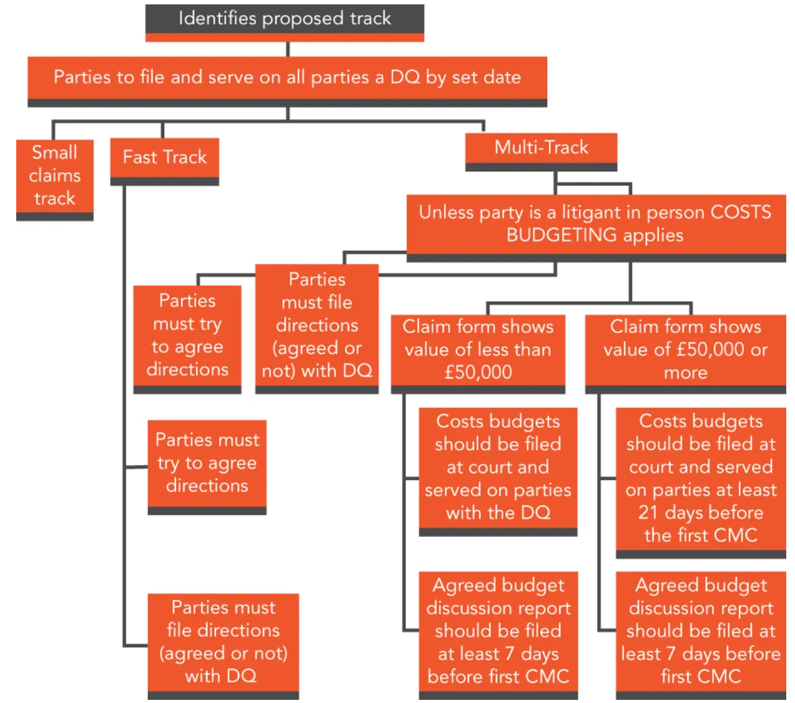
Notice of allocation

Slide 15

Any questions?

