Slide 1

change and stability management
Abdulfatah Esa

Slide 2
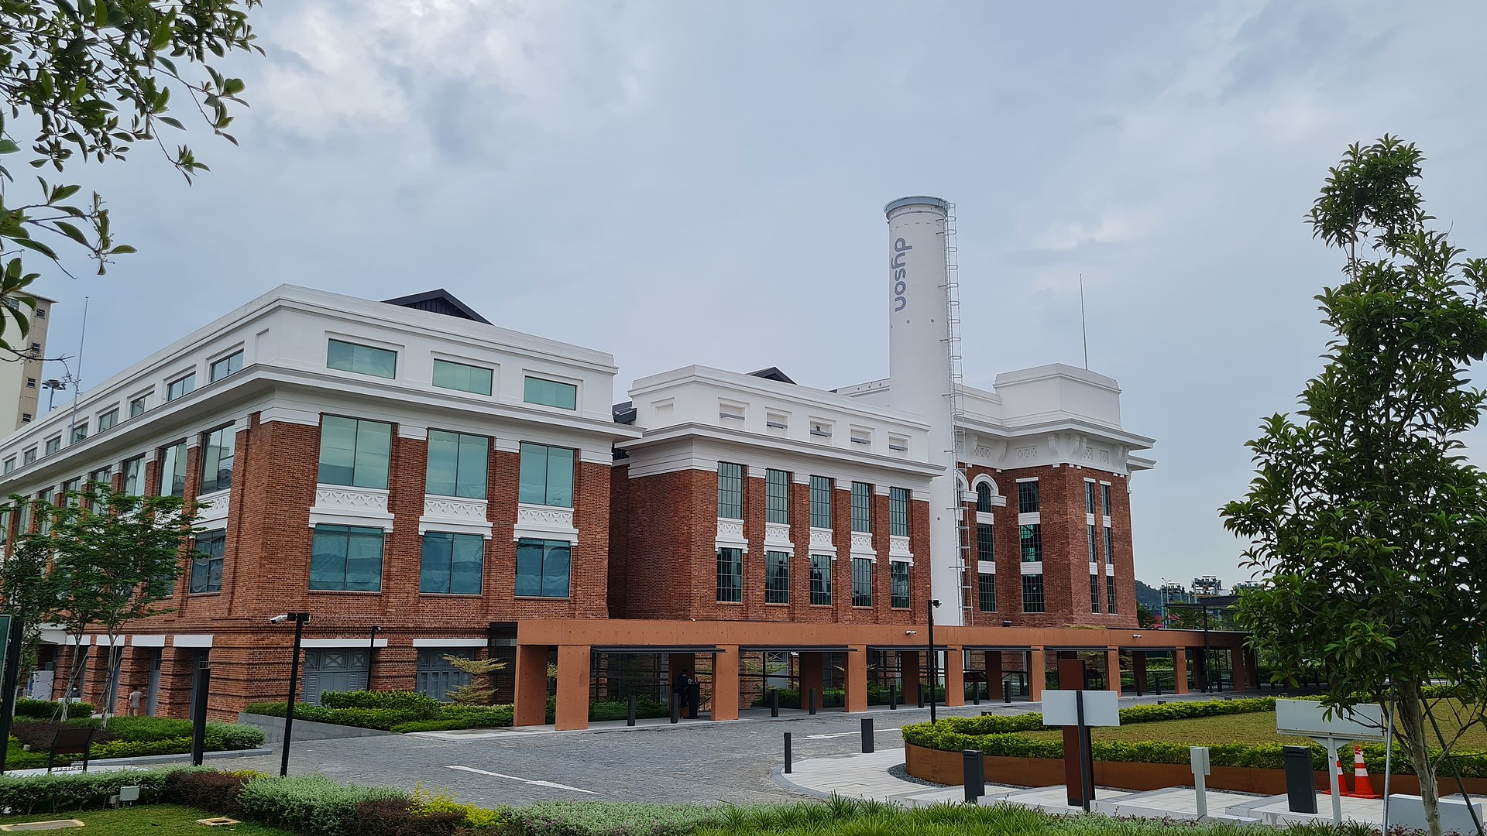
Dyson Limited

Slide 3
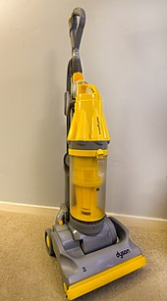
Background history
Sir James Dyson (2 MAY, 1974)
First established in 1991.
2019 move to Singapore

Slide 4
Reasons for Change
UK skill shortages,
tax breaks, (pwc, 2022)
Gateway to Asia
Large consumer market. (countrymeter,2022)

Slide 5
Pestel analysis for dyson
Political
Taxes and vats are different by countries
Operating in a country that a firm did not operate from before will bring out challenges
Economic
Increase and decrease on out goings
Social
Covid 19 adopted and trained people to become more cleaner which will encourage people to buy more of dysons product.
Tech
Most of dyson products are not easy to replicate and make a copy
Enviromental
Big awarenes on cleaning since covid 19
Legal
Dyson has a trademark and copy right on each product

Slide 6
Conclusion
As I have mentioned earlier that I find it hypocrite's and shamless decision to make to move abroad but it will be good for dyson since it will attract more consumers.

Slide 7
Bibliography
Patricia Cullen. (2019). Why did Sir James Dyson really move his HQ to Singapore?. [Online]. business leaders. Last Updated: 10 April 2019. Available at: https://www.businessleader.co.uk/why-did-sir-james-dyson-really-move-his-hq-to-singapore/ [Accessed 26 February 2023].
Andrew Arthur. (2022). Dyson officially opens new global HQ in Singapore. [Online]. business live. Last Updated: 25 march 2022. Available at: https://www.business-live.co.uk/commercial-property/dyson-officially-opens-new-global-23492773 [Accessed 26 February 2023].
pwc. (2022). Corporate - Tax credits and incentives. [Online]. Tax Summaries. Last Updated: 02 Oct 2022. Available at: https://taxsummaries.pwc.com/singapore/corporate/tax-credits-and-incentives [Accessed 20 February 2023].
country meters. (2022). Asia Population clock. [Online]. country meters. Last Updated: 27 Feb 2022. Available at: https://countrymeters.info/en/Asia [Accessed 20 February 2023].

