Slide 1
Sustainable Global Tourism
CSDR and plastic problems
Tourism destination management
Events and festivals sustainable practices.
BMTP5023

Slide 2


Slide 3


Slide 4
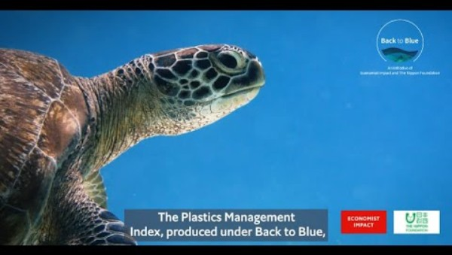
Plastics Management Index - Back to Blue

Slide 5
The Corporate Sustainability Reporting Directive (CSRD)
Adopted by the European Parliament and the Council on December 14, 2022, and entered into force on January 5, 2023. The CSRD amends existing regulations to enhance corporate sustainability reporting within the European Union.
CSRD ensures that businesses provide consistent, reliable, and comparable sustainability data, similar to how financial reporting is regulated. It replaces and expands the Non-Financial Reporting Directive (NFRD), making sustainability reporting a core part of corporate disclosures.
It mandates that companies disclose information on environmental, social, and governance (ESG) factors, aiming to provide stakeholders with a clearer understanding of corporate sustainability practices.

Slide 6
CSRD - Corporate Sustainability Reporting Directive
The Corporate Sustainability Reporting Directive (CSRD) is a reporting framework introduced by the European Union (EU) to improve the transparency, consistency, and reliability of sustainability reporting by companies (also referred to as "undertakings").
Key Aspects of CSRD:
Enhancing Transparency – Companies must provide clear and detailed sustainability information, making it easier for stakeholders (investors, regulators, and the public) to assess their environmental and social impact.
Consistency & Standardization – The CSRD introduces common reporting standards, ensuring that companies disclose information in a comparable format across industries and countries.
Reliability & Assurance – Reported sustainability data must be auditable and verifiable, improving trust in the information provided.
Decision-Making Support – High-quality, standardized sustainability disclosures help investors and policymakers make informed, sustainable decisions.

Slide 7
Impact on Tourism Destinations:
Tourism destinations are increasingly recognizing the importance of aligning with CSRD standards to ensure sustainable practices and meet stakeholder expectations.
By integrating ESG reporting into destination management, these locations can enhance transparency, build trust with travelers, and promote long-term resilience.
This approach not only addresses environmental concerns but also emphasises social factors such as community engagement and cultural preservation.

Slide 8
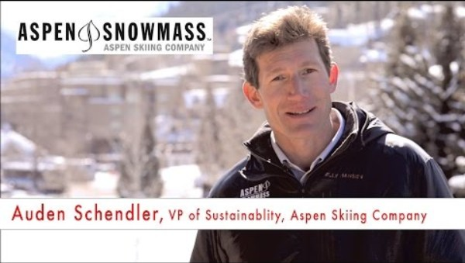
Aspen Skiing Company - Environmental Practices

Slide 9
Influence on Festivals and Events:
Festivals and events, especially those organized by large entities or linked to corporate sponsors, are also affected by the CSRD. Event organizers are now more accountable for reporting on various ESG metrics, including waste management, energy consumption, and social impact.
This shift encourages the adoption of sustainable practices, such as reducing carbon footprints and enhancing community involvement, to align with the broader sustainability goals outlined by the CSRD.
https://destination-360.com/future-proofing-destinations-with-csrd-compliance

Slide 10

Smart Sustainable Plastic Packaging Event Highlights

Slide 11

What are we doing ?
Flexible Skills Programme | Business Wales
Green Ambition | Business Wales
Global : Plastics Management Index
Groundbreaking National Pilot Paves Way for New Policy to Drive Sustainability in Outdoor Events - Vision for Sustainable Events
Aspen Destination Management Plan | Aspen

Slide 12
Assignment 2
Date : Thursday 27 th march
Group presentation
10 minutes each
Scenario 1: a Sustainable Music Festival at a large outdoor venue.
Scenario 2: Devising a comprehensive Destination Management Plan (DMP) for a sustainable ski resort.

Slide 13

Today – 2 groups one for and one against
Notes:
Going to watch 2 videos – one is going to support one not

Slide 14
Additional links
Baumüller, J. and Sopp, K. (2021) 'Double materiality and the shift from non-financial to European sustainability reporting: review, outlook and implications', Journal of Applied Accounting Research.
https://destination-360.com/future-proofing-destinations-with-csrd-compliance
https://youtu.be/xKYw0qTiywE?si=Rq8OZImYa1eJFZsy
The plastic backlash: what's behind our sudden rage – and will it make a difference? | Plastics | The Guardian
The coronavirus pandemic has totally derailed the war on plastic | WIRED UK

Slide 15


