Slide 1
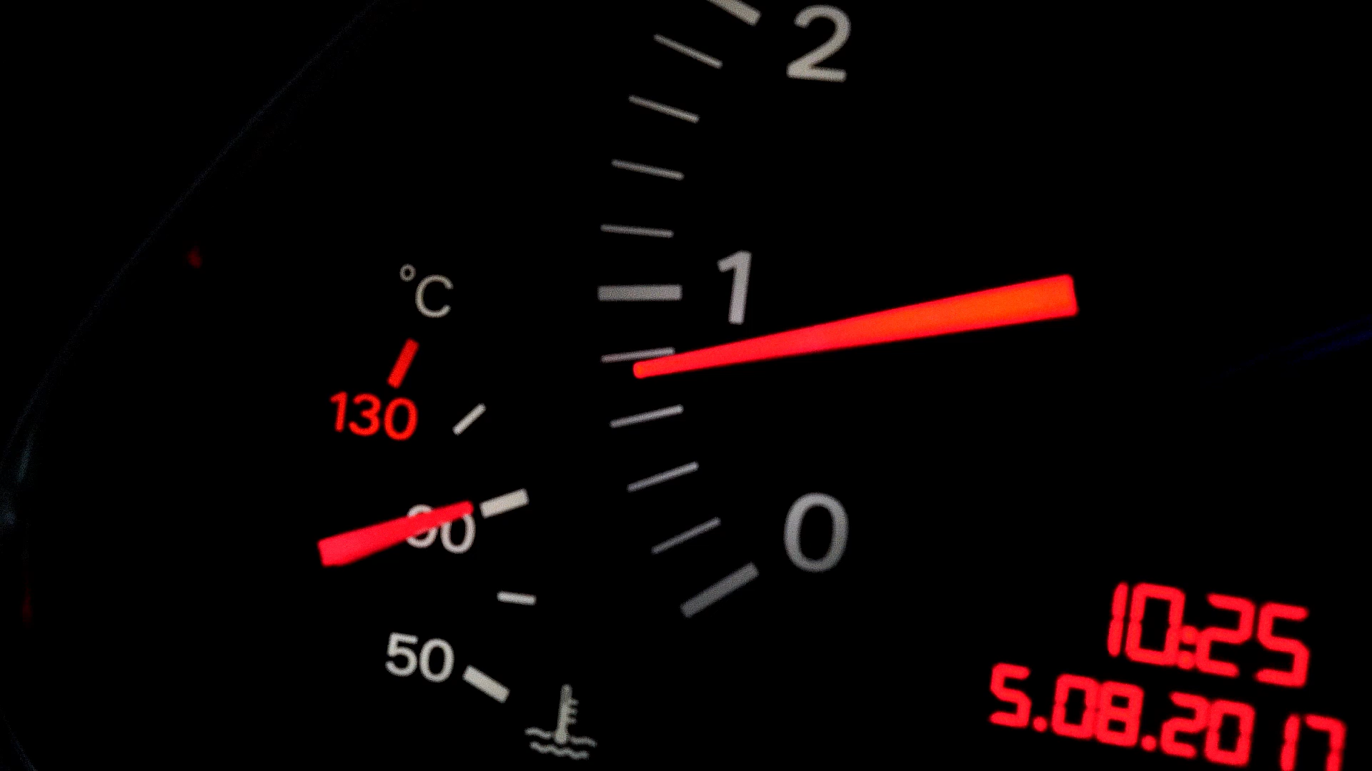
Fuel sources for muscle and exercise metabolism
Chapter 3

Slide 2
Fiber Types
Human muscle fibers are commonly divided into
  Type I: classified as slow-twitch fibers
  Type IIa: classified as fast-twitch fatigue-resistant fibers
  Type IIX: classified as fast-twitch fatigable fibers
See table 3.1 for characteristics of each fiber type.
The proportions in which type I, IIa, and IIX are found differ substantially among muscles and among individuals.
(continued)

Slide 3
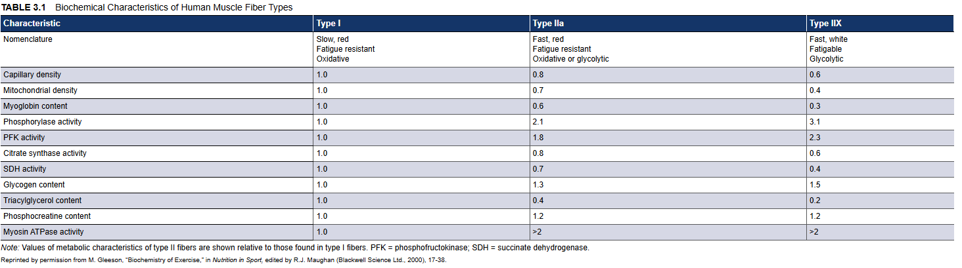
Fiber Types (continued)

Slide 4
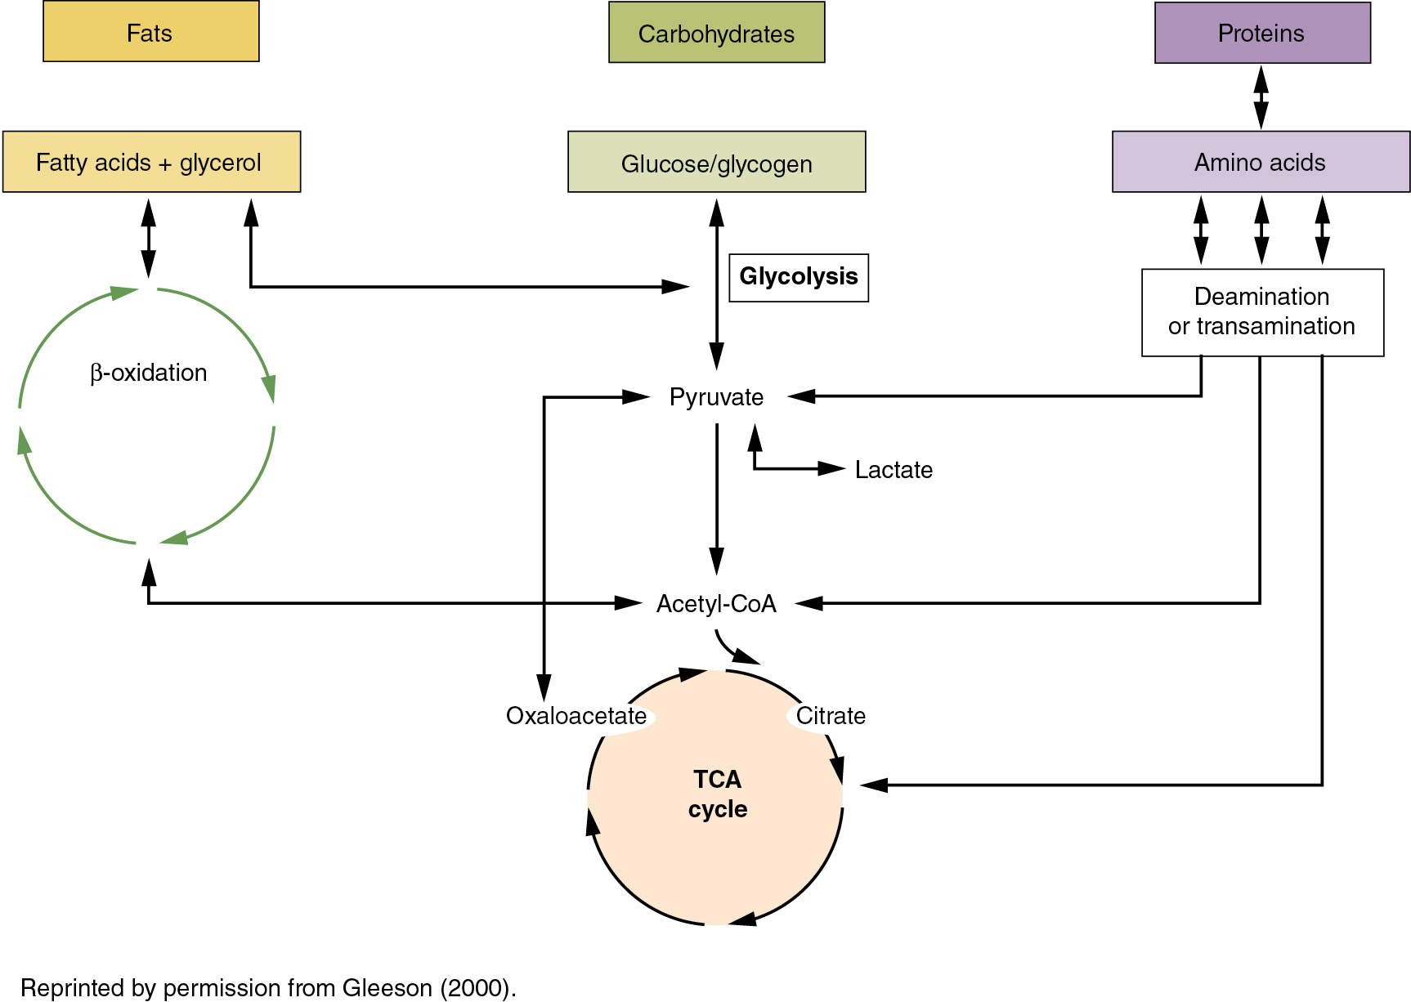
Figure 3.2
Notes:
3.2 The main pathways of energy metabolism using carbohydrates, lipids, and proteins as energy sources.
Reprinted by permission from M. Gleeson, "Biochemistry of Exercise," in Nutrition in Sport, edited by R.J. Maughan (Blackwell Science Ltd., 2000), 17-38.

Slide 5
Phosphocreatine in Anaerobic Metabolism
Phosphocreatine (PCr) is present in the sarcoplasm of muscle at about three times the concentration of ATP.
ADP + PCr + H⁺ → ATP + Cr
Phosphocreatine hydrolysis is initiated at the immediate onset of contraction and is the fastest available means of resynthesizing ATP. The reaction also buffers some H⁺, which would otherwise contribute to early fatigue.
The rate of PCr hydrolysis begins to decline after only a few sec­onds of maximal force generation.

Slide 6
Table 3.3 ATP Resynthesis From Anaerobic and Aerobic Metabolism
 | Max rate of ATP resynthesis (mmol ATP/kg w.w./s) | Delay time*
PCr breakdown | 2.25 | Instantaneous
Glycolysis | 1.10 | 5-10 s
Glycogen oxidation | 0.70 | 1-3 min
Glucose (from blood) oxidation | 0.35 | ~90 min
Fat oxidation | 0.25 | >2 h
Notes:
*Approximate delay time before maximal rates are attained after onset of exercise.
Reprinted by permission from M. Gleeson, "Biochemistry of Exercise," in Nutrition in Sport, edited by R.J. Maughan (Blackwell Science Ltd., 2000), 17-38; permission conveyed through Copyright Clearance Center, Inc.

Slide 7
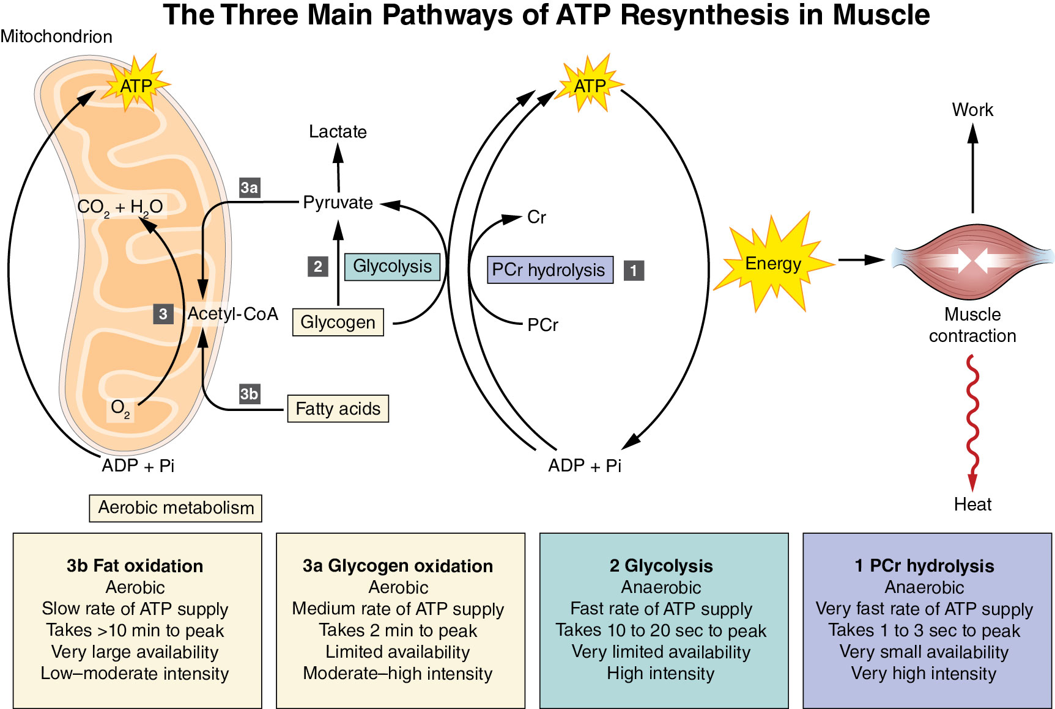
Infographic 3.1
Notes:
Infographic 3.1 The three main pathways of ATP resynthesis in muscle

Slide 8
Glycolysis in Anaerobic Metabolism
See figure 3.5 for a simplified illustration of glycolysis.
Carbohydrate provides energy by anaerobic metabolism, with lactate as the end prod­uct, or by complete oxidation to carbon dioxide and water.
The net effect of anaerobic glycolysis is conversion of one molecule of glucose to two molecules of pyruvate. This process makes two molecules of ATP available per molecule of glucose (derived from blood) that is broken down.
(continued)

Slide 9
Infographic 3.1
Notes:
Infographic 3.1 The three main pathways of ATP resynthesis in muscle

Slide 10
Carbohydrate Oxidation
Carbohydrate and fat are oxidized in the mitochondria via the TCA cycle (also known as Krebs cycle) and oxidative phosphorylation.
In the aero­bic resynthesis of ATP, oxygen is the final electron acceptor in the electron transport chain, and it combines with hydrogen to form water.
A total of 38 ATP molecules are resynthesized from the complete oxidation of glucose to CO₂ and H₂O.
Glucose + 6 O₂ + 38 ADP + 38 Pi → 6 CO₂ + 6 H₂O + 38 ATP

Slide 11
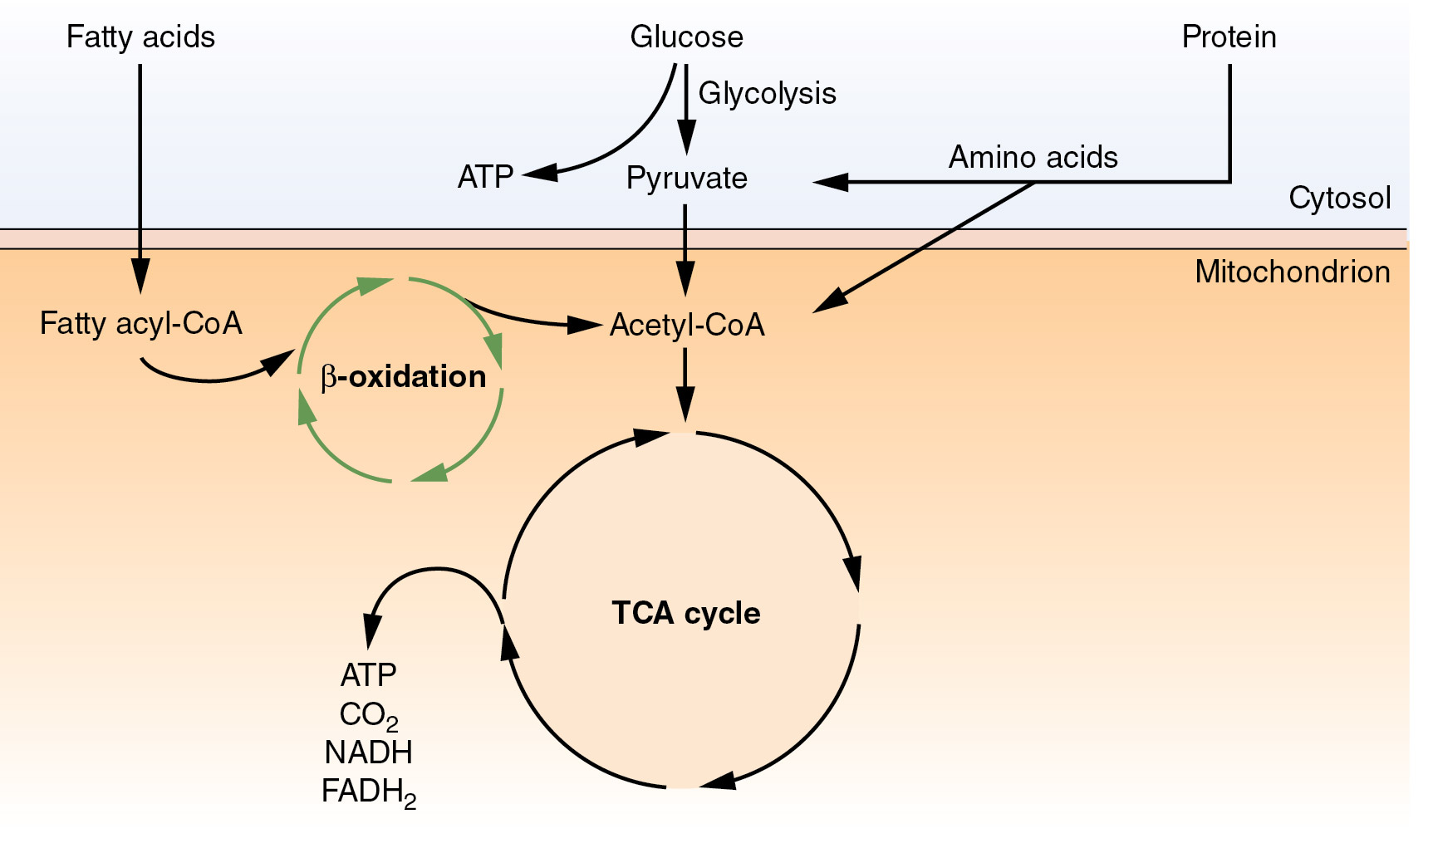
Figure 3.6
Notes:
Figure 3.6 Formation of acetyl-CoA occurs from the catabolism of carbohydrates, fats, and proteins. Acetyl-CoA is oxidized in the tricarboxylic acid cycle, which generates carbon dioxide, reduced coenzymes, and ATP.

Slide 12
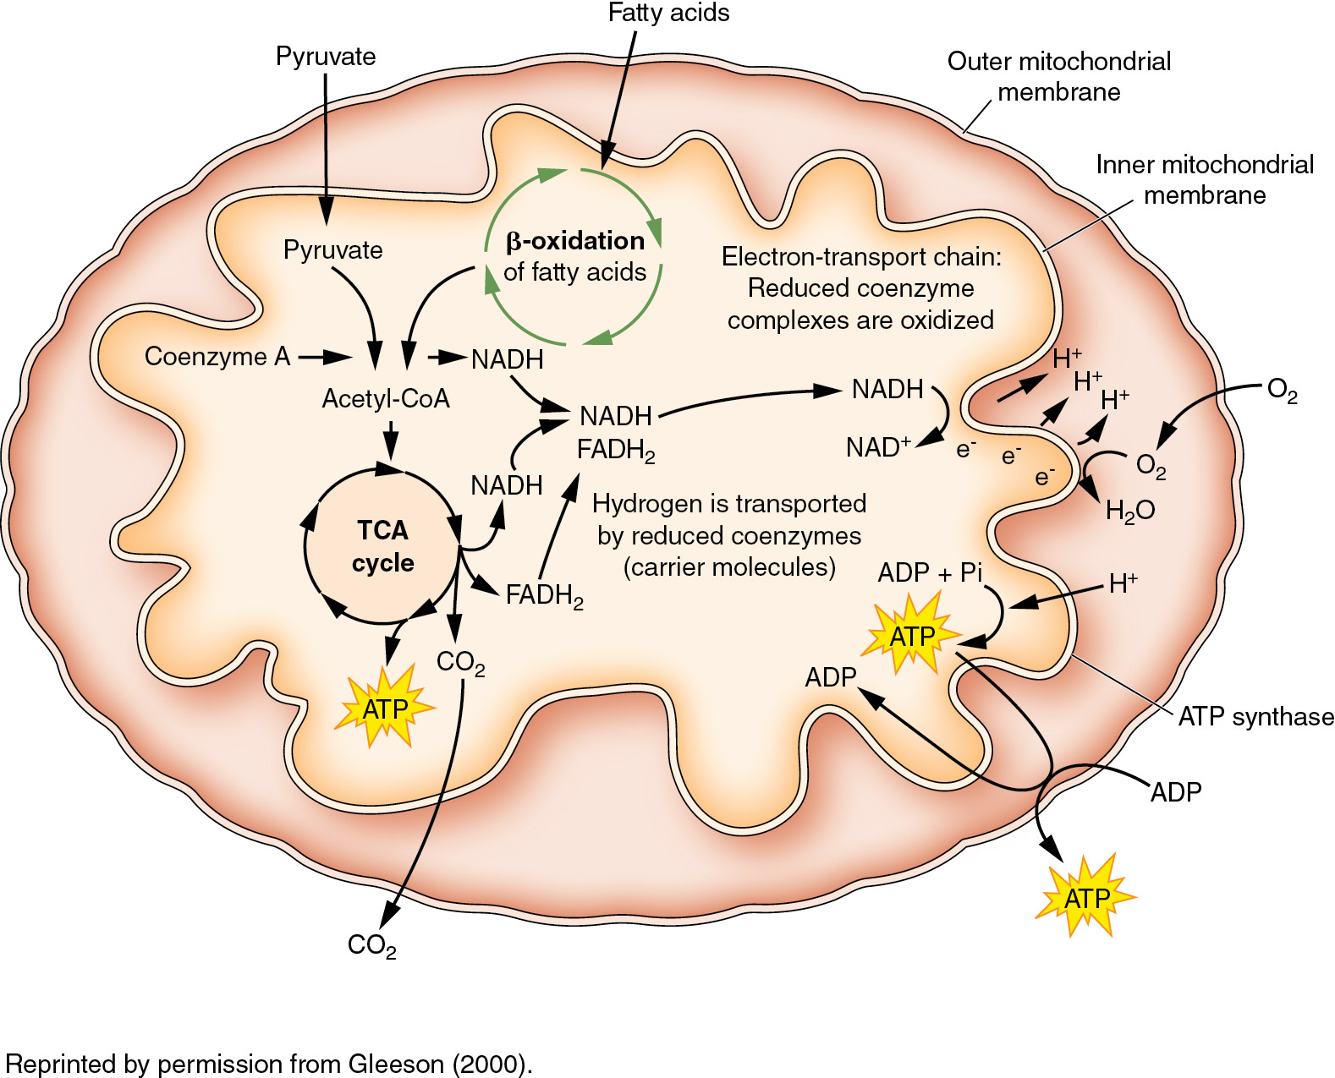
Figure 3.8
Notes:
Figure 3.8 The TCA cycle generates the reduced coenzymes NADH and FADH₂. Oxidation of these coenzymes in the electron-transport chain releases energy that is used for the resynthesis of ATP. This process is called oxidative phosphorylation.
Reprinted by permission from M. Gleeson, "Biochemistry of Exercise," in Nutrition in Sport, edited by R.J. Maughan (Blackwell Science Ltd., 2000), 17-38; permission conveyed through Copyright Clearance Center, Inc.

Slide 13
Carbohydrate Depletion
Carbohydrate stores are rapidly depleted during exercise (muscle glycogen) or during fasting (liver glycogen).
Muscle glycogen stores are normally depleted after 1 to 2 hours of hard exercise. In very high-intensity exercise, the muscle glycogen content falls rapidly but is not completely depleted at the point of fatigue.
Carbohydrate is the major fuel for muscle activity in high-intensity exercise; when the muscle glycogen stores are depleted, only low-intensity exercise is possible.

Slide 14
Glycogen and Performance
The time that a fixed exercise intensity can be sustained is related to the size of the preexercise muscle glycogen store.
The size of the store depends on the pattern of exercise and diet in the previous hours and days.
High carbohydrate intakes are needed to restore depleted glycogen stores during periods of heavy training or following endurance events.
With high intakes, the stores can be restored within 24 to 48 hours.

Slide 15
Fat as a Fuel for Exercise
The principal storage form of fat in the body is triacylglycerol, mostly located in white adipose tissue.
Triacylglycerol stores are also found in liver and muscle and as lipoproteins in blood.
Muscles cannot oxidize triacylglycerols directly.
The triacyl­glycerol molecule must first be broken down into its fatty acid (FA) and glycerol components by lipolysis.
This process is activated during exercise by the actions of catecholamines, glu­cagon, and cortisol.

Slide 16
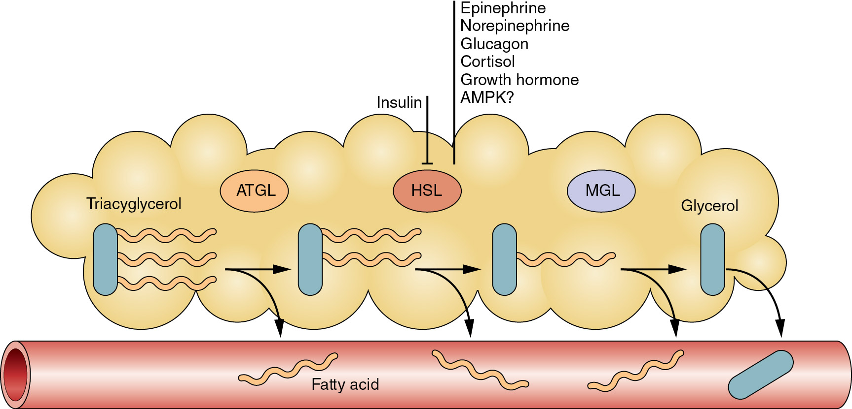
Figure 3.9
Notes:
Figure 3.9 Lipolysis in adipose tissue mobilizes free fatty acids, which enter the circulation and thus become available for muscle to use as a fuel for exercise. There are three different lipases involved in the breakdown of one triacylglycerol molecule. Insulin inhibits lipolysis.

Slide 17
Fat Transport and Oxidation
The principal sources of fat fuels for exercise are blood-borne FAs derived from adipose tissue and intramuscular triacylglycerol (lipid droplets in the cytoplasm).
FAs are transported from blood into muscle fibers via the CD36 fatty acid transporter.
FAs are linked to carnitine for transport into the mitochondria, where they are broken down into two-carbon units and linked to coenzyme A to form acetyl-CoA.
Acetyl-CoA is oxidized in the TCA cycle.

Slide 18
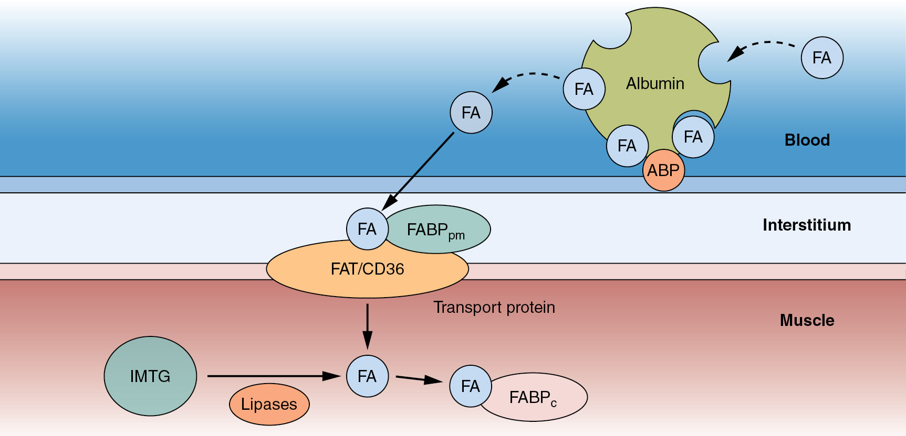
Figure 3.10
Notes:
Figure 3.10 Fatty acid uptake by skeletal muscle. ABP = albumin binding protein; FABP = fatty acid binding protein.; FAT = fatty acid transporter; IMTG = intramuscular triacylglycerol; HSL = hormone-sensitive lipase.

Slide 19
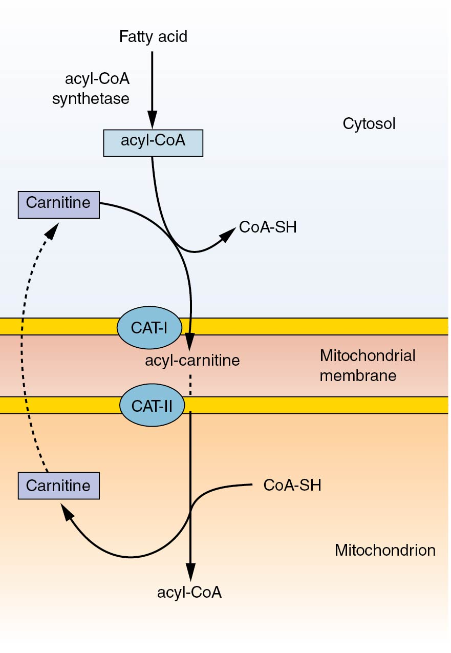
Figure 3.12
Notes:
Figure 3.12 Carnitine aids the transport of long-chain FAs across the mitochondrial membrane. Inside the mitochondrion, carnitine is removed and fatty acyl-CoA is re-formed, which frees carnitine to diffuse back across the mitochondrial membrane into the cytoplasm.

Slide 20
Intramuscular Triacylglycerol (IMTG)
Another source of FAs is the IMTG stores in the muscle.
Type I muscle fibers have a higher content of IMTG than type II muscle fibers have.
IMTG stores decrease during exercise and are used as an important source of energy.
Endurance exercise training increases the triacylglycerol content of muscle.
Like adipose tissue, muscle contains a hormone-sensitive lipase that is influenced by catecholamines and insulin.

Slide 21
Amino Acid Oxidation
After removal of the amino (NH₂) group, the carbon skeletons of amino acids (AAs) can be used for oxidation, but only six of the available 20 AAs in protein are oxidized in significant amounts by muscle: asparagine, aspartate, glutamate, isoleucine, leucine, and valine.
AA oxidation has been estimated to contribute up to only about 15% of energy expenditure in resting conditions.
During exercise, this relative contribution likely decreases to less than 5% because of an increasing importance of carbohydrate and fat as fuels.

Slide 22
Table 3.5 Energy Stores in the Average Adult Male
Fuel type | Mass | Energy available | Exercise time (min)
Liver glycogen | 0.10 kg (0.22 lb) | 1,600 kJ (382 kcal) | 20
Muscle glycogen | 0.40 kg (0.88 lb) | 6,400 kJ (1,530 kcal) | 80
Blood glucose | 0.01 kg (0.02 lb) | 160 kJ (38 kcal) | 2
Fat | 12.3 kg (27.1 lb) | 442,000 kJ (105,641 kcal) | 5,550
Protein | 10.0 kg (22.0 lb) | 170,000 kJ (40,611 kcal) | 2,130
Notes:
Note: Assumes a body mass of 80 kg (176 lb), a fat content of 15% of body mass, and a protein content of about 12% of body mass. The value for blood glucose includes the glucose content of extracellular fluid. The exercise times are the approximate times that these stores would last if they were the only source of energy available during exercise at marathon-running pace (equivalent to an energy expenditure of about 80 kJ [19 kcal]/min).
Reprinted by permission from M. Gleeson, "Biochemistry of Exercise," in Nutrition in Sport, edited by R.J. Maughan (Blackwell Science Ltd., 2000), 17-38; permission conveyed through Copyright Clearance Center, Inc.

Slide 23
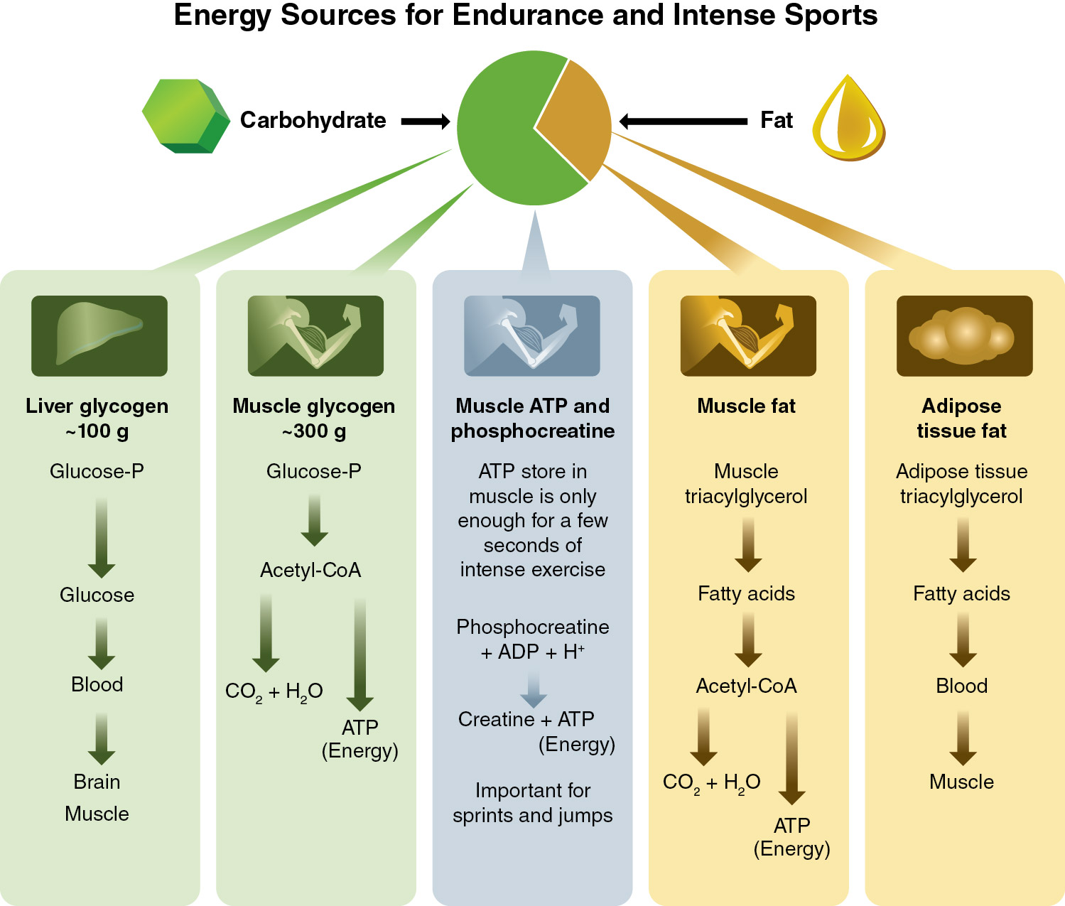
Infographic 3.2
Notes:
Infographic 3.2 Energy sources for endurance and intense sports.

Slide 24
Regulation of Muscle Metabolism
Intracellular factors
  ATP/ADP
  Pi
  AMP
  Ca²⁺
Hormones and cytokines
  Insulin
  Catecholamines
  Glucagon, growth hormone, and cortisol
  Interleukin-6

Slide 25
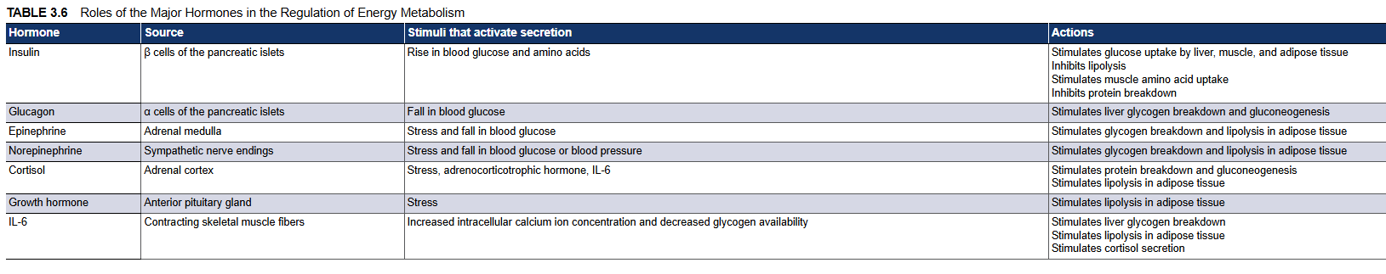

Slide 26
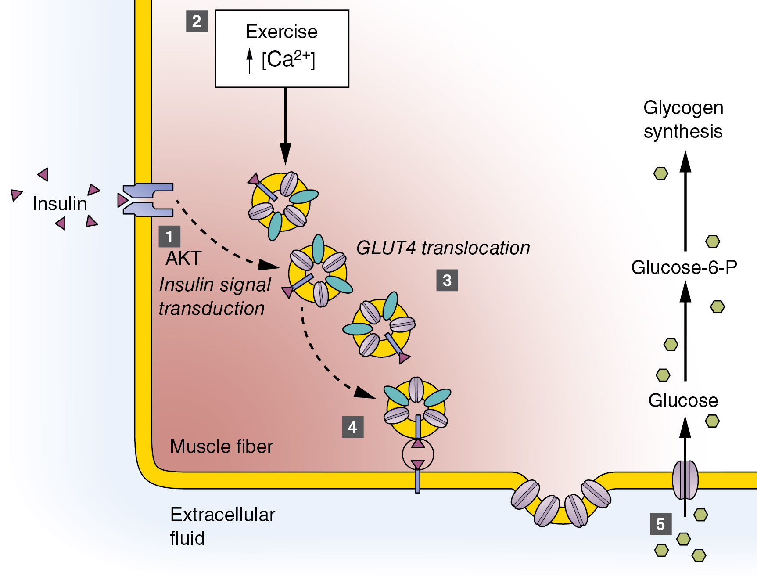

Slide 27
Factors Influencing Fuel Selection for Exercise
Substrate availability
Diet
Exercise intensity
Exercise duration
Training status
Hormones
Previous exercise
Environmental conditions

Slide 28
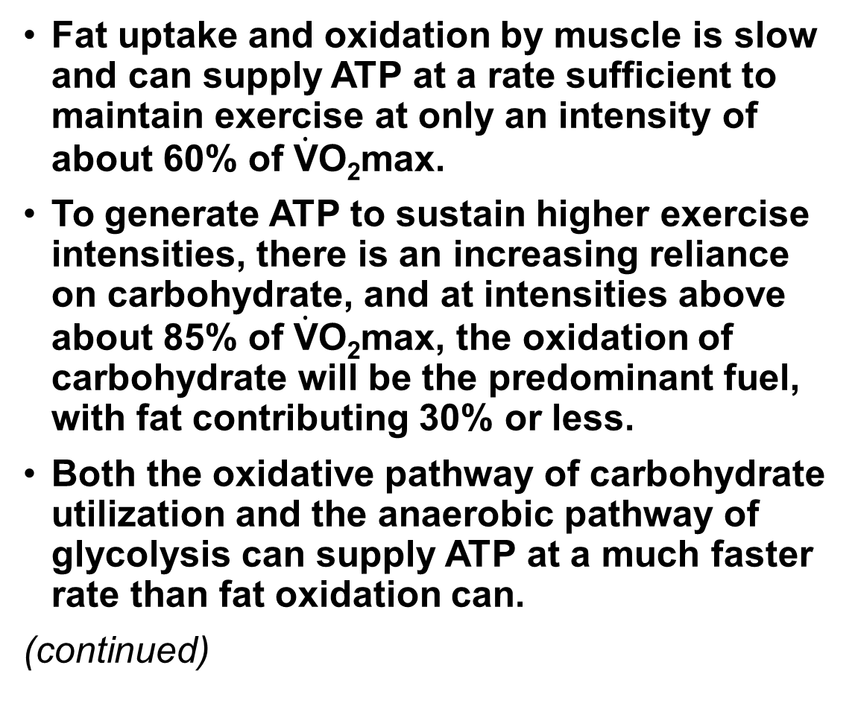
Fuel Selection for Exercise
Fat uptake and oxidation by muscle is slow and can supply ATP at a rate sufficient to maintain exercise at only an intensity of about 60% of $\dot{\text{V}}$O₂max.
To generate ATP to sustain higher exercise intensities, there is an increasing reliance on carbohydrate, and at intensities above about 85% of $\dot{\text{V}}$O₂max, the oxidation of carbohydrate will be the predominant fuel, with fat contributing 30% or less.
Both the oxidative pathway of carbohydrate utilization and the anaerobic pathway of glycolysis can supply ATP at a much faster rate than fat oxidation can.
(continued)

Slide 29
Fuel Selection for Exercise (continued)
During most forms of submaximal exercise, a mixture of fat and carbohydrate is oxidized to provide energy for muscular contraction.
Fat oxidation makes an increasing contribution to ATP regeneration as exercise duration increases (up to 80% of total energy required for exercise lasting several hours).
Utilizing more fat at moderate to high exercise intensities allows greater sparing of the limited carbohydrate reserves, permitting exercise to be prolonged.
Endurance training increases the capacity to oxidize fat.

Slide 30
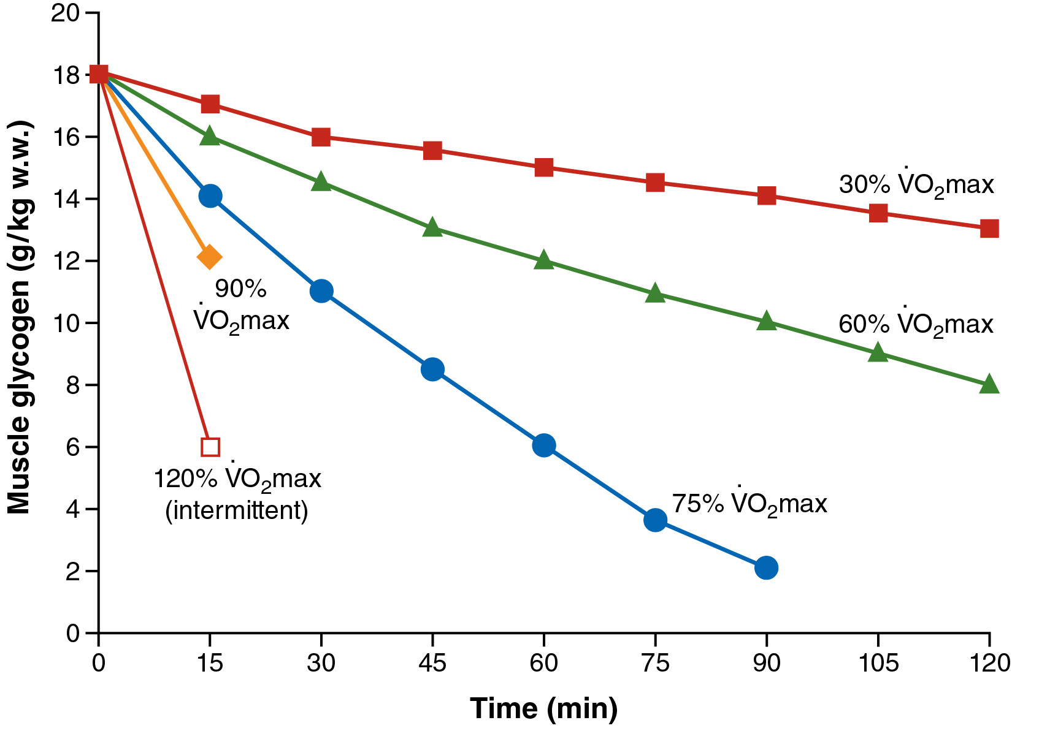

Slide 31
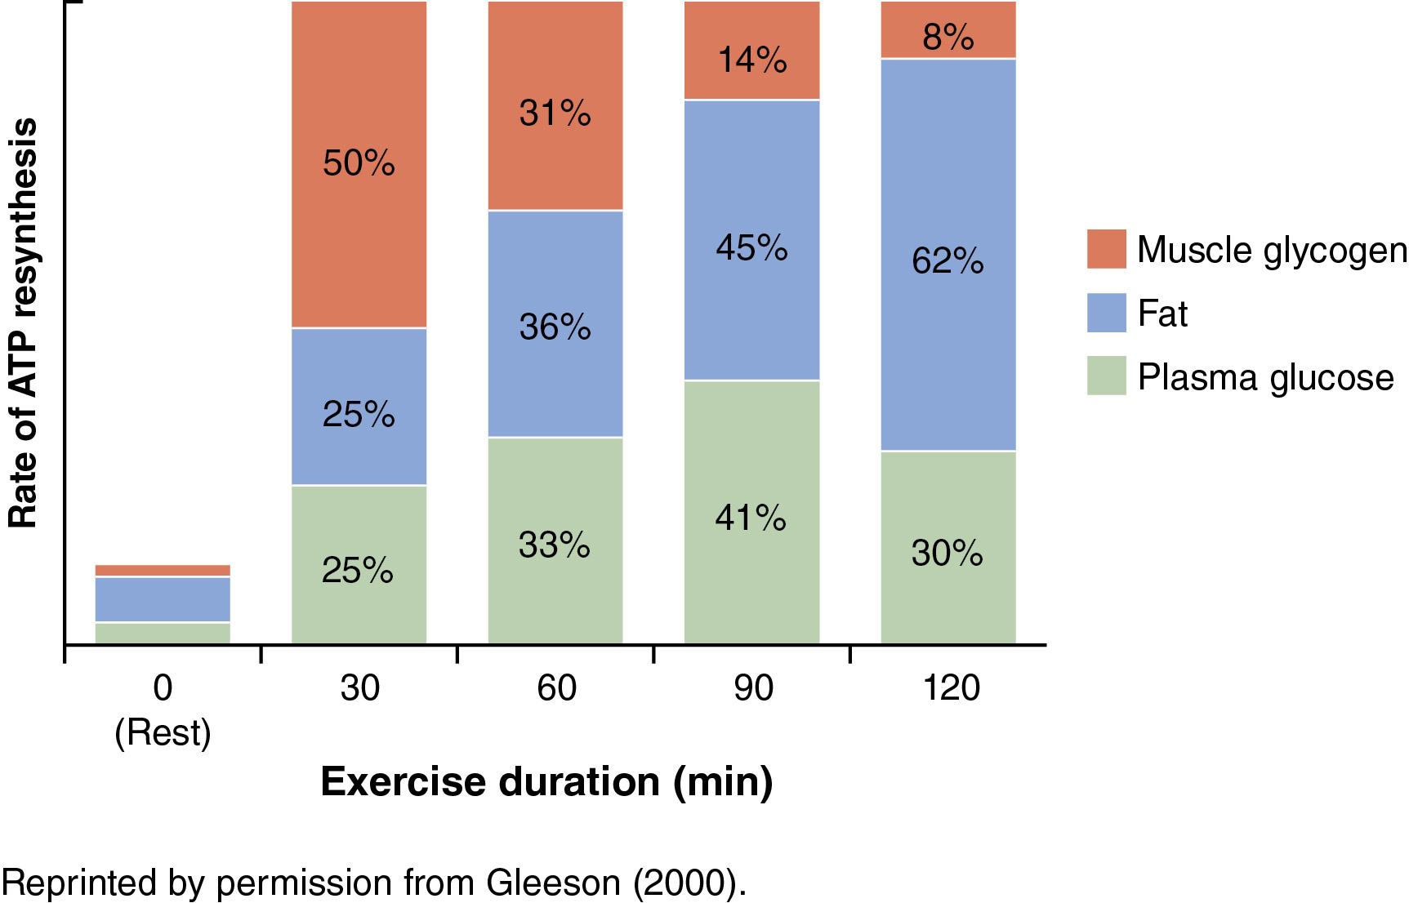
Figure 3.27
Notes:
Figure 3.27 Changes in the relative contributions of the major fuel sources to ATP resynthesis during prolonged submaximal exercise at an intensity equivalent to about 60% of VO₂max (approximately 10 times the resting metabolic rate).
Reprinted by permission from M. Gleeson, "Biochemistry of Exercise," in Nutrition in Sport, edited by R.J. Maughan (Blackwell Science Ltd., 2000), 17-38; permission conveyed through Copyright Clearance Center, Inc.

Slide 32
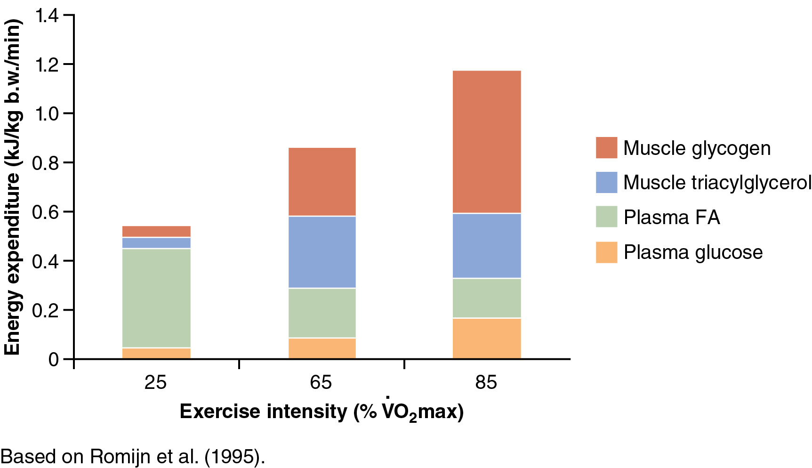
Figure 3.28
Notes:
Figure 3.28 The contributions of different fuel sources to energy expenditure at three different exercise intensities.
Based on Romijn et al. (1995).

Slide 33
Fatigue in High-Intensity Exercise
Fatigue, the inability to maintain a given or expected force or power output, is an inevitable feature of maximal exercise.
Typically, the loss of power output or force production is likely to be in the range of 40% to 60% of the maximum observed during 30 seconds of all-out exercise.
Many factors contribute to fatigue, but during maximal short-duration exercise, it will be caused primarily by a gradual decline in anaerobic ATP production or an increase in ADP and Pi accumulation.

Slide 34
Fatigue in Prolonged Exercise
In high-intensity exercise lasting 1 to 5 minutes, lactic acid accumulation may contribute to the fatigue process.
At marathon-running pace, muscle glycogen stores alone can fuel about 80 minutes of exercise before depletion.
Oxidation of blood glucose (derived from liver glycogen stores) enables ATP production to be maintained and exercise to continue.
When muscle and liver glycogen become depleted, ATP production becomes compromised because of the inability of fat oxidation to increase sufficiently to offset this deficit.

Slide 35
Hypoglycemia and Central Fatigue
Prolonged exercise, particularly after a period of fasting or a diet low in carbohydrate, results in hypoglycemia, which may be a direct cause of fatigue.
Hypoglycemia is detected by the brain and causes symptoms of tiredness and dizziness.
This central fatigue could then reduce the degree of skeletal muscle recruitment by the motor cortex, causing a fall in muscle force generation.
In the heat, performance is decreased, and exercise-induced hyperthermia is associated with central fatigue.

Slide 36
Metabolic Adaptations to Training
Muscle adaptations to aerobic endurance training include increases in capillary density and mitochondrial size and number.
The activity of the TCA cycle and of other oxidative enzymes increases, and a concomitant increase occurs in the capacity to oxidize both fat and carbohydrate.
Endurance training also increases the relative cross-sectional area of type I fibers, increases intramuscular content of triacylglycerol, and increases the capacity to use fat as an energy source during submaximal exercise.
(continued)

Slide 37
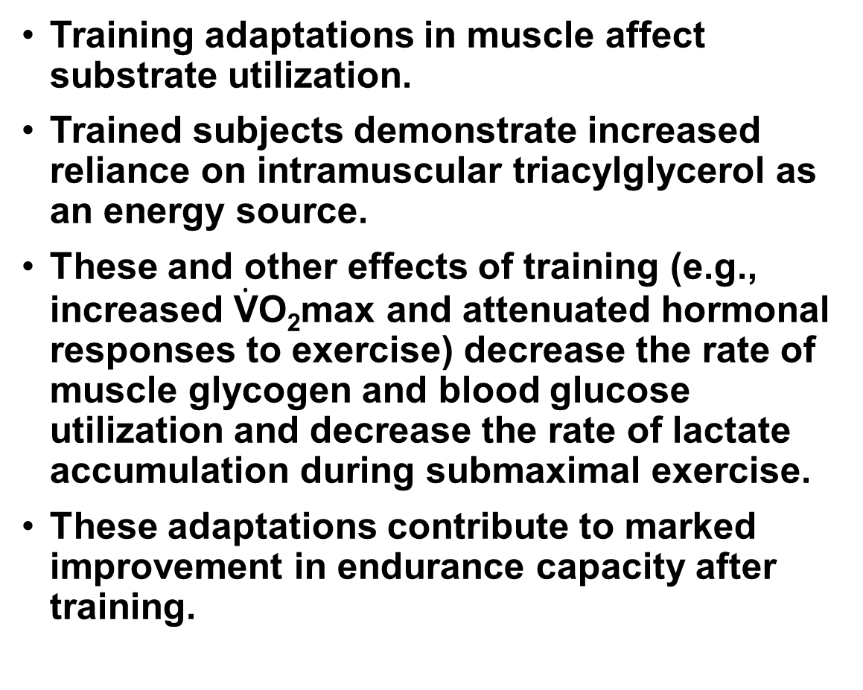
Metabolic Adaptations to Training (continued)
Training adaptations in muscle affect substrate utilization.
Trained subjects demonstrate increased reliance on intramuscular triacylglycerol as an energy source.
These and other effects of training (e.g., increased $\dot{\text{V}}$O₂max and attenuated hormonal responses to exercise) decrease the rate of muscle glycogen and blood glucose utilization and decrease the rate of lactate accumulation during submaximal exercise.
These adaptations contribute to marked improvement in endurance capacity after training.

Slide 38
Glycogen and Endurance
Training Adaptations
Low levels of muscle glycogen may enhance the mRNA content of some genes involved in exercise metabolism.
Genes for some metabolic enzymes, including citrate synthase and β-hydroxyacyl-CoA dehydrogenase, are upregulated to a greater extent in response to exercise when exercise is performed with low preexercise glycogen.
Some signaling proteins, such as AMP-activated protein kinase (AMPK), possess glycogen binding domains, and when glycogen is low, these proteins are more active toward their specific targets.

Slide 39
Nutrition, Performance, and Training Adaptations
A variety of nutrition interventions involving dietary manipulation, supplements, and ingestion of sports foods or beverages during exercise can have an impact on metabolic responses to exercise and athletic performance.
Performance-enhancing (ergogenic) supplements include β-alanine, bicarbonate, caffeine, creatine, and nitrate.
Nutrition can also influence adaptations to endurance or resistance training.

Slide 40
Antioxidants Impair Training Adaptations
Consuming megadoses of vitamins C and E impairs some adaptations to endurance training, including mitochondrial biogenesis.
Free radicals are generated during exercise and act as signals for wider adaptive responses in muscle and other tissues.
This raises questions about the approach to protecting tissues that promotes frequent supplementation with antioxidant nutrients.

