Slide 1

Tesco quality Management
Presentation for Customer Relationship Management in the attention of Senior Management Team of TESCO

Slide 2

What is Quality for TESCO
Quality enhances a company's brand reputation in the marketplace. When a corporation establishes a positive reputation, it will attract more customers and profit.
All non-food goods are submitted to a factory pre-shipment inspection by a Tesco colleague, a factory employee who has been trained, or an authorised third party. These inspections involve verifying that the product meets the desired quality standards, as well as ensuring that it is safe and lawful.

Slide 3

Quality models and processes
Balance Scorecard Model-BSC
Also known as Tarket Setting and Achievement that provides four key areas:
Financial Profitability- It provides high customer satisfaction levels; increase spend and keep the customer satisfied.
Customer Perspective- It's an improved long term customer relationship resulting in more clients.
Internal View/Productivity- It deals with data collection perspective that identifies CRM targets and segments.
Innovation-Creative Teams- It sets up targets for innovation process within the CRM system.
Quality Education
Tesco provides high-Quality Education System and continues to invest in training for its employees so that they can 'get on' at work and at home. TESCO aims to ensure that their employees have the skills they need to thrive in the future as the company grows. In addition to enhancing their current abilities, the quality education system provides possibilities for colleagues to reskill in areas where demand is expected to rise. There were 1,265 new apprenticeships available in 2018.
Quality Manage- Tesco have a routine testing programme through which Tesco products are regularly tested by independent expert laboratories to make sure that they are safe, legal and meet the exacting quality specifications.
The benefits for this Quality model is build long term relationship with customers and suppliers, build trust, and satisfaction.

Slide 4

Quality Models Advantage and Disadvantage
BSC Model: Advantage
build long term relationship with customers and suppliers, build trust, and satisfaction. Customer loyalty that will maximizes profit, customer lifetime value.
BSC Model: Disadvantage
In general, most defects are caused by people and system failure machine, software failure and hardware failure. Cost barriers, logistics problems, internal politics, credibility, corporate culture.
Total Quality Management: Advantage
It has high customer satisfaction approach, has trust, loyalty, target commitment with all employees, organization culture, credibility in suppliers and employees.
Total Quality Management: Disadvantage
Poor quality services from employees, "take it or leave it" attitude to a customer, treating employees as productive robots, competitive pricing, insufficient value for customers and employees.

Slide 5
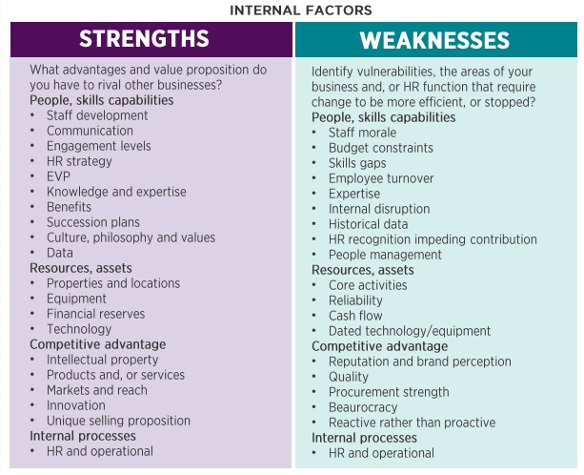
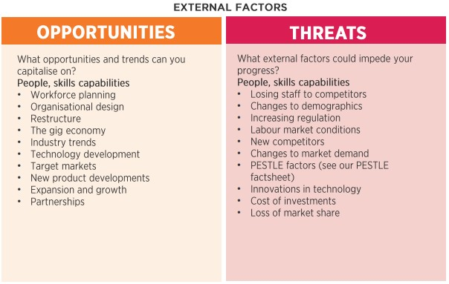
Swot analysis

