Slide 1
ECES5007/C
Lines of Enquiry
Llwybrau Ymholi
Sesiwn 9 / Session 9

Slide 2
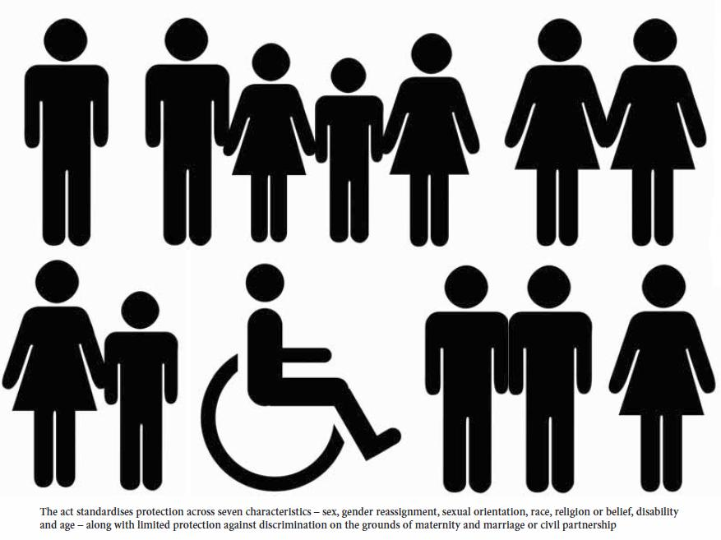
Deddf Cydraddoldeb 2010
Equality Act 2010

Slide 3
Nodau
Aims
Diffiniadau
Fframwaith damcaniaethol
Datblygiadau polisi
Deddf Cydraddoldeb 2010
Enghreifftiau o addysg
Definitions
Theoretical framework
Policy development
Equality Act 2010
Examples from education
Notes:
What policies would benefit students? E.g. Abolition of tuition fees, smaller class sizes, new buildings
What organisations and actions would be involved in bringing about thes new policies i.e. what is the policy environment
a) The Government and the Minister for Education – At Westminster and WAG- bring in new policies
b)Civil servants – draft and administer new laws
c) Parliament – commons and Lords – passes new laws
d) political parties – put new policies into their manifestoes for approval by electorate
e) Pressure groups – lobby all the above for change and new laws – N.U.S./U.C.U./ University vice chancellors.
f) Individuals....students parents What can they do? Write to M.P.s/AMs; demonstrate/ vote in elections/ write to papers etc. –

Slide 4
Cysyniadau defnyddiol
Useful concepts
Yn eich geiriau eich hunan beth yw’r gwahaniaeth rhwng
  Cydraddoldeb a
  Chyfiawnder
Beth yw anffafriaeth?
Distinguish in your own words between:
  Equality and
  Equity
What is discrimination?
Notes:
Linking with SJSI 4007

Slide 5

Cydraddoldeb
Equality
Cyfleodd cyfartal ar gyfer holl aelodau cymdeithas
O feddwl am gyflogaeth, golyga hyn bolisiau sydd yn gwaredu’r rhwystrau o anffafriaeth, gwella mynediad i swyddi, addysg ac hyfforddiant
Os ydy mynediad i swyddi yn agored I bawb, mae incwm yn codi, mae cyswllt cymdeithasol yn gwella ac mae eithrio cydmdeithasol yn lleihau
Equal opportunities for all members of a society
Applied to employment this means having policies to remove the barriers of discrimination, improving access to jobs, education and training.
If access to employment becomes open to all then not only do incomes rise but social contact improves and social exclusion is reduced.
Notes:
Blakemore (2003) distinguishes between ‘minimalist’ and ‘maximalist’ principles regarding equal opportunities The minimalist position places the emphasis on opportunity and treating people FAIRLY or on an equal basis. Discrimination on grounds of gender, ‘race’, disability etc is viewed as unfair , unjust and in most cases now illegal. However the maximalist position places the emphasis on equality and seeks to create EQUAL OUTCOMES. Rather than just banning unfair discrimination policies must positively encourage or discriminate so that minorities and other disadvantaged groups benefit equally from employment opportunities or the welfare system (Blakemore p.28)

Slide 6

Cyfiawnder
Equity
Mae’r cysyniad o GYFIAWNDER yn ymestyn y cysyniad o gydraddoldeb
Dydy e ddim yn canolbwyntio ar debygrwydd darpariaeth
Er mwyn ymgyrraedd at lefel dda o addysg ayyb mae’n rhaid trin teuluoedd, unigolion a chyfiawnder yn hytrach nad yn gyfartal
Efallai cânt eu trin yn wahanol er mwyn cael cyfiawnder yn y pen draw
EQUITY is an idea that extends the concept of equality.
Does not focus on sameness and similarity of provision
In order to achieve an end-state or outcome in which all receive a good level of education etc. then it is necessary to treat individuals, families and groups equitably rather than equally.
This may mean treating them differently in order to ensure there is equality between them in the end.
Notes:
Blakemore uses the example of hunger and a cake. If there is one cake and two people, one of whom has not eaten for 24hurs and one who last ate 6 hours ago, then equity dictates that the hungriest receives a bigger slice than the one who is only mildly hungry. This is not equal treatment but it is equitable or fair. Positive discrimination.

Slide 7
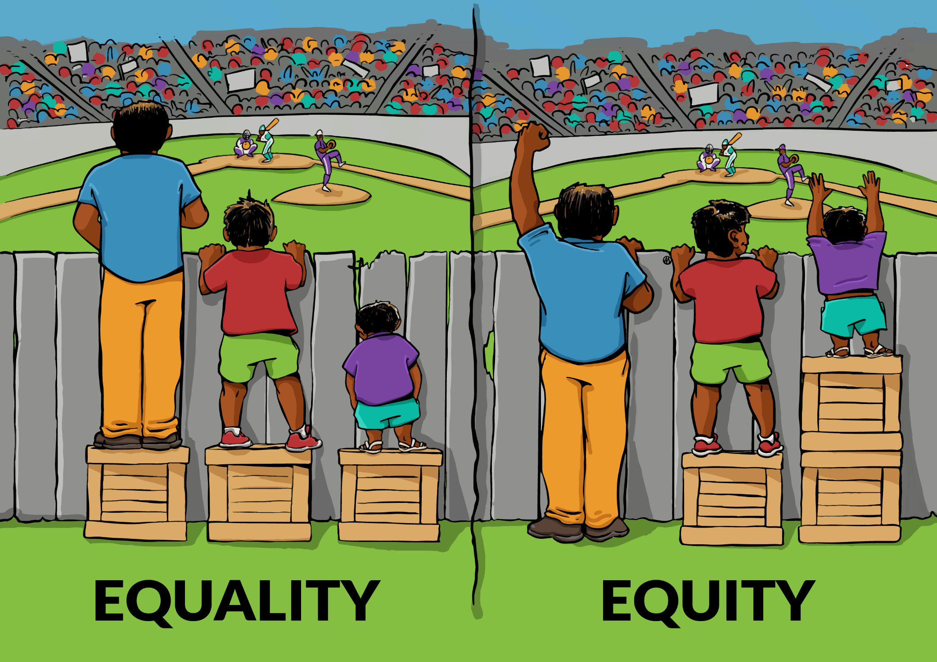
Interaction Institute 2016

Slide 8

Tasg/
Task
Mewn parau
  trafodwch sut y galluogir cyfiawnder mewn sefyllfa ysgol
  trafodwch sut y galluogir cyfiawnder mewn sefyllfa gymdeithasol
In pairs
  discuss how equity is enabled in a school situation
  discuss how equity is enabled in a social situation

Slide 9

Anffafriaeth
Discrimination
‘To treat one particular group of people less favourably than others because of their race, colour, nationality, or ethnic or national origin.’
‘Direct Discrimination – a person directly discriminates against another person when factors that are not related to merit, ability, potential are used as a reason for treating them differently and discriminating against them’
(Institute of Race Relations,n.d)
Notes:
Indirect discrimination – this occurs when there are provisions, criteria or practises in place that have a discriminatory effect on certain groups of people. For example, a dress code that requires women to wear a knee length skirt could be indirectly discriminatory against women from a certain cultural or religious groups. www.bangor.ac.uk/hr/equalitydiversity/Definitionsof discrimination.php.en?text=true 21/11/2011

Slide 10

Gorthrwm
Oppression
“Inhuman or degrading treatment of individuals or groups; hardship and injustice brought about by the dominance of one group over another; the negative and demeaning exercise of power. Oppression often involves disregarding the rights of an individual or group and is thus a denial of citizenship.” (Thompson 1993, p. 31)

Slide 11
Thompson’s PCS model
S
C
P
Thompson, 2006
Notes:
Personal
Beliefs, attitudes and behaviour.
Ideas which people have about themselves and others which they accept as ‘true’.
A tendency to respond in a particular way when encountering certain people or situations.
How people regard and/ or treat others.
Cultural
Assumed consensus about what is true, right, good, normal.
Commonly accepted values and codes of conduct.
Structural
Structures and institutions within society which act to perpetuate social divisions, prejudice and discrimination.
Example:
P: Young man in the club you work at makes offensive and derogatory comments about a gay man who attends also. He says that ‘gay people are not natural’ or ‘normal’.
C: Gay people largely repulse the community around him, and many of the community members are involved with the local church, holding firm views about 'sexual morals'.
S: Popular tabloid media berates the ‘abnormal’ activities of gay people. Religious leaders of all faiths support the instatement of laws to stop equal rights for gay people. Legislation is passed by parliament that compromises the rights of gay, lesbian and bisexual people. There is an overwhelming 'consensus' of power used in all forms of structural life.

Slide 12
Thompson’s PCS Model
Sylfaen ar gyfer adlewyrchu beirniadol
Rhyngweithiad cymhleth rhwng y tri lefel
Medrid ystyried hiliaeth, er enghraifft, ar y tri lefel ac mae rhyngweithiad rhwng y lefelau
A basis for critical reflection
Complex interaction of the three levels
Racism, for example, can be considered at the three levels and there is interaction between the three levels
Thompson, 2006

Slide 13
PCS Model : Personal
Personol neu Seicolegol
Lefel unigol o feddyliau, teimladau a gweithrediadau
Caiff ein meddyliau, ein teimladau a’n gweithrediadau am grwpiau mewn cymdeithas eu siapio, i raddau beth bynnag, gan ein profiadau ar lefel bersonol
Personal or Psychological
Individual level of thoughts, feelings and actions
Our thoughts, feelings and actions about particular groups in society will be shaped, to a certain degree at least, by our experiences at a personal level
Thompson, 2006

Slide 14
PCS Model : Cultural
Dulliau ar y cyd o weld, meddwl a dweud
Consensws a dybir am beth sydd yn iawn
Cydymffurfio i normau cymdeithasol
Rhannu ystyr
Rheolau anysgrifenedig
Shared ways of seeing, thinking and doing
An assumed consensus about what is right
Conformity to social norms
Shared meanings
Unwritten rules
Thompson, 2006

Slide 15
PCS Model : Structural
Rhwydwaith o rhaniadau cymdeithasol
Perthnasau pwer
Sefydliadedig- patrymau o feddwl, iaith ac ymddygiad
Pwerau ehangach o rymoedd cymdeithasol
Network of social divisions
Power relations
Institutionalized- firmly established patters of thought, language and behaviour
Wider level of social forces
Thompson, 2006

Slide 16

Tasg
Task
Ystyriwch yr enghreifftiau
Dynodwch y mathau o anffafriaeth / gwahaniaethu
Defnyddiwch y model PCS i ddynodi’r anffafriaeth
Consider these examples
Identify the main issues of discrimination.
Use the PCS model to identify the discrimination

Slide 17
Disgybl wrth athro “ Ond Miss, mae jôcs hiliol yn ddoniol, mae Jasprit yn chwerthin, felly mae’n rhaid eu bod yn OK”
Mae disgybl yn cwyno bod merch Asiaidd yn cael cuddio ei choesau yn Ymarfer Corff
Disgybl gwyn yn dweud yn uchel yn y dosbarth a nifer yn cytuno’n uchel bod gormod o ‘sponging refugees’ yn mynd ymlaen am eu hawliau
Pupil to teacher “ Oh but Miss, racist jokes are funny, Jasprit laughs at them, so they must be OK”
A pupil complains that an Asian girl is allowed to cover her legs in PE
A white pupil says loudly in class to loud approval from others that there are too many ‘sponging refugees going on about their rights’

Slide 18
Dau ddisgybl 6ed dosbarth hoyw yn cael stwr gan eu athrawon am ddal dwylo ond mae’r athrawon yn derbyn yr un ymddygiad gyda chyplau sydd ddim yn hoyw
Athrawon benywaidd a gwrywaidd yn meddwl bod merched yn llai galluog na bechgyn
Gwersi AG yn adlewyrchu dim ond tradoddiad Cristnogol y wlad hon
Two gay sixth formers in North Wales are told off by their teachers for hand holding but the teachers tolerate the same behaviour among straight couples
Men and women teachers think girls are less intelligent than boys
RE lessons only reflect the Christian tradition of this country

Slide 19
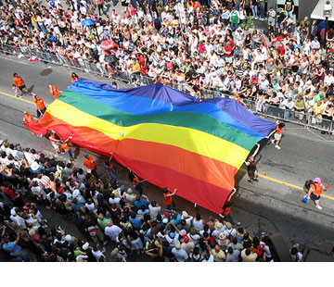
Gay Pride
Until 1967 the male homosexual act was a criminal offence punishable by jail in the U.K.
The Gay Rights Movement also emerged in the 1960’s triggered by the Stonewall riots of 1969.
It challenged the identity imposed upon gay people and sought enforceable civil rights for Gay and Lesbian people in all spheres of life.
Tan 1967 roedd y weithred rhywiol gwrwgydiol dynol yn drosedd a fedr cael carchar yn y DU
Datblygodd Mudiad Hawliau’r Hoywon yn y 60au yn dilyn terfysg Stonewall
Heriodd yr hunaniaeth a roddwyd ar bobl hoyw a galw am hawliau dynol ar gyfer bobl hoyw a lesbiaid ym mhob rhan o fywyd
Notes:
The Stonewall riots were a series of spontaneous, violent demonstrations against a police raid that took place in the early morning hours of June 28, 1969, at the Stonewall Inn, in the Greenwich Village neighborhood of New York City. They are frequently cited as the first instance in American history when people in the homosexual community fought back against a government-sponsored system that persecuted sexual minorities, and they have become the defining event that marked the start of the gay rights movement in the United States and around the world.

Slide 20

Mudiad Hawliau’r Duon
Black Rights Movement
Rosa Parks' story
Stori Rosa Parks

Slide 21
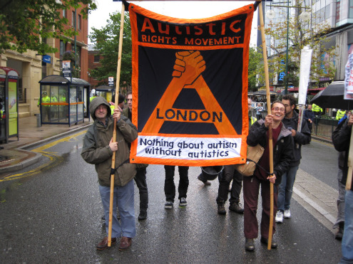
Mudiad Hawliau Anabledd
Disability Rights Movement
Dechreuwyd yn yr UDA yn y 60au
Mynnu’r hawl I fyw yn annibynnol, adeiladau hygyrch, trafnidiaeth ayyb
Yn y 70au, 80au, mwy radical
Milwriaethu yn y DU hefyd
Rhoi sialens i fodel meddygol anabledd
yn y 90au, hawliau yn cael eu cydnabod mewn deddfwriaeth y ddwy ochr i Fôr yr Iwerydd
Began in USA in 1960s
Demanding the right to independent living, accessible buildings, transport etc.
In 1970s,80s became more radical with demonstrations, sit-ins, lock-outs
Growth of parallel militancy in UK
Challenged the medical model of disability
In 1990s rights recognized in anti-disability discrimination legislation on both sides of the Atlantic
Notes:
Following and inspired by black rights and women’s movements
1990 Americans with Disabilities Act

Slide 22
Datblygiad polisi gwrth- anffafriaeth
Development of anti-discrimination policy
1970 ( Diwygiwyd 1984) Deddf Cyflog Cyfartal
1975 Deddf Gwahaniaethu ar Sail Rhyw
1976 Deddf Gwahaniaethu ar Sail Hil
1995 Deddf Gwahaniaethu ar Sail Anabledd
1970 (Amended 1984)Equal Pay Act
1975 Sex Discrimination Act
1976 Race Relations Act
1995 Disability Discrimination Act

Slide 23
Datblygiad polisi gwrth- anffafriaeth
Development of anti-discrimination policy
2003 Rheoliadau Cyfartaledd Cyflogaeth ( Tueddfryd Rhywiol)
2003 Rheoliadau Cyfartaledd Cyflogaeth ( Crefydd)
2006 Rheoliadau Cyfartaledd Cyflogaeth ( Oedran)
2003 Employment Equality Regulations (Sexual Orientation)
2003 Employment Equality Regulations (Religious Belief)
2006 Employment Equality Regulations (Age)

Slide 24
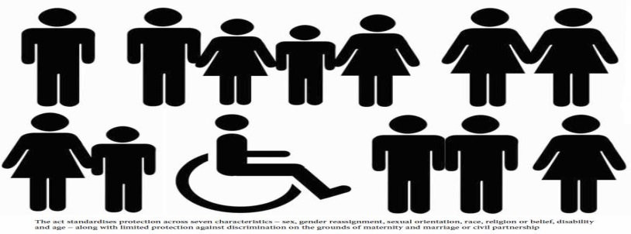
Deddf Cydraddoldeb 2010
Equality Act 2010
Daeth i rym Hydref 2010
Unwyd 9 darn o ddeddfwriaeth
Cydgordio a symleiddio llawer o ddeddfwriaeth am anffafriaeth
Deddf Cydraddoldeb 2010
Came into force in October 2010
Merged nine main pieces of legislation including DDA, Race Relations Act, Sex Discrimination Act
It harmonises and simplifies the mass of anti-discrimination legislation (EHRC,2010)
Equality Act 2010

Slide 25

Deddf Cydraddoldeb 2010
Equality Act 2010
Mae’n amddiffyn yr unigolyn o driniaeth annheg ac o anffafriaeth
Mae un dyletswydd yn ymdrin â naw nodwedd a gaiff eu amddiffyn
Hil, rhyw, tueddfryd rhywiol, oedran, anabledd, crefydd neu gred, newid rhyw, beichiogrwydd neu famolaeth, bod yn briod neu mewn partneriaeth sifil
It protects the individual from unfair treatment and discrimination
There is a single public sector equality duty covering nine protected characteristics
Race, sex, sexual orientation, age, disability, religion or belief, gender re-assignment, pregnancy or maternity, being married or in a civil partnership.

Slide 26
References
EHRC (2010) What is the Equality Act? Available at:http://www.equalityhumanrights.com/legal-and-policy/equality-act/what-is-the-equality-act/ ( Accessed 12-10-2011)
Gaine,C (2005) We’re all white, thanks: the persisting myth about ‘white’ schools, Staffordshire: Trentham Books.
Institute of Race Relations(n.d.) Discrimination Available at:www.irr.org.uk/statistics/discrimination.html (Accessed 12-10-2011).
Thompson,N.(2012) Anti-Discriminatory Practice. London: Palgrave Macmillan.
Image of Equality / Equity. Available at http://interactioninstitute.org/wp-content/uploads/2016/01/IISC_EqualityEquity.png ( Accessed 27.07.17)

