Slide 1
Sport Confidence
Part 2 – Week 4 and 5
Sport and Exercise Psychology

Slide 2
Aims of lecture
To introduce the construct of self-efficacy / sport-confidence
To illustrate the various approaches taken to studying confidence (and self-efficacy
Describe and explain Vealey’s (1986) original conceptualisation/model of sport-confidence
Highlight the limitations of the Vealey’s (1986) original conceptualisation of sport-confidence
Discuss the rationale for a reconceptualised model of sport-confidence (Vealey’s 1998; 2001)
Identify the differences within Vealey’s (2001) reconceptualised model of sport-confidence to her original (1986) conceptualisation

Slide 3
Bandura’s Self Efficacy Theory (1977; 1997)
Self-efficacy theory (Bandura, 1977, 1997)
    What is it? – Define it……..

Slide 4
What is it?
Self-Efficacy Theory…
Bandura (1977, 1997)
“One's belief that a certain level of performance can be attained” (Bandura, 1977)
“… beliefs in one’s capabilities to organise and execute the course of action required to produce given attainments” (Bandura, 1997)
A situation-specific form of self-confidence.
      It is unstable (e.g. aspects of the game; from moment to moment)
    A Social Cognitive Framework
Early research suggested SE derived from four sources of information

Slide 5
Bandura’s Self Efficacy Theory…
According to the theory, efficacy expectations are predicted by four factors in descending order of importance / sources of S.E.
  Performance Accomplishments
  Vicarious Experience
  Verbal Persuasion
  Emotional Arousal

Slide 6
Performance Accomplishments
  - Most powerful / more positive – higher S.E.
Will depend on difficulty of task, effort expended, physical guidance received, temporal patterning of success or failure.
Success at a difficult task independently early in learning stages / success in simple task with help following experience of early failures (Bandura, 1982, Feltz, 1988).

Slide 7
Strategies for Enhancing Self-Confidence: Implications for Sport Psychologist
Performance Accomplishments
  Goal-setting
  Changing focus of success (Task / ego)
  Best performance imagery
  Focus on success rather than failure
  Attributional re-training (effort / ability)

Slide 8
Vicarious Experience
Seeing others perform the skill in question
Relying on others to judge own capabilities – matching
Strategies
Modelling (similar ability)
Video analysis

Slide 9
Verbal Persuasion
Persuasive techniques used by self or others in order to manipulate behaviour.
Verbal encouragement and feedback
Mediating factor – importance and credibility of the persuader
Strategies
Imagery
Positive thought control
Role of the coach and significant others

Slide 10
Emotional Arousal
Least important predictor
Performers appraisals of their emotional arousal rather than actual physiological states
It is the performers cognitive appraisal / interpretation of the physiological response which will contribute to efficacy expectations
Factors such as fatigue & pain included in this source.
Strategies
Relaxation
Reframing (preparation)

Slide 11
Why did Vealey (1986) propose Sport-confidence instead of Self Efficacy Theory
SE Theory developed and based on general behaviour causation (not sport specific).
Vealey questioned whether SE sources were salient to the unique organisational culture of sport

Slide 12
Vealey (1986) defined Sport-confidence and proposed a model of Sport-confidence
Definition of Sport-confidence:
  The belief or degree of certainty individuals possess about their ability to be successful in sport

Slide 13
Vealey’s (1986)
Conceptual model of
Sport confidence
Objective
sport situation
Sport Confidence
(trait)
X
Competitive orientation
(performance or outcome)
Sport Confidence
(state)
Behavioural
responses
Outcomes
e.g. attributions, perceptions of success, satisfaction

Slide 14
Vealey’s (1986) model of Sport-Confidence…
Sport-confidence separated into two constructs:
  SC-trait – the belief or degree of certainty individuals usually possess about their ability to be successful in sport
  SC-state – the belief or degree of certainty individuals possess at one particular moment about their ability to be successful in sport
Additional Construct included
  Competitive Orientation
  Similar to Goal Achievement Theory (Nicholls, 1989) – Success means different things to different people (Task/Ego.... performance/outcome etc)
  A relatively trait like construct
  Tendency to strive towards achieving task/performance goals or ego/outcome

Slide 15
Vealey’s (1986)
Conceptual model of
Sport confidence
Objective
sport situation
Sport Confidence
(trait)
X
Competitive orientation
(performance or outcome)
Sport Confidence
(state)
Behavioural
responses
Outcomes
e.g. attributions, perceptions of success, satisfaction

Slide 16
Criticisms of Vealey’s 1986 model…
Limited support
    no sign. relationship between competitive orientation and SC-state (Martin & Gill, 1991)
    SC-trait a better predictor of sport behaviour and performance than SC-state (Roberts & Vealey, 1992)
  Dispositional-state approach difficult to validate
    More likely that confidence on a continuum from trait like to state like…. (Vealey, 2001)
Limitations of Vealey (1986)
  Does not account for individual differences/athlete characteristics (e.g., gender, sport-type, etc.)
  Failure to illustrate how organisational and social culture of sport influences confidence (e.g., motivational climate, goals of sport programme, elite vs non-elite)
  The determinants (sources) of confidence were not specified (think SE)
  A focus on the simple dichotomy of state
  and trait sport-confidence was limited

Slide 17
Criticisms of Vealey’s initial model…
Therefore, Vealey et al. (1998) suggested
Revised conceptualisations of sport-confidence are required due to several limitations inherent within the 1986 conceptualisation Proposed a more advanced framework (1998) which she refined in 2001 :

Slide 18
Vealey’s Reconceptualised model…
Based on a social-cognitive perspective
  Social origins of behaviour.... importance of appraisal to underpin situational behaviour (motivation, emotions and actions)
  Social-cognitive theorists indicate understanding the situations that either increase or decrease SC is more important than assessing overall levels (i.e., trait SC) of SC relative to others
    (i.e, sources of SC)
Social-cognitive framework (i.e., closer links to Bandura's SE theory)
    A single sport confidence construct (not state and/or trait)
    Inclusion of organisational cultural influences
    Inclusion of sources (determinants) of confidence that are salient to the performer (Vealey et al., 1998)

Slide 19
Vealey (2001): Further revised to a model to underpin research on confidence effects in sport (sources in yellow)
Demographic and Personality Characteristics
Organizational Culture
Achievement
Self-Regulation
Sport Confidence
Social Climate
Affect
Behaviour
Cognition
Uncontrollable External Factors
Performance
Physical Skill and Characteristics

Slide 20
Identifying the Sources of Sport-Confidence….
Vealey et al. (1998)
4-phase project (n = 500 athletes)
    What are the relevant sources of confidence for an athlete?
      Deductive approach – based on a review of literature
    Used high school/collegiate team/individual sport performers to verify
    Developed a valid and reliable measure
      Sources of Sport Confidence Questionnaire (SSCQ)

Slide 21
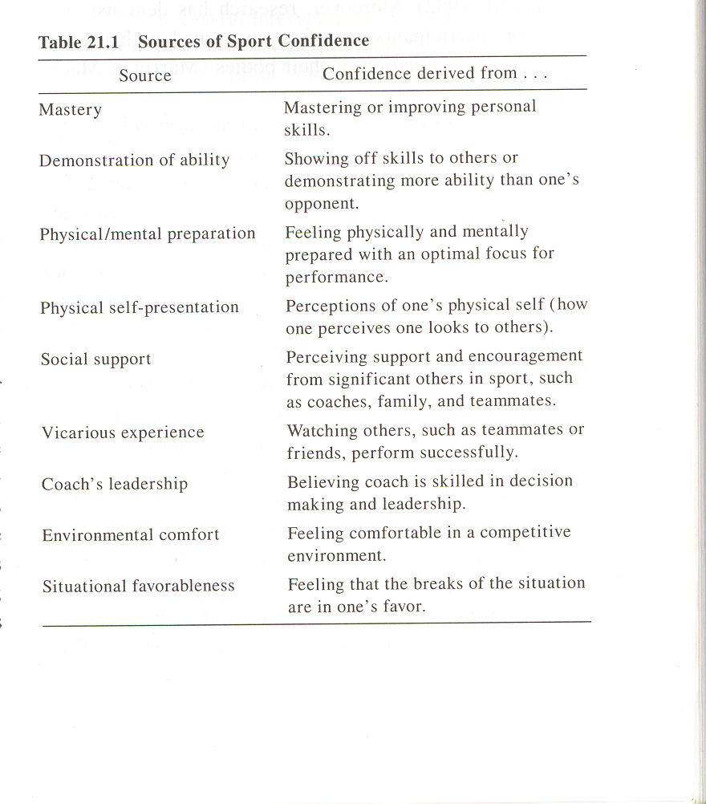
Vealey et al.’s (1998)
9 Sources of Sport-Confidence….
3 broad domains
Achievement
Self-regulation
Social climate

Slide 22
Vealey (2001): Further revised to a model to underpin research on confidence effects in sport (sources in yellow)
Demographic and Personality Characteristics
Organizational Culture
Achievement
Self-Regulation
Sport Confidence
Social Climate
Affect
Behaviour
Cognition
Uncontrollable External Factors
Performance
Physical Skill and Characteristics

Slide 23
Implications of the nine sources of SC….
1. Mastery
2. demonstration of ability
3. physical/mental preparation
4. physical self-presentation
5. social support
6. vicarious experience
7. coaches leadership
8. environmental comfort
9. situational favourableness.
Athletes gain confidence from achievement
Athletes gain confidence from self-regulation
Athletes gain confidence from a positive and achievement-nurturing social climate

Slide 24
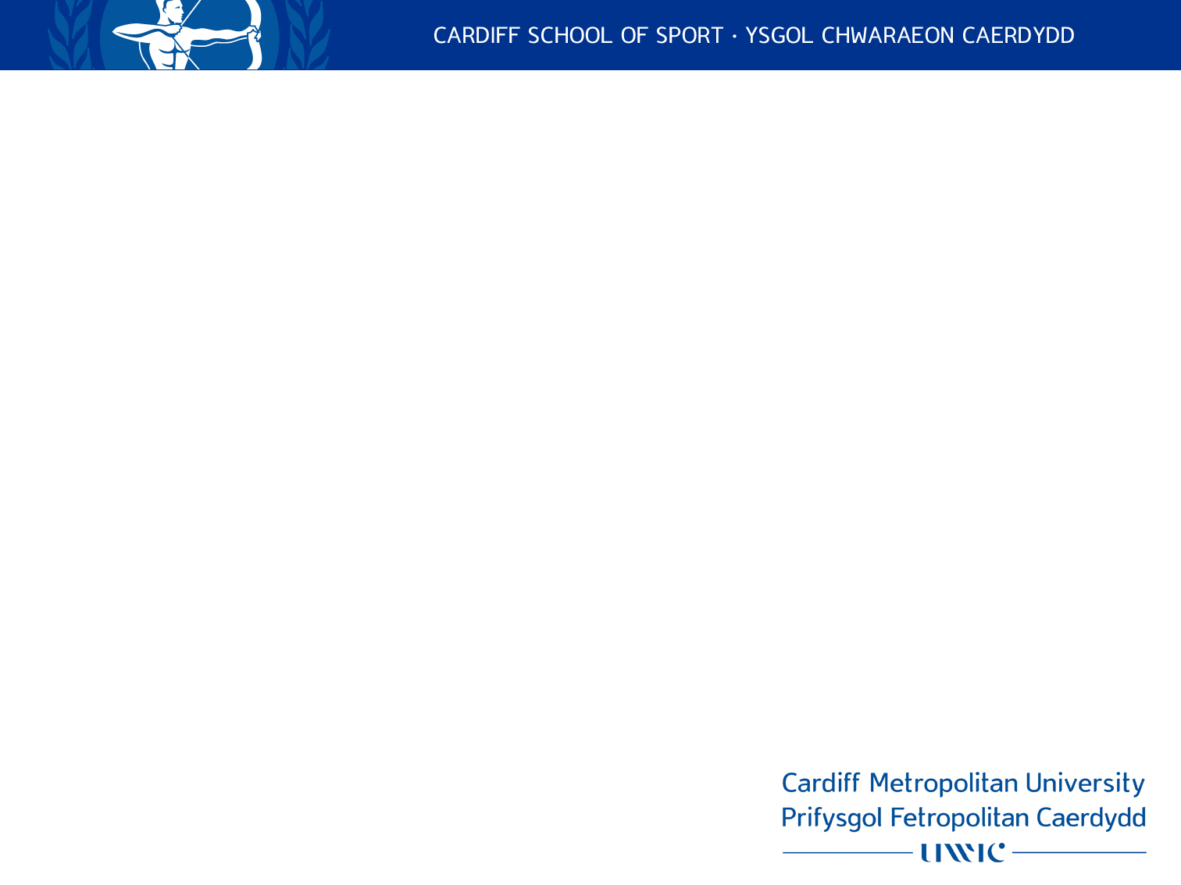

Slide 25
Summary….
The rationale for a sport-confidence model
The original conceptualisation/model of sport-confidence (Vealey, 1986)
The issues / limitations of the initial conceptualisation of sport-confidence
The rationale for a reconceptualised/updated model of sport-confidence (Vealey, 2001; Vealey and Chase, 2008)
The reconceptualised model of sport-confidence
Highlighted the key sources of sport-confidence in Vealey’s work

Slide 26
References…
Hays, K., Maynard, I., Thomas, O., & Bawden, M. (2007). Sources and Types of Confidence Identified by World Class Sport Performers. Journal of Applied Sport Psychology, 19, 434-456.
Kingston, K., Lane, A., & Thomas, O. (2010). A temporal examination of elite performers sources of sport-confidence. The Sport Psychologist, 18, 313-332.
Martin, J.J., & Gill, D.L. (1991). The relationship between competitive orientation, sport-confidence, self-efficacy and anxiety and performance. Journal of Sport and Exercise Psychology, 13, 149-159.
Vealey, R. S. (1986). Conceptualization of sport-confidence and competitive orientation: Preliminary investigation and instrument development. Journal of Sport Psychology, 8, 221-246.
Vealey, R. (2001). Understanding and enhancing self-confidence in athletes. In, R.N., Singer, H. A., Hausenblas, & C.M., Janelle. Handbook of Sport Psychology, 2nd Edition. New York: Wiley.
Vealey, R.S., Hayashi, S.W., Garner-Holman, M., & Giacobbi, P. (1998). Sources of sport confidence: conceptualization and instrument development. Journal of Sport and Exercise Psychology, 20, 54-80.

