Slide 1



Slide 2
Agenda
  Introduction
    Project brief
    Aim & Objectives
    Gantt Chart
  Literature review
    Booking systems comparison
    Cloud providers comparison
  Methodology
  Design overview
    System architecture
    UI design mockups

Slide 3


Introduction
Project brief
Aim & Objectives
ISOC reservations is a restaurant booking system web application
hosted in cloud
The overall aim of this project is to develop a restaurant booking system web application hosted in Azure cloud.
Decision making:
Experience on existing similar systems
Objectives:
To do research about several existing restaurant booking systems
To identify the required technological stack, tools and resources
To design the normalized database structure and infrastructure
for proposed solution
To analyse OWASP (Open Web Application Security Project) [1]
guideline for security aspects
To learn and enhance required technologies and tools
To define and develop the functionalities for each type of end-user
Architecture and Technology Stack diversity
Technical skills improvement and career progression
Target audience:
Restaurants located in UK
End-users (customers)

Slide 4

Functionalities
ISOC_Admin
Restaurants On-boarding
ISOC Reservations Roles
Admin
Host
Customer
ISOC_Admin
ISOC Reservations Roles
Admin
Host
Customer
ISOC_Admin
Admin
Account management
Restaurant profile management
Host
Bookings management
Capacity monitoring
Waiting List management
Customer
Personal account management
Booking request
Anonymous Customer
Booking request

Slide 5
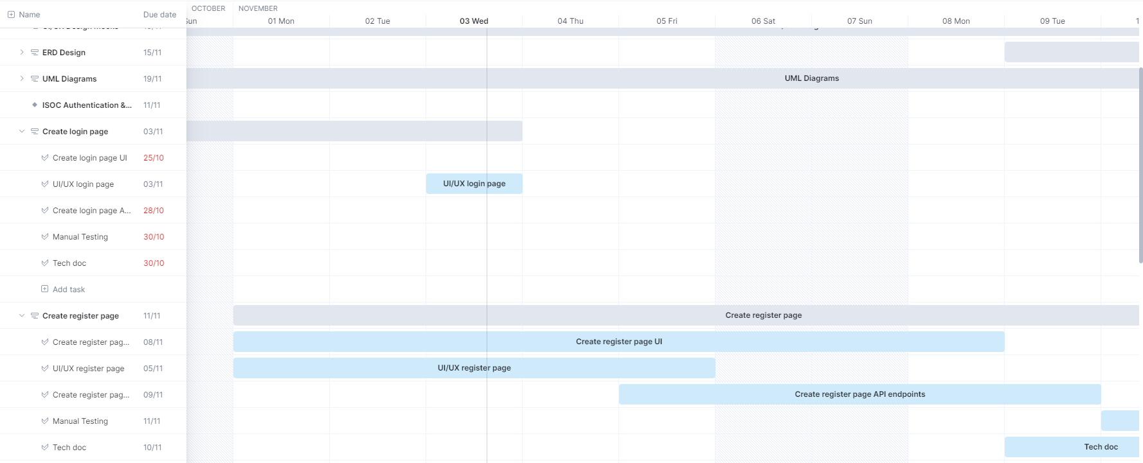
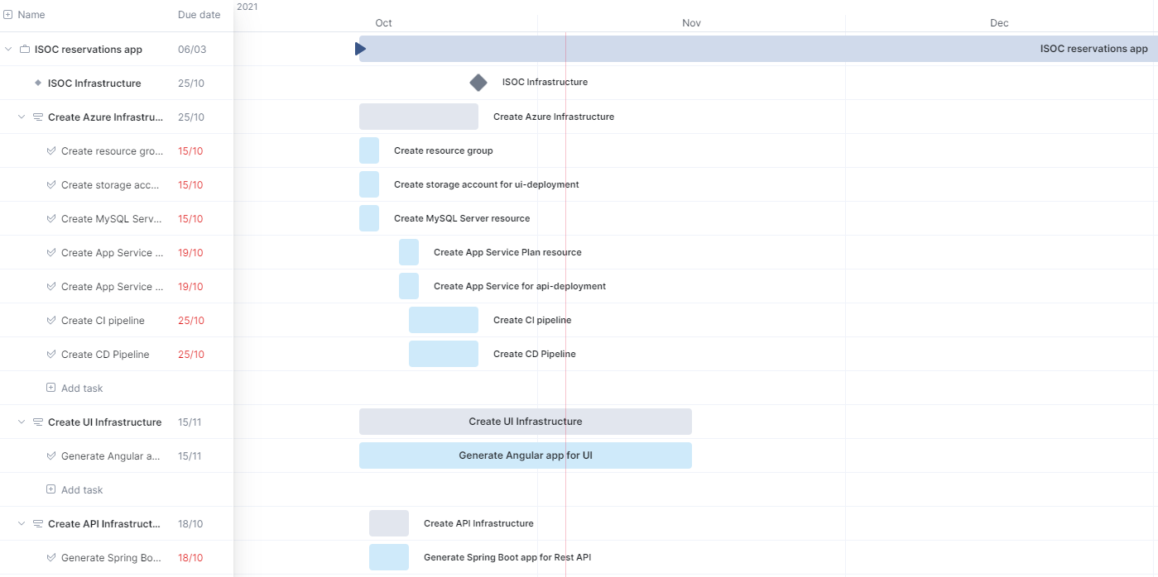
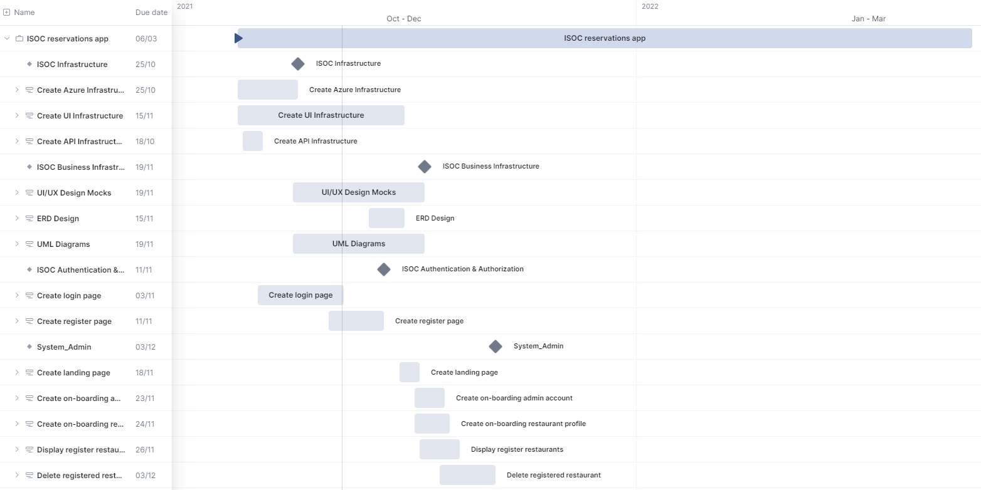
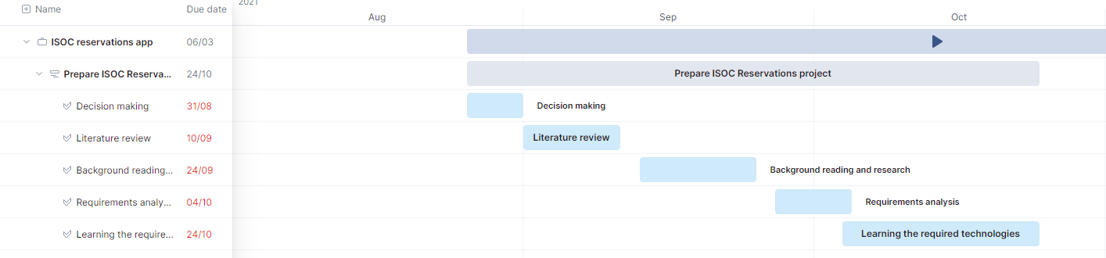
Gantt Chart

Slide 6


Literature review
Research on
Microsoft Azure & Amazon Web Services
Research on several similar systems
System name | Features | Disadvantages
Yelp Reservations [2] | Mobile and Website reservations Feedback Management Waitlist Management Reminders Email Marketing | Must sign a 12-month contract to purchase Yelp Waitlist or Reservations. $750 early termination fee applies.
OpenTable [3] | Web and mobile (iOS and Android) email and SMS confirmations Capacity Monitoring Seat / Table Optimization Waitlist Management Feedback Management Email Marketing Deposits / Prepayment Processing | User Experience Tier-pricing
TablesReady [4] | Waitlist Management Online / Website Reservations Promotions Management Reminders | Missing multiple features: (Mobile reservations, Feedback Management, Seat / Table Optimization, Text/SMS Communications, Capacity Monitoring) Upfront hardware cost
Both providers offer common advantages [5][6]:
Large amount of services
Free subscriptions & student subscriptions
Cost optimization and Pay as you go services
Increased security
Decision making [6]:
Microsoft Azure – first cloud provider
approved by the European Union’s data
protection authorities
Easier to learn

Slide 7
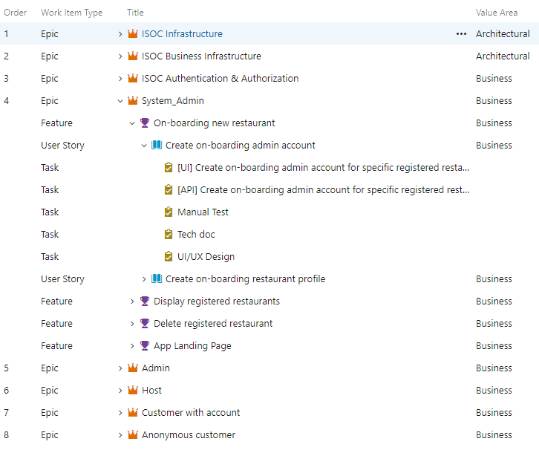
Methodology
Agile methodology
Technology stack / Tools
Java 8
Angular 12
Node
Spring Boot
Spring Data JPA
Spring Security
Microsoft Azure
Storage Account
App Service
Key Vault
MySQL Database
Application Insights
Azure DevOps
IntelliJ IDEA
Visual Studio Code
MySQL Workbench

Slide 8
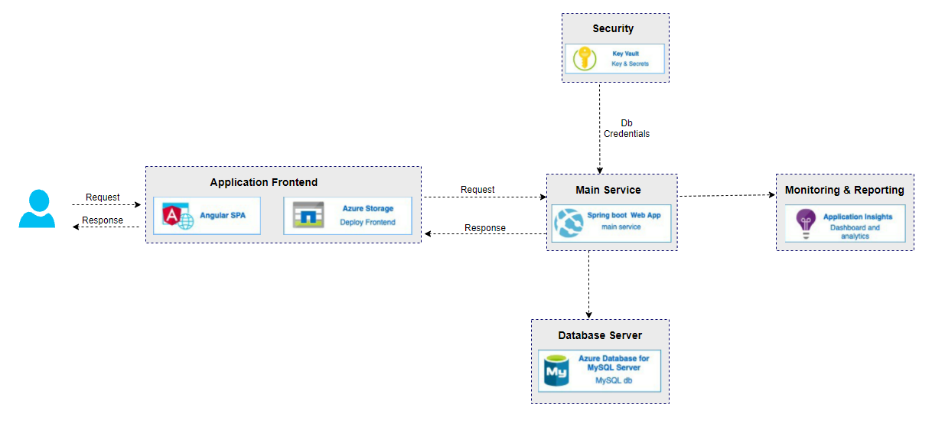
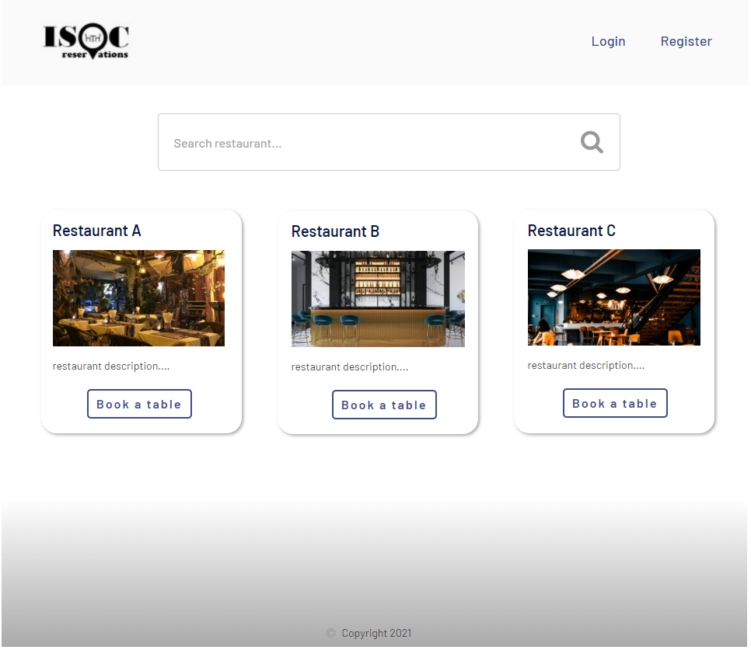
Design overview
System architecture
UI Design Mockups

Slide 9
Conclusion
Key areas covered:
Comparison on several existing booking systems
Web application architecture hosted in Azure Cloud
Diversity of technology stack and tools used following Agile methodology

Slide 10
References
[1] OWASP Foundation | Open Source Foundation for Application Security. Available: https://owasp.org/
[2] Yelp for Restaurants' Guest Manager maximizes your earning potential. Available: https://restaurants.yelp.com/
[3] Restaurant Reservation Software | OpenTable. Available: https://restaurant.opentable.com/
[4] TablesReady Waitlist, Reservations, Queue Management and Paging System. Available: https://www.tablesready.com/
[5] Cloud Services - Amazon Web Services (AWS). Available: https://aws.amazon.com/
[6] Cloud Computing Services | Microsoft Azure. Available: https://azure.microsoft.com/en-gb/

Slide 11
Q & A

