Slide 1
LCBB6000
Dissertation
The Literature Review

Slide 2
What is a Literature Review?
A literature review is a description of the literature relevant to a particular field or topic. It gives an overview of what has been said, who the key writers are, what are the prevailing theories.
A literature review is not just a summary of everything you have read on the topic. It is a critical analysis of the existing research relevant to your topic, and you should show how the literature relates to your topic and identify any gaps in the area of research.

Slide 3
Why Conduct a Literature Review?
A literature review offers an overview of significant literature published on a topic
To highlight research possibilities that have been overlooked implicitly in research to date. That it helps to identify knowledge gaps
To sample current opinions in newspapers, professional and trade journals, thereby gaining insights into the aspects of your research questions and objectives that are considered newsworthy.
To discover and provide an insight into research approaches, strategies and techniques that may be appropriate to your own research questions and objectives
It may help you to develop an analytic framework.
To discover recommendations for further research.

Slide 4
Proposal Literature Review Plan
Look to your dissertation title, research objectives/research questions/ hypothesis to help influence the content of your literature review.
Include definitions of key terms from different authors.
Include one model/theory related to your topic area and apply the model to the company/industry chosen.
Critically analyse the chosen model.

Slide 5
How To Search The Literature
Read books and articles you know, or are recommended by your supervisor.
Keep notes based on your reading.
Note the keywords used.
Note other literature which might be interesting later.
Generate your own keywords.
Search your institution’s library.
Search online (using an appropriate database).
Examine titles and abstracts for relevance.
Retrieve selected items, read, take notes.
Check regularly for new material.

Slide 6
Warning: Using Internet Sources
Search engines find sites but do not evaluate them.
Dictionaries and encyclopaedias are fine for basic definitions, but little else.
Many Internet sites serve a commercial purpose, so don’t be taken in by propaganda.
Rely on academic sites (usually.ac or .edu), government sites (.gov), not-for-profit institutions (.org), in that order.
Download and save all material found on the Internet. Sites are dynamic and you may not find the data a second time. Your institution may also require proof when defending your thesis.

Slide 7
Searching For Books And Articles
Start with module reading-lists
Consult the references and bibliographies of recommended textbooks
Use the library of UWTSD
  to find out what is available
  to find out UWTSD’s subscriptions to on-line databases
Use electronic databases
  SSCI (Social Sciences Citation Index) (wok.mimas.ac.uk), ABI/INFORM (proquest.com)
  EBSCO (epnet.com)
  Use key words and define search parameters

Slide 8
Referencing your work
A source is usually referenced in two parts:
1) the citation, in your text at the point of use;
2) full publication details, in a reference list, or bibliography, at the end of your dissertation or report.
There are two main referencing conventions:
1) the author-date system, of which the Harvard system is most used;
2) the footnote system.
Bibliography
  Always include a list of references (bibliography) at the end of your work.
  Don’t be tempted to have a longer bibliography - only list those resources actually cited.

Slide 9
Plagiarism
Plagiarism means pretending that we, ourselves, wrote what others actually wrote.
Plagiarism is always a crime, since it destroys the foundations of the research edifice.
Institutions vary in terms of the seriousness with which they view the offence.
  Punishment can range from resubmission to expulsion.
  Reputation is always lost.

Slide 10
From where to begin? Map Out A Search Strategy
A search strategy is a systematic plan for tracking down sources.
To create a search strategy appropriate for your research question:
  Consult a reference librarian and take a look at your library’s Web site, which will give you an overview of available resources.
  Use Technology Effectively:
  http://library.iugaza.edu.ps/
  https://scholar.google.com.my/
  https://www.researchgate.net/home
  https://www.academia.edu/

Slide 11
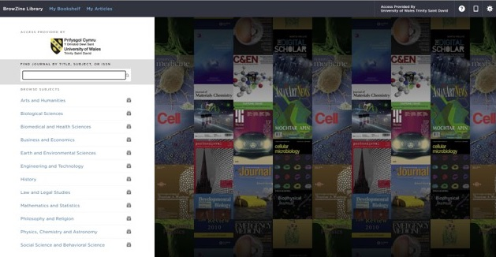
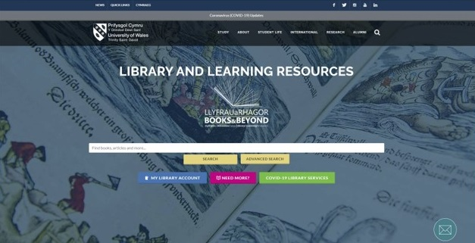
From where to begin? Use Technology Effectively

Slide 12
From where to begin? Locate Other Sources
You can find a variety of reliable sources using online tools. For example:
  https://www.oecd.org/competition/publicationsdocuments/reports/
  https://www.un.org/en/development/desa/publications/
  https://www.worldbank.org/en/research
  https://www.gov.uk/government/collections/publications
  https://www.librariesconnected.org.uk/page/librariesfromhome

Slide 13
Are Wikis (Wikipedia) a Good Source?
In general, Wikipedia may be helpful if you’re checking for something that is common knowledge (facts available in multiple sources, such as dates and well-known historical events).
However, many scholars do not consider Wikipedia and wikis in general to be appropriate sources for college research. Authorship is not limited to experts; articles may be written by amateurs who are not well informed.
And because the articles can be changed by anyone, controversial texts are often altered to reflect a particular perspective and are susceptible to bias.
When possible, locate and cite another, more reliable source for any useful information you find in a wiki.

Slide 14
From where to begin? Select Sources Worth Your Time & Attention
Decide if a source is:
  Relevant,
  Current,
  Scholarly enough,
  and a suitable length for your purposes.

Slide 15
From where to begin? Read with an open mind and a critical eye
As you begin reading the sources you have chosen, keep an open mind.
Do not let your personal beliefs prevent you from listening to new ideas and opposing viewpoints.
Your research question — not a snap judgment about the question — should guide your reading.
When you read critically, you are not necessarily judging an author’s work harshly; you are simply examining its assumptions, assessing its evidence, and weighing its conclusions.

Slide 16
Sources:
Saunders, M.N.K. (2019) Research methods for business students. 8th ed. Harlow: Pearson.
Adams, J. (2014) Research Methods for Business and Social Science Students. New Delhi: SAGE Publications.
O’Gorman, K. (2015) Research methods for business & management: a guide to writing your dissertation. 2nd ed. Oxford, England: Goodfellow Publishers Ltd.
Zikmund, W. G. (2010) Business research methods. 8Th ed. Mason, OH: South-Western Cengage Learning.
Clippinger, D. (2017) Business research reporting. Business Expert Press.

