Slide 1
Psychology for health and social care
Athene Hamilton
2120033
BMHP4003
Neale Haddon
Why is psychology important working as a social worker

Slide 2

This Photo by Unknown Author is licensed under CC BY-SA

Slide 3
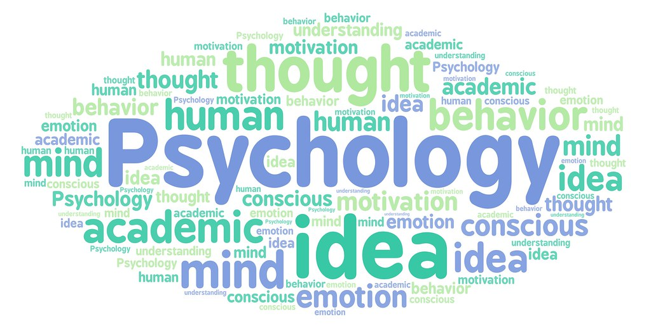
What is Psychology ?
Psychology is the scientific study of the human mind and how it functions this includes the study of the conscious and the unconscious mind
This Photo by Unknown Author is licensed under CC BY

Slide 4
psychology
Developmental theory is that of the sequence of development in children from birth
Behavioural
develop insight into Mental health
Psychology helps to understand yourself and others
Improve decision making,
Develop critical thinking
From the moment we are born we are actively involved in the process of learning.
Piaget's stage theory is the most influential developmental theory of cognitive development. He suggested that children go through different stages of development, and at each stage they think qualitatively differently to the stage before
. Older children are capable of thoughts that are simply beyond younger children.

Slide 5

Psychology
Theories of development are important as they can help and influence
practices and under stand behaviour.
Jean Piaget's theory.
Four broad stages of cognitive development
0-2yrs Sensorimotor stages, which the child development of object
2-7 Pre-operational stages, which the child uses their thinking
7-11 concrete operational stage where the child
11year and up formal operational stage where young people can think about thing, and can have ideas in their minds.
This Photo by Unknown Author is licensed under CC BY-SA

Slide 6

Social worker
Understanding the family
Building trust
Meeting the basic and complex needs of all people
Enhance human well-being
This Photo by Unknown Author is licensed under CC BY-SA-NC

Slide 7
summary
Theories are there to describe how people receive, process and retain knowledge during learning.as well as prior experiences
Piaget theory state that children develop schemas based on their direct experience, and as they develop so does their thinking. Also based on Piaget work it helps to manage children behaviour
And as Piaget uses the word schema which refers to a conclusion of taught
Also there are five primary educational theories of learning which are also involve in jean Piaget theory when constructing in the development of children
Behaviourism, cognitive ,constructivism, humanism, and connectivism are the 5 most used in development in people to get better outcome improving and learning everyday.

Slide 8
References
Jean Piaget(1896-1980) cognitive development
Gross, R, D.,(2015),Psychology: The science of mind and behaviour7thedn,H publishing: eBook collection(EBSCOhost)
Carlson, N, R., Buskist, W.,(2013)Psychology: UEL, Pearson Education UK ,2013
Lev Vygotsky's social cognitive Theory (1896-1934)
On cognitive development John H Flavell Child Development. Vol.53,No 1 (Feb).,1982).,pp 1-10,1982(10 pages published By :Wiley http://doi.org/10.2307/1129634http//www.jstor.org/stable/1129634
John Bowlby(Febuary26,1907-September2,1990) Early childhood attachment
Howard, Gardner Developmental psychology :an introduction .Glenview I11.,Scott,Foresman,1982

