Slide 1
CertHE Applied Leadership and Management in the Workplace
Module: BMSK4013
Management Communication

Slide 2
Blended Learning ​
Session 9

Slide 3
Today’s Session
Effects of communication on motivation
Criteria for self evaluation
PDP

Slide 4
Communication for motivation
In business, knowing how to communicate effectively in order to inspire the employees is a job that many managers are trying to achieve.
The reason is simple: motivation eventually leads to more productivity.
Motivation in the workplace is often triggered when the managers find their way of speaking to the employee.
Effective communication by the managers will result in changing the mood within the team and inspire employees to work harder towards common goals.

Slide 5
Communication for motivation
Motivation in the workplace heavily depends on how the manager influences their workers.
It is a fact that employee feel more enthusiastic to work when they have a proactive leader who pay attention to the workers.

Slide 6
Communication for motivation
Business owners and managers need to understand the role of communication in employee motivation, as it can sometimes be the most basic communication errors that lead to employee dissatisfaction.
Remember the communication elements and barriers that prevent effective communication?

Slide 7
Communication for motivation
Information
The company should distribute information that employees consider vital, such as changes in the company's business focus or planned changes in the workforce, unless that information is company confidential.
Relationships
A workplace operates on the effective relationships built between employees, managers, departments and all levels of the company. Clear and honest communication helps to encourage and strengthen those relationships.
Decision-Making
Employees should be allowed as many ways as possible to offer their ideas and opinions, and be part of the decision-making process.
Improvement
Communication between the employee and manager, as well as the employee and human resources, is critical in developing training programs that improve the employee's job skills and motivate her to succeed.

Slide 8
Communication for motivation
Employees need guidance from their supervisors, and management needs input from the entire team in order for the company to succeed.
To help foster an open and honest culture, many companies host communication sessions that can provide measurable benefits to all employees.

Slide 9
Criteria for Self evaluation
What makes a good communicator?
What makes an effective motivator?
Do you have what it takes?

Slide 10
Personal Development Plan
Gap Analysis
PDP

Slide 11
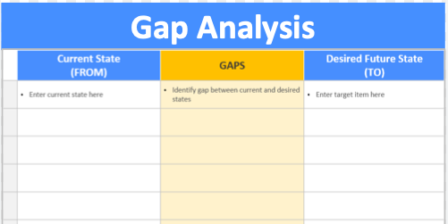
Personal Development Plan

Slide 12
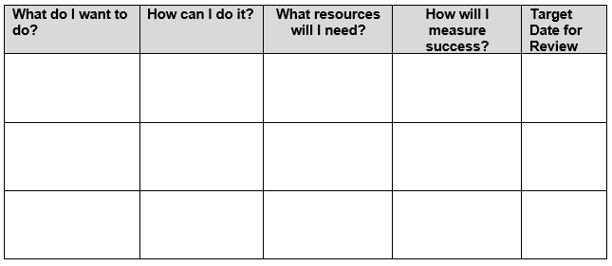
Personal Development Plan

Slide 13
Summary
Take 5 minutes to reflect on the session and summarise your learning from today.

Slide 14
References
Maund, A., Schriek, M., & Tinkler, P. K. (2017). Certificate in higher education : skills for the workplace student yearbook. Sage Publications.
Morgan, P. (2017). Business student’s guide to study and employability. Sage.

