Slide 1
Understanding Shona’s Development Through Bowlby’s Attachment Theory
Psychology in Health and Social CareModule Code: LCHS4010
Student Name:Cristina Nicoleta Stoiculescu
Lecturer: Rizwan Nadim

Slide 2
Content list
Introduction – Shona’s Case Study
Shona’s Key Developmental Concerns
Bowlby’s Attachment Theory
Ainsworth’s Attachment Classifications
Applying Attachment Theory to Shona
Biological & Cognitive Development
Social, Emotional & Behavioural Development
Nature and Nurture
Strengths of Attachment Theory
Weaknesses & Limitations
Critical Evaluation & Conclusion References

Slide 3
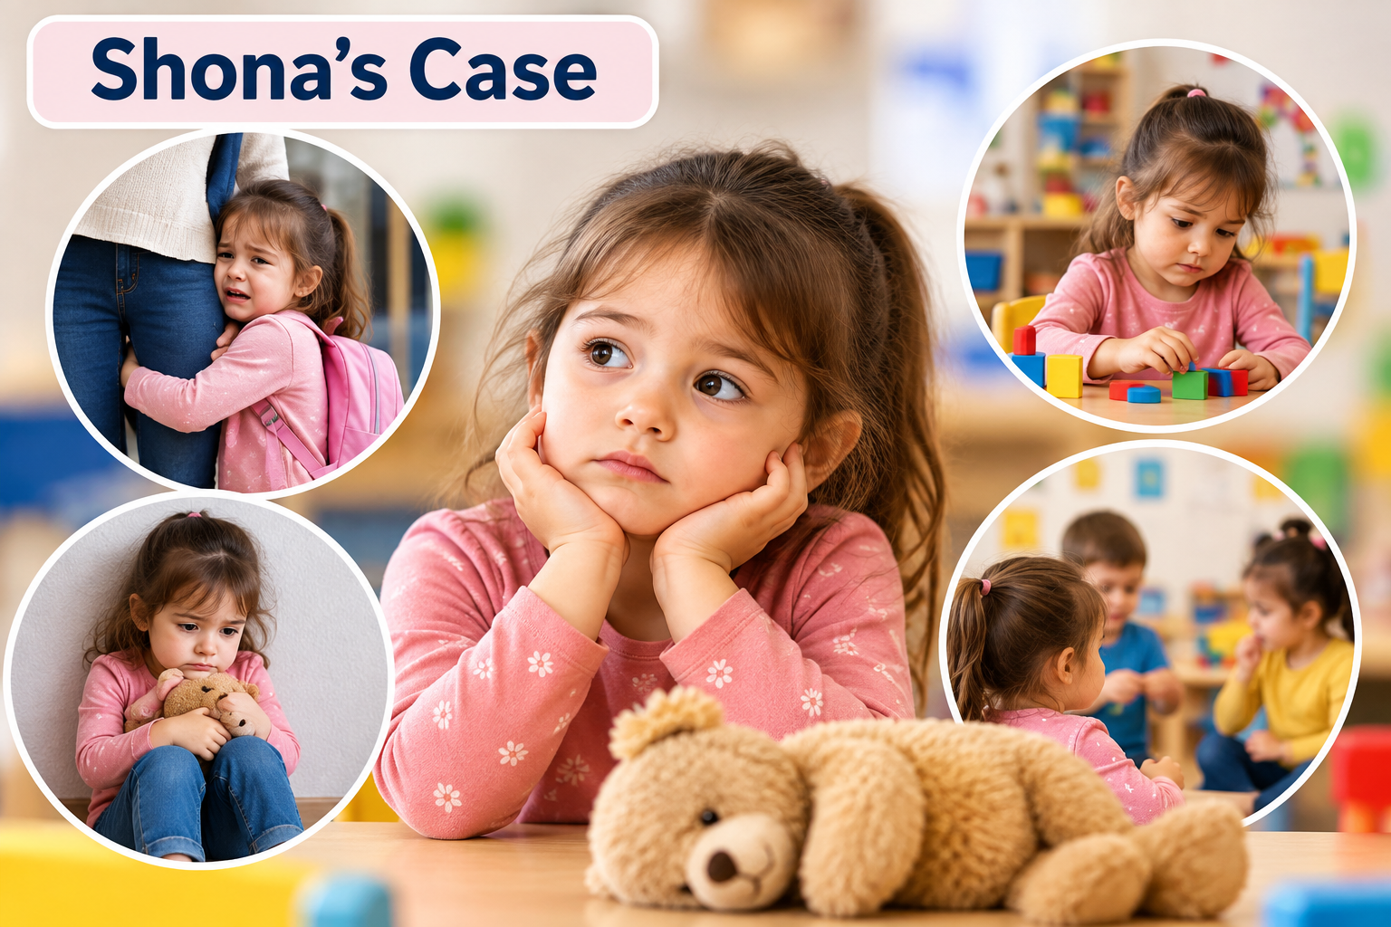
Shona’s Case: Key Developmental Concerns
3 years old and recently joined nursery
Separation from carers causes anxiety and distress
Limited verbal communication may affect expression and interaction
Difficulty engaging in group play and peer relationships
New nursery environment may influence adjustment
Needs assessment across biological, cognitive, social, emotional and behavioural development (WHO, 2023; UNICEF and UNESCO, 2024)
Notes:
Shona is three and has a number of interrelated developmental issues. When she is away from the carers this can impact on her emotional security and settling into the nursery. Because she has limited ability to communicate verbally, it may affect cognitive development and the expression of her needs; her lack of ability to play in a group may limit opportunities for developing social skills and peer relationships. Children's development has been multidimensional; that is, physical, cognitive, language, and socio-emotional development are all intertwined with children's experiences and environments (UNICEF and UNESCO, 2024). However, Shona needs to be assessed in a more comprehensive way than from an attachment lens (WHO, 2023).

Slide 4
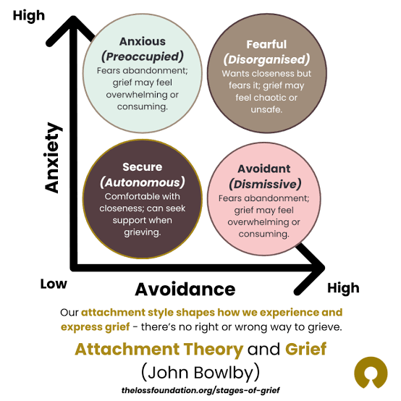
Bowlby’s Attachment Theory: Application to Shona
Core Concepts and Case Application:
Attachment is an emotional bond between a child and caregiver.
Attachment behaviours have an evolutionary function, promoting proximity and protection (Bowlby, 1969).
A trusted caregiver provides a secure base for exploration.
Shona’s separation anxiety may reflect activation of attachment-seeking behaviour when her carers leave.
Early relationships contribute to an internal working model of self and others.
Greater emotional security may support Shona’s exploration, communication and social interaction (Duschinsky et al., 2026).
Notes:
One of the key concerns in the case study that concerns Shona relates to her concerns when she is separated from her carers, which is a focus of Bowlby's Attachment Theory. Bowlby (1969) suggested that when children feel threatened or insecure, they will approach attachment figures. A sensitive caregiver can serve as a stable base for a child to confidently explore from. For Shona this might be the time where the unfamiliar nursery and the departure from the familiar carers could trigger attachment-seeking behaviour. It is important to remember that while the word attachment can be used to describe anxiety, it doesn't necessarily represent a specific type of attachment (Duschinsky et al, 2026).

Slide 5
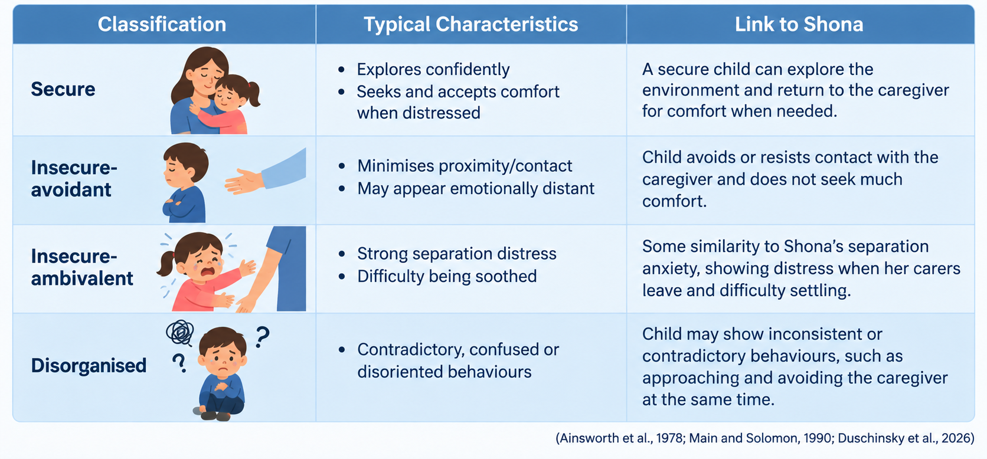
Ainsworth’s Attachment Classifications:
Notes:
The Strange Situation is an elaboration of Bowlby's theory by Ainsworth et al. (1978) that examined how children responded when exploring, separating and reuniting with their caregivers. Individual differences in attachment related behaviour can be understood more by the four classifications provided by the lecturer's material. These feelings are similar to one of insecure-ambivalent attachment traits - separation distress. But, there are no data on her behaviours during confrontation, escape and conflicting behaviours in the case. With all the evidence provided it would not therefore be appropriate to make a classification of Shona’s attachment pattern. Current attachment theory research is concerned with careful evaluation of attachment and cautions against unhelpful and misunderstanding generalisation(s) of attachment classifications in professional practice (Duschinsky et al., 2026).

Slide 6
Applying Attachment Theory to Shona
What Might the Theory Explain?
Carer leaving may activate Shona’s attachment system (Bowlby, 1969).- An unfamiliar nursery may increase her need for security and proximity (Duschinsky et al., 2026).
Separation from familiar carers may contribute to anxiety and distress (Bowlby, 1969).
Reduced emotional security may limit exploration and engagement with the environment (Ainsworth et al., 1978).
Attachment-related distress may indirectly affect peer interaction and social participation (Duschinsky et al., 2026).
Shona cannot be assigned an attachment classification from this scenario alone; careful observation and assessment are necessary (Duschinsky et al., 2026).
Notes:
This abandonment distress in Shona could be a possible link of attachment theory. Bowlby (1969) suggested that separation or perceived threat triggers attachment behaviour, prompting children to approach cared-for familiar figure(s). For Shona, entering into an unknown nursery could raise her difficulties in relation to his or her emotional security. However, her confidence in exploring, communicating and participating socially may shrink for a time if she feels distressed (Ainsworth et al., 1978). But it can't automatically be assumed that a separation reaction expressed as anxiety or worry means Shona has insecure attachment. Current attachment theory literature warns against the use of classifications of attachment behaviours without evaluation and context (Duschinsky et al., 2026).

Slide 7
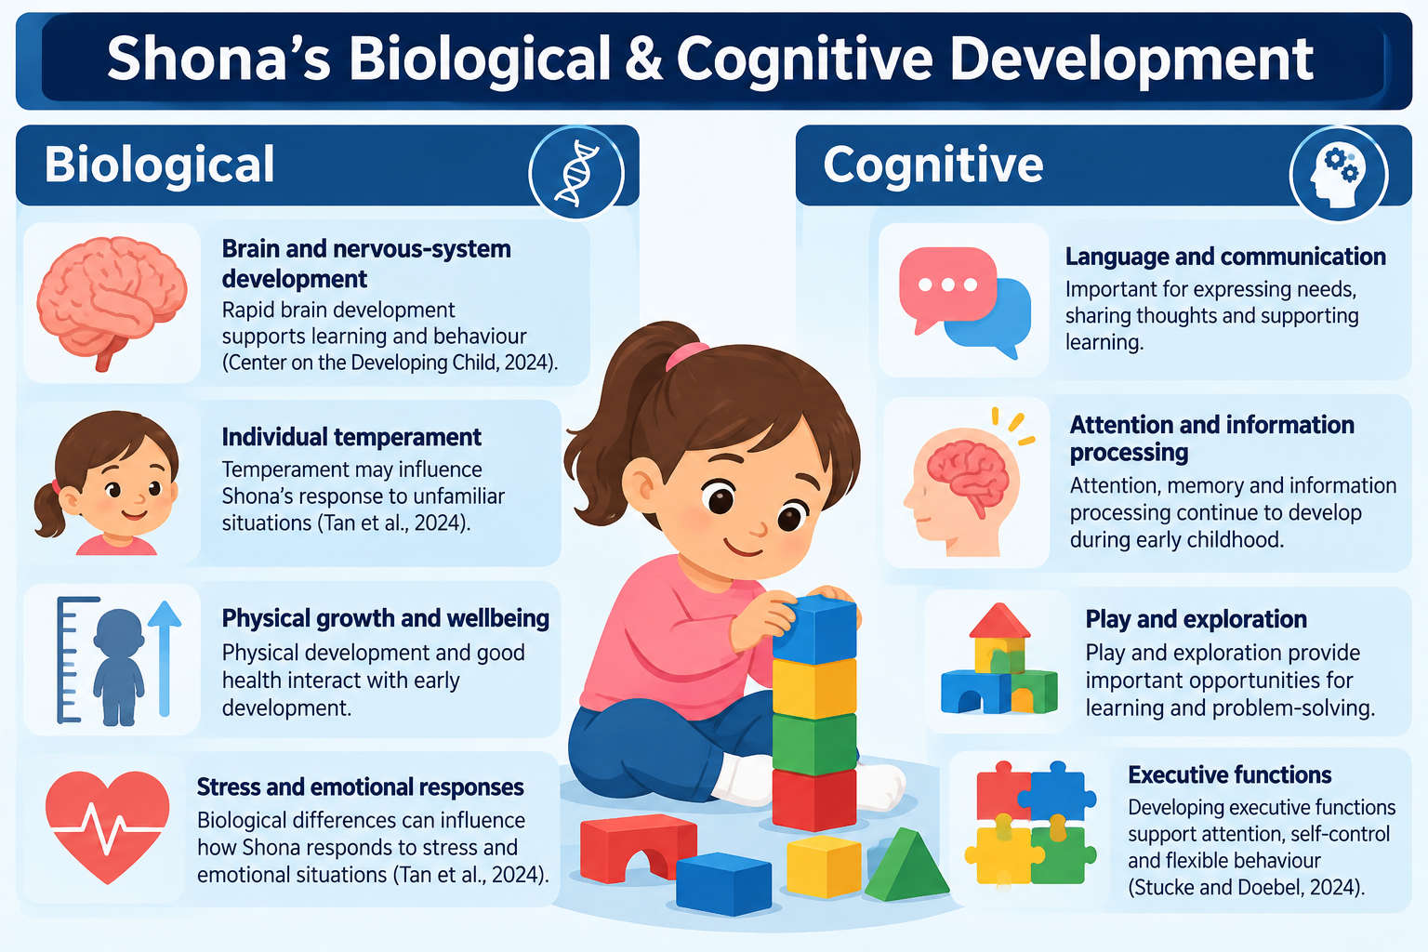
Shona’s Biological & Cognitive Development
Notes:
Biologically, Shona is going through an important phase of development of her brain and nervous system, as well as changes in individual temperament which can predict changes in emotional responses to separation and an unfamiliar setting such as a nursery school (Tan et al., 2024). Cognitively, due to restricted verbal expression she may have limitations in expressing her needs and may be impaired in her learning. Executive function develops in early childhood and has been linked with social competence, adaptive classroom behaviour, emotional regulation (Stucke and Doebel, 2024).

Slide 8
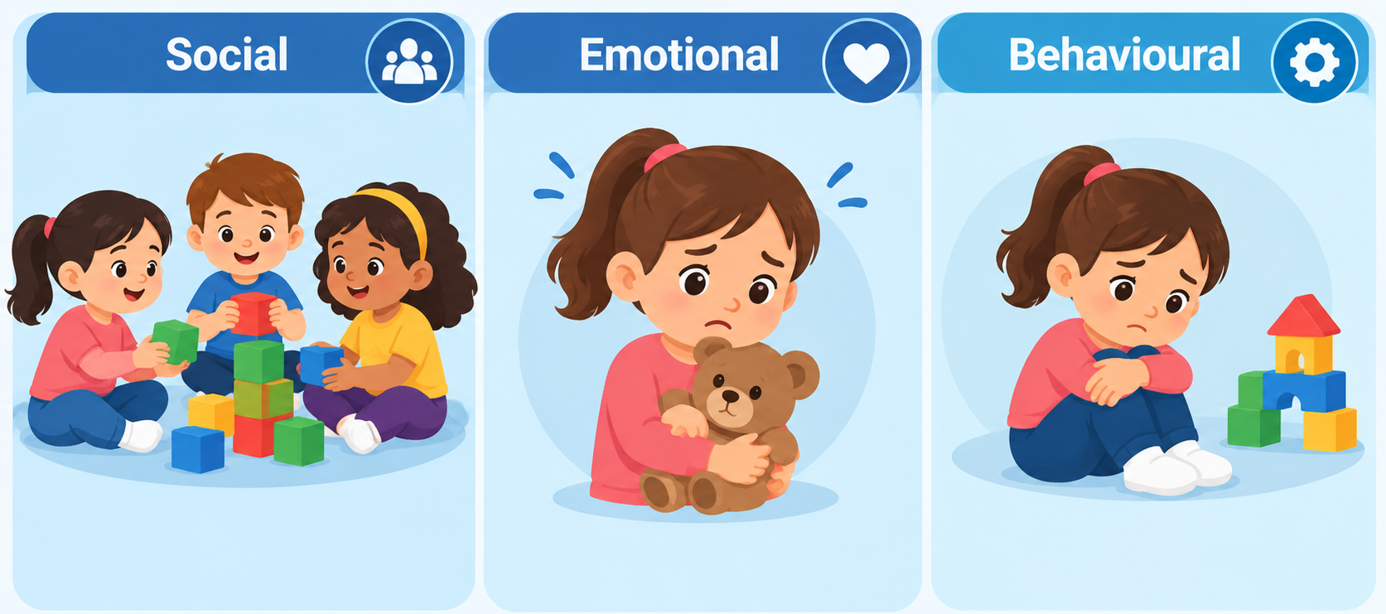
Shona’s Social, Emotional & Behavioural Development
Social
Difficulty with group play may limit peer interaction.
Positive relationships can support social competence and communication.
Shona is developing cooperation, sharing and participation skills (Kaur, Gendron-Cloutier and Montreuil, 2024).
Emotional
Separation from carers may trigger anxiety and distress.
Shona is still developing emotional regulation.
Consistent, responsive relationships can promote emotional security and trust (Kaur, Gendron-Cloutier and Montreuil, 2024).
Behavioural
Behaviour may communicate underlying emotional needs or distress.
Withdrawal may reduce participation in play and learning.
Practitioners should observe patterns and context rather than make assumptions from isolated behaviours (Kaur, Gendron-Cloutier and Montreuil, 2024).
Notes:
Socially, Shona's struggle with group play could impact opportunities for communication and cooperation practices. Separation anxiety indicates that she requires assistance coping with anxiety in the new nursery setting. Withdrawal of behaviour or limited participation needs to be seen in the context of her needs and not just as problematic behaviour. When there is a concern of attachment difficulties, it is important to be aware of children's needs and not go overboard with behaviour-reduction methods (Kaur, Gendron-Cloutier and Montreuil, 2024).

Slide 9
Nature and Nurture: Application to Shona
Nurture
Caregiver responsiveness can influence Shona’s sense of security (Bowlby, 1969).
Family relationships provide early social and emotional experiences
Nursery experiences may influence how Shona adjusts to separation.
Language, play and peer interaction provide important developmental opportunities.
Social and cultural environments shape children’s experiences and relationships (Duschinsky et al., 2026).
Nature
Genetic influences contribute to individual development.
Temperament may affect how strongly Shona responds to separation and unfamiliar situations (Tan et al., 2024).
Brain maturation supports developing emotional regulation, attention and communication (Center on the Developing Child, 2024).
Bowlby proposed a biological/evolutionary basis for attachment behaviour (Bowlby, 1969).
Interaction: Shona’s development is best understood through the interaction of biological characteristics and environmental experiences, rather than nature or nurture alone (Duschinsky et al., 2026).
Notes:
Both nature and nurture are included in Bowlby’s theory. In terms of nature, attachment behaviour is likely to have evolved to ensure that children get assistance when they need it; attachment will depend on the individuality of children and their temperament, such as how they react when their carers are out of sight (Bowlby, 1969; Tan et al., 2024). In so far as the caregiver is responsive and the experiences of Shona in her new nursery might affect their emotional security and adjustment, a nurture aspect may be involved. Hence, her separation anxiety, communication and social participation should not be considered biologic or caregiver and development is a dynamic interplay between the child and her environment (Duschinsky et al., 2026).

Slide 10
Strengths of Attachment Theory
Provides a well-established framework for understanding early caregiver–child relationships (Opie et al., 2026).
Explains separation distress and proximity-seeking when children feel threatened or insecure (Opie et al., 2026).
The secure-base concept explains how emotional security can support exploration and increasing independence.
Connects responsive caregiving with early socio-emotional development (Opie et al., 2026).
Has clear practical relevance for professionals working with young children and families.
Contemporary research continues to support key attachment concepts while correcting common misconceptions (Opie et al., 2026).
Attachment-based interventions show evidence of improving caregiver–infant relational outcomes (Wittkowski, Crompton and Wan, 2025)
Notes:
One of the advantages of attachment theory is its continuing applicability to the study of young children like Shona. Secure-base theory provides an explanation for the linking between emotional security and the encouragement of exploration, and between separation and seeking proximity (Opie et al, 2026). This will provide professionals with a helpful framework to understand Shona's distress but will not result in an automatic labelling of her behaviour. Not insignificantly, the theory also has empirical support. Wittkowski et al., (2025) conducted a comprehensive review of 40 studies of attachment-based interventions that showed enhanced relational outcomes for caregiver–infant, but the quality of the evidence differed among the interventions.

Slide 11
Weaknesses & Limitations of Attachment Theory
May overemphasise early caregiver relationships (Opie et al., 2026).
Children can form attachments with multiple caregivers.
Cultural differences can influence attachment behaviours (Bakaraki, Dourbois and Kosiva, 2024).
Attachment patterns are not fixed or deterministic.
Cannot fully explain Shona’s language and cognitive development.
Shona’s separation anxiety alone cannot determine her attachment type (Opie et al., 2026).
Notes:
While much is important within attachment theory, it has its limitations. The first formulations were centered around the primary caregiver (usually the mother), while children can form significant attachments to multiple caregivers. Furthermore, care-giving practices that vary throughout a culture also render attachment behaviors non-translatable between cultures (Bakaraki, Dourbois and Kosiva, 2024). Attachment patterns are not diagnoses or predictions of future development. Someone wouldn't have to be separated to have an insecure attachment, nor is it enough to be separated to have an insecure attachment because this doesn't 100% explain some of Shona's other problems, such as her lack of verbal skills, cognitive functioning or difficulties with other peers. To avoid overinterpreting, there should instead be a holistic assessment by professionals (Opie et al., 2026)

Slide 12
Critical Evaluation & Conclusion
Critical Judgement
Bowlby explains well:
Shona’s separation anxiety
Need for emotional security
Secure-base behaviour and exploration (Bowlby, 1969; Opie et al., 2026)
Explains less well:
Limited verbal communication
Wider cognitive development
Full range of social and behavioural difficulties
Biological, environmental and cultural influences (Bakaraki, Dourbois and Kosiva, 2024)
Conclusion
Attachment theory is valuable for understanding Shona’s emotional responses, but it should be combined with a holistic view of her development rather than used as a complete explanation (Opie et al., 2026).
Notes:
According to Bowlby's hypothesis, children feared losing their mums, as evidenced by Shona's separation anxiety, and needed to feel safe in unfamiliar situations, as shown by Shona's nursery experience. Safe environments encourage participation/exploration (Bowlby, 1969). In explaining her limited verbal and cognitive skills, attachment theory has limits. Cultural, biological, and environmental aspects should also be considered. Attachment theory requires a complete, evidence-based review of Shona's evolution because it has only been given a partial explanation (Opie et al., 2026).

Slide 13
References
Ainsworth, M.D.S., Blehar, M.C., Waters, E. and Wall, S. (1978) Patterns of Attachment: A Psychological Study of the Strange Situation. Hillsdale, NJ: Lawrence Erlbaum Associates.
Bakaraki, M.P., Dourbois, T. and Kosiva, A. (2024) ‘Attachment theory across cultures: An examination of cross-cultural perspectives and alloparenting practices’, Clinical Neuropsychiatry, 21(4).
Bowlby, J. (1969) Attachment and Loss: Volume 1: Attachment. London: Hogarth Press.
Center on the Developing Child at Harvard University (2024) Brain Architecture. Harvard University. https://developingchild.harvard.edu/key-concept/brain-architecture/?utm
Duschinsky, R. et al. (2026) ‘Practitioner Review: Clinical insights from attachment theory and research for professionals working with young children and their families’, Journal of Child Psychology and Psychiatry.
https://pmc.ncbi.nlm.nih.gov/articles/PMC13102048/?utm
Kaur, L., Gendron-Cloutier, L. and Montreuil, M. (2024) ‘Care practices and approaches with children experiencing attachment difficulties: A scoping review’, Children and Youth Services Review, 156, 107265. https://www.sciencedirect.com/science/article/pii/S0190740923004619?utm
Main, M. and Solomon, J. (1990) ‘Procedures for identifying infants as disorganized/disoriented during the Ainsworth Strange Situation’, in Greenberg, M.T., Cicchetti, D. and Cummings, E.M. (eds.) Attachment in the Preschool Years. Chicago: University of Chicago Press.
Opie, J.E. et al. (2026) ‘Practitioner Review: Clinical insights from attachment theory and research for professionals working with young children and their families’, Journal of Child Psychology and Psychiatry, 67(5), pp. 723–739. doi: 10.1111/jcpp.70126.
https://acamh.onlinelibrary.wiley.com/doi/full/10.1111/jcpp.70126?utm
Stucke, N.J. and Doebel, S. (2024) ‘Early childhood executive function predicts concurrent and later social and behavioral outcomes: A review and meta-analysis’, Psychological Bulletin, 150(10), pp. 1178–1206. https://pubmed.ncbi.nlm.nih.gov/39418439/
Tan, E. et al. (2024) ‘Social versus non-social behavioral inhibition: Differential prediction from early childhood of long-term psychosocial outcomes’, Developmental Science, 27(1), e13427. https://pubmed.ncbi.nlm.nih.gov/37345685/
UNICEF and UNESCO (2024) Global Report on Early Childhood Care and Education: The Right to a Strong Foundation.
https://www.unicef.org/reports/global-report-early-childhood-care-and-education-right-strong-foundation?utm
Wittkowski, A., Crompton, C. and Wan, M.W. (2025) ‘Manualised attachment-based interventions for improving caregiver-infant relationships: A two-stage systematic review’, Clinical Child and Family Psychology Review, 28, pp. 71–100. https://link.springer.com/article/10.1007/s10567-024-00497-0?utm
World Health Organization (WHO) (2023) Nurturing Care Practice Guide: Strengthening Nurturing Care Through Health and Nutrition Services. Geneva: WHO.
https://www.who.int/teams/maternal-newborn-child-adolescent-health-and-ageing/child-health/nurturing-care?utm

