Slide 1


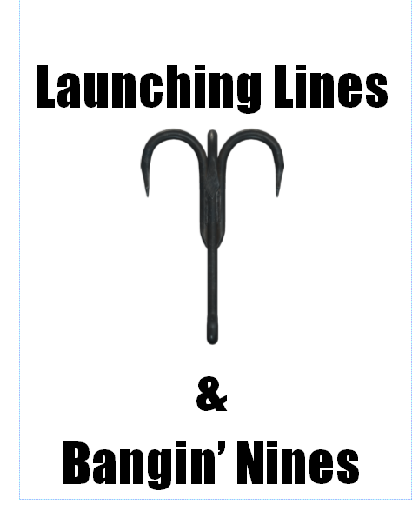
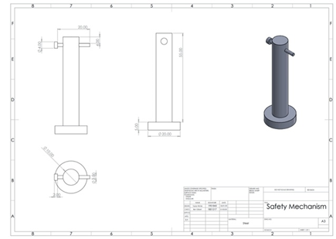
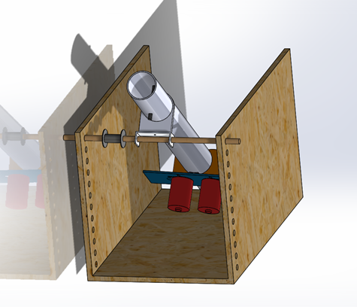
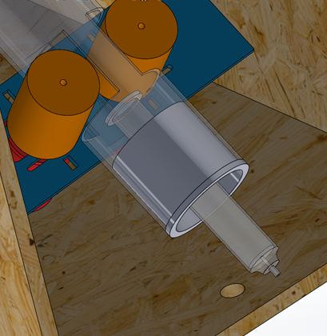
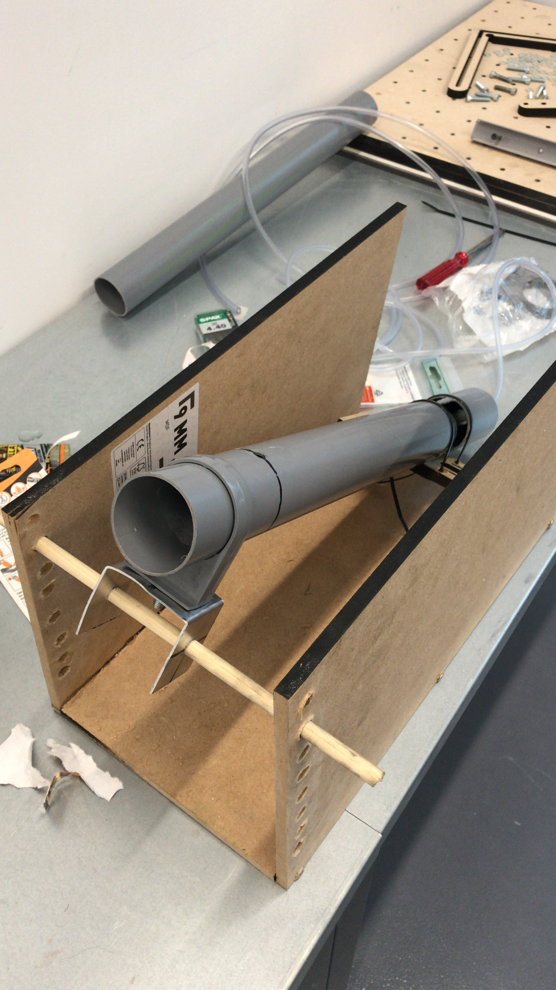
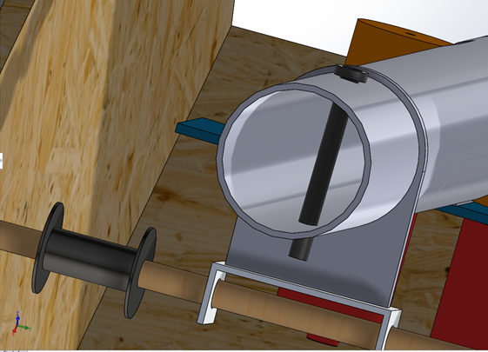



Your Pic
Project: IMechE Line Launcher
Lewis Aubrey, Ben Gilbert, Olivia Jenkins, Taylor Winter
Kerry Tudor, Richard Morgan
School of Engineering
BEng Motorsport & Automotive Engineering
Introduction
The target for this project was to design and build a Line Launching device as per the regulations set out by The Institution of Mechanical Engineers. The device must be able to fire a squash ball with a line attached to any distance between 2 and 6 metres and cost no more than £30 to build. Below is a CAD model of our final design using electric motors to launch the squash ball.
Energy Release
A syringe has been used as a pressurised air system. The syringe is attached to the bottom end of the barrel by a small plastic tube that leads into the base of the barrel. When the syringe is compressed, the air pressurised air releases the squash ball into the motors in the barrel. The motors can then be triggered from a small electrical trigger, thus firing the squash ball out of the end of the barrel.
Figure 2 shows a technical drawing of the safety pin drawn by Taylor Winter.
Chassis/Base
This new design that the group members Lewis and Ben came up with used 3 9mm MDF boards, one as a base and two screwed either side to the base, after the base had been formed the groups plan was to drill holes every 1 inch above another to allow a wooden tube to be put through the holes either side, this would then support the tube where the motors are mounted onto to be able to be adjusted via increasing or decreasing the height at which the wooden tube is put through both holes, this allows easy adjustability which is ideal when facing changing heights distances and angles to be targeted.
Figure 4 shows the design for the syringe trigger system at the base of the barrel. In this image the barrel has been made transparent so that the inner parts are visible. The high grip rotors are pictured in orange with the electric motors shown in red and the motor plate in blue.
Figure 1 shows a CAD model of the completed design drawn by Ben Gilbert.
Power Generation
The line launcher uses an electric firing system to generate the power required to launch the squash ball.
It comprises of:
2 540 size brushed motors
2 high grip rotor wheels
1 motor mounting plate
1 circuit board with potentiometer control
1 12V battery pack
When the Squash ball is pushed by the trigger mechanism into the spinning rotor wheels it is squeezed between them and then forced out the other side at high speed propelling it out of the barrel.
The system is both highly efficient and highly adjustable while remaining cost effective so as not to blow the budget.
Safety Mechanism
Although the design is simple, it is a dependable one. A simple bolt has been used to put through the end of the barrel as the safety system. It works in the same way as a cable lock method often used in gun barrels. When the pin is inserted the squash ball won’t be able to exit the end of the barrel, therefore stopping the line launcher from being accidentally fired causing harm to people or the surroundings. As the bolt is made of steel it can withstand a great amount of force without breaking, this brings another aspect of safety into it, as the bolt can be seen as a reliable safety mechanism.
Figure 5 shows the line launchers safety pin subsystem and line management spool, both illustrated in black. These are both cost effective and efficient designs that use simplicity to their advantage.
Figure 3 shows a photo of the finished chassis design with the barrel mounted to it. The main reason for this simple design was to keep the overall cost down while still retaining a good amount of angle adjustability.
Acknowledgements
Thanks to:
Andrew Tibbott
Dave Cooper
Paul Davies
For assistance with assembly and manufacture.
Line Management
A DIY spool, made of plastic is used to easily and efficiently control the 9.2 meter fishing line that is attached to the ball. As shown in figure 1, the spool is a cylinder shape, with raised edges to stop the wire from falling off. The wooden pole is placed through the spool allowing it to sit aside the mounted tube. The wire will be connected to the ball and follow the ball through the tube ready for launch and the excess wire is lightly coiled around the rotatable spool. As the ball is launched, this spool allows the wire to uncoil at the same speed as the ball is launched, and follow behind without getting tangled or restricting the balls trajectory speed. The wire can then be manually recoiled onto the spool in preparation for the next launch.
References
Design Challenge General Specification and Rules (October 2019)
School of Engineering

