Slide 1

What is a research proposal?
Statement of intent
  Academically prepared to complete the research
  Audience: peers, supervisors, examiners
<number>
Notes:
Proposal for research grant
What are you going to do to contribute new knowledge / findings / applications to a scientific field
Obtain MONEY to do this
Audience: peers, grant review panel
<number>

Slide 2

What is a research proposal?
A research proposal is your PLAN
  It describes in detail your study
  Decisions about your study are based on the quality of the proposal
    Approvals to proceed by the Institutional Review Board
<number>
Notes:
It’s a detailed plan- before you get in the car→ describing research area you’re working in and n
What you know, Where you want to go and how are you going to get there.
How do you show that you are academically prepared?
PLAN-
You understand your problem
Knowledge base
Technical skill
Infrastructure Support to pull this plan off
Plan has to get approved for you to get started
<number>

Slide 3
Importance of a research proposal?
Contract between you and your committee
Serves to protect the student
  Demanding additional requirements
Protects the committee from the student
  From delivering a degree of poor quality
<number>
Notes:
<number>

Slide 4
What are the essential ingredients?
The Issue
What problem does your research address?
Research Design
How will the research achieve its objective?
Benefit
What will the research contribute?
Figure adapted from MIT OCW
<number>
Notes:
Issue/ Purpose
Original and relevant research problem
Comprehension of important material
(Map) Understanding of proposed methodology
Technical skills required
(Petrol/financing) Benefit
<number>

Slide 5
Research proposals make you:
OUTLINE steps in your proposed research
Provide yourself with intellectual CONTEXT
JUSTIFY your research
Be CREATIVE
THINK through your experiments
Anticipate potential PROBLEMS
Anticipate a realistic TIMETABLE
Figure adapted from MIT OCW
<number>
Notes:
Outline: Clarify Thoughts and Develop Ideas ---- Beginning to end– See the whole picture
Teach yourself: Figure out and find what is important to know.
Aspect creativity: No one is telling you what you need to know.
Justify: Why is this work important. If your work doesn’t matter to you, it shows.
Experiments: What do you need to order?
<number>

Slide 6
Getting started
Title
Outline
Literature Review
Methodology
Methods of data collection and analysis
Ethical Issues
Timeline
Resources
Outcomes
Reference list
Title
Background
Problem statement
Aim and objectives
Rationale and context
Methodology
Plan of work
Resources / Support
Outcomes
Reference list
Know the requirements BEFORE you start
<number>
Notes:
Rule of thumb: Find out what your departments expects
<number>

Slide 7
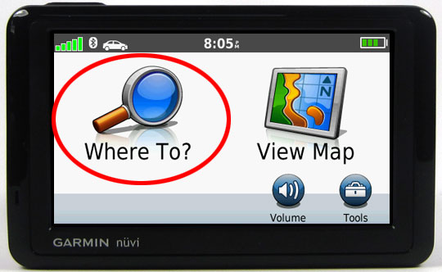
Title
GPS address
  Mini-abstract
  Clear
  Concise
  Subject 1st
<number>
Notes:
The title is like the address you type into your garmin-→ everything is positioned according to it
<number>

Slide 8

Problem statement
Short SO WHAT statement
Purpose
  Blueprint for your literature review
  Focus your committee at the beginning
  Keep them on track throughout your proposal
<number>
Notes:
Get everyone on the same page
<number>

Slide 9
Problem statement
E.g.
Malaria remains the most devastating infectious disease, particularly in Africa. One reason is that the parasite causing the disease is resistant to all clinically useful antimalarial drugs. We therefore have to devise alternative strategies to target the parasite.
<number>
Notes:
<number>

Slide 10
Literature review
This is NOT just a summary of literature
Show how your project:
̶̶ Literature SUPPORTS your hypothesis
̶̶ EXTENDS previous work
̶̶ AVOIDS previous mistakes
̶̶ IS UNIQUE to previously followed paths
<number>
Notes:
Opinionated document convincing your committee that you know your field, interpret and synthesize your own thoughts
Make your own figures
Makes you understand why your research matters -→ Motivates you through the dark days of your masters
Why is your study important?
Describe the significance of the research question or problem
Answer the “so what?” question
<number>

Slide 11

The narrative of a good literature review
Reader
knows
Reader doesn't know
<number>
Notes:
The introduction should lead the reader step by step, sentence by sentence, through a chain of connected sentences that leads to the most important sentence in the entire thing: the thesis. This should be at the end. If the thesis is not at the end, then you're not writing a funnel-shaped introduction
<number>

Slide 12
The narrative of a good literature review
Introduce the field:
broad focus
Malaria
Epidemiology
<number>
Notes:
<number>

Slide 13
The narrative of a good literature review
Focus on certain aspects in field of interest
Life cycle
Current control
<number>
Notes:
Narrow down areas
Be more specific
Emphasis on area of interest
<number>

Slide 14
The narrative of a good literature review
Resistance
End with gap analysis
<number>
Notes:
Based on previous sections, what is not known?
Identify the specific problem
Ends in your research question / hypothesis
HOW DOES YOUR HYPOTHESIS FILL THE GAP-→ RELEVANCE AND NOVELTY
<number>

Slide 15
Purpose
Funnel point is your purpose:
  The purpose can be framed as a research question or hypothesis
  BE CONCISE
    One sentence!!!
    Solution to your problem
<number>
Notes:
<number>

Slide 16
Support the hypothesis
Malaria
Epidemiology
Life cycle
Current control
Resistance
<number>
Hypothesis
Notes:
Current reviews (past 3-5 years)
Insert your referencing as you write your lit review
<number>

Slide 17
Make a list of references
Malaria
Epidemiology
Life cycle
Current control
Resistance
<number>
Notes:
Current reviews (past 3-5 years)
Insert your referencing as you write your lit review
<number>

Slide 18

Internet/Referencing
Narrow down your search terms
Peer-reviewed articles
Current literature
Review vs primary literature
<number>
Notes:
Synthesize recent literature into coherent narrative (within the past 5 years)
<number>

Slide 19
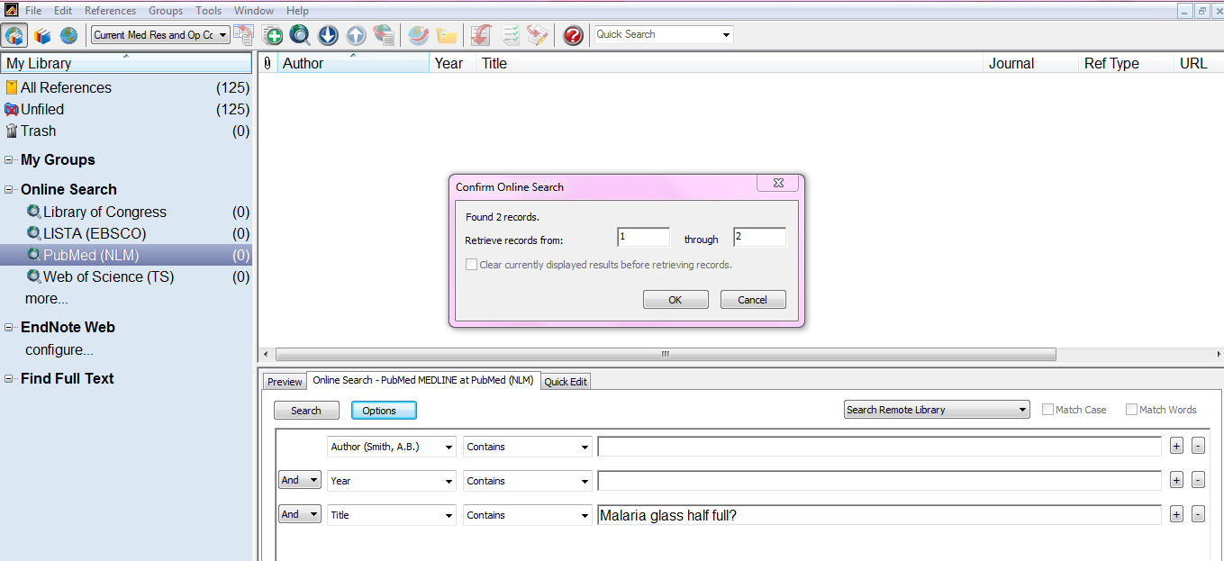
Endnote
<number>
Notes:
Synthesize recent literature into coherent narrative (within the past 5 years)
<number>

Slide 20
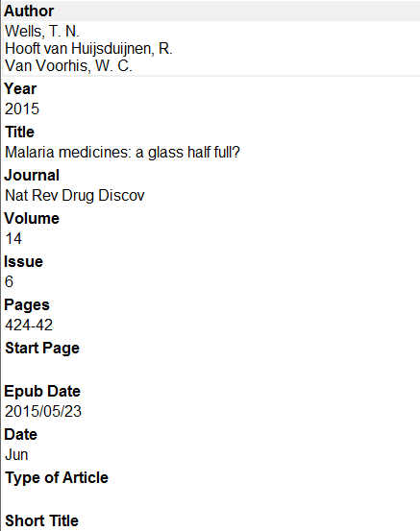
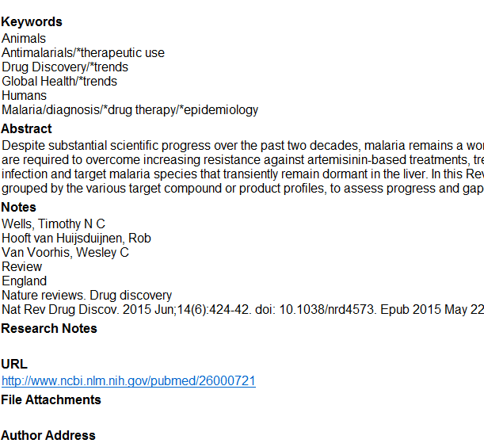
<number>
Notes:
<number>

Slide 21

Plagiarism
Reference immediately after mentioning
  Not end of paragraph
ALWAYS identify source
Summarise useful points
<number>
Notes:
Synthesize recent literature into coherent narrative (within the past 5 years)
<number>

Slide 22
Purpose
Funnel point is your purpose:
  The purpose can be framed as a research question or hypothesis
  BE CONCISE
    One sentence!!!
Leads directly into Aims and Objectives
<number>
Notes:
<number>

Slide 23
Aims and Objectives
The purpose of this research is to……
Aims
- short but general statement of intent
Objectives
- very specific statements that define the practical steps you will take to achieve your aim(s)
<number>
Notes:
Focus everyone→ get them back to same page.
<number>

Slide 24

Methodology
Section used to JUDGE the validity of results and conclusions
This section of your proposal has multiple parts
  Instrumentation and infrastructure
  Study groups and ethics
  Access to samples
  Data analysis
Justify your method choice
Show you understand the principles
Prove feasibility of your study
<number>
Notes:
Strict evaluation
If your scientific methods aren’t good your science isn’t good
Pull the plug on your project
<number>

Slide 25
Experimental design
In vitro cultivation:
P. falciparum 3D7, W2
Full IC₅₀ determination on asexual parasites
Induction: gametocytogenesis
Assessment C and N metabolism
In vitro assessment of inhibition of viability of gametocytes
Phenotype microarrays
Identify lead analogues
Cytotoxicity determination
<number>
Notes:
<number>

Slide 26

Timeline
Helps you keep your experimental design in the correct order
Avoids “dead” time
When building your timeline
  Consult with other students in your lab that have done similar studies
<number>
Notes:
<number>

Slide 27
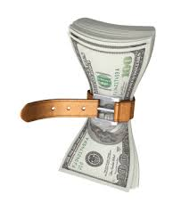
Budget
Give you an appreciation of research costs
Prevents you from overspending!
Provide specific explanations for:
  Need for specific technologies
  Need for other financial requests (e.g. conference, instrumentation, staff, bursaries etc).
  Do you really need this kit?
<number>
Notes:
<number>

Slide 28
Outcomes
What do you expect the results to be?
Measurable
  E.g. you will get a degree
  New patent / paper
Qualitative
  Contribute understanding to subject / new technology / application
<number>
Notes:
Can you think …..From what literature tells you→ what do you expect?
<number>

Slide 29


Revise and Edit
Back-up proposal everyday!
Always print on paper and edit
Use standard font
Number your pages
Read out loud
<number>
Notes:
One sentence one thought
<number>

Slide 30
Common pitfalls to avoid
  Forget to include table of contents
  Not connecting the proposed research to the literature review
  Not enough detail about methods
  Jargon & sweeping generalities
  Relying solely on your supervisor
<number>
Notes:
<number>

Slide 31
Improving Your Odds
Know what the evaluation criteria will be and CHECK that you meet these
Start with an outline
Read approved proposals
Once “finished” ask others to proofread
Use diagrams to illustrate models
Make sure your mentor approves it before you submit
<number>
Notes:
<number>

Slide 32
Evaluation of proposals
  The aims/objectives are likely to be achievable in the given time period
  The rationale for the proposed study is reasonable
  The scientific design is described and adequately justified
<number>
Notes:
<number>

Slide 33

Any Questions?
<number>
Notes:
<number>

Slide 34

Questions and Answers
Usually you have thought more about the material than anyone else
Anticipate typical questions and prepare for them
  Methodological bias? Uncertainties? Exceptions? Priorities?
Still concerned about questions?
  Make extra slides – perhaps on details of instrumentation or methodology
http://www.regislasvegas.org/images/class-pic-hand-raised.jpg
<number>

Slide 35
Questions and Answers
Questions definitely help you in writing up your research
  Identifies parts the audience did not understand
Can you repeat the question?
  Also if you heard the question incorrectly, it presents an opportunity for clarification
If you don’t know the answer?
<number>

Slide 36

Questions and Answers
Keep your answers short and to the point
– don’t respond with another lecture
Don’t say that a question is bad, or that you addressed it already
If the questioner disagrees with you
  Defuse the situation
http://www.erp.wisc.edu/profdev/Talkhandout05.doc
http://www.cartoonstock.com/newscartoons/cartoonists/ato/lowres/aton893l.jpg
<number>

Slide 37
Difficult Questions, continued
If you really don't know the answer
  Say "Interesting, I will look into that" or “That’s a good point, let’s discuss it afterwards”
If the questioner disagrees with you and it looks like there will be an argument then defuse the situation
  "We clearly don't agree on this point, let's go on to other questions and you and I can talk about this later"
http://www.erp.wisc.edu/profdev/Talkhandout05.doc
<number>

Slide 38
Resources
http://www.cgd.ucar.edu/cms/agu/scientific_talk.html
Micheal Alley:
  Craft of scientific presentations
<number>
Notes:
<number>

Slide 39

Any Questions?
<number>
Notes:
<number>

