Slide 1

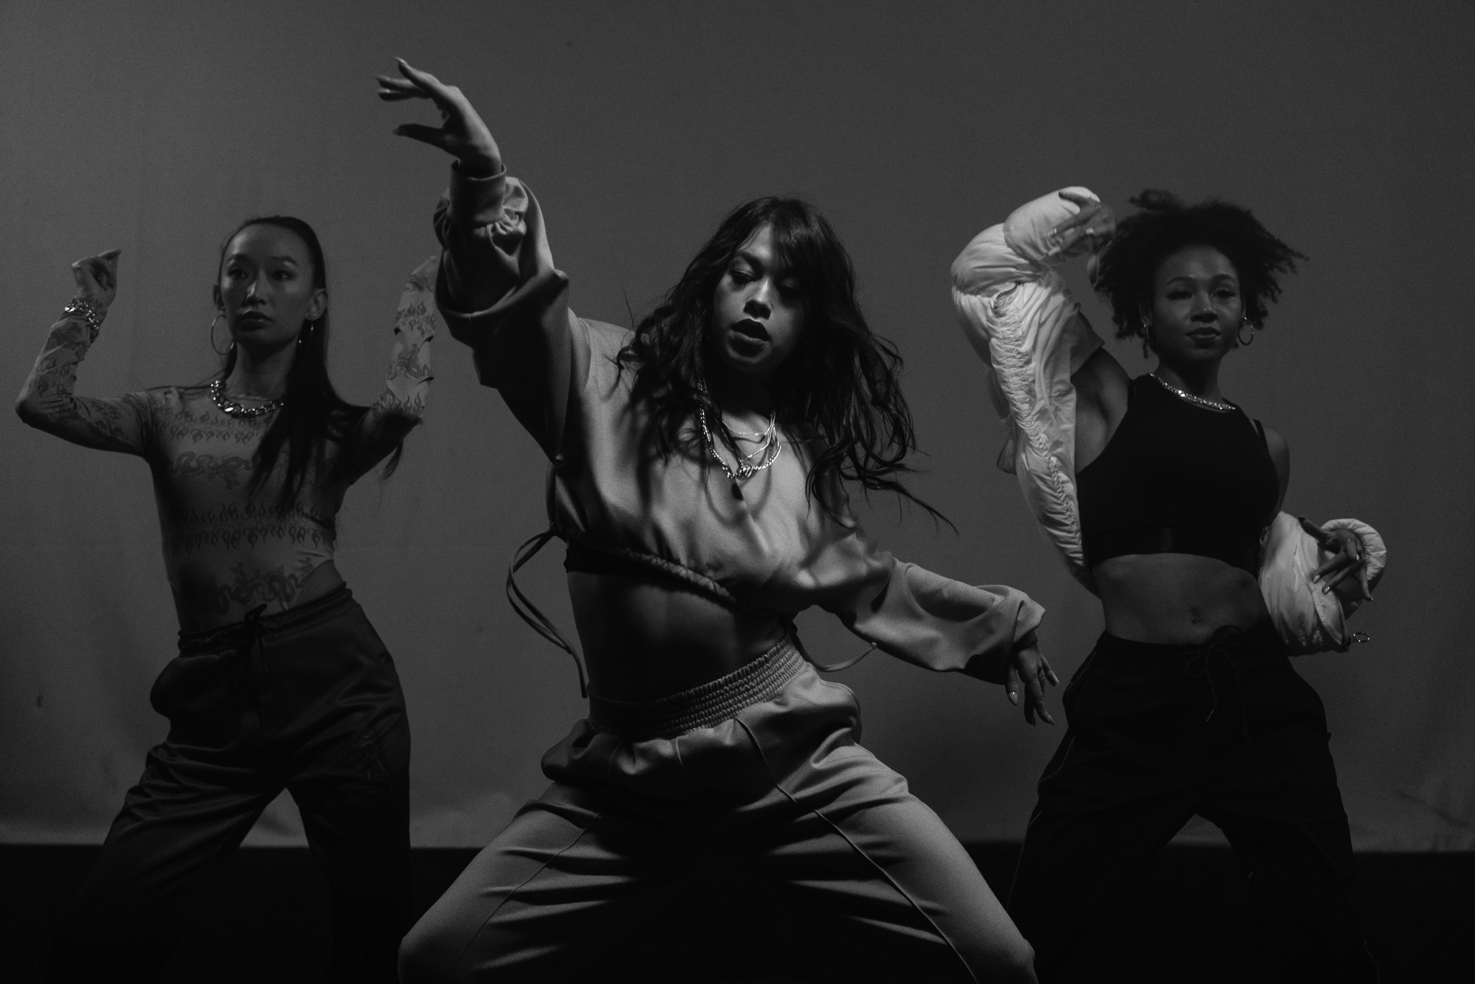

DIANA DANCE SPACE
Business Plan Presentation
Diana Levit
Student number:2439819

Slide 2
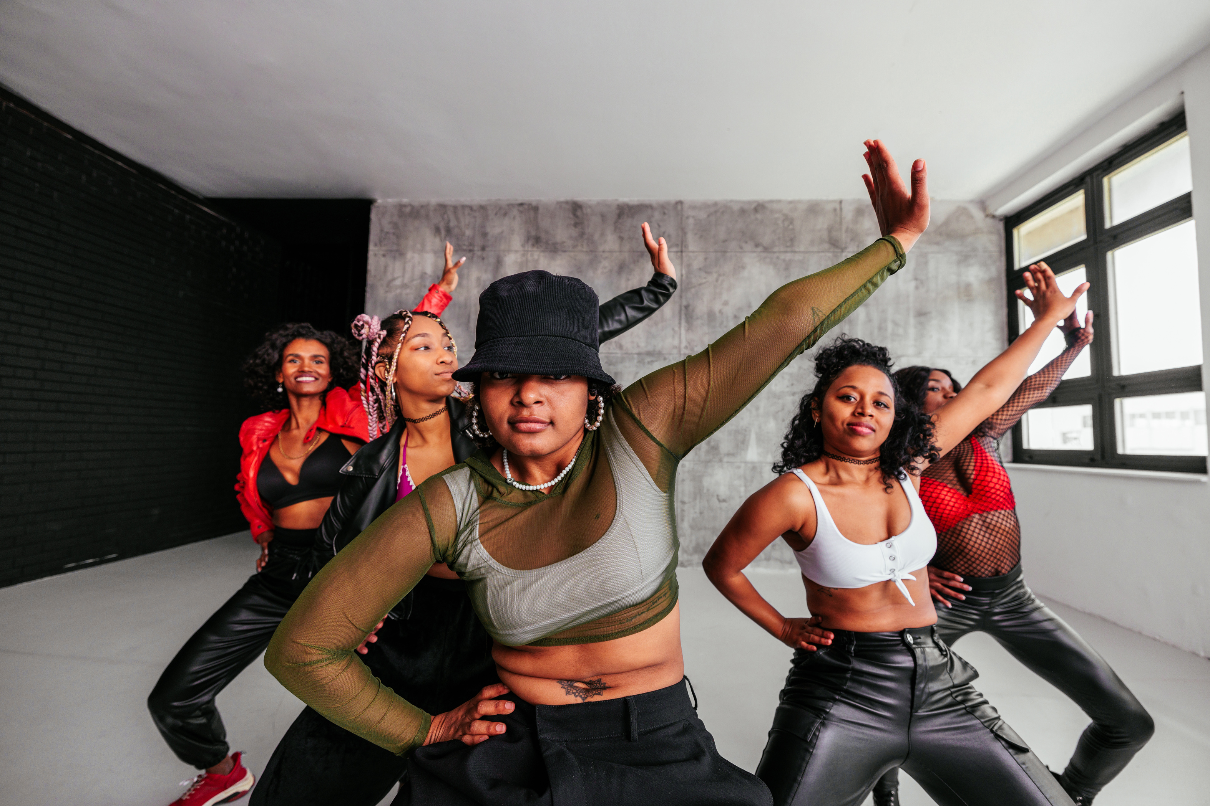

STUDIO SHODWE
ABOUT DANCE
Diana Dance Space — a professional dance studio in Camden Town.
Offers classes in contemporary, heels, hip-hop, and ballroom for children, beginners, and professionals.
Our mission is to create a supportive and inspiring environment where students can express themselves, build confidence, and grow creatively.
We help each student develop their skills, find their unique style, and reach their full potential.

Slide 3
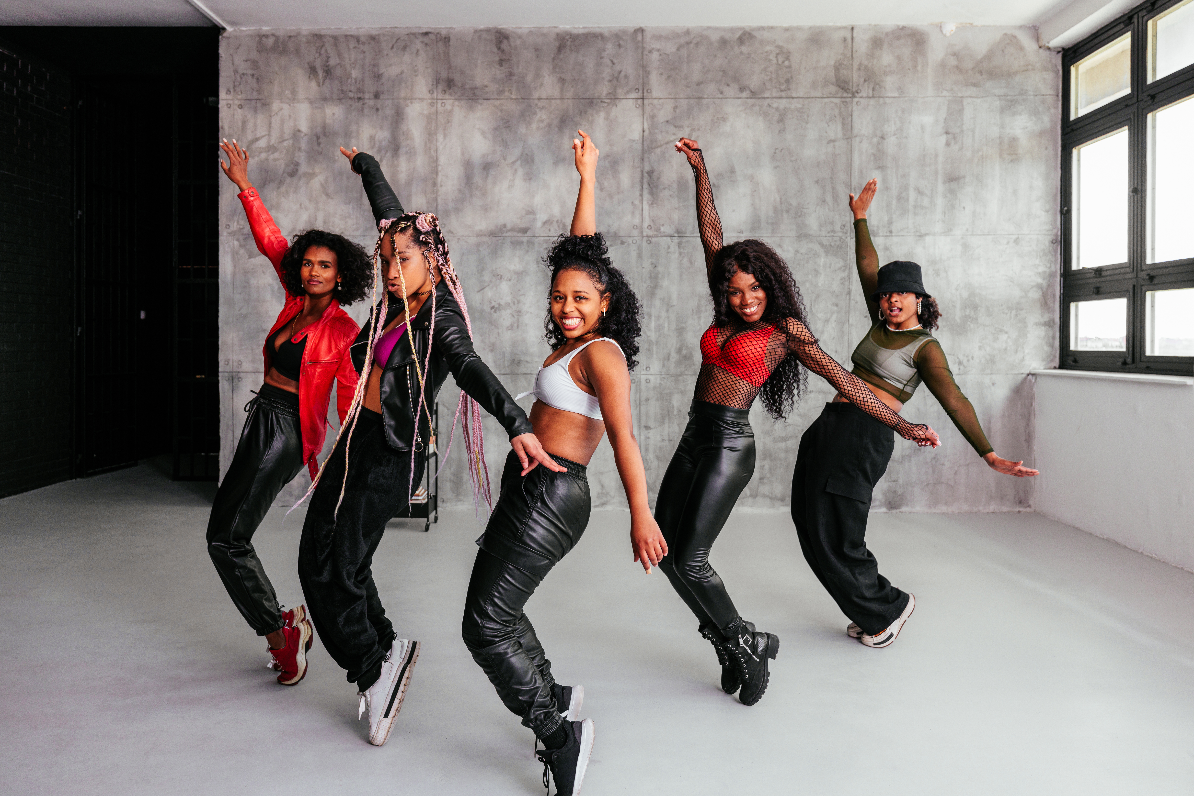
MY MANAGEMENT STRUCTURE
  Diana Dance Space – Team Structure
  Diana Dance Space is led by the Owner, Diana Levit, who oversees the overall vision and development of the studio.
  The Manager, Anna Kovalenko, is responsible for daily operations and coordination.
  The teaching team is headed by the Head Instructor, Dmytro Hrytsenko, who manages instructors and assistant instructors, ensuring high-quality training.
  Administrative tasks are supervised by the Head of Administration, Olha Melnyk.
  Her team includes the receptionist, Maria Pavlenko, and the Social Media Manager, Ihor Tkachen, who handles online presence and promotion.
  There are also open positions within the team, including instructor and janitor roles.

Slide 4
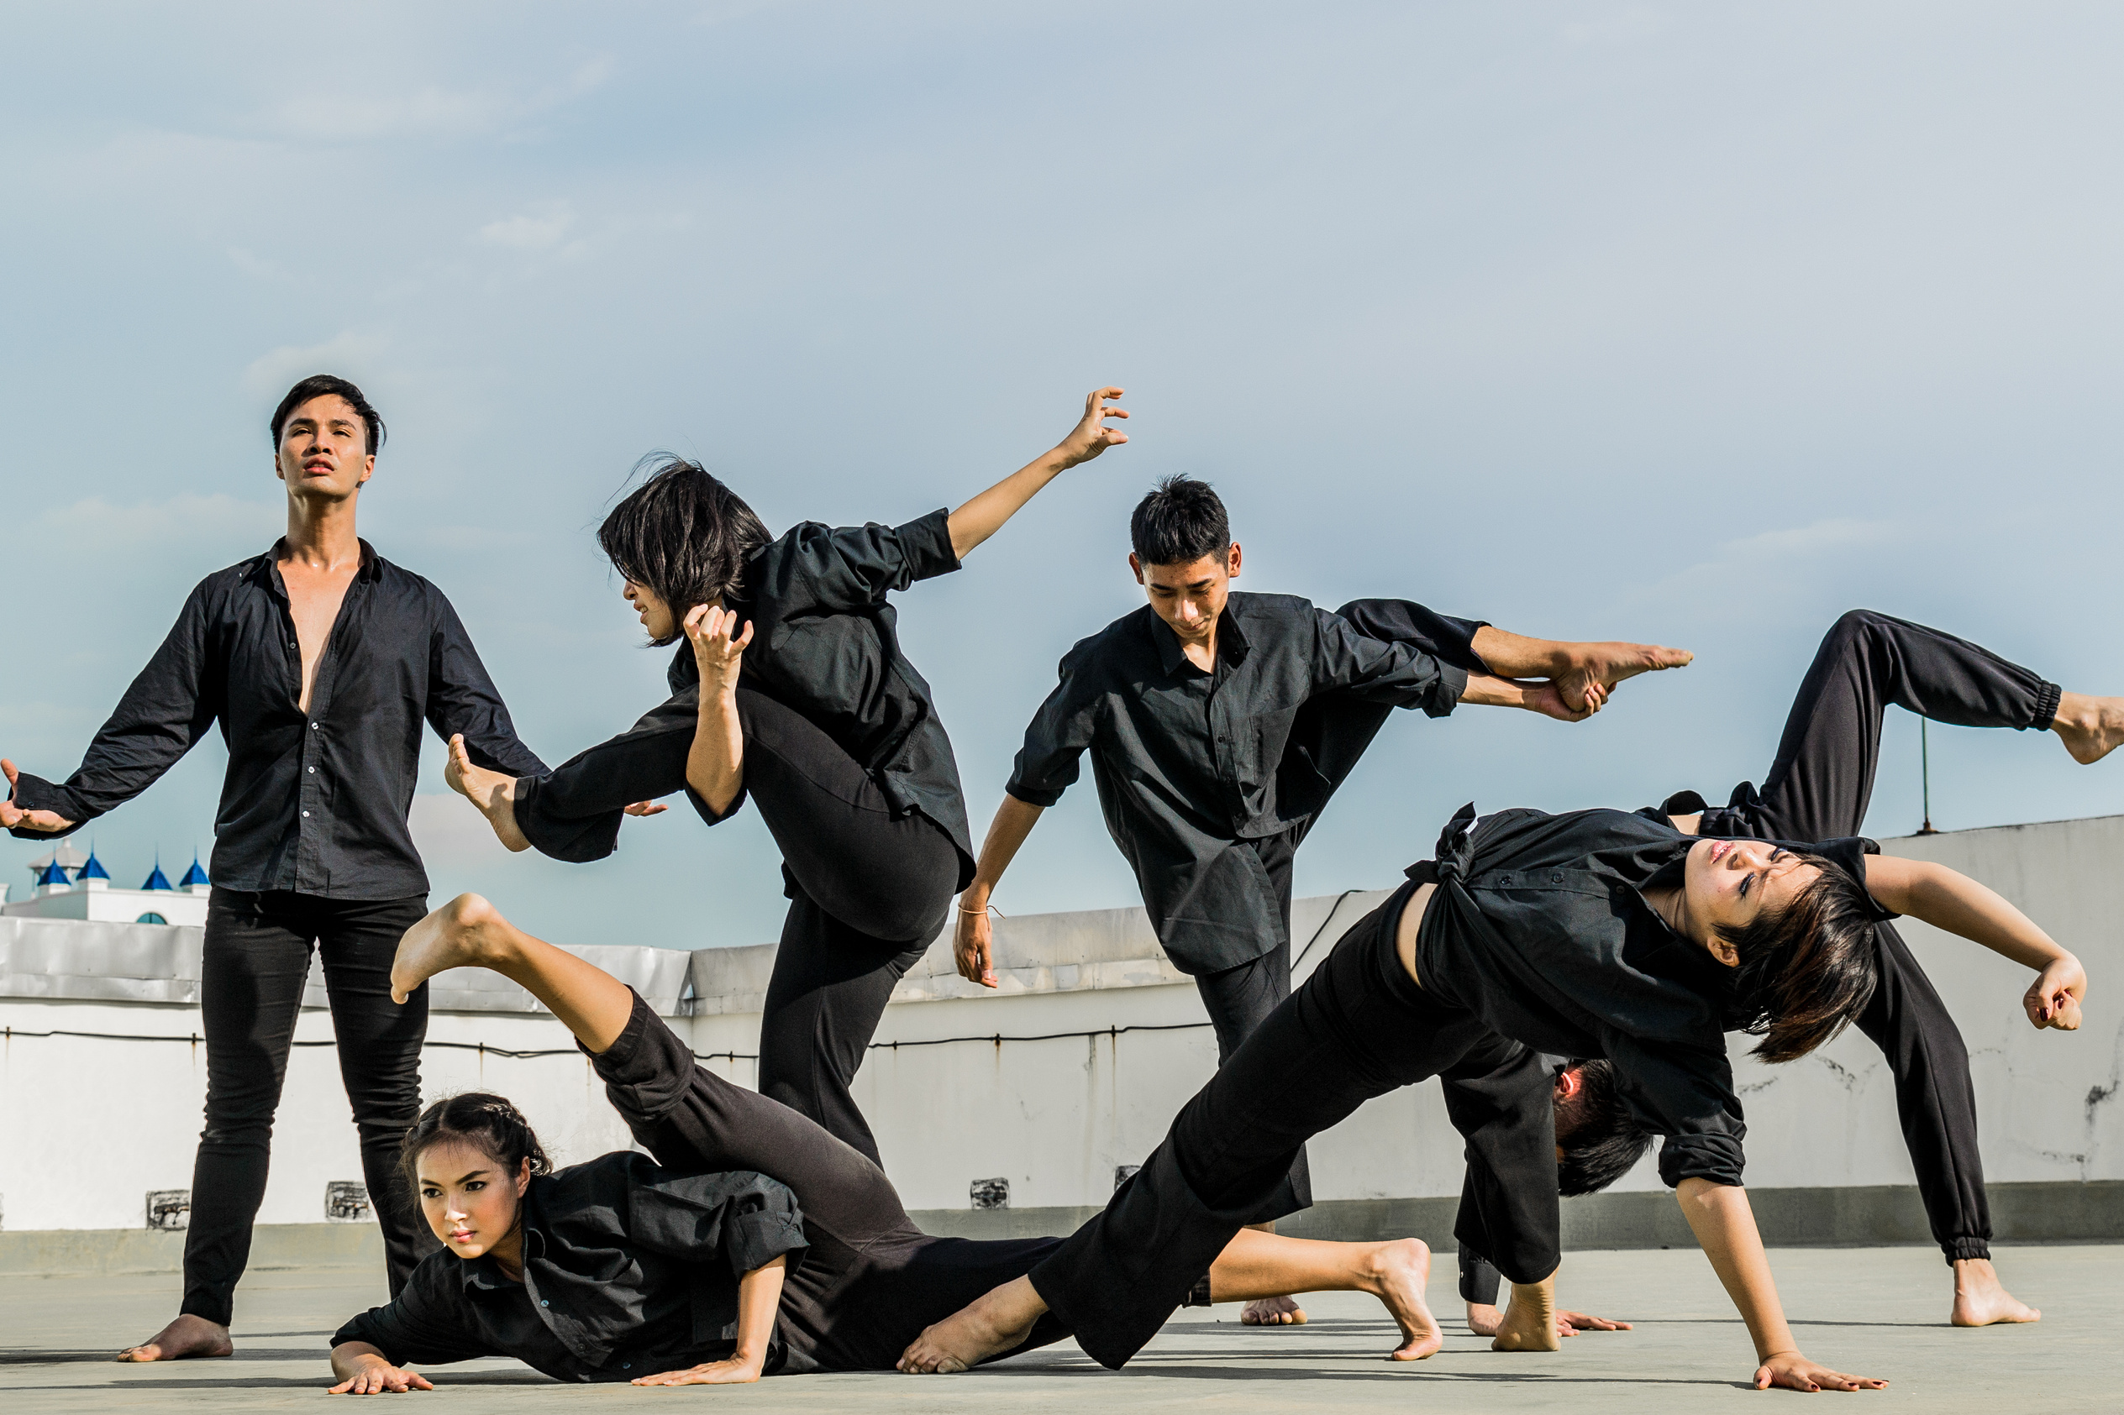
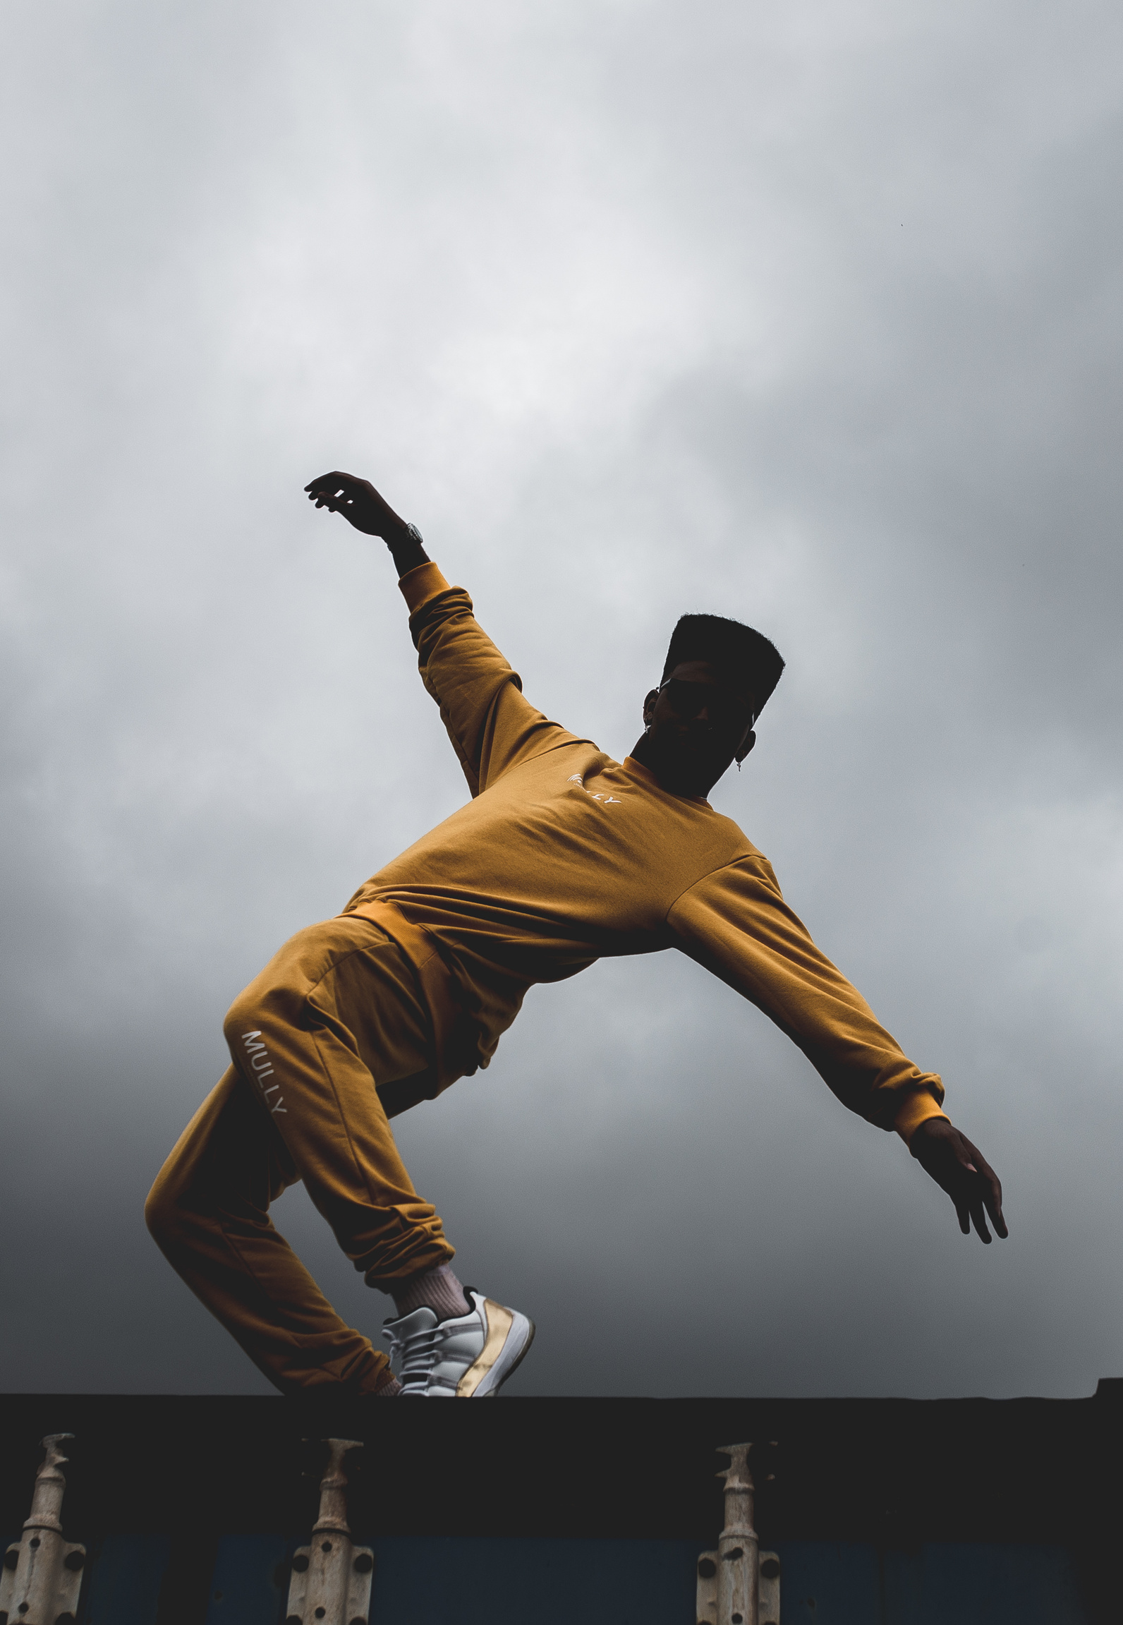
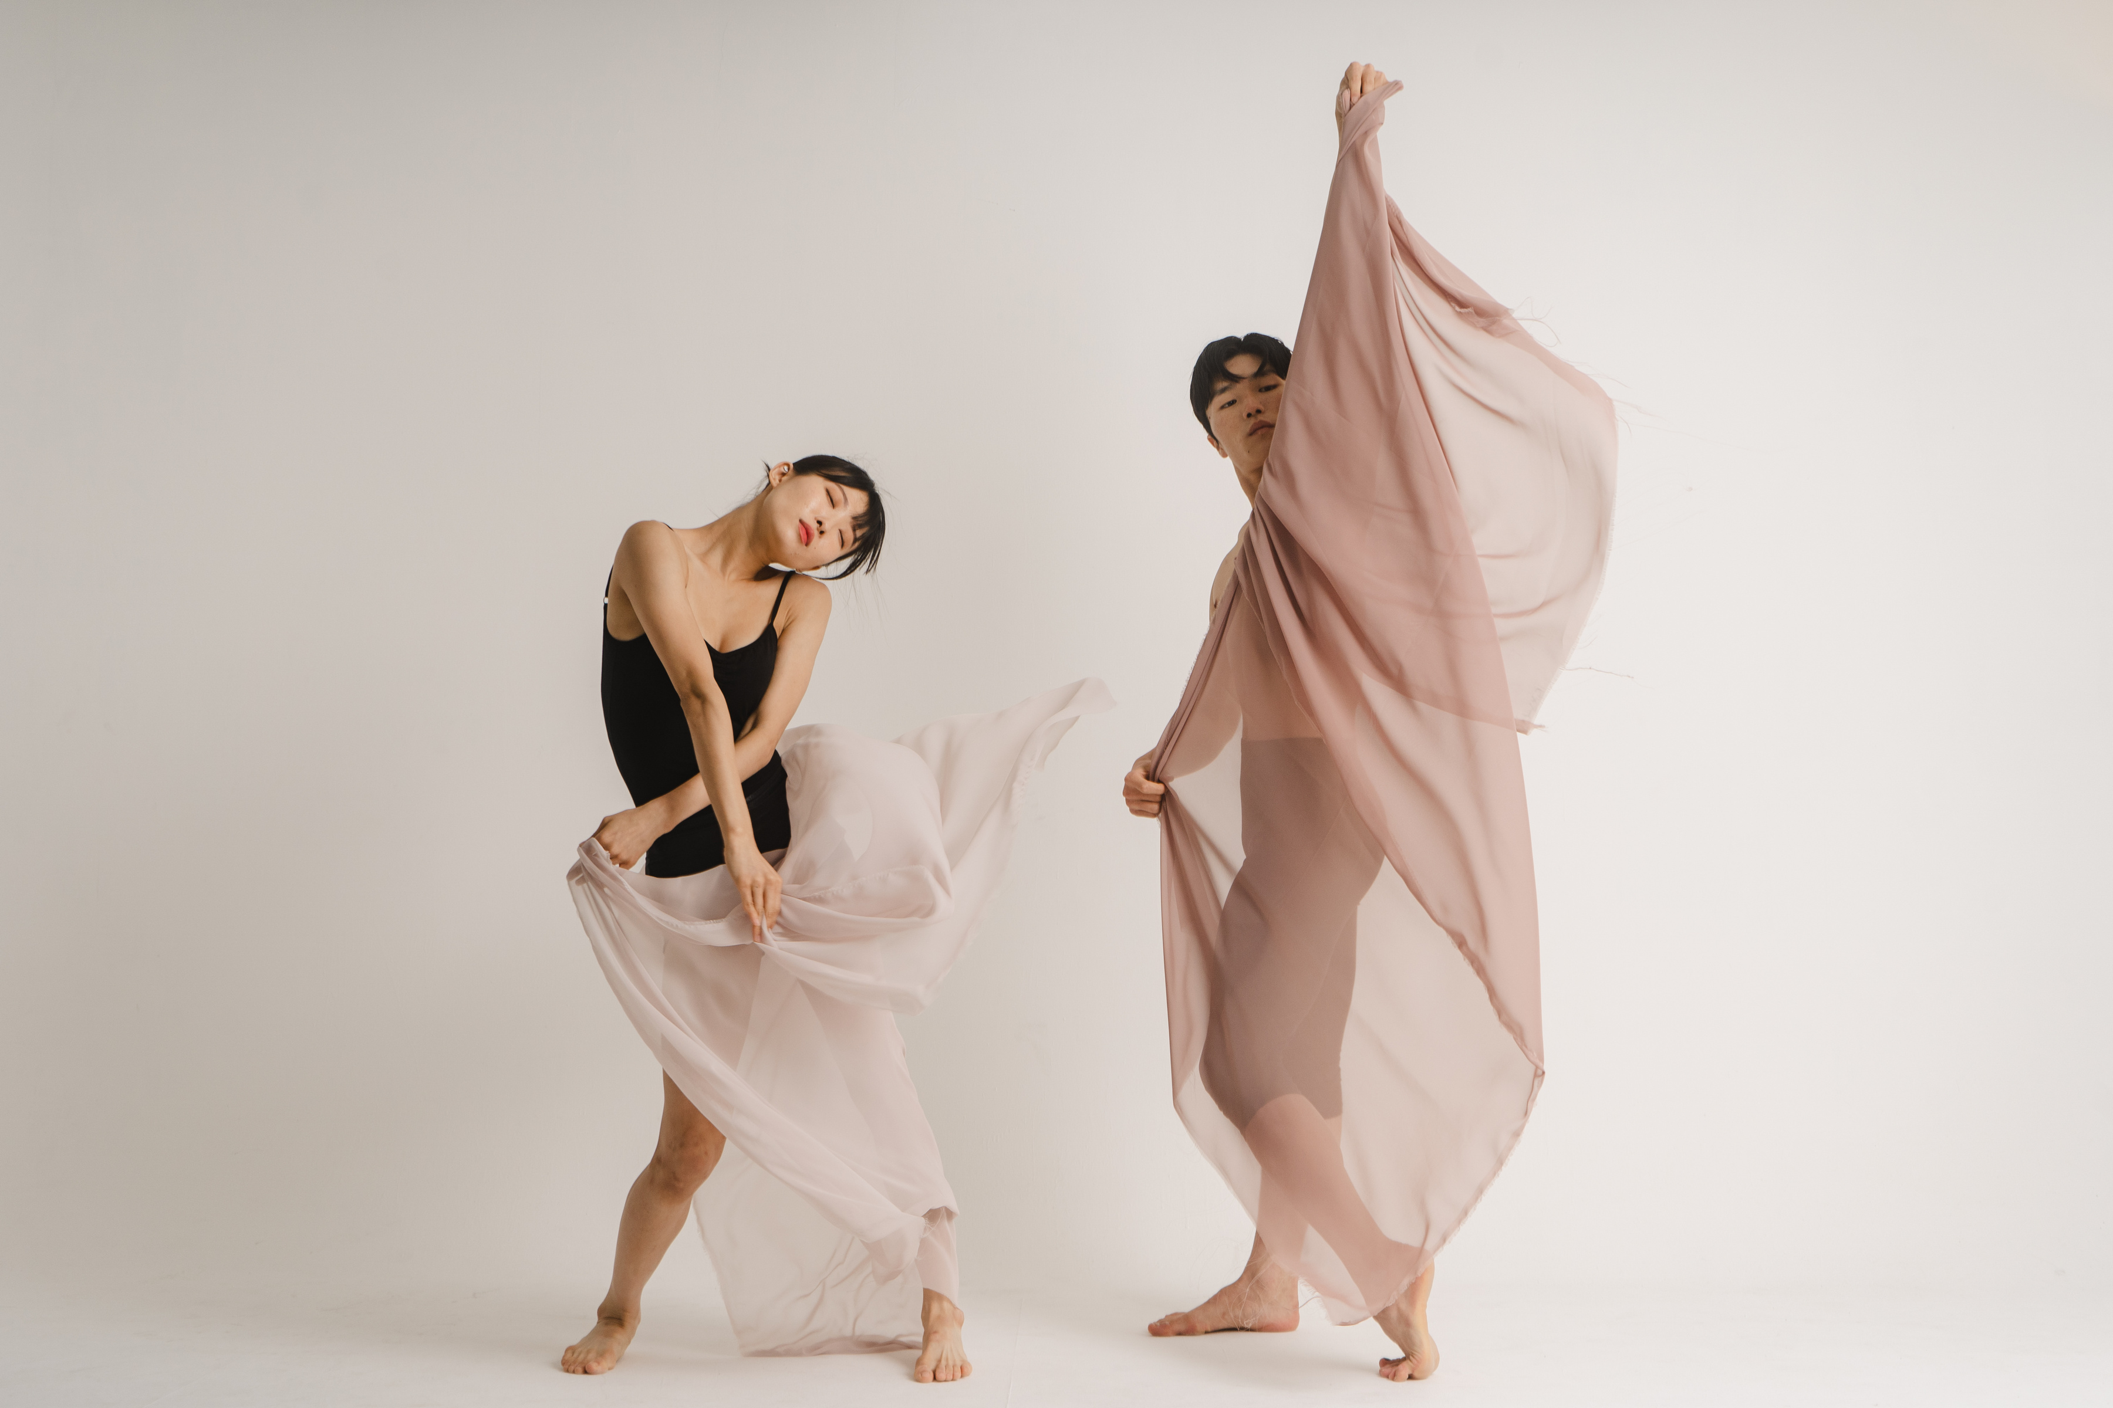
LEGAL FORMAT
Diana Dance Space Ltd is registered as a Private Limited Company (Ltd) in the United Kingdom, providing limited liability and ensuring that the owner’s personal assets are protected from business-related risks.
This legal structure enhances the company’s credibility and professional image, making it more attractive to clients, partners, and investors. It also enables the business to enter into formal contracts, secure lease agreements, and apply for funding opportunities.
Furthermore, the Ltd structure offers tax efficiency and supports effective financial management, while allowing for future growth, including the expansion of operations and the employment of staff.

Slide 5
PESTEL ANALYSIS – DIANA DANCE SPACE LTDENT AND MEDIA
  Political:
  Compliance with local regulations, including business licensing, zoning, and health and safety standards, is essential. Opportunities include grants and partnerships with schools or community organisations—e.g., UK Arts Council funding can cover up to £10,000 for community programs. Regulatory changes and permit costs (often £500–£2,000 per year) may present challenges.
  Economic:
  Economic conditions influence consumer spending on leisure activities. The UK dance and fitness market is valued at over £1.5 billion, with growing interest in wellness and creative classes. Opportunities exist for offering diverse classes and flexible memberships. Risks include rising rent (average studio space in London: £25–£40 per sq ft per year) and competition from other studios or online platforms. Flexible pricing and private lessons can help increase revenue by 10–15% annually.
  Social:
  Trends in health, wellness, and community engagement support demand for dance activities. The studio can attract children, adults, and families through inclusive programming. Approximately 65% of Londoners participate in regular fitness or dance activities, highlighting a strong potential audience. Changing trends and the impact of social media reviews require proactive brand management.

Slide 6
MARKETING COMMUNICATION
1. Facebook is better suited for adults aged 35–60 I can post announcements there about recruiting children for groups of different ages, since I plan to create groups for various age groups.
2. Instagram is more for young people, and it requires a lot of effort because 90% of young people use this platform now. I can film videos about what I do, take various photos, showcase all my workshops and my work, and run targeted ads to help promote my profile.
3. TikTok is also a platform where you can post videos, and it’s used by a lot of young people.
Social media plays a critical role in building brand recognition, trust and consistency. Every post, comment, video and interaction reinforce who you are, what you stand for and how people feel about your business. Over time, this repeated exposure builds familiarity. When people recognise a brand, they are more likely to engage with it, search for it directly, and choose it over competitors. In 2026, strong brands are not built through campaigns alone, but through ongoing presence and meaningful interaction on social platforms where audiences already spend their time.

Slide 7
FINANCIAL
1. Startup Costs
  Studio renovation (mirrors, flooring): £12,000
  Sound systems (3 rooms): £3,000
  Furniture & reception: £4,000
  Branding & website: £2,000
  Licenses & insurance: £1,500
  Initial marketing: £2,500
  Equipment: £3,000
  Total Startup Cost: £28,000
2. Fixed Costs (Monthly)
  Studio rent: £4,500
  Business rates: £600
  Utilities: £500
  Instructors’ salaries (2): £4,800
  Reception/Admin: £1,500
  Insurance: £200
  Accounting: £150
  Total Fixed Costs: £12,250
3. Variable Costs (Monthly Forecast)
Jan: £2,000 | Feb: £2,300 | Mar: £2,600
Apr: £2,950 | May: £3,500 | Jun: £4,000
4. Revenue Forecast
Jan: £6,000 | Feb: £8,000 | Mar: £10,500
Apr: £13,500 | May: £16,000 | Jun: £18,000
5. Profit/Loss Projection
Jan: -£8,250 | Feb: -£6,550 | Mar: -£4,350
Apr: -£1,700 | May: £250 | Jun: £1,750
6. Break-even Point: Month 5 (May)
7. Investment Required: £48,850 (~£50,000)

Slide 8
THANKYOU
Dance Your Heart Out!

