Slide 1
HPAR7007 Archaeological Specialist Practice
Session 9
Equipment and HE Science Advisors

Slide 2
Session outline
Time management task results
Equipment
Reference resources
Matthew Nicholas and Sylvia Warman- Historic England Science Advisors

Slide 3
KSBs
S4 | select, secure, check and calibrate suitable equipment and reference resources

Slide 4
Time management exercise
Monitor and record how you spend a typical day/week

Slide 5
Time management exercise
Monitor and record how you spend a typical day/week
Reflection
Is the pattern of time use what you expected?
How realistic are your expectations of how much time you can spend on your primary task?
Are non-work tasks eating into your work time, and if so is there any way to reduce them?

Slide 6
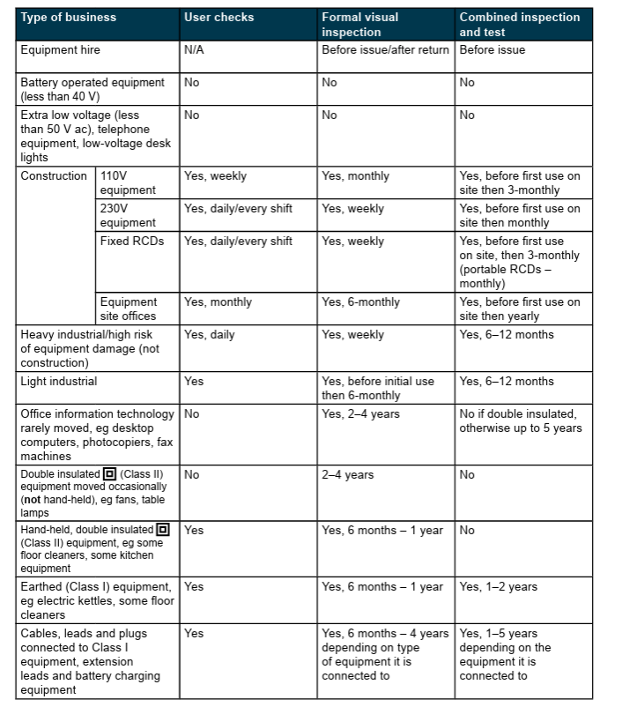
Equipment
Documentation
Set up
Calibration
Use
Maintenance
Storage
User responsibilities
https://www.hse.gov.uk/pubns/priced/hsg107.pdf

Slide 7
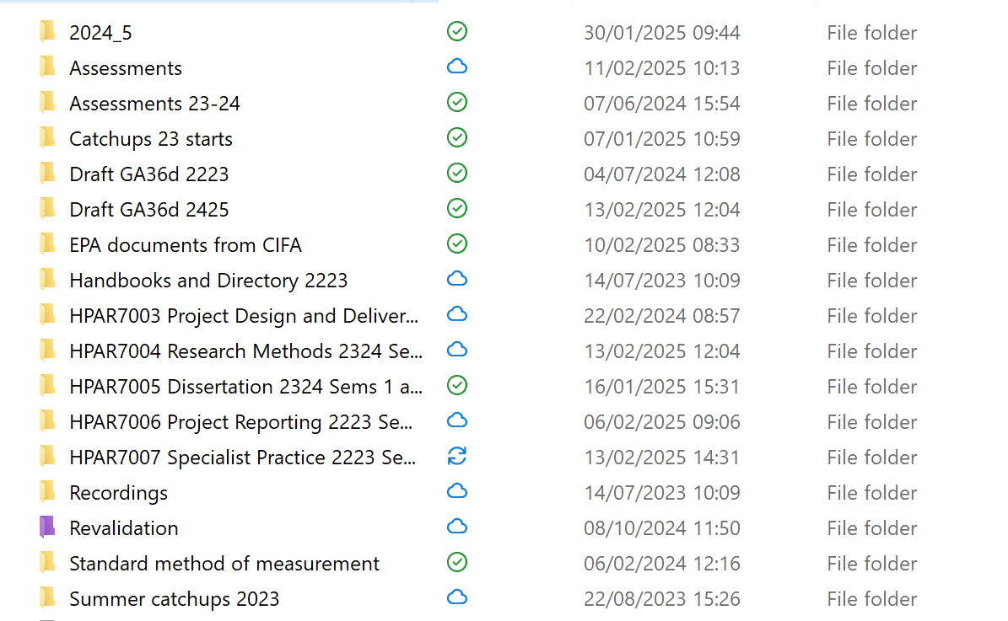
Equipment - IT
Security
Updates
Backing up
Data management
  Folders
  Naming
  Version control
Tailoring/personalisation
Disaster recovery plan

Slide 8
Reference resources
accessibility
currency
  Dynamic datasets
reliability
relevance

Slide 9
Reference resources
accessibility
currency
  Dynamic datasets
reliability
relevance
Examples:
  HERs/ ADS

Slide 10
Reference resources
accessibility
currency
  Dynamic datasets
reliability
relevance
  Pottery Fabric Type Series

Slide 11
Reference resources
accessibility
currency
  Dynamic datasets
reliability
relevance
  Animal bone atlas
  Animal Bone Metrical Archive Project (ABMAP)
  https://archaeologydataservice.ac.uk/archives/view/abmap/#:~:text=The%20Animal%20Bone%20Metrical%20Archive,from%20excavations%20in%20southern%20Britain.

Slide 12
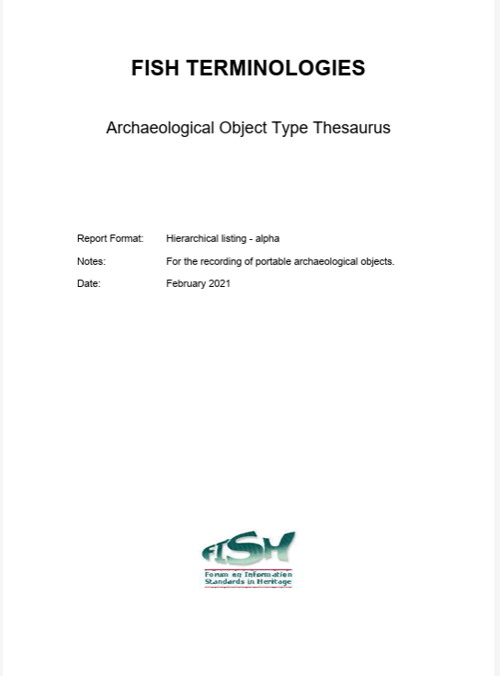
Reference resources
accessibility
currency
  Dynamic datasets
reliability
relevance
  FISH Thesauruses
  https://heritage-standards.org.uk/fish-vocabularies/

Slide 13

Reference resources
accessibility
currency
  Dynamic datasets
reliability
relevance
  Inizan, M.-L., Reduron-Ballinger, M., Roche, MH., and Tixier, J. 1999 Technology and Terminology of Knapped Stone. CREP, Nanterre Cedex, France.

Slide 14
KSBs
S4 | select, secure, check and calibrate suitable equipment and reference resources

