Slide 1

Education for Sustainable Development and Global Citizenship
Leah Delloy

Slide 2

What is Education for Sustainable Development and Global Citizenship (ESDGC)?
“Education for Sustainable Development and Global Citizenship (ESDGC) is education that will prepare young people for life in the 21st century” (Wales. Department for Children, Education, Lifelong Learning and Skills, 2008a, pg. 4). The ESDGC aims to achieve this through values, attitudes, skills and understanding.
It aims to teach young people “about the big issues in the world - such as climate change, trade, resource and environmental depletion, human rights, conflict and democracy, - and about how they relate to each other and to us” (Wales. Department for Children, Education, Lifelong Learning and Skills, 2008b, pg. 4).
ESDGC places an emphasis on the importance of how we treat one another, no matter where we live and states that everyone has an important role to play.
(Kannsma, 2021)

Slide 3
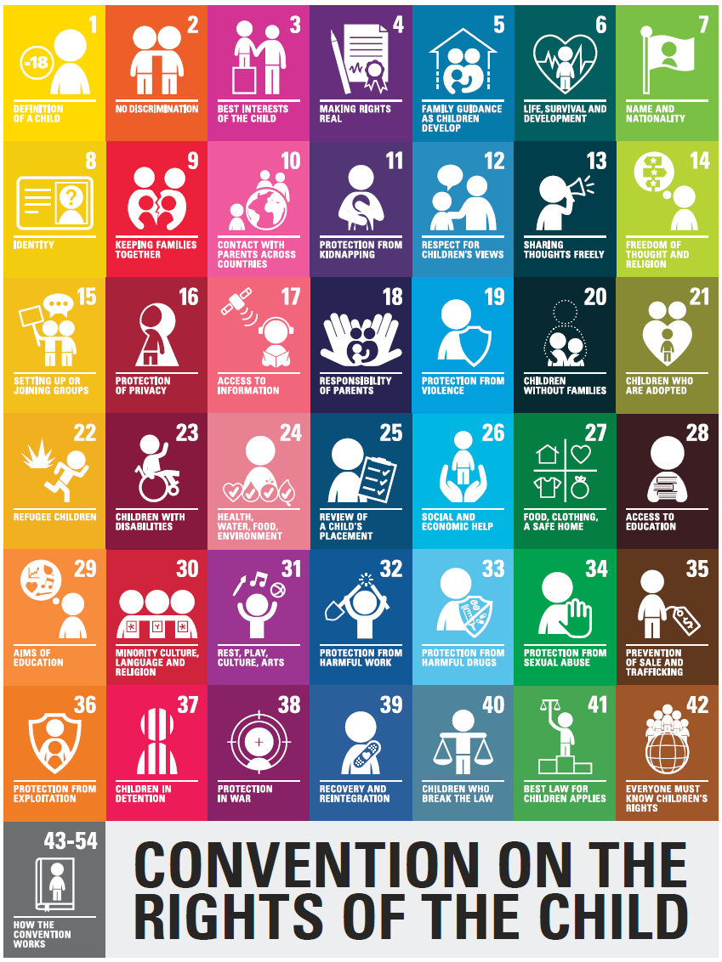
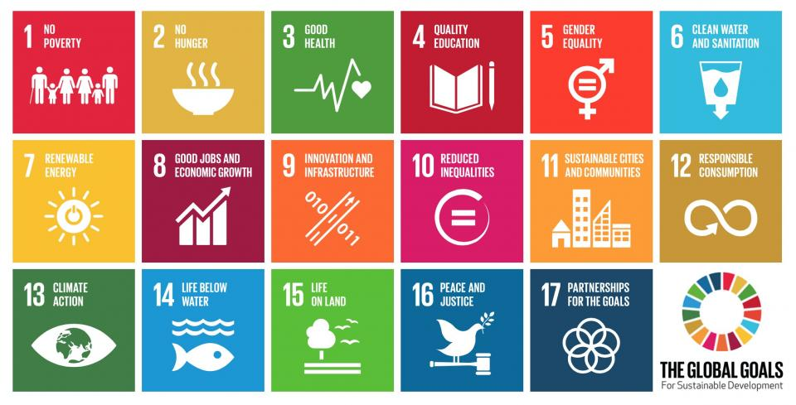
International Policies that Link to ESDGC
(Association for Young People’s Rights, 2019)
UNCRC
“The United Nations Convention on the Rights of the Child (UNCRC) is an international agreement setting out the rights of children” (Wales. Department for Children’s Rights, 2019, pg.1).
Wales became the first country to make the UNCRC a part of the domestic law in 2011 (Children’s Commissioner for Wales, 2021, pg.1).
The UNCRC sets out “civil, political, economic, social and cultural rights of every child, regardless of their race, religion or abilities” (https://www.savethechildren.org.uk/what-we-do/, no date, pg. 1) which often supports ESDGC.
The 42 rights are put in place to ensure children and young people grow up safely, healthy and happily (Children’s Commissioner for Wales, 2021, pg.1).
Sustainable Development Goals
The Sustainable Development Goals (SDGs) were “adopted by all United Nations Member States in 2015, it provides a shared blueprint for peace and prosperity for people and the planet, now and into the future” (https://sdgs.un.org/goals, no date, pg.1).
The 17 goals “recognize that ending poverty and other deprivations must go hand-in-hand with strategies that improve health and education, reduce inequality, and spur economic growth – all while tackling climate change and working to preserve our oceans and forests” (https://sdgs.un.org/goals, no date, pg.1).
https://www.un-page.org/page-and-sustainable-development-goals, no date)

Slide 4

Policies in Wales that link to ESDGC
Well-being of Future Generations (Wales) Act 2015
“The Well-being of Future Generations Act gives us the ambition, permission and legal obligation to improve our social, cultural, environmental and economic well-being” (Future Generations Commissioner for Wales, 2021, pg. 1).
The act demands public bodies in Wales to consider how their decisions can have a long term effect, whilst encouraging them to work better with others to prevent problems such as climate change, poverty and health inequalities (Future Generations Commissioner for Wales, 2021, pg. 1).
Successful Futures
In 2014, Professor Graham Donaldson was asked by the Welsh Government to review the National Curriculum (Donaldson, 2015, pg. 3). Donaldson created 4 purposes that he believes all young children should be. The 4 purposes are:
“ambitious, capable learners, ready to learn throughout their lives
enterprising, creative contributors, ready to play a full part in life and work
ethical, informed citizens of Wales and the world
healthy, confident individuals, ready to lead fulfilling lives as valued members of society” (Wales. Department for Curriculum for Wales, 2020, pg. 1).
(Emmaculate Care Services, 2021)

Slide 5
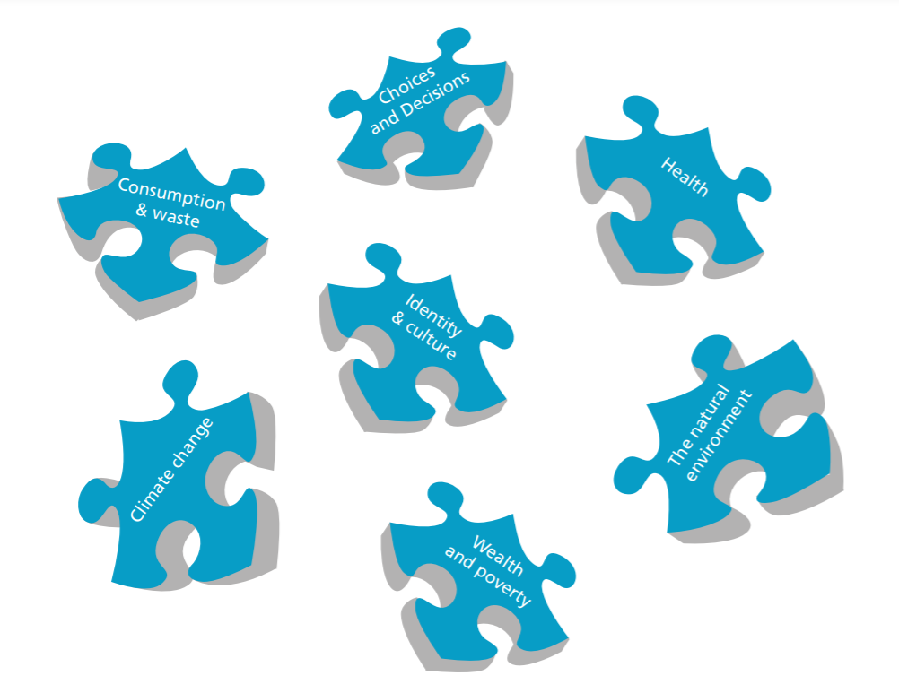
How is the ESDGC Implemented Within Schools?
ESDGC should not been seen as an additional subject to be taught within schools, but should be seen as a way of life. It is embedded within schools through discrete changes to the National Curriculum and should be implemented into all aspects of learning (Wales. Department for Children, Education, Lifelong Learning and Skills, 2008a, pg. 4).
ESDGC recognises that the world is unequal and unjust, although it aims to teach young people that this can be amended by the attitudes, values and behaviours of the citizens that live within it (Wales. Department for Children, Education, Lifelong Learning and Skills, 2008a, pg. 4).
(Wales. Department for Children, Education, Lifelong Learning and Skills, 2008b, pg. 5).

Slide 6

Pupil Voice
(The Federation of Bursledon Schools, 2015)
Within a setting, children from year 2 up to year 6 are involved in pupil voice groups. There are 10 pupil voice groups based on different responsibilities within schools such as Healthy Heroes and Safety Squad. The pupil voice groups meet once a fortnight to discuss ideas on how to make improvements to the school based on the topic of their group.
Children from nursery up to year 6 also have pupil voice sessions in class. Before each topic all children are given the opportunity to have a discussion with the class teacher on what they would like to learn from the topic and how they would like to learn it. Foundation phase children also have the opportunity to plan and design what they would like in their role play area based on the topic.
This links with the choices and decisions theme of the ESDGC as the children are given the opportunity to make changes within the school and make decisions about their learning.
This also links to Article 12 of the UNCRC which states “when important decisions are being made that affect you, you have the right to give your opinion and to be taken seriously” (https://www.savethechildren.org.uk/content/dam/gb/reports/humanitarian/uncrc19-child-friendly.pdf, no date, pg. 1).

Slide 7

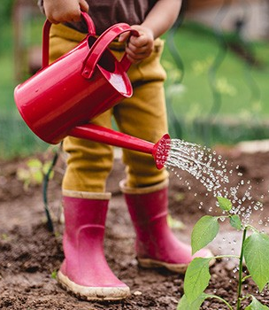
Eco Schools
(Bradbury, 2021)
“Eco-Schools is a global programme engaging 19.5 million children across 67 countries, making it the largest educational programme on the planet” (https://www.eco-schools.org.uk/, no date, pg. 1).
Eco-Schools aim to inspire children and young people to make positive changes to their school and surrounding area, as well as encouraging them to make positive decisions in order to achieve an environmentally sustainable world (Eco-Schools Northern Ireland, 2019). Eco-Schools can also help children and young people to improve on other key skills such as literacy and numeracy, whilst supporting ESDGC (https://www.keepwalestidy.cymru/pages/category/eco-schools, no date, pg. 1).
Within a setting there is a pupil voice group called Eco Warriors. Children within that group have discussions with one another and a member of staff about what the school is already doing to be eco friendly and areas that need developing.
As a result of what the setting already has in place to be eco friendly and gaining the Eco-Schools award they are meeting a number of the 7 themes within ESDGC:
“Consumption and waste
Choices and decisions
Health
Climate change
The natural environment” (Wales. Department for Children, Education, Lifelong Learning and Skills, 2008b, pg. 5).
(St Blaise CE Primary School, 2015)

Slide 8
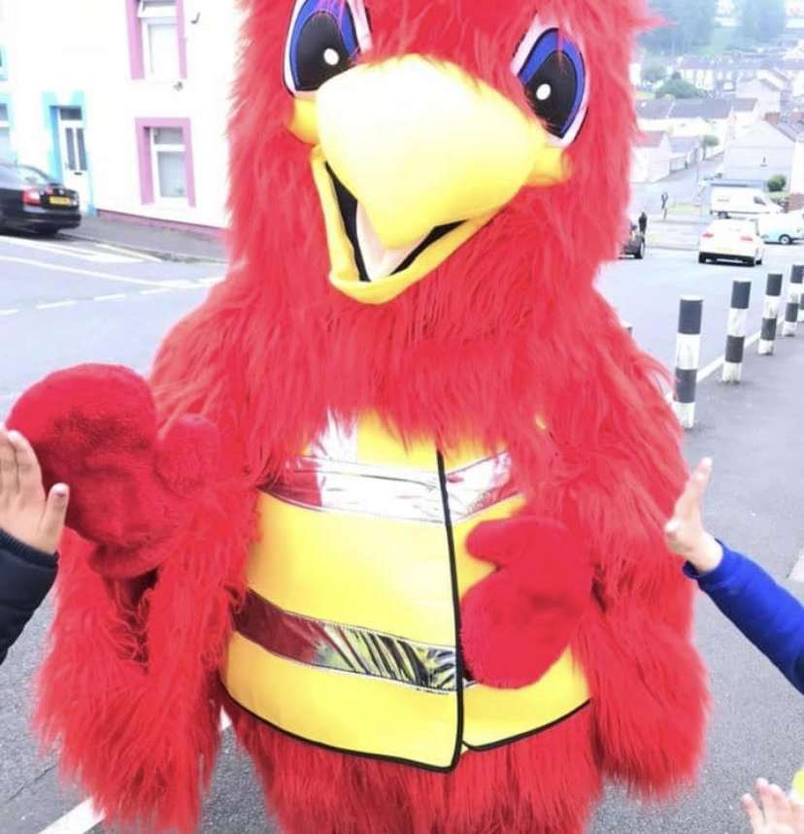
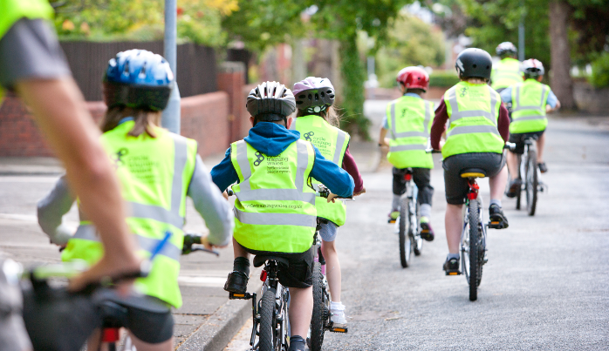
Walking Bus and Cycle Training
To support the Eco-Schools programme, children are encouraged use more eco friendly ways to travel to school.
Walking Bus
For one week a year the school sets up a walking bus. Before the week of the walking bus, children are educated on climate change and how traveling by car affects the climate. The school decides on a convenient spot in the local area where all students attending the school are encouraged to meet to walk to school together. The children that attend the walking bus are greeted by the character Rocky the Rooster and receive Dojo Points as a reward for not traveling to school by car.
Cycling Training
Children in year 5 and 6 are also offered cycle training to educate them on how to cycle safely to school. The training starts off with the children learning how to cycle safely on the school yard and then progresses to the instructors taking the children out on to the streets. This gives the children more confidence when cycling and has proven to encourage children to cycle to school on a daily basis.
Both of these interventions not only support Eco-Schools, but also link to the theme climate change within ESDGC. By giving the children an alternative method of travel, the school is teaching the children to take responsibility for making the world a better place and to consider how their actions can affect climate change.
Links to the UNCRC- Article 6 “You have the right to grow up and be healthy” (Children’s Commissioner for Wales, 2021, pg. 1).
(Cycling Training Wales, 2021)

Slide 9

Language of the Month
In practice, one primary school celebrates language of the month. One member of staff picks a different language to be celebrated each month which is often based on the different languages children speak within the school.
There is an assembly at the beginning of the month to introduce the language, and any children within the school that speak that language are invited to stand at the front of the assembly to help the teacher introduce it. The parents of the children are often also invited to watch and/or participate within the assembly.
Within the assembly the children learn about what country the language is spoken in, traditions within that country and how to say simple words such as ‘hello’ and ‘thank you’.
Language of the month shows significant links to the identity and culture theme within ESDGC as it helps children to respect and value diversity. It also links to Article 30 of the UNCRC which states “Your right to use your own language” (Children’s Commissioner for Wales, 2021, pg. 1).
(Katsarova, 2017)

Slide 10
Thank you for listening!

Slide 11
Reference List
Association for Young People’s Health (2019) 30 years of the United Nations Convention on the Rights of the Child [Online]. Available at: https://www.youngpeopleshealth.org.uk/30-years-of-the-united-nations-convention-on-the-rights-of-the-child (Accessed: 18 February 2021).
Bradbury, K. (2021) Fruit & veg for kids to grow [Online]. Available at: https://www.bbcgoodfood.com/howto/guide/easy-crops-kids-grow (Accessed: 18 February 2021).
Children’s Commissioner for Wales (2021) UNCRC. Available at: https://www.childcomwales.org.uk/uncrc-childrens-rights/uncrc/ (Accessed: 18 February 2021).
Cycle Training Wales (2021) Cycle Training [Online]. Available at: https://www.cycletrainingwales.org.uk/ (Accessed: 18 February 2021).
Donaldson, D Prof. (2015) Successful Futures. Available at: https://gov.wales/sites/default/files/publications/2018-03/successful-futures.pdf (Accessed: 21 February 2021).
Eco-Schools https://www.eco-schools.org.uk/ (no date) (Accessed: 17 February 2021).
Emmaculate Care Services (2021) Key Policies [Online]. Available at: https://www.emmaculatecareservices.co.uk/courses/key-policies/ (Accessed: 21 February 2021).
Future Generations Commissioner for Wales (2021) Well-being of Future Generations (Wales) Act 2015). Available at: https://www.futuregenerations.wales/about-us/future-generations-act/#:~:text=The%20Well%2Dbeing%20of%20Future%20Generations%20Act%20requires%20public%20bodies,health%20inequalities%20and%20climate%20change (Accessed: 21 February 2021).
Kannsma (2021) Kids around the World - Europe & Africa [Online]. Available at: https://www.dreamstime.com/stock-illustration-kids-around-world-europe-africa-holding-hands-globe-objects-grouped-separate-layers-image42299504 (Accessed: 16 February 2021).
Katsarova, I. (2017) Celebrating The European Day Of Languages [Online]. Available at: https://epthinktank.eu/2017/09/25/celebrating-the-european-day-of-languages/ (Accessed: 18 February 2021).

Slide 12
Keep Schools Tidy https://www.keepwalestidy.cymru/pages/category/eco-schools (no date) (Accessed: 18 February 2021).
Save the Children https://www.savethechildren.org.uk/content/dam/gb/reports/humanitarian/uncrc19-child-friendly.pdf (no date) (Accessed: 17 February 2021).
Save the Children https://www.savethechildren.org.uk/what-we-do/childrens-rights/united-nations-convention-of-the-rights-of-the-child (no date) (Accessed: 19 February 2021).
St Blaise CE Primary School (2018) Eco School [Online]. Available at: https://www.st-blaise.oxon.sch.uk/eco-school/ (Accessed: 18 February 2021).
The Federation of Bursledon Schools (2015) Pupil Voice Week [Online]. Available at: https://www.bursledonschools.co.uk/news/?pid=3&nid=1&storyid=42 (Accessed: 19 February 2021).
United Nations https://sdgs.un.org/goals (no date) (Accessed: 20 February 2021).
Wales. Department for Children, Education, Lifelong Learning and Skills (2008a) Education for Sustainable Development and Global Citizenship- A Common Understanding for Schools. [Online]. Available at: https://hwb.gov.wales/api/storage/eaf467e6-30fe-45c9-93ef-cb30f31f1c90/common-understanding-for-school.pdf (Accessed: 16 February 2021).
Wales. Department for Children, Education, Lifelong Learning and Skills (2008b) Education for Sustainable Development and Global Citizenships- Information for Teacher Trainees and New Teachers in Wales. [Online]. Available at: https://hwb.gov.wales/api/storage/66a188a2-144c-4584-a223-b371b40f6632/information-for-teacher-trainees-and-new-teachers.pdf (Accessed: 16 February 2021).
Wales. Department for Children’s Rights (2019) Children’s rights in Wales. [Online]. Available at: https://gov.wales/childrens-rights-in-wales (Accessed: 18 February 2021).
Wales. Department for Curriculum for Wales (2020) Developing a vision for curriculum design. [Online]. Available at: https://hwb.gov.wales/curriculum-for-wales/designing-your-curriculum/developing-a-vision-for-curriculum-design/#curriculum-design-and-the-four-purposes (Accessed: 21 February 2021).

