Slide 1
Marketing Plan
Sports Marketing – Jacob Baker 1902157

Slide 2
Newport Civil Service A.F.C
Newport Civil Service A.F.C is a club with two senior teams currently playing in the gwent county division leagues, they have youth teams from under 4’s up until under 16’s and 2 girls teams currently under 13’s and under 11’s the team train using their 3G facilities which is based in Bettws, Newport and is alongside their 11 a side pitch.
Newport Civil Service A.F.C was founded 1963, they have gradually been able to play in the Gwent county division leagues but prior to this originally operated and worked their way through the Newport and district leagues.

Slide 3
The Plan
The plan to help grow Newport Civil Service A.F.C in the future is to attempt to gain a higher social media presence across all social media platforms and try to attempt it in a unique way for a local football club, gaining a social media following can be a beneficial factor in growing as a club and a company for their 3G football facilities, Assaad and Gomez (2011) state that “companies can gain benefits through using social network in their marketing.”
Using social media platforms to gain a following will lead to using the 3G football facilities to host a variety of different football events and all using the 11 a side pitch to host different football events.
Also using profits to invest back into the 3G facilities in order to make them more enticing to use.

Slide 4
Aims & Objectives
It is set out for the club to originally gain a local following within the community and gain social interaction in order to offer club content and therefore be able to promote any events. Social Media marketing will help to hopefully over time acquire an audience who enjoy local football, Assaad and Gomez (2011) state that “Social networks help in improving the marketing of organizations to new insights about the brand”
Some potential future events that are proposed to take place are 5 and 6 a side tournaments for all different age groups and for males and females. Different 11 a side games such as first team vs. second team or past vs. present. Alongside these events making sure drink vendors and food vendors are available.

Slide 5
Aims & Objectives
The aims of marketing the club is hopefully to get as many eyes on the club as possible and for as many people to attend events and use the facilities so therefore needing to make the most eye catching content possible across social media to hopefully attract an audience further than local, Borah et al (2020) states that “Online virality has attracted the attention of academics and marketers who want to identify the characteristics of online content that promote sharing.”
To give the best chance of engaging with the local community and hopefully a larger audience there will be an account for Newport Civil Service across Facebook, Twitter, Instagram, TikTok and Youtube and the content offered will be recording 11 a side games and posting, posting the games for 6 a side games in the local facility and updating social media of league standings. Also trying to make some content with the players doing quizzes, player profiles and a host of many other activities.

Slide 6
Situation Analysis
Internal Issue’s may consist of:
Not enough help from the club.
Players and club members not agreeing with the posts on social media.
Lack of engagement to start off with from the club members and players.
Management not wanting certain things being published.
Management not wanting to host certain events.

Slide 7
Situation Analysis
External Issue’s may consist of:
Not enough local engagement
Lack of numbers attending events
Other clubs who do similar stuff getting the engagement as competitors
Other facilities advertising better and taking away customers.
Not enough people attending events.

Slide 8
Marketing Segments - Behavioral
Behavioral analysis will consist of having a solely focused advertisement on what content is being produced which is primarily based around football and targeting a football based audience. “Exhibiting common characteristics to target and focus on positioning a product to entice customers to view and engage with.” (Elrod et al, 2018)
This will consist of using all the social media platforms and analysing and following pages and accounts who look to enjoy football and engaging with these accounts too gain a small following to begin with, leading to them seeing all posts and advertisements on our social media pages.

Slide 9
Marketing Segments - Psychographic
Using psychographic analysis for marketing will consist of analysing and evaluating the attributes of consumers mental attributes and using them to as a collective to see what is being enjoyed, as stated by Staples (200) “Proponents explain that psychographics refinement of target marketing-enables businesses to successfully zero-in on the client bull's-eye or hot buttons.”
Upon analysing what is being enjoyed by the consumers we can then tailor the products being published and the events being hosted to be something that they will be more likely to engage with and will events hopefully attend.

Slide 10
Marketing Segments - Demographic
Analysing via demographic is commonly used in order to view what people are taking part and engaging with the products such as viewing the amount of students engaging, what gender and the different age groups, Son et al (2013) states that “Geo-Demographic Analysis (GDA) has been being widely used in various applications such as the planning and distribution of products and services.”
Using this to look at the different people that can be targeted with marketing and different products and events, for example if there are a vast majority of 18 – 25 year olds engaging then hosting a tournament to include that age group.

Slide 11
Marketing Segments - Geographic
Geographic analysing is pinpointing an exact geographical area and marketing a product towards that area, as stated by Southwell et al (2010) “Variables describing geographic communities should predict the likelihood of residents accepting campaign invitations to pass along information to friends, family, and others.”
This will be used as with most events and social media the local community will be targeted will also having posters around the area and giving leaflets to shops to pass out.

Slide 12
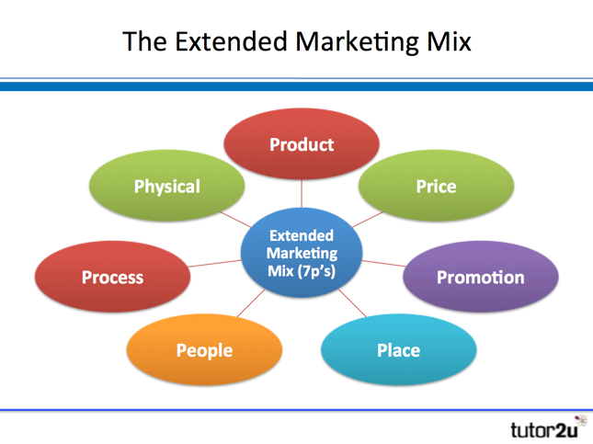
Marketing Mix – 7 ps
Product – Coming up with content for social media or hosting a variety of different events.
Price – Putting a price in place for entry to events.
Promotion – Designing promotional posters and leaflets to promote events and social media and advertising across social media.
Place – Using the designated facilities.
People – Engaging with the community.
Process – Following all the steps and plan put in place.
Physical – Making sure everyone engaging has a pleasant experience.

Slide 13
Summary
To summarise this presentation it is to begin with advertising all social media platforms for Newport Civil Service A.F.C and advertise events that will be held on their behalf. Then to begin looking at producing a variety of football content that can become engaging to anyone watching.
The first main target audience is the local community in order to gain an initial following and local support. Will look to host events in order to help renovate the 3G facilities making them more appealing to then with the right promotion and engagement with the community lead to more engagement online and more people attending events and using the facilities.

Slide 14
References
Assaad, W and Gomez, J.M (2011). 'Opportunities and Risks' Social Network in marketing (Social Media Marketing), 2(1), pp.13. International Journal of Managing Public Sector Information and Communication Technologies Journals. (Accessed: 26th May 2020)
Borah, A., Banerjee, S. and Lin, Y. (2020). 'Improvised Marketing Interventions in Social Media' [Online] Available at: https://journals-sagepub-com.ezproxy.uwtsd.ac.uk/doi/full/10.1177/0022242919899383 (Accessed: 29th May 2020)
Edward, S. (2000). 'Psychographic target marketing: (Buying) actions speak louder than words', 95(11), pp.86-96. Advisor Today. Available at: https://search-proquest-com.ezproxy.uwtsd.ac.uk/docview/216385855?accountid=130472&rfr_id=info%3Axri%2Fsid%3Aprimo (Accessed: 29th May 2020)
Elrod, J.K. and Fortenberry, J.L. (2018). 'Target marketing in the health services industry: the value of journeying off the beaten path', 18(3), pp.18. Available at: https://search-proquest-com.ezproxy.uwtsd.ac.uk/docview/2158351518?rfr_id=info%3Axri%2Fsid%3Aprimo (Accessed: 28th May 2020)
Son, L.H., Cuong, B.C and Long, H.V (2013). 'Spatial interaction – modification model and applications to geo-demographic analysis', Knowledge-Based Systems, 49(1), Elsevier Journals. Available at: https://www-sciencedirect-com.ezproxy.uwtsd.ac.uk/science/article/pii/S0950705113001548 (Accessed: 28th May 2020)
Southwell, B.G., Slater, J.S., Rothman, A.J., Friedenburg, L.M., Allison, T.R. and Nelson, C.L. (2010). 'The availability of community ties predicts likelihood of peer referral for mammography: Geographic constraints on viral marketing', Social Science & Medicine. 9(71), pp.1627-1635. Elselvier. Available at: https://www-sciencedirect-com.ezproxy.uwtsd.ac.uk/science/article/pii/S0277953610006337 (Accessed: 29th May 2020)

