Slide 1
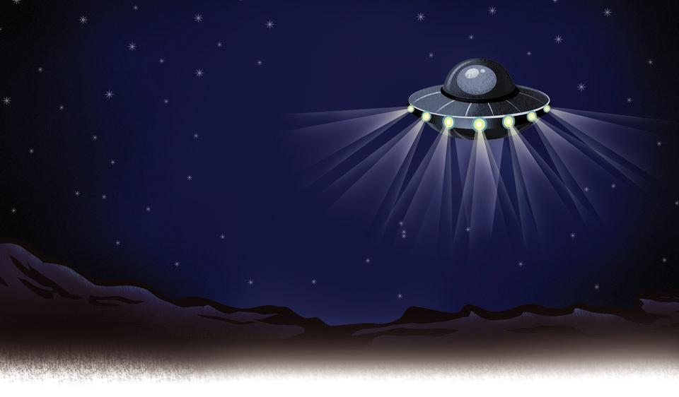
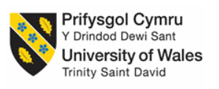
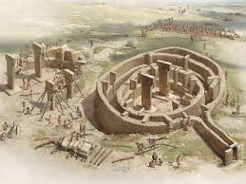
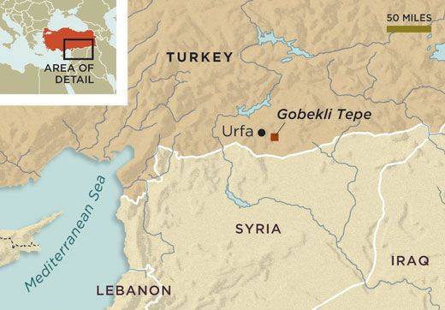
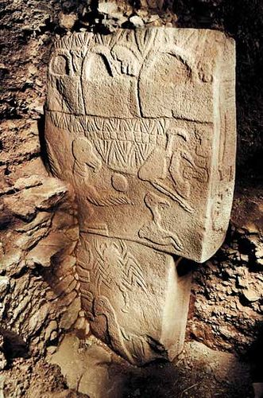
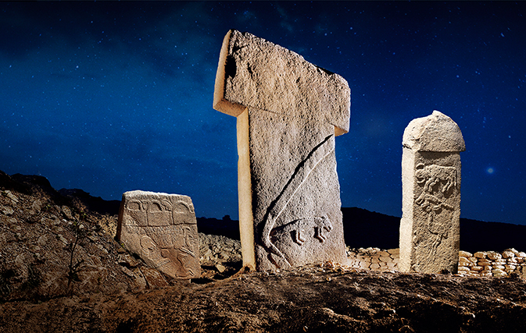
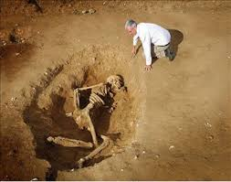
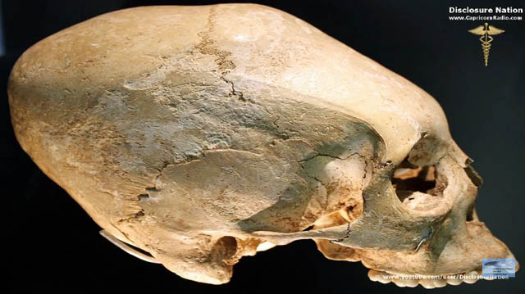
Gobekli Tepe: The Truth is Out There!
Gobekli Tepe is one of the oldest archaeological sites known to man, GT is recognised as being the oldest temple in the world by archaeologists. Pseudo-archaeology is a theory which goes against main stream theories put forward about this site. Pseudo-archaeology, just as it does about all the major archaeological sites claims that man at this time neither had the tools nor the technology to create such a temple. If the archaeologist does not address these issues which are normally all to quickly dismissed or overlooked, how can we refute them so easily?
1
Data set 1, will use the literature which deals with the claims by pseudo-archaeologists. Although the literature is somewhat dubious (Collins 2014, Scranton 2015) in this field, there is no reason why these theories cannot be addressed. Claims from pseudo-science about Gobekli Tepe include that people of the time neither had the knowledge or the skills required to create such a place and therefore needed help from other worlds or in some cases giants.
Data set 2, will involve looking at first hand literature from Klaus Schmidt the archaeologist who had been working on the site for 30 years. I have also used peer reviewed papers published on the site by other archaeologists on the basis of the evidence found there. Experimental archaeology from other sites involving moving large stones. Also The Tepe Telegrams which contains news and notes from the Gobekli Tepe Research Staff.
2
The aims and objectives of looking at this site will involve looking at primary sources to determine fact from fiction. Was it possible to build this temple without the help of aliens? Were there giants that helped build it? Also pseudo-archaeologists make many claims about what these stone inscriptions may mean including aliens, handbags and a cataclysmic event. Looking at the claims of the pseudo-archaeologists and first hand accounts it will hopefully be possible to determine the truth.
Looking at both data sets it is clear that people of this time did have the technology and knowledge to create this marvellous temple. Despite claims from pseudo-archaeologists that the tools available at this time did not have the capabilities to cut the stones in this way it has been proved that they can. Experimental archaeology has also proved that stones of this size can be transported easily enough and claims of giants skeletons being found at this site cannot be validated. Pseudo-archaeology may have its place but unfortunately not at this site.
3
4
5
Bibliography, Collins, A. 2014. Gobekli Tepe : Genesis of the Gods: The Temple of the Watchers and the Discovery of Eden. Bear & Company. Vermont. Scranton, L. 2015. Point of Origin: Gobekli Tepe and the Spiritual Matrix for the Worlds Cosmologies. Bear & Company. Vermont. Images 1, Ancient Aliens 2, Phys,org 3, Didim guide 4, Mike Philbins 5, Pinterest Theme image, Alamo

