Slide 1
Developing and Managing Individuals and Teams
LCLM5002
Fayza Boukhenifer
2335538

Slide 2

Recruitment and Selection for Cadbury’s Business Transformation Project

Slide 3
Table of Contents
Introduction to Cadbury 03
Recruitment Process Overview 04
Job Analysis, Description & Person Specification 05
Interview Type 1 – Structured Interview 06
Interview Type 2 – Competency-Based Interview 07
Interview Type 3 – Panel Interview 08
Questioning Techniques 09
Face-to-Face vs. Online Interviews 10
Comparison Table 11
Recommendations 12
Conclusion 13
References 14

Slide 4

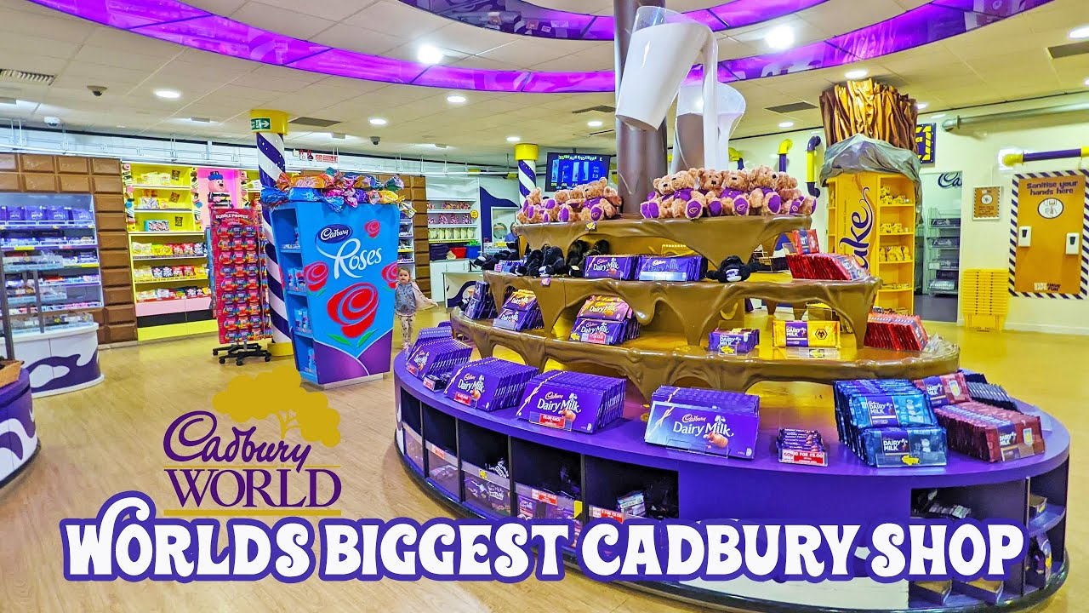
Introduction to Cadbury (Birmingham)
Cadbury was established in 1824 in Birmingham and has grown to be one of the most well-known confectionery brands in the world and currently falls under the parent company Mondelez international.
The company is still based in Bournville, Birmingham, where its tradition of quality and innovation is still maintained in the UK.
Cadbury is already experiencing a significant Business Transformation Project in order to improve its digital supply chain, operational effectiveness, and sustainability practices.
The Human Resources department is very crucial in attracting competent professionals who can lead this transformative initiative.

Slide 5
Recruitment Process
Workforce planning
Job analysis
Job description and person specification
Sourcing candidates
Screening and shortlisting
Interviews and assessments
Selection and onboarding
Recruitment is the process of choosing the appropriate individual to work in the appropriate job at the appropriate time in order to achieve organisation objectives. It starts with proper planning of workforce and job analysis to find out the staffing requirement. Candidate sourcing is done through a clear job description and person specification, which is then followed by screening and shortlisting. The structured interviews and tests provide equal treatment and success in the selection, as the successful candidate will be finally selected and successfully onboarded.

Slide 6
Job Analysis, Description & Person Specification
Job Role- Business Transformation Project Manager
Job Analysis
This will determine the most important duties and responsibilities, competencies needed and reporting line of the role to make sure that they align with the transformation goals of Cadbury.
Job Description
The digital supply chain integration project will be guided by the manager who will manage project timeframes and timelines, as well as organize cross-functional teams to achieve efficiency and innovativeness.
Person Specification
Management/Engineering Degree, more than five years of experience in project leadership, good communication, innovation and adaptability skills.
Job Analysis
Job Description
Person Specification

Slide 7

Interview Type 1- Structured Interview
Structured interview is based on a standard set of predetermined questions to be administered to all the candidates, and this helps in maintaining uniformity and fairness in the recruitment process.
This will reduce the level of bias and will enable the objective comparison of the applicants on their responses. It is especially good in managerial positions where dependability and openness are a must.
As an example, questions such as, explain a time when you conducted digital transformation in a manufacturing environment will be used to test the leadership, analytical and problem solving abilities of the candidate in real life situations.

Slide 8

Interview Type 2- Competency-Based Interview
Competency-based interview is based on behavioral demonstrations of how the candidate has performed in the past to determine how he/she will perform in future. It assists in measuring the main competencies leadership, teamwork, problem-solving, and adaptability.
The candidates would be requested to give particular illustrations of how they have exercised these skills in the former positions. As an example, Tell me about a situation when you were a leader of a diverse team in the context of change. The approach is useful in determining how the candidates use their skills in real and practical business situations.

Slide 9

Interview Type 3: Panel Interview
The panel interview involves a group of interviewers, who are usually the HR representative, Line Manager and Project Head, in order to have a balanced and fair evaluation process. Such an approach will collect a wide range of opinions on the suitability of each applicant to the position and reduce the influence of personal bias.
It is especially useful in high-stake jobs, like the Business Transformation Project Manager, where strategic decision-making, ability to lead and technical skills will need to be thoroughly evaluated in the context of several professional perspectives.

Slide 10

Questioning Techniques
Successful interview process can be achieved through effective methods of questioning, which can enable interviewers to determine the knowledge, reasoning and problem solving skills of the candidates.
Inquisitive questions can also be used to help respondents give more detailed answers, like when you ask them, Can you tell me more about the way you dealt with that situation? Questions used in Socratics disrupt the reasoning and choice of a decision, such as, What is it about your choice of approach? Questions that are leading can be used to steer answers although caution is needed to ensure the question is not biased.
Open-ended questions such as How would you manage stakeholder resistance? enable the candidates to speak freely and show their thoughts and communication abilities and analytical skills.

Slide 11

Face-to-Face Interview
Face interview enables the interviewer to interact face to face with the candidate and this will enable the interviewer to develop rapport with the candidate as well as to determine non-verbal skill like body language, confidence and interest.
Such a conventional method tends to make the communication process more personal and natural and minimizes the threats of disruptions caused by technology. But it may be time consuming, it involves coordination of schedules and it is not as flexible as virtual methods.
It is still effective in the measurement of interpersonal skills and emotional intelligence in managerial recruitment despite these shortcomings.

Slide 12

Online Interview
Online interviews offer flexibility and low cost means of assessing the candidates, as organizations can tap talent in various places without having to travel. This method is especially effective in preliminary screening or in those positions that are available remotely.
Nonetheless, online interviews can be affected by connection or technical problems that can interfere with the process. Also, there is a more difficulty to measure soft skills, non-verbal and interpersonal dynamics that are more accurately perceived in face-to-face communication.

Slide 13
Comparison Table
Criteria | Face-to-Face | Online
Rapport | Strong | Moderate
Cost | High | Low
Accessibility | Limited | Global
Time Efficiency | Moderate | High
Non-verbal Assessment | Excellent | Limited

Slide 14

Recommendations
To achieve successful recruitment in Cadbury, competency based interview can be applied in hiring managerial positions to determine skills and recent performance.
Controlled questioning must be incorporated in order to be fair and consistent. The accessibility and depth of assessment can be balanced by a hybrid interview method which combines both face-to-face interview and online interview.
Interviewers are also supposed to be trained on bias-awareness to minimize subjective influences.
Lastly, the connection between metrics in recruitment and performance will aid in measuring the effectiveness of the hiring decisions and aid in the overall organisational success in the long run.

Slide 15
Conclusion
Recruitment is paramount to the success of the Cadbury business transformation project in terms of selecting the appropriate talent to enhance strategic goals. Proper job analysis, interview skills and proper questioning methods will allow hiring candidates who are compatible with the company values and competencies. Integration of both the conventional face-to-face ways of having interviews and the new advanced online methods will help in maximizing diversity, equity, and accessibility which will ultimately help in maintaining the performance on a sustainable level and creating a high performing and engaged workforce that can produce transformative outcomes.

Slide 16
References
Huffcutt, A.I. & Murphy, S. (2023) ‘Structured interviews: moving beyond mean validity’, Industrial and Organizational Psychology, 16(3), pp. 344–348. Available at: https://www.cambridge.org/core/services/aop-mean-validity-div.pdf
Berry, C.M., Lievens, F., Zhang, C. & Sackett, P.R. (2024) ‘Insights from an updated personnel-selection meta-analytic matrix’, Journal of Applied Psychology. Available at: https://www.ovid.com/journals/japsy/pdf/10.1037/apl0001203~insights-from-an-updated-personnel-selection-meta-analytic?utm_source=chatgpt.com
Afandi, A.R., Rahmani, N.S., Jesika Pontoh, D., Maulana, A.I., Widianti, A. & Trifiani, R.N. (2024) ‘Competency trend in human resource (HR) development: a scoping review’, Psikologika: Jurnal Pemikiran dan Penelitian Psikologi, 29(1). Available at: https://journal.uii.ac.id/Psikologika/article/view/28981
Sarangi, P., Mishra, R. & Padhi, A. (2025) ‘Balancing skills and expectations: AHP analysis of competency-based recruitment in the EdTech sector’, Future Business Journal, 11, Article 57. DOI: 10.1186/s43093-025-00483-0.
Peasgood, T., Bourke, M., Devlin, N., Rowen, D., Yang, Y. & Dalziel, K. (2023) ‘Randomised comparison of online interviews versus face-to-face interviews to value health states’, Social Science & Medicine, 323, p. 115818. DOI: 10.1016/j.socscimed.2023.115818.
Wingate, T.G., Bourdage, J.S. & Steel, P. (2024) ‘Evaluating interview criterion-related validity for distinct constructs: a meta-analysis’, International Journal of Selection and Assessment. DOI: 10.1111/ijsa.12494.
Oktuğ, Z. (2023) ‘Examination of the differences between online and face-to-face interviews during a recruitment process in terms of candidates’ self-efficacy levels’, Journal of Economics and Administrative Sciences, 19(2), pp. 57–66.
Ahl, P. (2023) ‘How structured interviews are linked to job performance’, Alva Help. Available at: https://help.alvalabs.io/en/articles/10541075-how-structured-interviews-are-linked-to-job-performance
Bahri, E.S. & Salsiati. (2025) ‘The identification of competency-based human resource development strategy’, International Journal of Strategic Studies, 2(1), pp. 1–7. DOI: 10.59921/icestra.v2i1.50.
SIS International (2025) ‘F2F interviews and online: The pros and the cons’. Available at: https://www.sisinternational.com/f2f-interviews-and-online-the-pros-and-the-cons/

