Slide 1

Marketing management
Online MBA
BMMB7012
Welcome
Session
Gwyneth Jones
may 2023

Slide 2
a bit about myself – Gwyneth Jones
My name is Gwyneth Jones. I am a full time lecturer at UWTSD
I joined the University of Wales Trinity Saint David in 2023. As a member of the university’s Institute of Management and Health, I specialise in Marketing Management and topics such as Market Research, Marketing Communications, Digital Marketing, Brand Management and Consumer Behaviour.
I have been lecturing for over 25 years and also have industry experience in marketing and consultancy. I have worked throughout the UK and internationally in Dubai, UAE. Within Strategic Marketing and HE education.
Prior to UWTSD I worked at The University of Southampton
I have an Master’s Degree in Strategic Marketing, The Chartered Institute of Marketing Post Graduate Diploma in Marketing and am a member of the CIM, CMI and HEA.
You can contact me at gwyneth.jones@uwtsd.ac.uk

Slide 3

How I would like to work with you
Be curious and embrace the topic of Marketing Management
Contribute to our discussions
Ask questions during our lectures or tutorials
Decide what groups you would like to set up (4 – 6 people per group)
  We will use groups for smaller discussion activities and group assignment tasks
  Decide who represents the Group
  Group Representative to inform me who are the members of your group (name and student number)

Slide 4
A bit about you – Please introduce yourself
Do you have any work experience?
What is your current role?
What is your organisation’s industry background?

Slide 5
Module – on campus vs. online
Gwyneth Jones
Online module
Tuesday / Mornings (UK)
Gwyneth Jones
On campus module
Wednesday Mornings (UK)
Moodle Module Page
Shared between both modules, incl.:
Module Handbook
Background material
Assignment submission links
Etc.
Communication through Teams
If in doubt – ask me! ☺

Slide 6
Module Setup
Overall
  10 weeks May– July 2023
Lectures & Tutorials
  Consist mainly of taught sessions, drawing upon the wide range of teaching resources available to you on Moodle
  On Campus: Wednesday 10am – 1pm Lectures
  Online: Tuesday 10am – 1pm Lectures
Assignment Focus Sessions
  Focus entirely on the requirements of the assignment
  By appointment only
  Can be used for:
    Review a draft of your assignment
    Assignment questions, specific to your assignment

Slide 7
Module timetable
Week No | On Campus Dates Wednesdays 10am – 1pm | Online Dates Tuesdays 10am – 1m | Activity
1 | 10th May 2023 | 9th May 2023 | Welcome Session
2 | 17th May 2023 | 16th May 2023 | Introduction to Marketing and the Marketing Concept
3 | 24th May 2023 | 23rd May 2023 | The Marketing Environment
4 | 31st May 2023 | 30th May 2023 | The Nature of Buying Behaviour
5 | 7th June 2023 | 6th May 2023 | Segmentation, Targeting & Positioning
6 | 14th June 2023 | 13th June 2023 | Assignment 1 – Assignment Focus Session
7 | 21st June 2023 | 20th June 2023 | The Marketing Mix
8 | 28th June 2023 | 27th June 2023 | Current Issues and Future Developments
9 | 5th July 2023 | 4th 2023 | Creating Competitive Advantage & Global Marketing
10 | 12th July 2023 | 11th July 2023 | Assignment 2 – Assignment Focus Session
Activity | Deadline | Feedback
Assignment 1 | Friday 23rd June 2023 | Friday 21st July 2023 TBC
Assignment 2 | Friday 21st July 2023 | Friday 18th August 2023 TBC

Slide 8

Marketing – what does it mean to you?
What does Marketing mean to you/an organisation you are associated with?
What do you think marketers do?

Slide 9
What is marketing?
“Marketing is “the achievement of corporate goals through meeting, and exceeding customer needs better than the competition.”
Fahy & Jobber 2012: 5
“Marketing is the management process responsible for identifying, anticipating and satisfying customer requirements profitably.”
The Chartered Institute of Marketing 2023
“Marketing is the process by which companies create value for customers and build strong customer relationships to capture value from customers in return.”
Kotler et al. 2013: 5
‘Management must think of itself not as producing products, but as providing customer-creating value satisfactions. It must push this idea (and everything it means and requires into every nook and cranny of the organisation. It has to do this continuously and with the kind of flair that excites and stimulates the people in it.’ (Theodore Levitt, 1960)

Slide 10
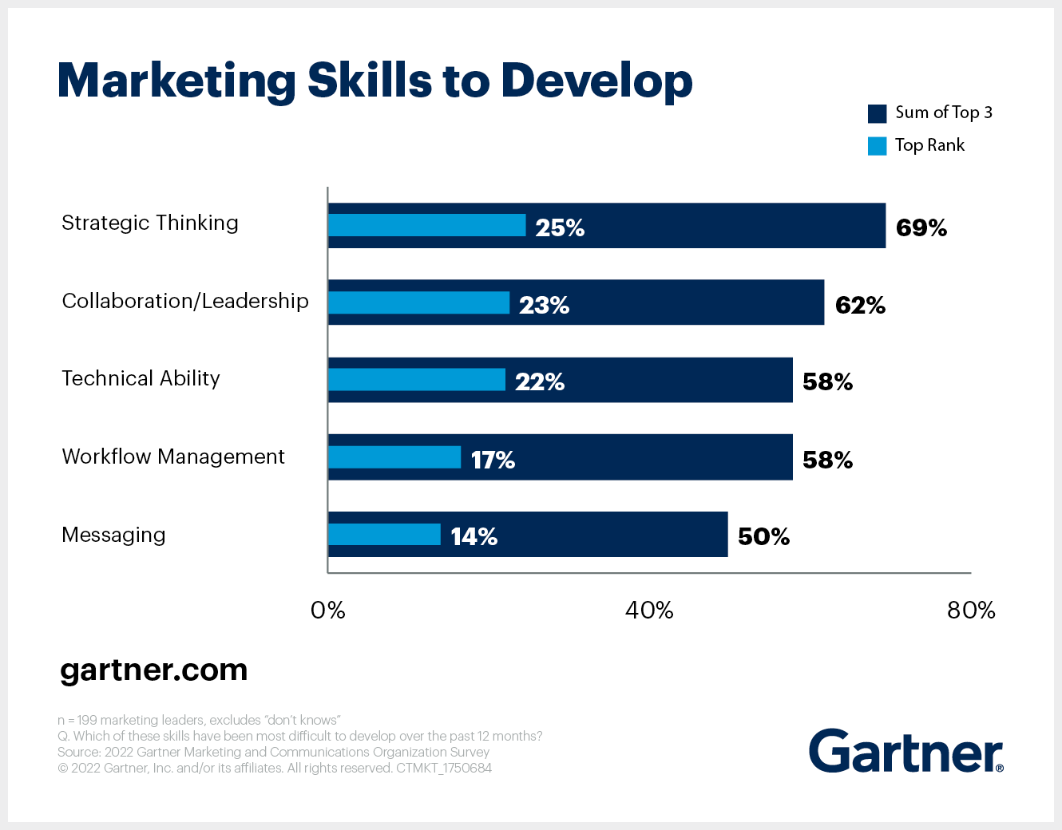
Evolving customer journeys have influenced marketing’s skills requirements
Question to Marketing Leaders: Which of these skills have been the most difficult to develop over the last 12 months? (Gartner 2022)

Slide 11
Gartner – Top Marketing Trends impacting 2023 marketing_predicts_for_2023_ebook.pdf (gcom.cloud)
Shifting customer behaviours amplify uncertainty - Amid inflation and economic uncertainty, customer demand and buying behaviours will fluctuate unpredictably.
Shared priorities may draw funding away from marketing departments that have yet to see their budgets return to pre-pandemic levels, resulting in lower performance against critical marketing goals.
Traditional sources of brand value are under pressure amid new forces: disruptive market entrants, heightened audience expectations, and the ease of digital learning about unfamiliar brands.
Gartner predicts that one in three businesses without a loyalty program today will establish one by 2027 to support first-party data collection and retain high-priority customers. Loyalty programs are an effective strategy to reward customers and collect critical data for personalisation and enhancing customer experiences.
Integration of AI will allow for smarter data driven marketing decisions

Slide 12
Introduction to mba Marketing management – module handbook
MODULE INTRODUCTION
To allow the student to assess the contribution of marketing in
any organisation and critically evaluate its marketing activities.
LEARNING OUTCOMES
Upon the successful completion of this module, the student should be able to demonstrate the ability to:
critically appraise key marketing activities and the contribution of the marketing department to the organisation.
anticipate and critically evaluate future developments in the field of marketing

Slide 13

Indicative content
The marketing concept: the changing nature of marketing, its key components and applications.
Scanning the external and internal marketing environments.
Market analysis and customer insight - market forces and failure, government intervention and failure in the market, competitive forces, consumer behaviour/expectations in a rapidly changing digital environment.
Market segmentation, target marketing and positioning and their use in creating value-delivering marketing strategies and marketing plans.

Slide 14

Indicative content (continued)
Understand how resources, assets, digital metrics, competences and capabilities support the achievement of delivering innovative strategies.
The marketing mix concept, its relation to segmentation and designing the marketing strategy.
Internal organisational marketing; communication of the corporate brand/reputation. Development of brand building techniques for delivering customer value/experience.
Understanding the strategic implications of the disruptive digital marketing environment

Slide 15

Indicative content (continued)
Internet ethics, new social contracts, global pressures, diversity of cultural mixes, managing difference and sustainable processes.
Analysis of models of ethics in the context of commercial priorities and market forces.
Current issues and future developments in marketing to ensure ongoing sustainability of the role of marketing as well as for organisations e.g. Search Engine Optimisation (SEO), Pay per Click (PPC), viral marketing, social media etc.

Slide 16
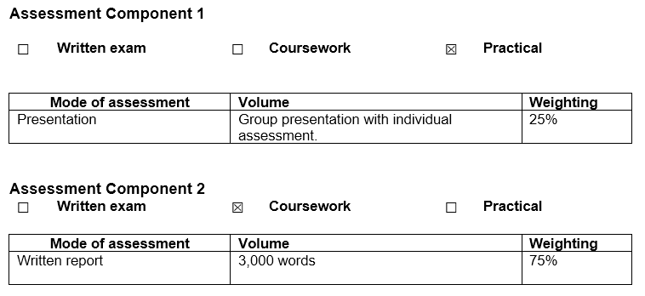
Assignments

Slide 17

Choosing an organisation for your assignment
If you are studying both Marketing and Strategy, you must chose different companies for each module
You must agree the company with me before you start working on it
The company that you chose for Marketing:
  Has to be the same for Assignment 1 (presentation) and Assignment 2 (report)
  Be very careful not to plagiarise each others work for the report!

Slide 18




Reminder: choosing case study companies for your Marketing & strategy assignments
Marketing Management
Strategic Management
Student A
Student B
Student C
Student D
Assignment 2
Four Individual Reports
Each of the four students writes a report about the same organisation
Student A
Student B
Student C
Student D
Student A
Student B
Student C
Student D
Four Individual Reports
Each of the four students writes a report about a different organisation compared to the one they worked on for the Marketing Assignment
Student A
Student B
Student C
Student D
Assignment 1
One Presentation

Slide 19
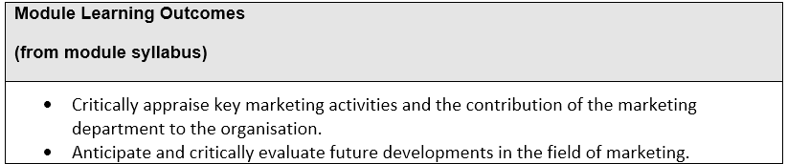
Assignment 1 – group presentation
Assignment Title – Future Developments in the Field of Marketing

Slide 20
Assignment 1 – task description
You are required to undertake a critical analysis of a Contemporary Issue in Marketing Management through the production of a 12-18 minute (+/- 10%) Group Video Presentation.
You may base your analysis on an organisation that you are familiar with, but you should agree with your lecturer beforehand that your chosen organisation is appropriate for the task.
Once you have decided on an organisation to use as your case study, your video presentation should address the following tasks:

Slide 21
Assignment 1 – task 1
Task 1: Identify a Relevant Contemporary Issue in Marketing Management
You should begin your video presentation by introducing yourselves and your chosen case study organisation and inform the listener of the issue that you have identified by defining and explaining it. You should also be clear as to why this is an issue especially for the Marketing Department at your chosen case study organisation.
Issues that you may wish to investigate (but not limited to) include:
  The use of Corporate Social Responsibility (CSR) in promotional material.
  Developments in social media and its use as a marketing platform.
  The development of technology and/or artificial intelligence (AI).
  Ethics in Marketing / Marketing Research / Marketing Channels / Advertising and Promotion.
  Price vs. Quality.
  Functionality vs. Symbolism.
  Changes in consumer buying behaviour because of changes to regulations on General Data Protection (GDPR).
  Or an issue of your own identification.

Slide 22
Assignment 1 – task 2
Task 2: Provide an Analysis of the Challenges Faced as A Result of your Chosen Issue
With the use of appropriate marketing tools, you should then provide an analysis of the challenges that your chosen case study organisation faces because of your identified contemporary issue.
Therefore, consider breaking down the key parts of the identified issue to uncover which are the most important elements that caused the biggest challenge to your case study organisation.
Within your analysis you should also be clear as to why these challenges are a result of your identified issue specifically.

Slide 23
Assignment 1 – task 3
Task 3: Critically Evaluate How Your Case Study Organisation Could Respond to the Challenges Presented by Your Identified Issue
Methods as to how your case study organisation should respond to the issues that you have identified should be critically evaluated in terms of their strengths and weaknesses before meaningful conclusions are drawn.

Slide 24
Assignment 1 – submission
As a group of 4 - 6 people, you will be expected to contribute fairly to the task, but you will be individually assessed, with individual grades and feedback provided.
Each member of the group must ensure they cover an element of critical analysis within their contribution to the task
Everyone will be required to contribute 3 minutes each, therefore the whole presentation should not exceed 12 (4 people) – 18 (6 people) minutes (+/- 10%).
You may use any video presentation software that you feel comfortable using for example, Adobe Spark, Vimeo, PowToon, Prezi Video, MS Teams.
However, it is important that your video does feature each member of the group, and you need to ensure that it is your voice that is being used to narrate your findings.
A Power Point Presentation can be used as a background, and it can incorporate a combination of supporting text, images and appropriate graphics that have been used to support your discussion – but please avoid reading from slides!

Slide 25
Assignment 1 – submission (continued)
A Presentation Template will be provided under the module documents tile on Moodle.
As a group you should work collectively to fully complete the Presentation Template, but only one member of the group should submit the template with a working link to your video presentation and a reference list by the submission deadline.
Other members of the group will be required to submit a signed Submission Template which can also be found under the module documents tile on Moodle as proof of submission.
**Please also note, that it is your responsibility as the student to ensure that the link to your video presentation does work and your assignment can be viewed for assessment and moderation purposes, therefore you may need to change any privacy settings to enable access**.

Slide 26
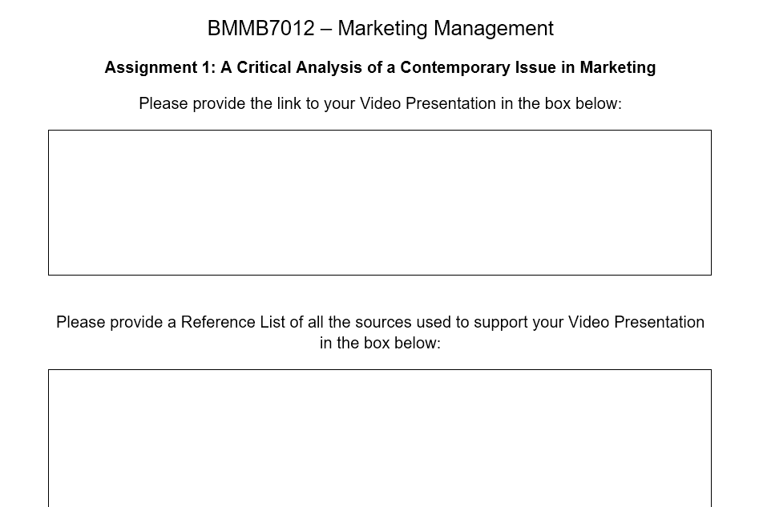
Presentation template
To be found on Moodle under Module Documents tile
Only one member of the group should submit the template
Your video link must be working!

Slide 27
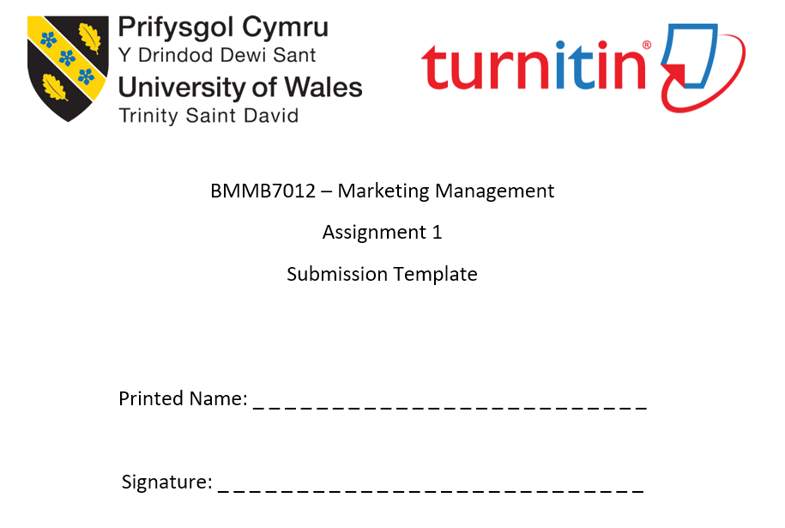
Submission template
Also to be found on Moodle under Module Documents tile
Other members of the group must submit a signed Submission Template
It is proof of submission
Without it, the lecturer cannot mark your work!

Slide 28
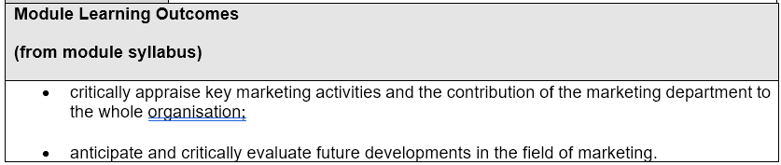
Assignment 2 – individual report
Title – Future Developments in the Field of Marketing
3000 words (+/- 10%)

Slide 29
Assignment 2 – task description
Individually, you are now required to produce a 3,000-word (+/- 10%) report that critically evaluates the role and activities of the marketing department within the same organisation that you researched for assignment 1 that will outline their future developments (what their marketing plan will be) to address the earlier identified challenges.
To achieve this, the following tasks should be considered…

Slide 30
Assignment 2 – task 1
Task 1: Provide a critical evaluation of your chosen organisation’s marketing activity
You should identify whether marketing activities within your chosen case study organisation were effective, giving sound justification for your decisions.
You should use evidence/examples to support your points (this can include links to examples of adverts or other marketing activity, where appropriate).
You should consider the following:
  The concept and importance of marketing: what resources are invested in marketing by your chosen organisation?
  The macro and micro marketing environment of the organisation: How have these influenced marketing strategy?
  Target market(s): who is the main audience for the organisation: why/how was this decided; what material is used to capture the target market (use examples); is this effective? Consider market segmentation, targeting, differentiation and positioning, and the marketing mix.
  Selection of media: what are the key channels/methods of communication used for marketing (social media/networking/email/search engine optimisation…); are these appropriate/effective; why/why not?
  Measuring success: how is the effectiveness of campaigns assessed; what are the measurement metrics? Is the marketing strategy effective / ineffective, how do they control marketing following this?

Slide 31
Assignment 2 – task 2
Task 2: Provide a conclusion addressing the shortcomings of your chosen organisation’s marketing strategy
It is important the conclusions drawn are based on your prior discussion.
The conclusion should not introduce new material, nor should the conclusions be ‘surprising’ based on what has been evaluated up to this point.

Slide 32
Assignment 2 – task 3
Task 3: Based on the conclusions drawn in Task 2, provide recommendations as to how your chosen organisation’s marketing strategy could be improved
These recommendations should be based on the conclusions provided for Task 2.
Recommendations not based on the conclusions drawn could be considered inappropriate.
You should give due attention to the feasibility of the recommendations you make: i.e., are these realistic within the budget and resource-limitations of your organisation?

Slide 33
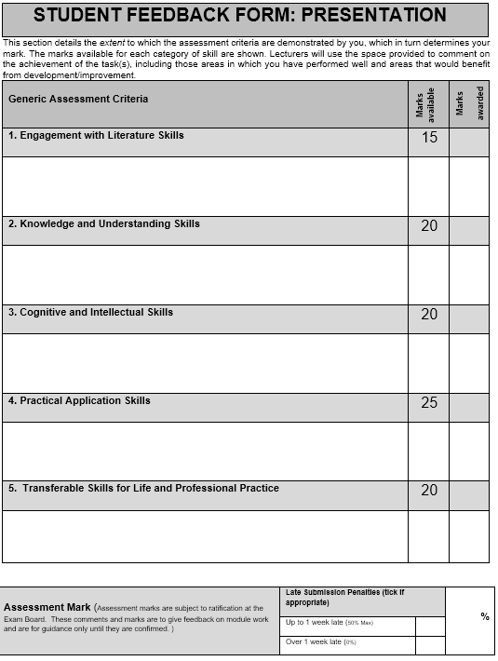

Student feedback form

