Slide 1

Addressing the problem of staff shortage in Proper Care, UK
Module : Problem Solving and Decision Making (BMSW 4004)
Tutor : Nicholas Worthington
Liviu Hadirca(2119291

Slide 2

Introduction
The National Health Service (NHS) is the umbrella term for the publicly funded healthcare systems of the United Kingdom (UK). Since 1948, they have been funded out of general taxation. There are three systems which are referred to using the "NHS" name (the NHS in England, NHS Scotland and NHS Wales).
Taken together, the four National Health Services in 2015–2016 employed around 1.6 million people with a combined budget of £136.7 billion.

Slide 3

Propblem
NHS hospitals and mental health and community providers are currently reporting a shortage of more than 100,000 FTE staff (representing one in eleven posts), severely affecting some key groups. One of the greatest challenges lies in nursing, with 41,000 nurse vacancies (one in eight posts), but there are also problems in medicine, particularly in some specialties and geographical areas, as well as some allied health professions. These pressures also extend beyond NHS trusts, with serious staffing issues in general practice.

Slide 4
What is understaffing?
Understaffing Means The Employment Of Too Few Members Of Staff. However, There Are Two Forms Of Understaffing. These Are:
Not Having Enough Staff In Your Business: This Is Probably The One You Thought Of First. Simply Put, This Is Where You Don’t Have Enough Staff To Cover All The Work Required To Run Your Business Smoothly.
Not Having Enough Staff At Any One Given Time: This Second Form Of Understaffing Is When There Are Multiple People Off All At The Same Time. This Can Come From Employees Being Off Sick, On Holiday, Out At A Conference, Or Maybe Just Working From Home.
This Second Form Of Understaffing Is The One That Goes Under The Radar. Until You Have Lots Of Staff Off At Once, You Will Probably Never Realize You Had An Issue.

Slide 5
5 ways understaffing can damage your business
1. Loss Customers
2. Brand Damage
3. A Decrease In Work Quality
4. Stressed Employees
5. High Staff Turnover Rate

Slide 6
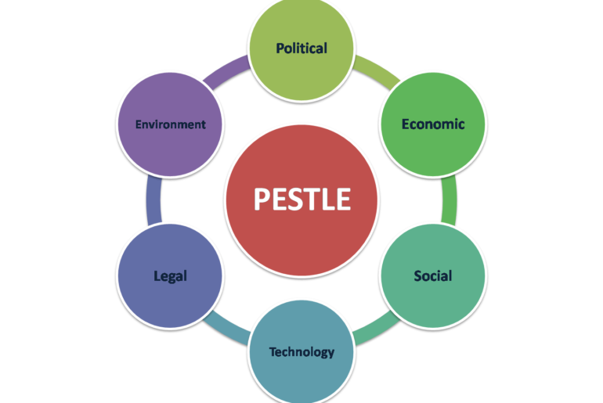

PESTLE
What is a PESTLE Analysis?
PESTLE analysis is a framework that can be used as a tool used to help identify the external factors that may affect a business or organization and commonly presented as a six pillar structure.(Macro environment ,No control)
These factors are:(Political, Economic, Social, Technological, Legal, Environmental)
PESTLE Analysis of the NHS
1.Political Factors(Brexit uncertainties(-))
2. Economic Factors(Economic downturn(-))
3.Sociocultural factors(Aging population(-))
4.Technological Factors(Improved healthcare(+))
5.Legal Factors (Litigation(-))
6. Environmental(Covid-19(-))

Slide 7
Fishbone Diagram
Ishikawa diagrams (also called fishbone diagrams, herringbone diagrams, cause-and-effect diagrams, or Fishikawa) are causal diagrams created by Kaoru Ishikawa that show the potential causes of a specific event.

Slide 9
Making rational decisions with defined criteria
Rational decision making leverages objective data, logic, and analysis instead of subjectivity and intuition to help solve a problem or achieve a goal.

Slide 10
SMART Targets
Setting SMART Goals means you can clarify your ideas and focus your efforts, which allows you to allocate your time in a way that promises the most return and the highest chance of achieving your goals.
Specific - I want to swap workers for robots
Measurable- Our goal is for the company to need 15% fewer workers
Attainable- My research has shown that we will be need by 10% less worker in that case
Realistic-By swap worker for robots we will be need lees employees
Time-Bound- 4-7 years

Slide 11
References
1.https://www.theguardian.com/society/2016/jan/18/10-truths-about-britains-health-service?CMP=share_btn_tw
2.NHS Sickness Absence Rates - NHS Digital
3. https://www.nuffieldtrust.org.uk/files/2019-03/1553101044_heaj6918-workforce-briefing-190320-web.pdf
4. https://www.e-days.com/news/understaffing-and-how-can-it-damage-your-business#:~:text=Understaffing%20can%20cause%20one%20of,help%20them%20buy%20from%20you
5. Ishikawa, Kaoru (1968). Guide to Quality Control. Tokyo: JUSE.
6. https://www.advergize.com/insights/pestle-analysis-examples-to-unlock-business-growth/
7. https://www.hydratemarketing.com/blog/the-importance-of-setting-smart-goals

