Slide 1
Narrative in Video Games vs Film
Ruth Heneghan | p148310
Research Methods and Communications

Slide 2


When films become games
Star Wars Battlefront II (2017), EA
Jurassic World Evolution (2018), Universal Studios
Notes:
When games are adapted into film, and films adapted into video games, a key component to their popularity is lost in translation.
When games are created from films the overall reception is higher on average than when games are adapted into film: adding interactivity adds to the appeal of the world, even if games that tie-in with films are often slated as bad (average scores rarely reach higher than 80%, but don’t fall far below 50% either)

Slide 3



When games become films
Resident Evil Film Franchise, distributed by Screen Gems
Doom (2005), Universal Pictures
Tomb Raider (2018), Warner Bros. Pictures
Notes:
The highest rated video game-based films on Rotten Tomatoes and Metacritic exceed the halfway mark for scores on 4 occasions, out of 34 games. When games are adapted into film, the interactivity of the narrative is taken away, as discussed by Torben Grodal in Media Entertainment: The Psychology of Its Appeal; Video Games and the Pleasures of Control. In his book he discusses the popularity of video games through the player’s ability to control the outcome and become a part of the narrative, as opposed to the passive viewing of films. Becoming immersed in games through the control exerted through play is what makes video games popular these days.
In Playing with Power in Movies, Television, and Video Games by Marsha Kinder, it is posed that film is no longer an important pastime (though this was written back in 1991, and the perpetuation of cinema to this day shows that this wasn’t entirely true). She writes that “the history of entertainment is driven by the pleasure principal—the alleviation of boredom and the pursuit of control or mastery” when speaking of her son’s interests. This shows in more recent studies into the spending culture and pastimes of people in modern times: in 2016 the US video game industry generated $30.4 billion in revenue in comparison to $11.38 billion revenue earned in the film industry.
Upon reviewing these figures, it is understandable that the film industry would try and adapt the popular games into film, to try and take back some of the revenue. But, as discussed above, when it comes to ‘alleviating boredom’ video games are more popular, and it is likely attributed to the interact-ability of said games.

Slide 4
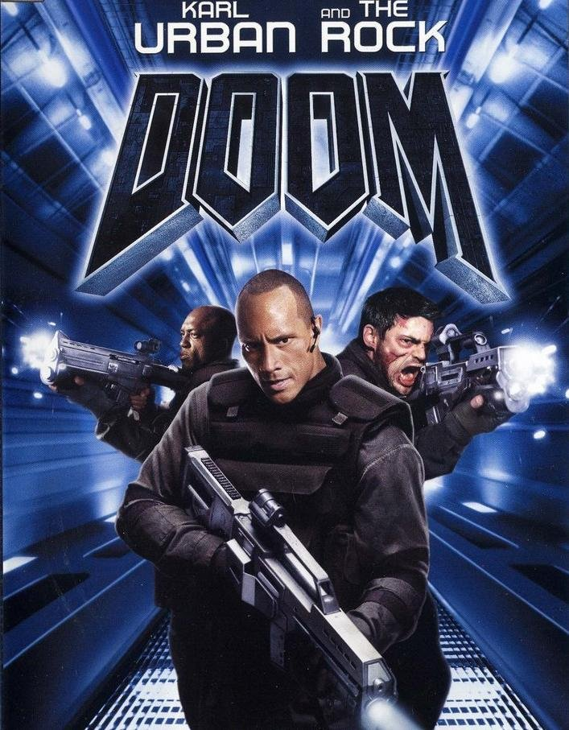
“Doom is like some kid came over and is using your computer and won’t let you play.”
Roger Ebert’s review of the 2005 film adaptation of Doom
Doom (2005), Universal Pictures
Notes:
When that interactivity is removed, the story is less engaging and suffers as a result (as seen through the waning scores of films based on video games). A review by Roger Ebert for the video game-based film Doom (2005) (based off a popular first-person series of games where the player character fights their way through the hoards of Hell from 1993) pertains to this, saying: “The movie has been inspired by the famous video game. No, I haven’t played it, and I never will, but I know how it is to not play it. Because I’ve seen the movie. Doom is like some kid came over and is using your computer and won’t let you play”. Once again this implies that while video game stories can be interesting to watch, when the interactivity is taken away it loses much of its charm. It’s not to say the film was bad, only that a lot of what makes it interesting (particularly with the Doom game series) is how you play, and watching the action happen without the satisfaction of being a part of it takes away from the overall experience.
Some films suffer from poor screen writing, such as the Tekken film in 2009, which currently holds a 0% rating on Rotten Tomatoes. It is said to have suffered due to the lack of collaboration between the film producers and the developers of the game series, as said by director of the series Katsuhiro Harada. This study aims to understand why games are not easily portrayed through the film medium.

Slide 5


Growing in Popularity
League of Legends World Championship Logo, Riot Games
Overwatch league, Blizzard
Notes:
Interactivity seems an integral part of games, yet there is a rising popularity in both eSports (watching teams play competitively in designated games) and the watching of people playing games on YouTube (often referred to as Let’s Play). The popularity of eSports is arguably similar to the popularity of regular sports such as football, where viewers identify with specific teams and bond together over the feeling of belonging to a community (as described in an article by Christine Emba in the Washington Post titled Why do we care about sports so much?). Following a team in a popular sport has been integral to social relationships for centuries (even in Wales, with cnapan being a popular sport before rugby and football), but the rise of gaming on YouTube clashes with the theory that taking the interactivity from video games ruins the experience.

Slide 6



Growing in Popularity
Jacksepticeye
Markiplier
Vanossgaming
Notes:
Jessy Garza, in an article of ODYSSEY, discusses possibilities of why watching other people play games online has become so popular. In her article she writes about the entertainment aspect of these videos, in which the person playing is a part of the entertainment. The example provided is when viewers are watching these individuals playing, it gives off a “comfortable atmosphere as if they’re right there next to you as they play these games”. Thousands of people come to watch these ‘Let’s Play’ers reacting to different games despite there being no interactivity with the game itself (though through the advancement of the YouTube’s website, it is now possible to communicate with players as they play live via video ‘streaming’), which puts it at odds as to why films based on video games aren’t popular despite interesting narrative. The interactivity has been taken away and left nothing but story for the viewer, with the addition of simply another person speaking over the game as they play. Referencing back to the negative review of the Doom (2005) film by Roger Ebert, where it felt like watching someone else play, it contrasts against the theory that the popularity of games is because of the interactivity.

Slide 7
Proposed Methodology
Test 1: Create a short gameplay experience and a filmed or animated scene from the same story. In two different groups individuals will experience one and then the other, and submit a review of each.
Test 2: Using already established story with both a film and a game, have groups experience the individual media together. An individual will play the game with an audience, to emulate the YouTube gaming situation; everyone watches the film as usual.
Notes:
To cover the complexity of the subject, and to gain as accurate a response as possible, the testing portion would be split into multiple tests. This is to study the responses to films based on video games and video games based on films: also, whether the same game and film can be enjoyed with other similarly to the situation displayed when people watch an individual playing a game.
For this test, a short gameplay demo and a short film or animation would be created based on the same story. A completely original story, or one based on an already popular story such as King Arthur, would be suggested, to create as neutral a situation as possible in the experiencing of these pieces of media. Both would be no longer than thirty minutes, to give those participating enough time to familiarise themselves with the material (particularly with the controls and mechanics of the game).
Two test groups would be required: one group would be shown the game first, and then the film or animation, the other would be given the opposite, before both groups would be asked to express which they preferred and why. They would be shown these media alone, with no audience and no outside stimulus, before giving their responses. The responses of both groups would then be brought together and compared, to see whether the ‘game based off the film’ was better or worse than the ‘film based off the game’. This is to test whether there is an actual problem with changing narrative between the two media, or if it is a biased gained from comparing the follow up to the original.
The second portion of the test would use pre-existing games, and their corresponding films. One person would play the game while others watch, thereby mimicking the ‘Let’s Play’ scenario, whilst others would watch the film adaptation of the same game. This would test to see if removing the interactivity from the situation is still enjoyable to the audience, and why it’s different to be watching gameplay rather than a film.

Slide 8
Proposed Outcomes
Notes:
By performing these tests, it is hoped that an understanding is reached as to why subjectively good film adaptations of games are difficult to achieve, and whether interactivity has any bearing on the outcome.
The results of the initial test—comparing ‘the film of the game’ versus the ‘the game of the film’—will aim to find out what causes the greatest difficulties when adapting one for the other, or if it is even achievable. Are these problems biases dependant on which media is seen first, resulting in comparisons being drawn (as films are often compared and derided when compared to their precursor books) or are they a problem in translating narrative between media, where the removal or inclusion of interactivity causes too much of an impact? With this test it is proposed that it is the former, where a bias is formed by the consumption of one before the other (if the material in use is suitably fair to both medias in question).
The results of the second test—to see what the main differences between watching another person’s gameplay of a video game versus a film adaptation of the same story—require a game-film pairing with similar review scores to keep results fair (for example if the film in question doesn’t correspond with the paired game in terms of reviews and reception). This portion of the test would be more difficult because of the balance between game and film required, but the expected result is that the game is popular because of the addition of a person entertaining as they play when removing the interactivity of the game itself. The person playing can still interact and converse with the audience (as evidenced by YouTube gamers, even if they aren’t actively getting a response whilst recording), whilst films require that the audience remain as silent spectators when regarding the narrative.

Slide 9
References
Chester, N. (2010). Tekken boss calls Tekken film "terrible". [online] destructoid. Available at: https://www.destructoid.com/tekken-boss-calls-tekken-film-terrible--181059.phtml [Accessed 5 Nov. 2018].
Ebert, R. (2005). Doom Movie Review & Film Summary (2005) | Roger Ebert. [online] Rogerebert.com. Available at: https://www.rogerebert.com/reviews/doom-2005 [Accessed 5 Nov. 2018].
Emba, C. (2016). Why do we care so much about sports?. [online] The Washington Post. Available at: https://www.washingtonpost.com/news/in-theory/wp/2016/03/14/why-do-we-care-about-sports-so-much/?noredirect=on&utm_term=.f9f8b0e552b8 [Accessed 5 Nov. 2018].
Garza, J. (2016). YouTube Let's Plays: Why They're So Popular. [online] The Odyssey Online. Available at: https://www.theodysseyonline.com/youtube-lets-plays-why-theyre-so-popular [Accessed 5 Nov. 2018].
Statista. (2017). North American box office revenue 1980-2017 | Statistic. [online] Available at: https://www.statista.com/statistics/187069/north-american-box-office-gross-revenue-since-1980/ [Accessed 5 Nov. 2018].
The Entertainment Software Association. (2016). U.S. Video Game Industry Generates $30.4 Billion in Revenue for 2016 - The Entertainment Software Association. [online] Available at: http://www.theesa.com/article/u-s-video-game-industry-generates-30-4-billion-revenue-2016/ [Accessed 5 Nov. 2018].

Slide 10
Bibliography
Adeoye, A. (2016). [online] Goombastomp.com. Available at: https://www.goombastomp.com/film-vs-video-games-craft-storytelling/ [Accessed 5 Nov. 2018].
Casey, D. (2018). Why Are Video Game Movies Always Terrible? | Nerdist. [online] Nerdist. Available at: https://nerdist.com/why-are-video-game-movies-always-terrible/ [Accessed 5 Nov. 2018].
Ceros Originals. (2017). Narrative Design and the Future of Video Game Storytelling. [online] Available at: https://www.ceros.com/originals/narrative-design-video-game/ [Accessed 5 Nov. 2018].
Dinehart, S. (2015). The Narrative Design Explorer. [online] Narrativedesign.org. Available at: http://narrativedesign.org/ [Accessed 5 Nov. 2018].
Foote, R. (2016). Who rules entertainment industry? Video games vs. film & music. [online] http://www.kfvs12.com. Available at: http://www.kfvs12.com/story/31140647/who-rules-the-entertainment-industry/ [Accessed 5 Nov. 2018].
Franich, D. (2018). Videogames vs. Movies: Which Medium is Greater?. [online] EW.com. Available at: https://ew.com/article/2011/08/18/movies-videogames-inception-red-dead-redemption/ [Accessed 5 Nov. 2018].
Griffin, S., Cheeseman-Meyer, E., Tarr, J., Shawl, N. and Ball, M. (2018). Learning Narrative Structure from Video Games. [online] Tor.com. Available at: https://www.tor.com/2018/01/19/learning-narrative-structure-from-video-games/ [Accessed 5 Nov. 2018].
MacDonald, K. (2018). Movie adaptations of video games are still mostly terrible. Why has no one cracked the code?. [online] the Guardian. Available at: https://www.theguardian.com/film/2018/mar/29/movie-adaptations-video-games-terrible-crack-code [Accessed 5 Nov. 2018].

