Slide 1
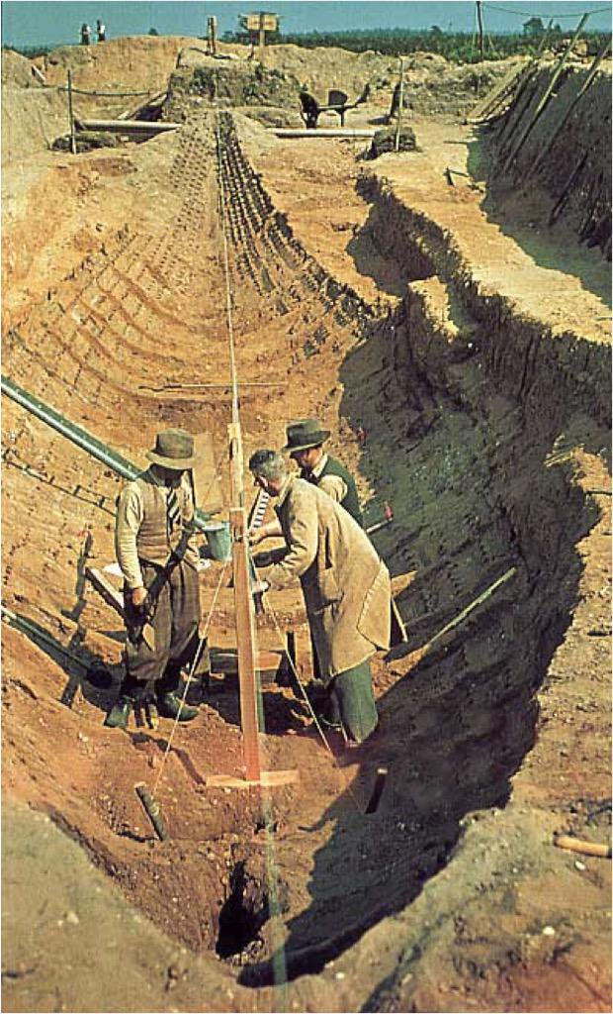



Reconstructing the Sutton Hoo ship
Name: Tim Kirk
Student No: 1710839
Module: HPAR6012
Using physical and digital modelling to aid the interpretation of digital datasets
By: Tim Kirk
Lead Shipwright
The Sutton Hoo Ship’s Company

Slide 2
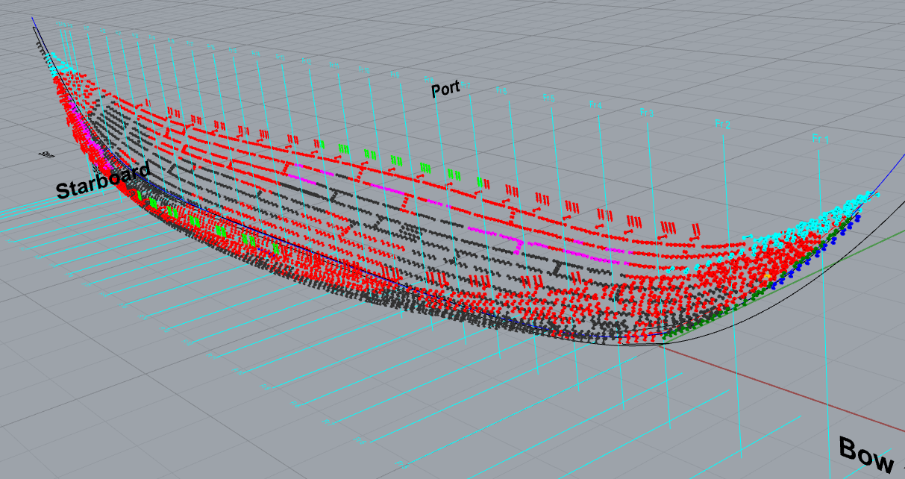
Source: Sutton Hoo Ship’s Company (SHSC)
Isometric view of rivet patterns developed using Rhino3D

Slide 3
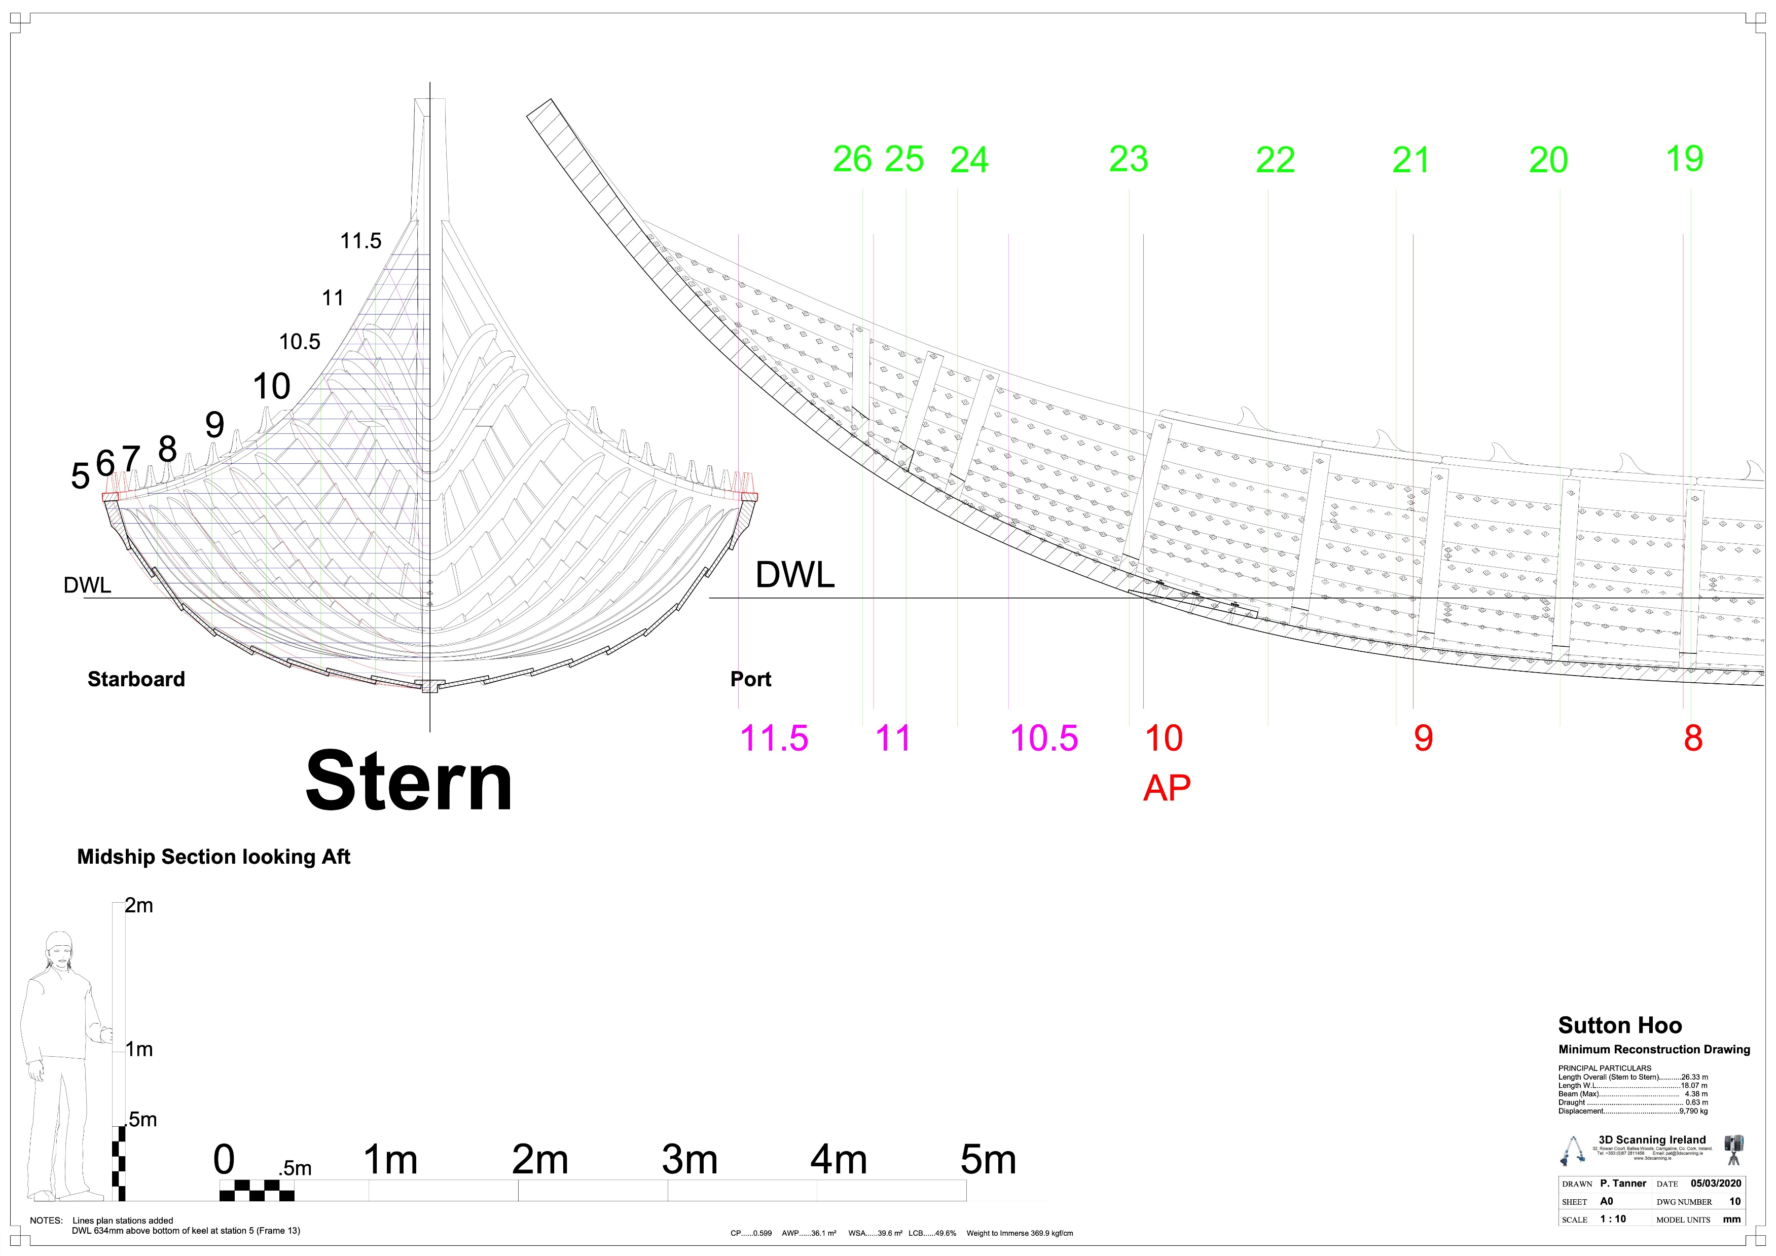
Source: SHSC

Slide 4
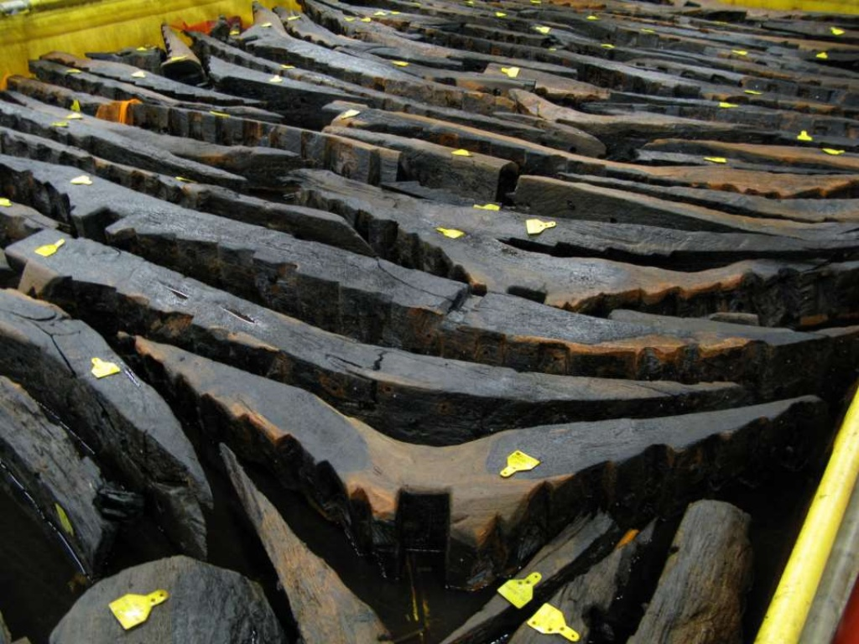
Source: Newport Ship Museum

Slide 5
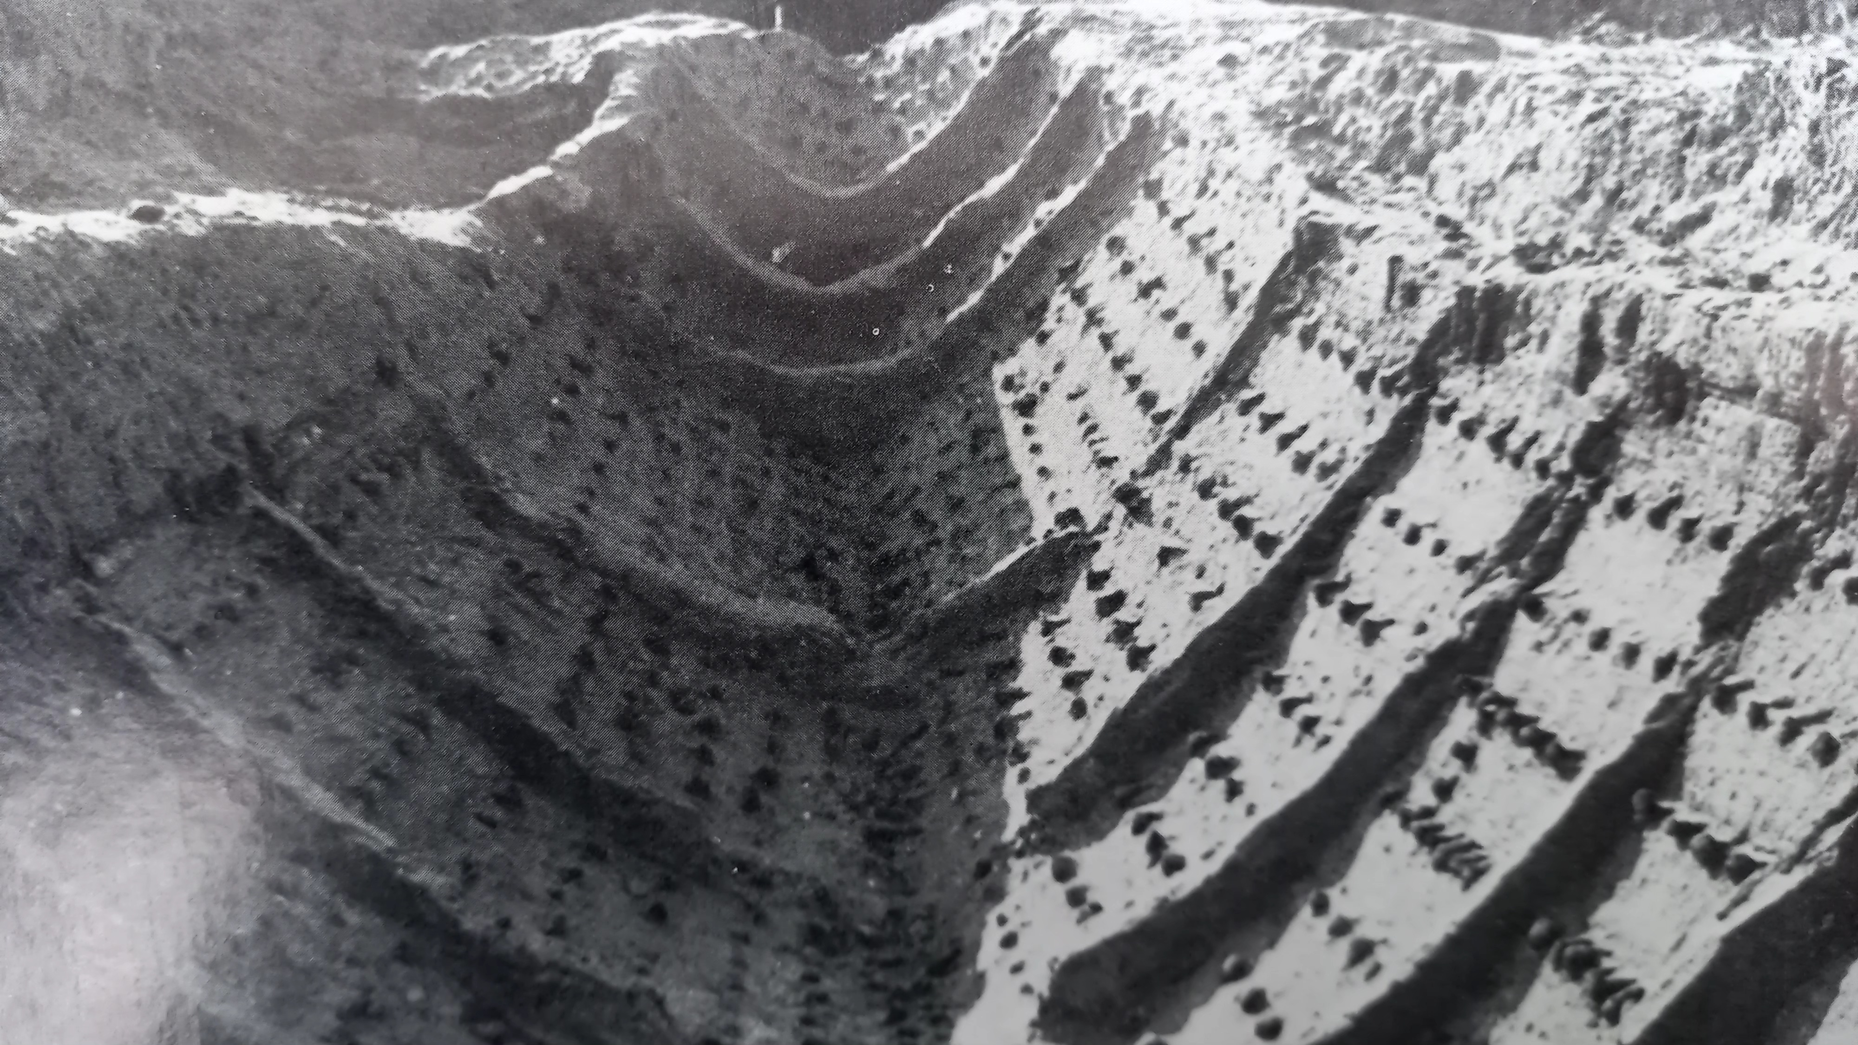
Source: Trustees of the British Museum

Slide 6
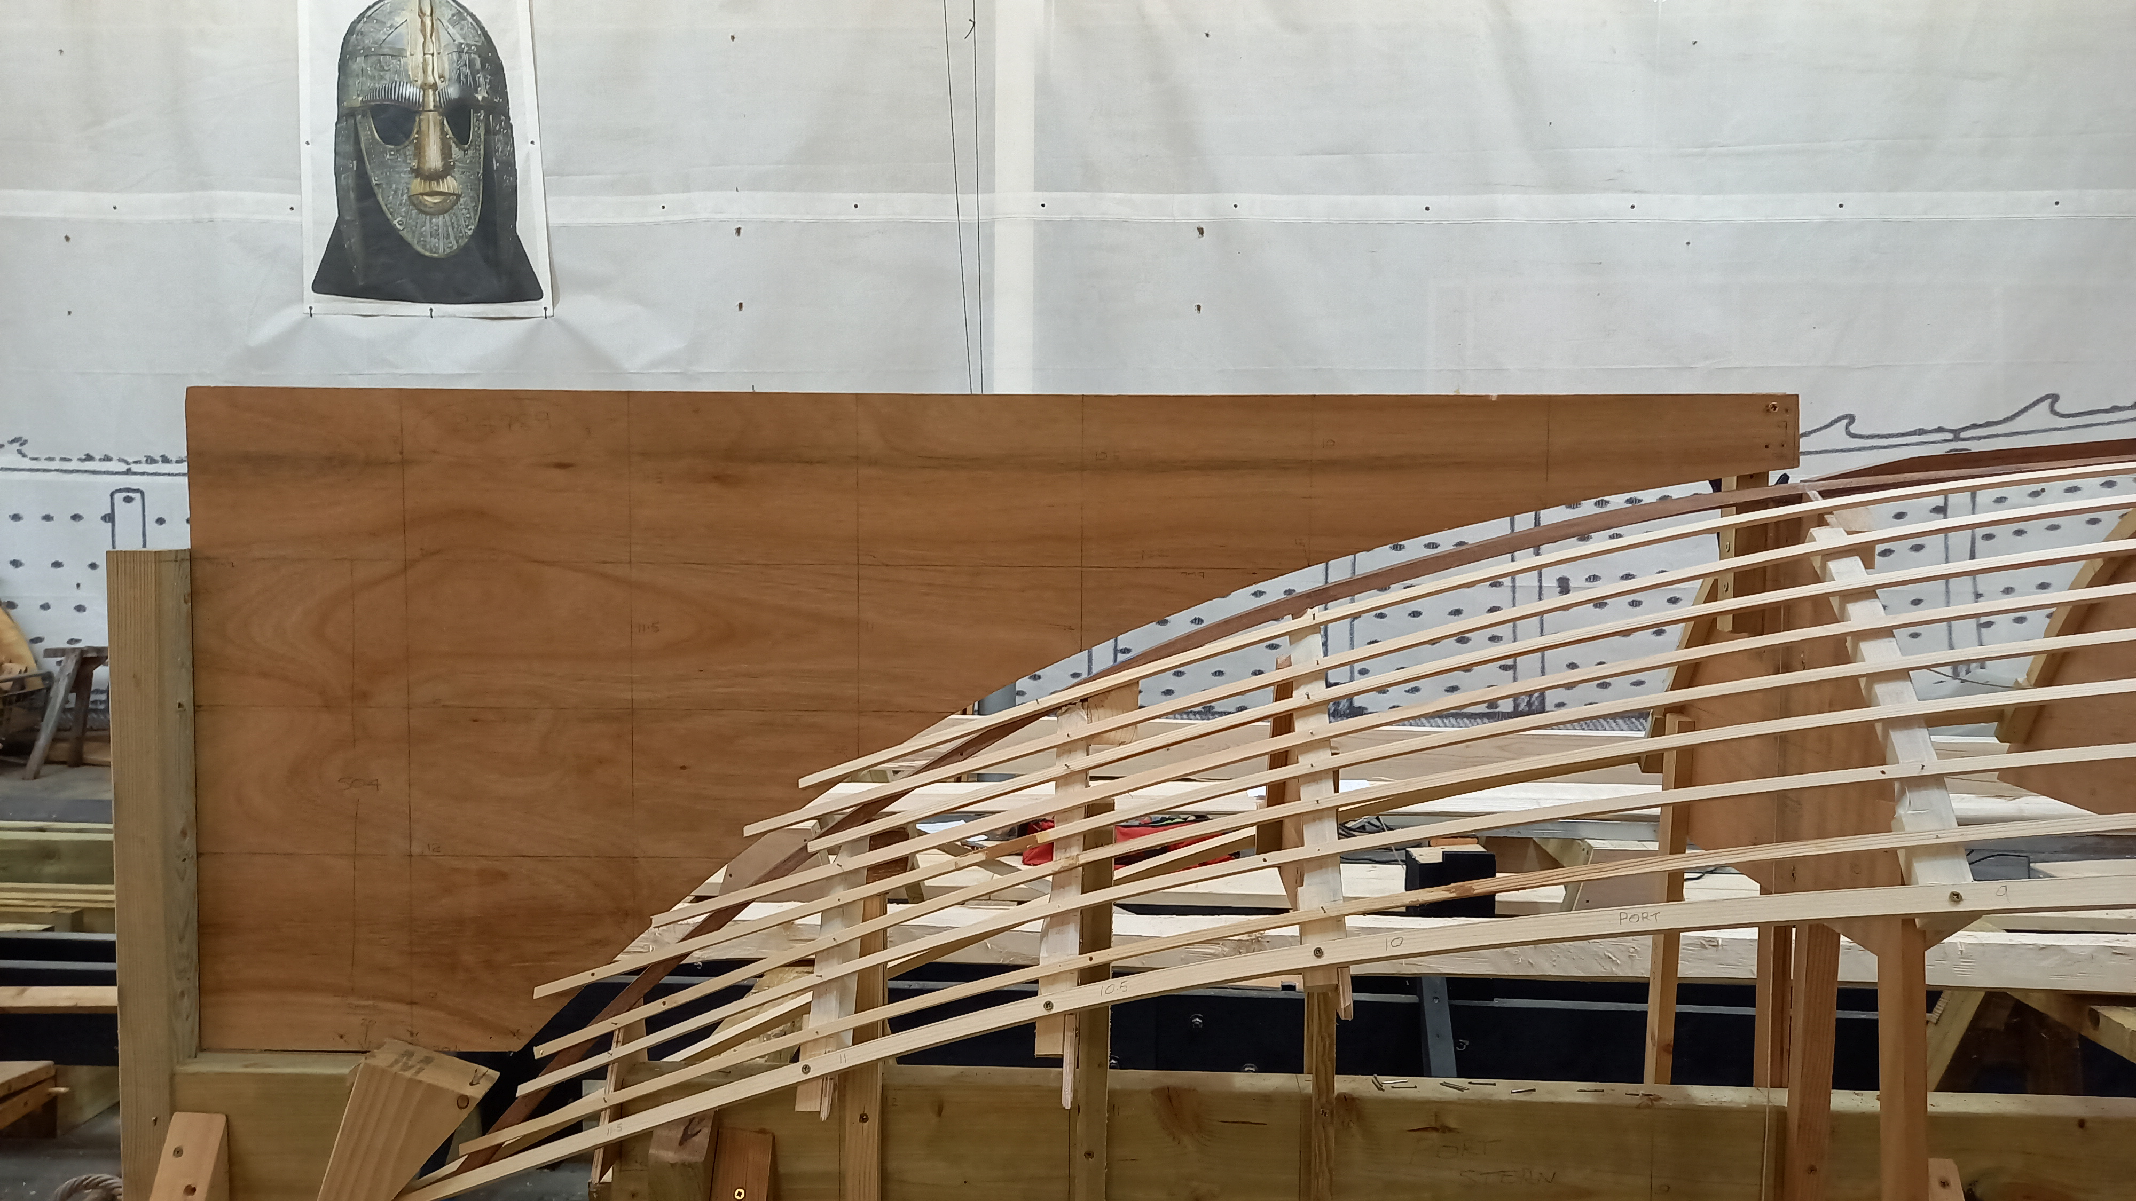
Photo: Author

Slide 7
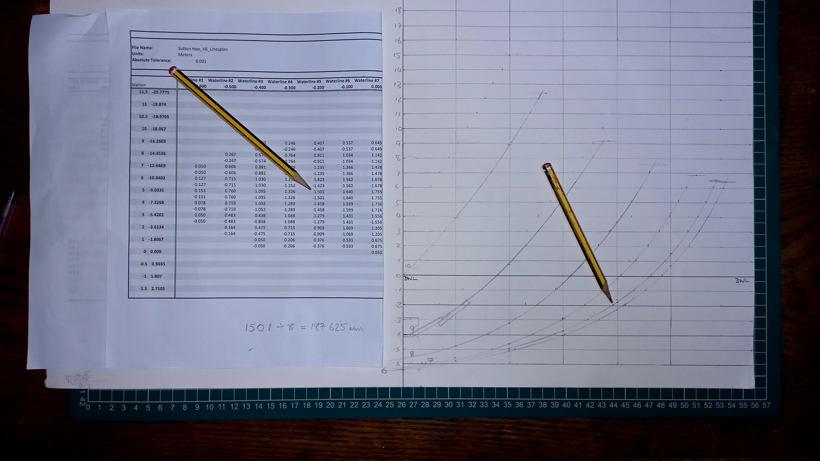
Photo: Author

Slide 8
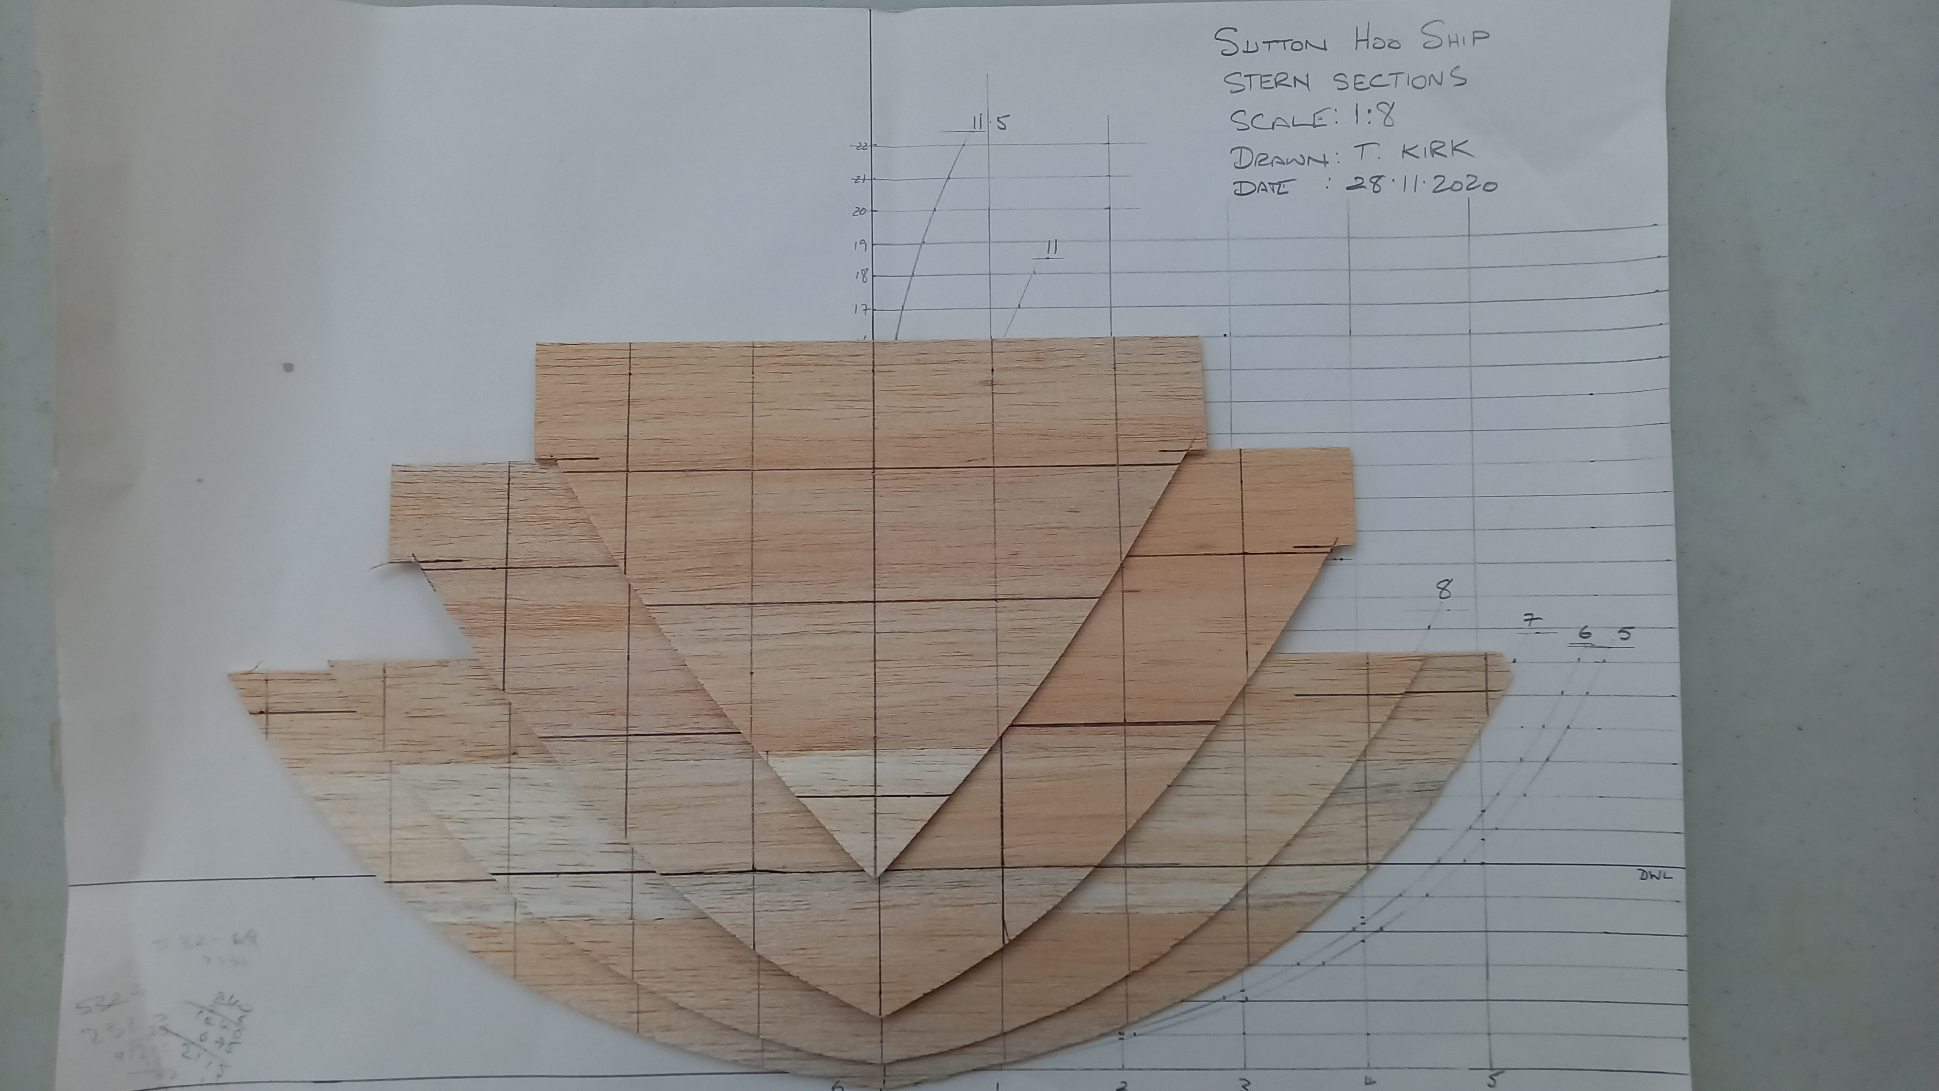
Photo: Author

Slide 9
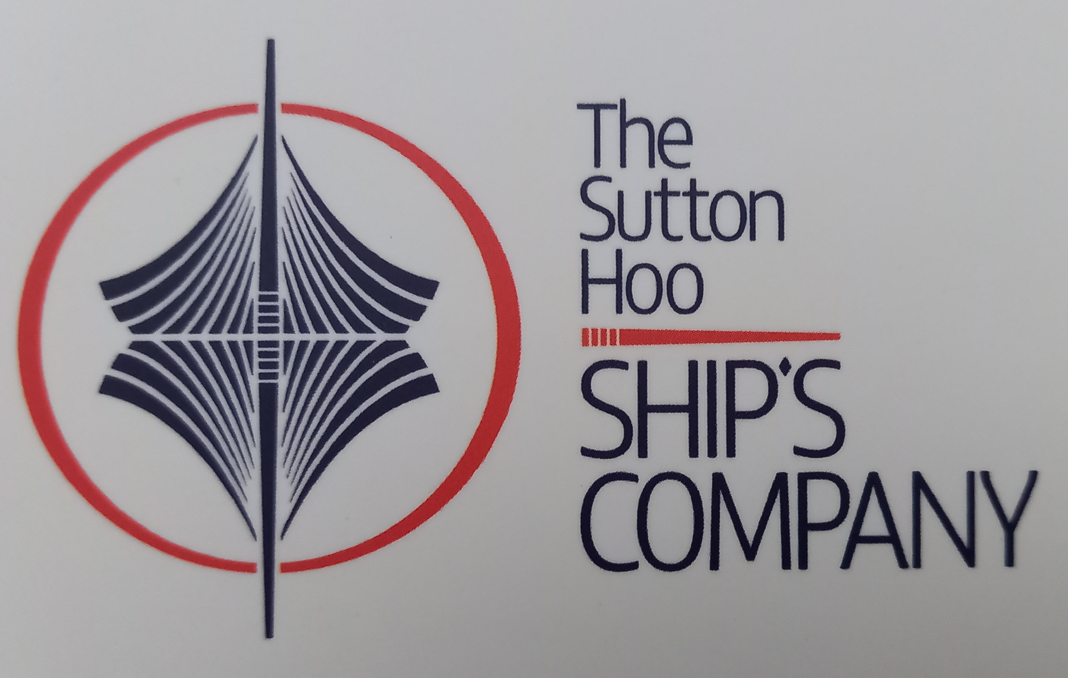
Bibliography
Bruce-Mitford, R. (1975). “The Sutton Hoo Ship Burial, Volume 1”. London: The Trustees of the British Museum.
Gifford, E. and Gifford, J. (1992). “Anglo-Saxon Sailing Ships”. Woodbridge: Creekside Publishing.
Ingold, T. (2013). “Making”. Abingdon: Routledge.
Phillips, C. (1940). “The Sutton Hoo Ship Burial: 1 – The Ship” in Antiquity, 14.53, pp. 6-27. Available at: https://www.doi.org/10.1017/SOOO3598x00014745. Last accessed 20.07.2020.
Tanner, P., Whitewright, J. and Startin, J. (2020). “The Digital Reconstruction of the Sutton Hoo Ship” in International Journal of Nautical Archaeology 49.1, pp. 5-28. Available at: https://www.doi.org/10.1111/1095-9270.12394. Last accessed 27.08.2020.
Website: www.saxonship.org
E-mail: contact@saxonship.org
YouTube: search for ‘Sutton Hoo Ship’s Company’
Instagram: suttonhooship

