Slide 1

PSYCHOPATHOLOGICAL CLASSIFICATIONS AND PROVISIONS (BMHP6029_LON)
STUDENT NAME: MOHAMMAD NURUL ISLAM
STUDENT ID: 2327900
LECTURER: BIANCA SANFILIPPO

Slide 2
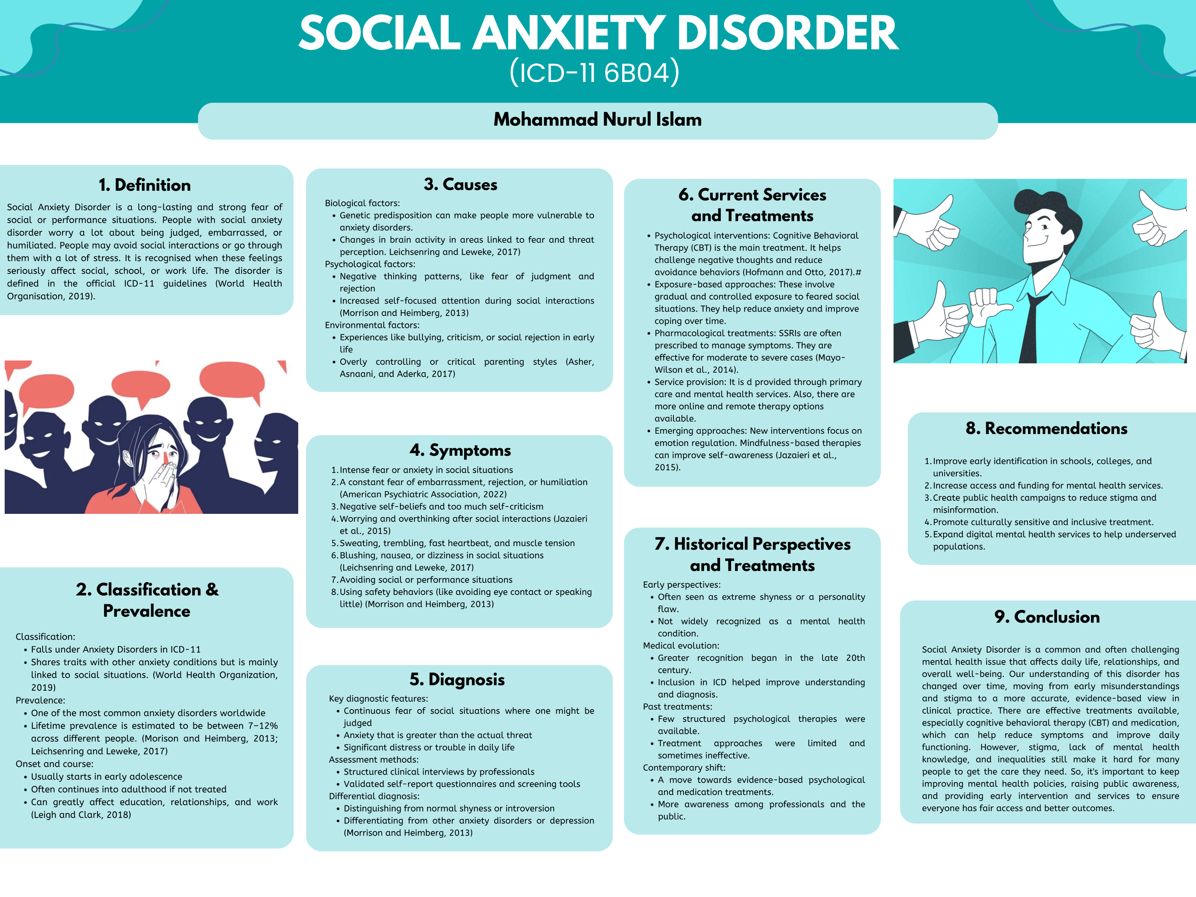

Slide 3
REFERENCES:
  American Psychiatric Association (2022) Diagnostic and statistical manual of mental disorders. Washington, DC: American Psychiatric Association Publishing.
  Asher, M., Asnaani, A. and Aderka, I.M. (2017) ‘Gender differences in social anxiety disorder: A review’, Clinical Psychology Review, 56, pp. 1–12.
  Hofmann, S.G. and Otto, M.W. (2017) Cognitive behavioral therapy for social anxiety disorder: Evidence-based and disorder-specific treatment techniques. 2nd edn. New York: Routledge.
  Jazaieri, H., Morrison, A.S., Goldin, P.R. and Gross, J.J. (2015) ‘The role of emotion and emotion regulation in social anxiety disorder’, Current Psychiatry Reports, 17(1), p. 531.
  Leichsenring, F. and Leweke, F. (2017) ‘Social anxiety disorder’, New England Journal of Medicine, 376(23), pp. 2255–2264.
  Leigh, E. and Clark, D.M. (2018) ‘Understanding social anxiety disorder in adolescents and improving treatment outcomes: Applying the cognitive model of Clark and Wells (1995)’, Clinical Child and Family Psychology Review, 21(3), pp. 388–414.
  Mayo-Wilson, E., Dias, S., Mavranezouli, I., Kew, K., Clark, D.M., Ades, A.E. and Pilling, S. (2014) ‘Psychological and pharmacological interventions for social anxiety disorder in adults: A systematic review and network meta-analysis’, The Lancet Psychiatry, 1(5), pp. 368–376.
  Morrison, A.S. and Heimberg, R.G. (2013) ‘Social anxiety and social anxiety disorder’, Annual Review of Clinical Psychology, 9(1), pp. 249–274.
  Stein, M.B. and Stein, D.J. (2008) ‘Social anxiety disorder’, The Lancet, 371(9618), pp. 1115–1125.
  World Health Organization (2019) International classification of diseases for mortality and morbidity statistics (11th Revision) (ICD-11). Geneva: WHO. Available at: https://icd.who.int/

