Slide 1
Beyond Persistence: Digital Political Skill Enactment and Dual Outcomes of Creative Deviance among UK Early-Career Professionals
A DBA Thesis Proposal — Exploring how early-career professionals navigate manager-rejected ideas in hybrid work environments
HYBRID WORK
ORGANISATIONAL BEHAVIOUR
HUMAN RESOURCE MANAGEMENT
INNOVATION MANAGEMENT
CREATIVE DEVIANCE
Nguyen Ngoc Quynh Tran | 2433797
Notes:
Hello everyone. My research asks what happens when an early-career employee continues with an idea after a manager has said no. I examine two outcomes: whether the idea moves forward, and whether the relationship with the manager becomes strained. Today, I will defend the research paradigm that makes this study possible.

Slide 2
ROADMAP
One argument in four moves
01
02
03
04
Locate the puzzle
Use Kuhn
Answer the brief
Defend the design
Experience → problem → model
How paradigms make research possible
Rules • reality • ontology–epistemology–methodology
Refinement journey • alternatives • boundaries
“The centre of gravity is not the full proposal; it is the paradigm that makes the proposal defensible.”
Notes:
I will first give the minimum context needed to understand the research problem. I will then use Kuhn to answer the brief's three questions: shared rules and exemplars; a shared outlook on reality; and the connection between ontology, epistemology and methodology. Finally, I will show how my position changed during the module and why I rejected credible alternative designs.

Slide 3





From Professional Experience to Academic Research
Professional Experience
Practice-based insights and challenges
Personal Curiosity
Questions arising from real-world practice
Academic Research
Systematic study to test ideas
The Professional Background
The Research Focus
I worked as an IT Business Analyst in a product company, helping people understand problems and turn ideas into practical solutions.
I am especially interested in how digital communication and political skill shape that situation in a hybrid, digitally connected workplace.
The Pivotal Question
The Outcomes Being Studied
What happens when someone keeps pursuing an idea after their manager says no?
Two key outcomes: innovation and the relationship with the manager.
Notes:
I used to work as an IT Business Analyst at a product company in Vietnam, helping people understand business problems and turn ideas into practical solutions. There were many times when I left a meeting feeling uncertain: my idea had been rejected, but the problem I wanted to solve was still there. My manager may have had valid concerns about budget, resources, timing or risk, but I still wondered whether things might have been different if I had better understood those concerns, gathered stronger evidence or involved the right people.
In hybrid work, deciding what to do next is even harder. An email leaves a written record that can be forwarded or misunderstood, and a reply such as ‘Noted’ or no reply that does not tell me whether the manager is busy, unconvinced or annoyed. Even seeking a colleague’s support may look constructive or appear to bypass the manager.
So, do I stop and possibly lose a valuable idea, or continue and risk appearing stubborn? That dilemma became the starting point for my research.

Slide 4
Golden Thread: Research Elements and Project Response
Beyond Persistence: Digital Political Skill Enactment and Dual Outcomes of Creative Deviance among UK Early-Career Professionals
Practical Problem | Managers in hybrid workplaces must decide whether employees' continued pursuit of a manager-unapproved idea represents valuable innovation or unacceptable organisational and relational risk.
Established Evidence | Prior research has established links between: Obsessive work passion, error-management climate and creative deviance Political skill and innovative work behaviour Political skill as a buffer against deviance-related social costs
Gap | Existing studies have not sufficiently integrated these strands within the same manager-unapproved incident to examine whether Digital Political Skill Enactment (DPSE) influences both innovative work behaviour and manager-relational strain among UK early-career professionals in hybrid work. The gap is configurational, contextual, and incident-specific.
Method Response | A one-time retrospective critical-incident survey of UK early-career hybrid workers will test five pre-specified hypotheses (H1–H5), targeting approximately 380 analysable cases and examining the moderating role of Digital Political Skill Enactment.
Expected Theoretical Contribution | Establishes Digital Political Skill Enactment as a boundary condition shaping the consequences of creative deviance, extending Political Skill Theory into a digital, incident-specific hybrid-work context.
Expected Practical Contribution | A provisional, employee-informed managerial decision-review framework with authorisation, governance and stop-point guardrails for handling unauthorised employee ideas.
Notes:
The practical problem is a difficult judgement: is continued work on a rejected idea useful initiative, or an unacceptable risk?
Previous studies have examined creative deviance, political skill, innovation and hybrid work, but largely as separate strands. My gap is therefore not that these ideas have never been studied. It is that they have not been sufficiently brought together within the same manager-rejected incident, for UK early-career professionals in hybrid work.
My response is a retrospective critical-incident survey testing five pre-specified hypotheses. The intended contribution is also dual: a bounded theoretical extension and practical guidance with clear authorisation and stop-point safeguards.

Slide 5
CONTEXT
Why this problem matters now
28%
≤ 6
12
Hybrid working
Early career
Incident window
of working adults in Great Britain, Jan–Mar 2025
years from entry to the first professional role
months for recalling one manager-rejected idea
“One concrete incident captures reported behaviour more precisely than a general opinion about persistence.”
Notes:
This context matters for three reasons. Hybrid work is now a normal part of UK working life. Early-career professionals may have less influence when challenging a decision. For example, after an idea is rejected, an employee may be unsure whether to request a private call, raise it in a Teams channel or approach a colleague first. Seeking expertise may look constructive, but it could also appear to the manager as building support behind their back.
And my survey asks about one specific incident within the previous twelve months, rather than asking only about general attitudes. This keeps the research focused on reported behaviour in a real organisational situation.

Slide 6
KEY CONCEPT 1
Creative deviance (CD) is a spectrum
Continuation after rejection or without authorisation
1
2
3
4
Stop
Quiet continuation
Active pursuit
Persistent effort
Accept decision
Refine privately
Build evidence / seek allies
Sustain work without permission
Same persistence → possible innovation + possible relational cost
Notes:
Creative deviance does not mean dishonesty or sabotage. In this study, it means continuing to develop an idea after explicit rejection or without authorisation. I measure it as a matter of degree, so employees who stopped and employees who continued can both remain in the sample. The central tension is simple: the same persistence may support innovation and also create relational cost.

Slide 7
KEY CONCEPT 2
Political skill — enacted digitally (Digital Political Skill Enactment – DPSE)
Social astuteness
Networking ability
Read people and context
Find credible support
DPSE
one incident
message • channel • timing • audience
Interpersonal influence
Apparent sincerity
Adapt the message credibly
Choose authentic tone and channel
Notes:
Political skill is the ability to understand people and influence them in a way that appears genuine rather than manipulative. Its four established dimensions are social astuteness, interpersonal influence, networking ability and apparent sincerity. My study asks how these abilities are enacted in one digital incident - through choices about message, channel, timing and audience. I call this Digital Political Skill Enactment, or DPSE.
[Sources]
- Ferris et al. (2005).
- Di Gangi et al. (2022).
[/Sources]

Slide 8
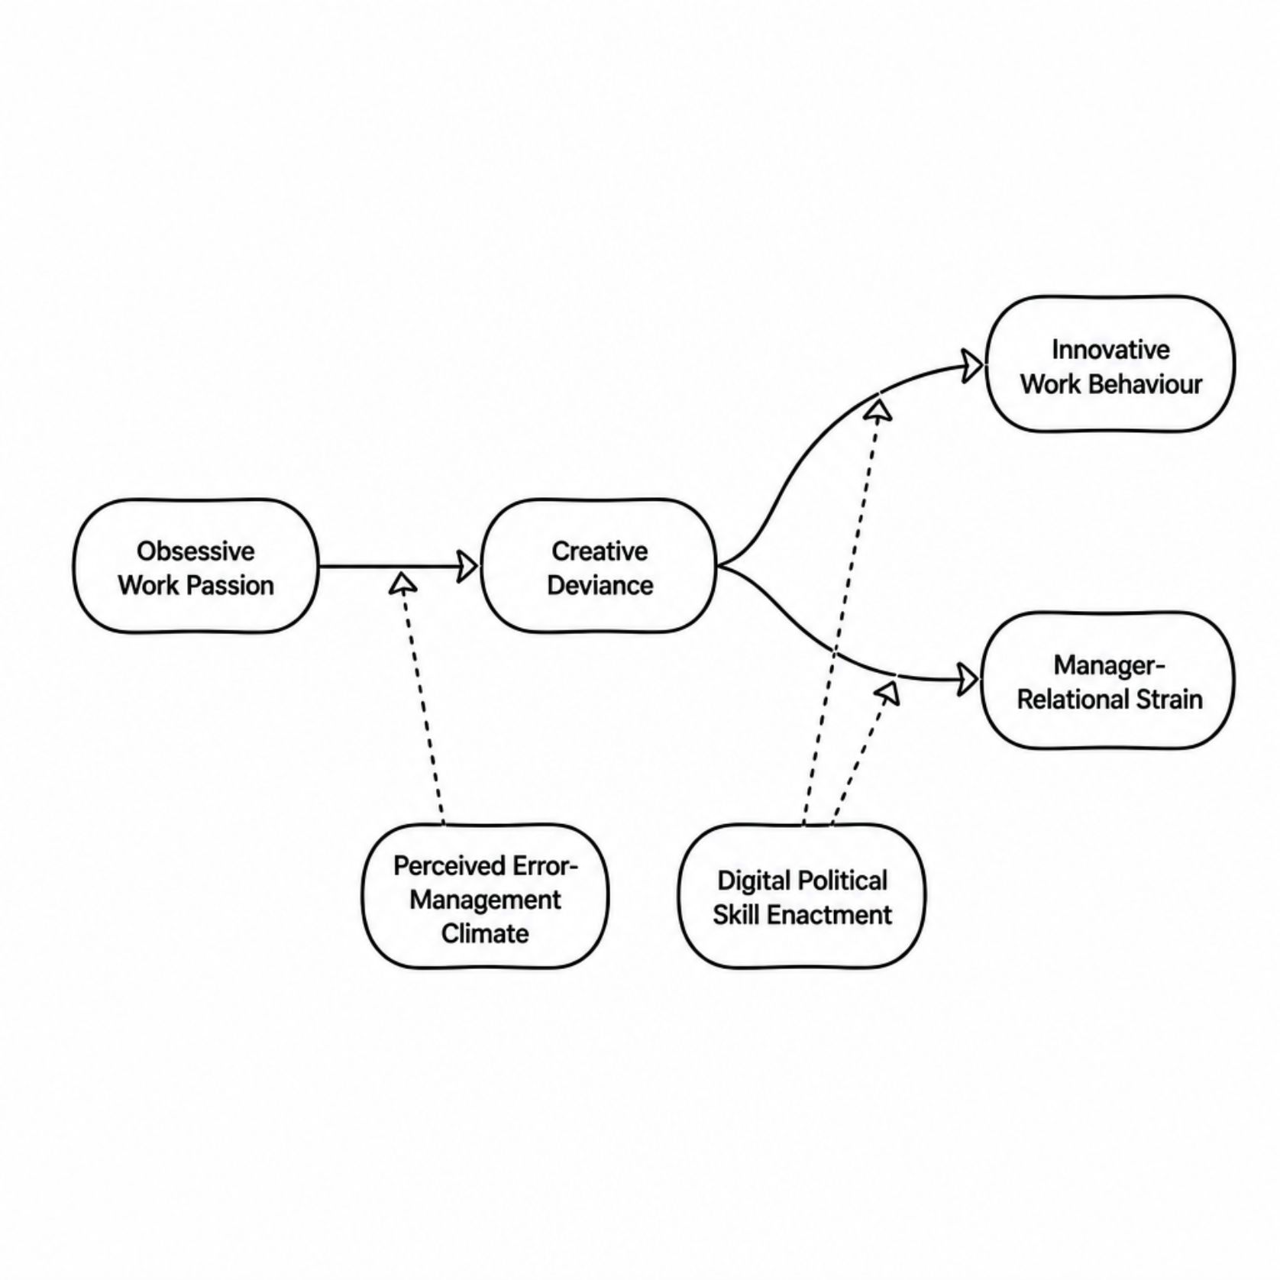
The Proposal Conceptual Model
Stage A — What Drives Creative Deviance?
1
Obsessive Work Passion
A strong urge to pursue the idea.
2
Perceived Error-Management Climate
Mistakes feel safe to learn from.
Stage B — What Creative Deviance Produces
1
Innovative Work Behaviour
Exploring, developing, championing and implementing the focal idea after the manager’s decision.
Any later authorisation is recorded to test whether it affects the findings.
2
Relational Strain
Tension with the focal-manager
Pre-incident relationship quality is measured separately.
Digital Political Skill Enactment shapes both — amplifying innovation and buffering relational damage.
Notes:
The model has two stages. First, I test whether obsessive work passion (for example, being unable to let go because you believe it could work) which is associated with creative deviance, and whether perceived error-management climate (whether employees feel mistakes can be discussed and learned from rather than punished) changes that association.
Second, I examine two outcomes of creative deviance: innovative work behaviour (means exploring, developing, gaining support for and moving the focal idea towards implementation) and manager-relational strain.
DPSE is proposed as a boundary condition: it may strengthen the innovation pathway and weaken the relational-strain pathway.
In one sentence, the model asks: what makes an employee persist, what happens when they do, and can the way they navigate the incident digitally change those outcomes?
What I meant by 'any later authorisation is recorded to test whether it affects the findings is that a manager’s initial ‘no’ may change if funding becomes available, risks are reduced or new evidence makes the idea more feasible. Because later approval may provide resources that increase IWB (but it is no longer creative deviance). The sensitivity analysis runs the model twice: first with all cases and then only with ideas that were never later approved. If the CD-by-DPSE relationship with IWB remains similar, the finding is not simply explained by later approval and the extra resources it may provide. If the relationship weakens or disappears, later approval may partly explain the reported IWB.
Also, what I meant by pre-incident relationship quality is measured separately is that the tension may already have existed before creative deviance so participants are asked to think about their relationship with that manager before the manager rejected the idea.

Slide 9
BOUNDED CLAIMS
The study at a glance
How does DPSE shape the two outcomes of creative deviance in manager-unapproved idea incidents?
O1
O2
O3
O4
O5
Describe incident patterns
Test OWP × climate → CD
Test CD → innovation + DPSE
Test CD → strain + DPSE
Translate into guidance
(Descriptive-Exploratory)​
(Explanatory-Confirmatory)
(Explanatory-Confirmatory)
(Explanatory-Confirmatory)
(Translational)
Confirmatory + associational | H3 and H5 are the principal theoretical extension | Open text is contextual only
Notes:
This slide records the full research question, objectives and hypotheses. The key point for today's presentation is that the study is mainly confirmatory and associational. H3 and H5 are the main theoretical extension because they test whether DPSE changes both outcomes. The descriptive objective provides incident context, but it is not a separate qualitative strand.
Main Research Question: How does Digital Political Skill Enactment shape the outcomes of creative deviance in manager-unapproved idea incidents among UK early-career professionals?
Sub-RQS:
RQ1. What reported patterns of channel, timing, audience, coalition, visibility and generative-AI assistance characterise participants' responses to a manager-unapproved idea?
RQ2. How does the association between obsessive work passion and creative deviance vary across levels of perceived error-management climate?
RQ3. How does the association between creative deviance and focal-idea innovative work behaviour vary across levels of DPSE?
RQ4. How does the association between creative deviance and focal-manager relational strain vary across levels of DPSE?
RQ5. How do optional open-text accounts converge with, complement, qualify or contradict the structured results, and how can the integrated findings inform a provisional managerial decision-review framework?
3. Research Aim: To explain how creative deviance may lead simultaneously to innovative work behaviour and manager-relational strain, and whether digital political skill enactment changes these relationships.
4. Reasearch Hypotheses
All focal variables refer to the same participant, idea, authorisation decision and manager.
H1: Perceived Error Management Climate moderates the association between Obsessive Work Passion and Creative Deviance: the association becomes more positive when Perceived Error Management Climate increases.
H2: Creative Deviance is positively associated with Innovative Work Behaviour.
H3: Digital Political Skill Enactment strengthen the association between Creative Deviance and Innovative Work Behaviour.
H4: Creative Deviance is positively associated with Manager-Relational Strain.
H5: Digital Political Skill Enactment attenuates the association between Creative Deviance and Manager-Relational Strain.

Slide 10
KUHN
A paradigm makes research possible
“Shared standards tell a community what counts as a meaningful problem, acceptable evidence and a defensible solution.”
Kuhn’s central value here is not the cycle alone — it is the common framework.
Normal science
Anomaly
Crisis
Revolution
New normal
My study: normal-science-style inquiry — an established framework applied to a narrower digital, incident-specific puzzle.
Notes:
I now move from the research puzzle to the intellectual framework that makes it research.
For Kuhn, a paradigm is not simply a personal belief. It is a shared framework that tells a research community which problems matter, which concepts are legitimate, which methods are acceptable and what counts as a satisfactory solution.
This is why a paradigm makes research possible: without shared standards, researchers would have no common basis for building or judging knowledge.
Kuhn calls most work within an accepted framework normal science. Anomalies may sometimes accumulate and contribute to crisis and change. But my study does not claim a revolution. It uses established theory and measures to solve a narrower puzzle inside an existing research community.

Slide 11
WORKING INSIDE THE PARADIGM
Q1 • Shared rules, standards and exemplars
SHARED EXEMPLAR
SHARED STANDARDS
SHARED PUZZLE-SOLVING
Political Skill Inventory
Reliability + validity evidence
Digital incident extension
Four established dimensions give the field a common vocabulary.
Research can be judged against accumulated measurement evidence.
Ask what the accepted framework has not yet resolved.
Critical boundary
The PSI was not designed for one digital, post-rejection incident.
DPSE remains a preliminary, theory-informed index — not a newly validated trait.
Notes:
The first required question asks how subscribers to a paradigm share rules, standards and exemplars.
In my field, the Political Skill Inventory is an important exemplar. It gives researchers a shared vocabulary through four dimensions and provides established standards for measuring political skill. Meta-analytic and reliability research also gives the community a basis for judging the quality of that evidence.
This shared framework makes my hypotheses possible. I do not have to invent the meaning of political skill from the beginning; I can work from accepted concepts and test a more specific puzzle.
However, the exemplar also has a limit. It was not designed specifically for one digital, post-rejection incident. My DPSE index therefore maps incident behaviour onto the four established dimensions, but I treat it cautiously as a preliminary, theory-informed index - not as a newly validated psychological trait.
So I work within the paradigm while also recognising where its existing exemplar may not fully capture the context I am studying.

Slide 12
SHARED OUTLOOK ON REALITY
Q2 • One event, more than one meaning
Employee
Manager
Responsible persistence?
MANAGER-REJECTED
INCIDENT
Challenge to authority?
Stakeholder
Useful initiative?
Bounded organisational reality with multiple situated interpretations
Notes:
The second question concerns the community's outlook on reality.
My pragmatic position begins with a simple assumption: the managerial decision and the employee's later actions occurred independently of my survey. I am not creating the incident by asking about it.
But I do not assume that the incident has one meaning shared by everyone. The employee may see responsible persistence; the manager may see a challenge to authority; another stakeholder may see something else.
I therefore describe it as a bounded organisational reality with multiple situated interpretations. The event is real, but my access to its meaning is partial. This avoids two extremes: treating the employee's account as a perfect objective record, or treating the incident as if nothing existed beyond personal interpretation.

Slide 13
ONTOLOGY → EPISTEMOLOGY → AXIOLOGY
Q3 • The philosophical chain
ONTOLOGY
EPISTEMOLOGY
AXIOLOGY
The incident occurred; meaning is situated.
Employee reports are partial, retrospective and fallible.
Professional experience creates attention — and possible sympathy — toward persistence.
What is real?
What can I know?
What values shape the study?
Real but interpreted event → partial knowledge → proportionate claims shaped by explicit values
Reflexive safeguard: professional experience explains the question — it does not count as evidence.
Notes:
This leads to the three connected foundations of my study.
Ontologically, I assume that the incident occurred, but that its meaning is situated and may differ across people.
Epistemologically, I mainly know the incident through the employee's retrospective account. That account can support fallible estimates of association, but it cannot provide the complete story, prove temporal order or establish causation.
Axiologically, the study is not value-free. My background as a Business Analyst makes me attentive to employee ideas and practical usefulness. It could also make me too sympathetic to persistence. I therefore treat my experience as a reflexive influence, not as evidence, and I keep managerial authority, organisational risk and clear stop points visible in the research.
The chain is therefore: a real but interpreted event; partial knowledge of it; and proportionate claims shaped by explicit values.

Slide 14
LOGIC BEFORE TECHNIQUE
From philosophy to methodology
PRAGMATIC PHILOSOPHY
Problem, evidence and useful consequences guide choices
METHODOLOGY
Primarily deductive • hypothesis-testing • theory-informed
DESIGN
One retrospective critical-incident survey
METHODS
Expert review • cognitive interviews • structured items • one bounded open text
One open-text item ≠ mixed methods
Notes:
Methodology is the overall logic connecting these assumptions to the research process. My methodology is pragmatic, primarily deductive, hypothesis-testing and theory-informed. Political Skill Theory directly guides H3 and H5, while the other hypotheses draw on adjacent literature.
The retrospective critical-incident survey is a method within that methodology; it is not the methodology itself. Expert review and cognitive interviews help refine the instrument before the main survey. One optional open-text item provides limited context, but it has no separate research question, sampling strategy or integrated qualitative analysis. For that reason, I do not describe the study as mixed methods.

Slide 15
QUALITY • BIAS • ETHICS • BOUNDARIES
Coherence in action
CLAIM BOUNDARY
QUALITY
Cross-sectional + retrospective
Association, not causation
Adapted and preliminary measures
Expert review • cognitive interviews • soft launch
BIAS
ETHICS
Recall • self-report • employee-only view
Anchor one incident • neutral wording • pre-specify
Unauthorised behaviour is not celebrated
Protect identity • governance • stop points
What I believe about reality limits what I can know — and what I can responsibly claim.
Notes:
The practical value of a paradigm is that philosophical choices become visible in design decisions.
Because my evidence is retrospective and cross-sectional, I make associational rather than causal claims. Because the study is deductive, the hypotheses, target sample and control variables are specified before examining the results. The operational target is 380 analysable cases, with 450 as the approved recruitment ceiling.
Quality is not guaranteed simply because I use established scales. Some measures are adapted to the focal manager and incident, and DPSE is preliminary. Expert review, cognitive interviews and a soft launch are therefore used to check whether participants understand the questions as intended.
The design also cannot remove bias. Recall may reconstruct the incident; self-report may make persistence appear more reasonable; and an employee-only account cannot confirm the manager's view. I respond through one-incident anchoring, neutral wording, pre-specification and cautious reporting - not by claiming that bias has disappeared.
Ethically, the study does not encourage unauthorised behaviour. It asks retrospectively about an incident, protects identifying details, and translates findings into guidance with authorisation, governance and stop points.
This is what coherence means in practice: what I believe about reality limits what I can know, and that limits what I can responsibly claim.

Slide 16
APPLYING KUHN REFLEXIVELY
My own small “new normal”
Starting assumption
Anomaly
Re-examination
New normal
Survey + open text = mixed methods
The label did not match the purpose
No separate qualitative question, sample or analytical strand
Pragmatic, primarily quantitative survey — not mixed methods
“I changed the label because I changed my understanding of what the design was actually doing.”
Notes:
This coherence was not present from the beginning.
At first, I assumed that a quantitative survey plus one open-text question automatically meant mixed methods. During the module, that assumption became difficult to defend. Pragmatism allows different forms of data, but the presence of two data types does not by itself create a mixed-methods design.
I returned to the purpose of the open-text item. It has no separate qualitative question, sample or analytical strand. It only helps contextualise structured responses. I therefore changed the proposal and now state clearly that the study is not presented as mixed methods.
Using Kuhn reflexively, I had a starting assumption, encountered an anomaly, questioned the label and reached a new normal. This is not a scientific revolution. It is a small example of how critical reflection improved the coherence of my own design.

Slide 17
CHALLENGE THROUGH TRADE-OFFS
Credible alternatives — different knowledge
Experiment / quasi-experiment
Stronger causal inference
Not aligned: no manipulation or causal claim
Qualitative interview / case study
Richer meaning and process
Different purpose: theory-building rather than pre-specified testing
Secondary / archival data
Less participant self-report
Focal perceptions and incident enactment are not available
Longitudinal / multi-source
Temporal evidence + manager view
Stronger for a broader question; higher access and burden
Final trade-off: less causal and interpretive depth • more feasible theory-testing across many individual–incident cases
Notes:
I also tested the final design against credible alternatives.
An experiment or quasi-experiment could support stronger causal inference, but my study does not manipulate the incident and does not seek a causal claim.
Qualitative interviews or case studies could provide richer meaning and process, but they would answer a different question. My primary purpose is to test pre-specified relationships rather than build theory inductively.
Secondary or archival data would reduce some self-report problems, but the focal evidence - how the employee read the rejection, adapted the message and experienced the relationship - is not available in a standard organisational database.
A longitudinal, multi-source design could add temporal evidence and the manager's account. That would be a stronger design for a broader question, but it would require greater access, time and participant exposure than this bounded study can support.
These alternatives are not inferior. They simply produce different knowledge. Comparing them clarified the trade-off I am making: less causal and interpretive depth, but a feasible, theory-testing study across a larger number of individual-incident cases.

Slide 18
Conclusion
Coherent normal science,
not a paradigm shift
The discipline is simple:
Claims
Methods
Recommendations
Shared framework
Concepts, exemplars and standards make the puzzle researchable.
Proportionate knowledge
Real event • partial employee report • bounded association.
must remain proportionate to the evidence the study can produce.
Reflexive improvement
Mixed-methods label corrected; bias and alternatives made explicit.
Thank you
Questions welcome
Notes:
To conclude, Kuhn helps me see that this study is possible because a research community already shares concepts, exemplars and standards of evidence.
My pragmatic position then connects a real but multiply interpreted incident to partial employee-reported knowledge and, therefore, to a bounded associational design.
The module also changed my own thinking. I corrected the mixed-methods label, made the limits of causation and bias clearer, and tested the survey against credible alternatives.
The result is not a paradigm shift. It is a more coherent piece of normal-science-style inquiry, in which the methods, claims and practical recommendations remain proportionate to the evidence the study can produce.
Thank you. I am happy to take your questions.

Slide 19
References
Carlson, J. R., & Zmud, R. W. (1999). Channel expansion theory and the experiential nature of media richness perceptions. Academy of Management Journal, 42(2), 153–170.
Clarke, N., & Higgs, M. (2020). Political skill and role overload as antecedents of innovative work behavior in the public sector. Public Personnel Management, 49(3), 444–469.
Di Gangi, P. M., McAllister, C. P., Howard, J. L., Thatcher, J. B., & Ferris, G. R. (2022). Can you see opportunity knocking? An examination of technology-based political skill on opportunity recognition in online communities for MTurk workers. Internet Research, 32(4), 1041–1075.
Faul, F., Erdfelder, E., Buchner, A., & Lang, A.-G. (2009). Statistical power analyses using G*Power 3.1: Tests for correlation and regression analyses. Behavior Research Methods, 41(4), 1149–1160.
Ferris, G. R., Treadway, D. C., Kolodinsky, R. W., Hochwarter, W. A., Kacmar, C. J., Douglas, C., & Frink, D. D. (2005). Development and validation of the Political Skill Inventory. Journal of Management, 31(1), 126–152.
Jacobson, R. K., & Viswesvaran, C. (2017). A reliability generalization study of the Political Skill Inventory. SAGE Open, 7(2), 1–17.

Slide 20
Kuhn, T. S. (1962). The Structure of Scientific Revolutions. Chicago: University of Chicago Press.
McLeod, S. A. (2020, May 01). Thomas Kuhn – science as a paradigm. Simply Psychology.
Munyon, T. P., Summers, J. K., Thompson, K. M., & Ferris, G. R. (2015). Political skill and work outcomes: A theoretical extension, meta-analytic investigation, and agenda for the future. Personnel Psychology, 68(1), 143–184.
Wang, Y. (2023). The impact mechanism of constructive deviance on workplace ostracism: The roles of political skill and workplace friendship. Current Psychology, 42, 23323–23331.
Wen, S., Zhang, L., Zhang, K., & Ouyang, M. (2025). The more creative, the more silent? The effect of subordinates' creative deviance on leader silence. Leadership & Organization Development Journal, 46(1), 53–65.
Wu, Y. J., Antone, B., DeChurch, L., & Contractor, N. (2023). Information sharing in a hybrid workplace: Understanding the role of ease-of-use perceptions of communication technologies in advice-seeking relationship maintenance. Journal of Computer-Mediated Communication, 28(4), zmad025.

Slide 21
Spector, P. E., & Jex, S. M. (1998). Development of four self-report measures of job stressors and strain. Journal of Occupational Health Psychology, 3(4), 356-367.
Vallerand, R. J., Blanchard, C. M., Mageau, G. A., Koestner, R., Ratelle, C., Léonard, M., Gagné, M., & Marsolais, J. (2003). Les passions de l'âme: On obsessive and harmonious passion. Journal of Personality and Social Psychology, 85(4), 756-767.
de Jong, J. P. J., & den Hartog, D. N. (2010). Measuring innovative work behaviour. Creativity and Innovation Management, 19(1), 23-36.

Slide 22
Appendix A. Core-Article Relevance Matrix (Proposal-Level)
Core article
Proposal-level evidence
Relevance and proposed contribution
Xu et al. (2026)
Research question addressed: Whether error-management culture conditions the relationship between obsessive work passion and creative deviance.
Data and method: Multi-wave, multi-source study of Chinese research-and-development team leaders.
Key finding: Error-management culture conditioned the obsessive-work-passion–creative-deviance relationship.
Relationship: Core adjacent study for H1.
Contribution: Contextual replication and extension to UK early-career employees across organisations using employee-perceived climate and a focal authorisation gate.
Clarke and Higgs (2020)
Research question addressed: The association between political skill and innovative work behaviour.
Data and method: UK sample of 249 junior doctors; remaining method details are not specified in the current proposal.
Key finding: Political skill was associated with innovative work behaviour.
Relationship: Adjacent direct political-skill–innovation relationship.
Contribution: Extend the question to incident-specific digital enactment as a boundary condition after a managerial authorisation decision.
Di Gangi et al. (2022)
Research question addressed: Technology-based political skill and opportunity recognition in online communities.
Data and method: Online-community context; further method details are not specified in the current proposal.
Key finding: Technology-mediated political skill has already been examined and shown to be relevant to opportunity recognition.
Relationship: Adjacent digital political-skill context.
Contribution: Extend the focus to enactment across hybrid digital and face-to-face channels around one manager-unapproved idea.
Wang (2023)
Research question addressed: Constructive deviance, workplace ostracism and the buffering role of political skill.
Data and method: Not specified in the current proposal; to be verified in the literature audit.
Key finding: Political skill buffered a deviance-related adverse social outcome.
Relationship: Adjacent political-skill buffering and relational-outcome evidence.
Contribution: Examine incident-specific digital enactment and focal-manager relational strain within the same manager-unapproved incident.
Shukla et al. (2024)
Research question addressed: Creative deviance and social undermining.
Data and method: Not specified in the current proposal; to be verified in the literature audit.
Key finding: Creative deviance was linked to a negative social outcome.
Relationship: Adjacent adverse social-outcome evidence.
Contribution: Narrow the relational outcome to focal-manager strain reported for the same incident.

Slide 23
Appendix B: Research Instruments
The following instruments were selected, adapted, or developed for this study. Each domain is listed with its source and any modifications applied.
Domain
Planned instrument and treatment
Focal-incident screen
Researcher-developed authorisation gate, manager definition, timing and status questions; expert reviewed and cognitively tested.
Obsessive work passion
Obsessive Passion subscale derived from Vallerand et al. (2003), subject to permission and minimal work-referent adaptation.
Perceived error-management climate
Selected items from van Dyck et al. (2005), adapted to the participant's immediate work environment and incident time; no aggregation.
Creative deviance
Creative-deviance measure assessed by Shukla et al. (2024), subject to permission and focal-incident instructions.
General political skill
18-item PSI (Ferris et al., 2005).
DPSE
Pre-specified formative index with four equal-weighted components mapped to the PSI domains.
Focal-idea IWB
Ten-item de Jong and den Hartog (2010) measure, adapted only for the focal idea and post-decision referent.
Focal-manager relational strain
Manager-referent adaptation of the four-item Interpersonal Conflict at Work Scale (Spector & Jex, 1998).
Covariates
Hybrid intensity, career tenure, recruitment source and pre-incident manager-relationship quality.
Exploratory context
Incident status; later authorisation; three or four factual AI-use questions; one optional bounded open-text prompt.

Slide 24
USE ONLY IN Q&A
Appendix • defence guardrails
Was the manager wrong?
Was your incident creative deviance?
Not necessarily. Scope, time and competing priorities may have justified the decision.
It explains positionality; it is not treated as evidence or claimed to map perfectly onto the authorisation gate.
Is DPSE a validated new construct?
Can the study establish causation?
No. It is a preliminary, theory-informed operational index.
No. It supports association, not temporal precedence or causal effects.
Why not mixed methods?
Main ethical boundary?
No separate qualitative question, sample, analysis or integration strand.
Persistence is not celebrated at any cost; guidance includes authorisation, governance and stop points.
Notes:
Q&A backup slide.
[Sources]
- Student PG1 proposal and revised presentation script.
[/Sources]

