Slide 1
Quantitative Analysis:
Questionnaire
(BMPE5006) Level 5
Kate Piper
Introduction and Experiences

Slide 2
Step 1:
Familiarisation of data
Step 2:
Initial coding
Step 3:
Generating themes
Step 4:
Validity and Reliability of themes
Step 5:
Defining and naming themes (to findings)
Step 6:
Interpretation and reporting

Slide 3
Step 1:
Familiarisation of data
Step 2:
Initial coding
Step 3:
Generating themes
Key Points to remember:
You want to be able to hear the voices and see the observations again and again
If you can transcribe your own data
Transcribing:
  Completely manually
  Teams recording
  Online transcribing software
Step 4:
Validity and Reliability of themes
Step 5:
Defining and naming themes (to findings)
Step 6:
Interpretation and reporting

Slide 4
Step 1:
Familiarisation of data
Step 2:
Initial coding
Step 3:
Generating themes
Key Points to remember:
Initial read through
NVIVO tools (word frequencies and word searches)
Already set coding (based on literature review or underpinning concepts)
Coding:
  Words to phrases
Step 4:
Validity and Reliability of themes
Step 5:
Defining and naming themes (to findings)
Step 6:
Interpretation and reporting

Slide 5
Step 1:
Familiarisation of data
Step 2:
Initial coding
Step 3:
Generating themes
Key Points to remember:
Collating codes
NVIVO/ by hand: adult and child nodes
Context (try not to take codes out of context)
Restructuring might be needed
*Organisation is needed (labelling and repeating)
Step 4:
Validity and Reliability of themes
Step 5:
Defining and naming themes (to findings)
Step 6:
Interpretation and reporting

Slide 6
Step 1:
Familiarisation of data
Step 2:
Initial coding
Step 3:
Generating themes
Step 4:
Validity and Reliability of themes
Step 5:
Defining and naming themes (to findings)
Step 6:
Interpretation and reporting
Key Points to remember:
Checking your data
  Interrater reliability
  Participant/ Respondent validation
  Saturation of themes

Slide 7
Step 1:
Familiarisation of data
Step 2:
Initial coding
Step 3:
Generating themes
Key Points to remember:
Themes now need to be presented as findings
What have your themes helped you find out?
ONE SENTENCE MAX
Consider having 1-3 quotes that represent the findings well
Step 4:
Validity and Reliability of themes
Step 5:
Defining and naming themes (to findings)
Step 6:
Interpretation and reporting

Slide 8
Step 1:
Familiarisation of data
Step 2:
Initial coding
Step 3:
Generating themes
Key Points to remember:
Mixed methods
  Findings could be presented in results sections:
    Quantitatively
    Representation of the findings through key quotes
Qualitative study
  Findings and discussion section
  Quotes interwoven with literature
Step 4:
Validity and Reliability of themes
Step 5:
Defining and naming themes (to findings)
Step 6:
Interpretation and reporting

Slide 9
Step 1:
Familiarisation of data
Step 2:
Initial coding
Step 3:
Generating themes
Step 4:
Validity and Reliability of themes
Step 5:
Defining and naming themes (to findings)
Step 6:
Interpretation and reporting

Slide 10
Choosing your questionnaire
Does it answer your question?
  Motivation – HOW or WHY are they are motivated?
Validity and Reliability (and widely used).
Use with chosen population (wording/ focus of questions).
Specific protocols of the questionnaire

Slide 11
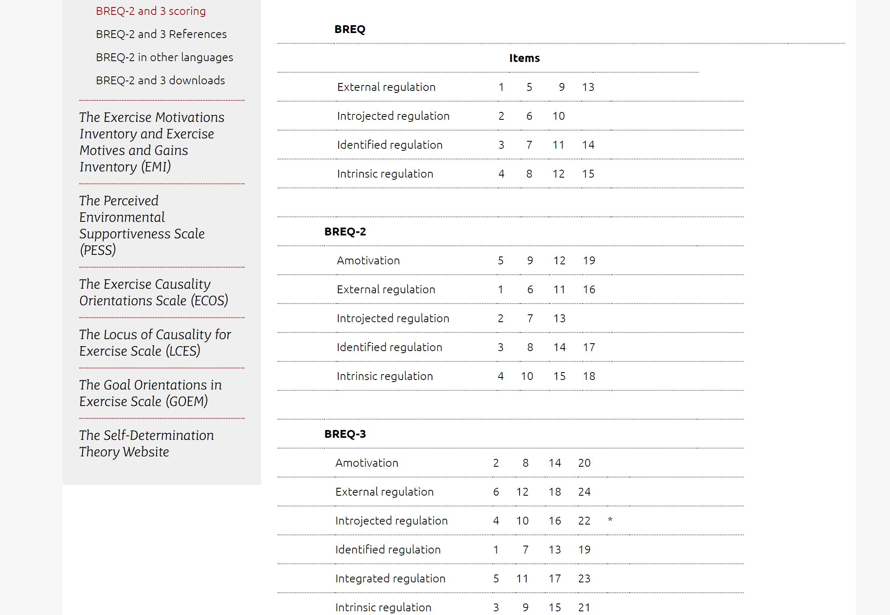
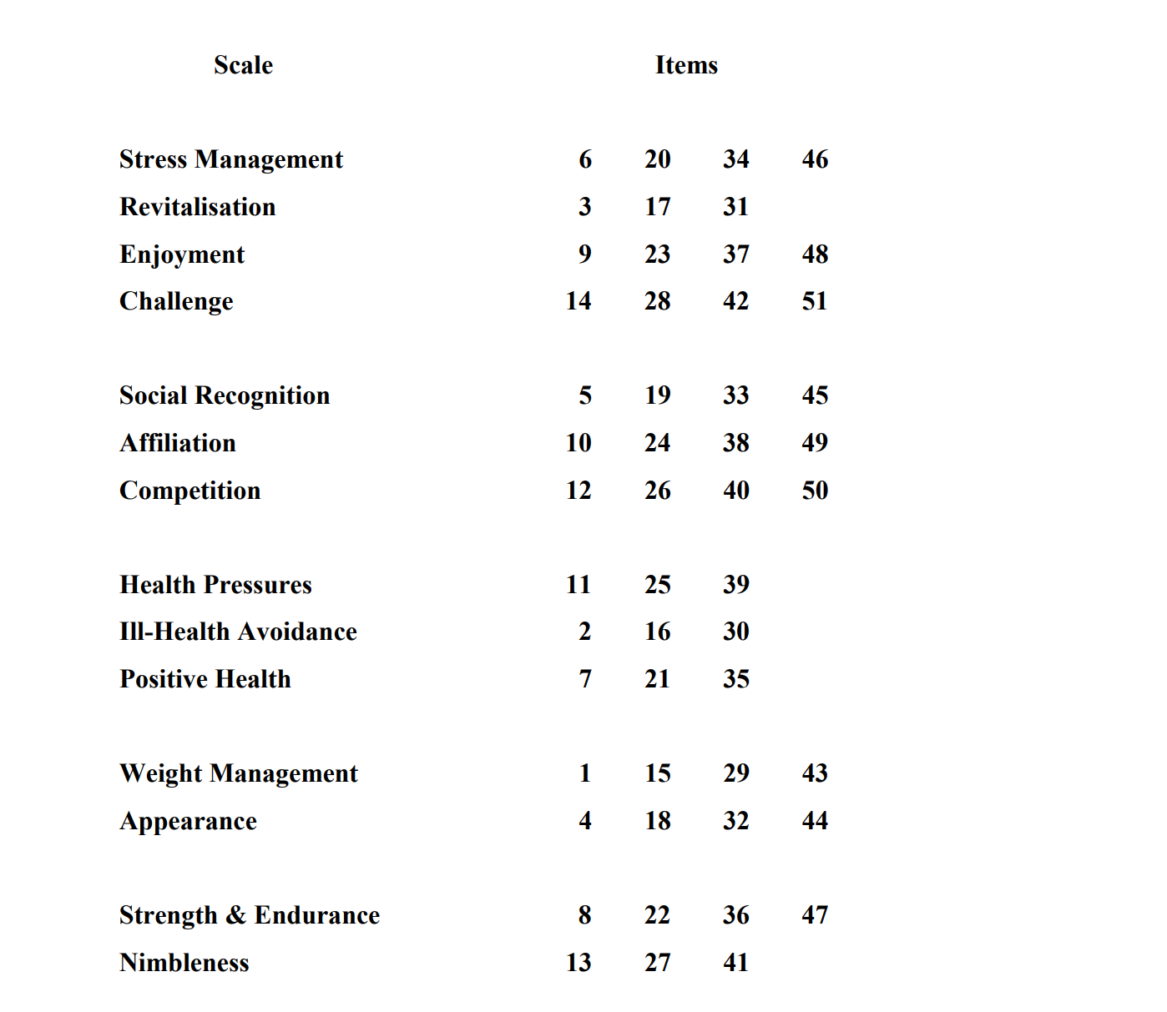
Choosing your questionnaire
Does it answer your question?
  Motivation – HOW or WHY are they are motivated?
Validity and Reliability (and widely used).
Use with chosen population (wording/ focus of questions).
Specific protocols of the questionnaire
Notes:
Does it answer your question. What do you want to know about motivations. How are they motivated – Group of students motivations around PE – self determination theory continuum between amotivation to intrinsic motivation. OR why a group of Parkun runners take part every Saturday (if we used a questionnaire CONTINUUM it wouldn’t show us much – mostly towards intrinsic end of continuum), however we could use a questionnaire that asks about different types of motives – health, enjoyment, stress management, social reasons etc etc.

Slide 12
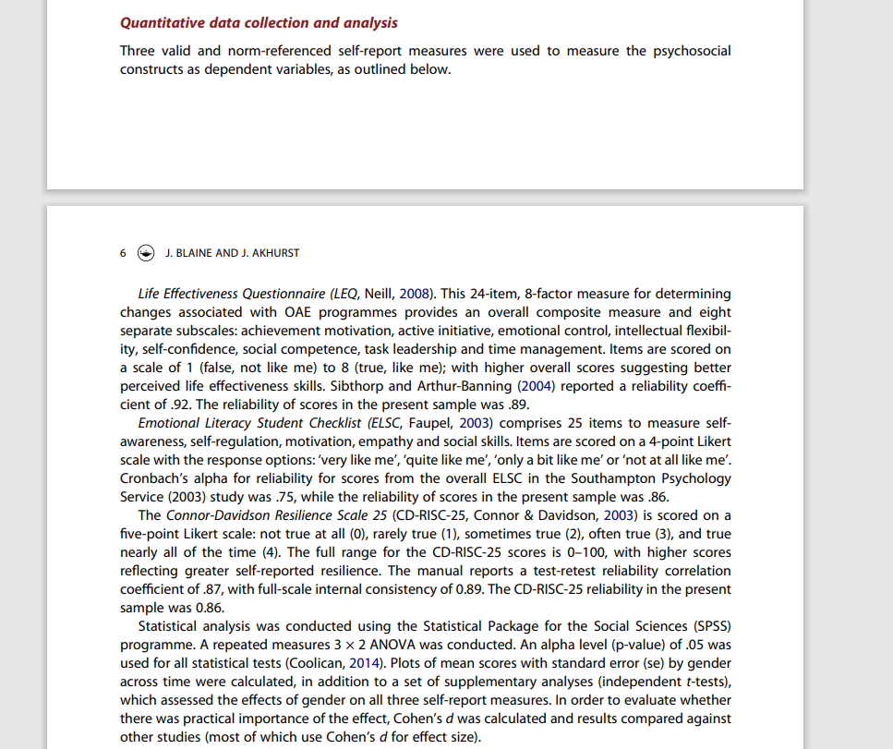
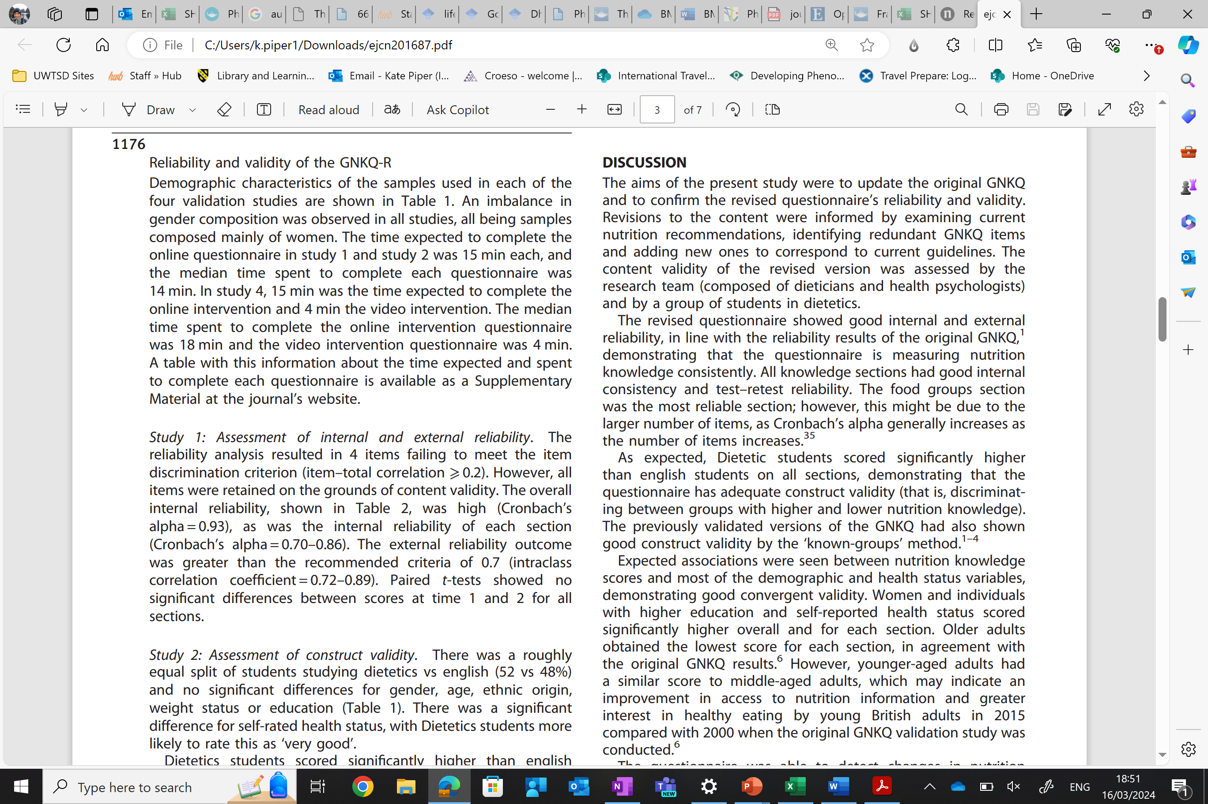
Choosing your questionnaire
Cronbach alpha
Coefficient alpha
Does it answer your question?
  Motivation – HOW or WHY are they are motivated?
Validity and Reliability (and widely used).
Use with chosen population (wording/ focus of questions).
Specific protocols of the questionnaire
Notes:
Validity and Reliability: Papers specifically focus on this and can be used to demonstrate validity of the study. Most studies use Cronbach alpha to demonstrate internal reliability/ consistency of [people’s] answers. Coefficient alpha (this is what it is also known as) tried to consider the latent variables (variables that cannot be measured – hidden variables – openness/ consciousness of their answers. Higher than a .7 is considered acceptable measure – the higher the better.
Title from paper: A journey into understanding gendered experiences of outdoor adventure education: Judith Blaine and Jacqui Akhurst
Title of second paper: Reliability and validity of a revised version of the General Nutrition Knowledge Questionnaire

Slide 13
Choosing your questionnaire
Does it answer your question?
  Motivation – HOW or WHY are they are motivated?
Validity and Reliability (and widely used).
Use with chosen population (wording/ focus of questions).
Specific protocols of the questionnaire
Notes:
Several questionnaires have been validated by authors to use :
in different languages
with different populations – children/ parents
Different types of activities (scale for marathoners that has been altered so the language better suits triathletes)

Slide 14
Choosing your questionnaire
Does it answer your question?
  Motivation – HOW or WHY are they are motivated?
Validity and Reliability (and widely used).
Use with chosen population (wording/ focus of questions).
Specific protocols of the questionnaire
Notes:
Once chosen the questionnaire may be split into subscales where a collection of questions fall under a certain subscale
Happiness outcomes among cadet women backpackers Guy Ilagan, Jill Ilagan, Robin Jocius, Renee Jefferson, Jenn Bennett-Mintz, Kally McCormick & Marguerite Farrell
Oxford happiness questionnaire as example.
Intrinsic motivation inventory.

Slide 15
Additional question needed
Demographic questionnaires
Keeping the questionnaire concise
Gender/ Age/ location/ education/ house hold status/ income etc etc

Slide 16
Logistics of questionnaires
Creation and sharing process
Collection: paper/ tablet/ link – PILOT!
Raw Data
Cleaning and preparing for SPSS
Numerical Spreadsheet and Coding bible
Analysis using SPSS.

Slide 17
Information
Demographic questions
Age (age)
Gender (all answered within two groups)
Age (8 groups)
Experience of MPSE (number of events/ how many years participating)
Location
Employment status
Household status
Income

Slide 18
Information
BREQ2: Amotivated to Intrinsic motivated
Amotivation
External Reg
Introjected Reg
Identified Reg
Intrinsic Reg
EMI-2: Motivation inventory with subscales
Positive Health
Enjoyment
Revitalisation
Strength & Endurance
Stress Management
Challenge
Ill-health avoidance
Nimbleness
Affiliation
Competition
Weight Management
Appearance
Social Recognition
Health Pressures
Demographic questions
Age
Gender (three groups offered, all answered within two groups)
Age (8 groups)
Experience of MPSE (number of events/ how many years participating)
Location
Employment status
Household status
Income

Slide 19
Your turn
Pick a questionnaire
Think of a research design that would work for the questionnaire
What analysis tests would you do?
  Correlation (relationship)
  T-tests (difference between 2)
  ANOVA (difference between 3+)
What would happen if normality is SIGNIFICANT?

Slide 20
DIFFERENCE – T-Tests
Independent t-test
  A comparison between two groups to see if they are different
Paired t-test
  Same group tested on two occasions/ two variables to see if there is a difference

Slide 21
Which type of t-test would the following use? (Paired of Independent?)
    Weight of a group at w1 and w6 of diet programme
    State anxiety levels for a group of males and a group of females,
    Comparison of 100m times between elite / non-elite runners,
    Levels of alcohol consumption for a group of students tested at the start of year 1 and at the end of year 1
    Mood state before and after exercise for a group
    Differences in motivation type between a group of exercisers and a group of non-exercisers,
    Strength test results for a group before and after weight training programme
    A comparison of nutritional levels between vegetarian and vegan diets
    Attendance figures between school 1 and school 2

Slide 22
Parametric | Non-parametric
Independent-samples ttest | Mann-Whitney U Test
Pair samples ttest | Wilcoxon Rank test
Between groups anova | Kruskal-Wallis test / Welch’s anova
Repeated measures anova | Friedman test

