Slide 1



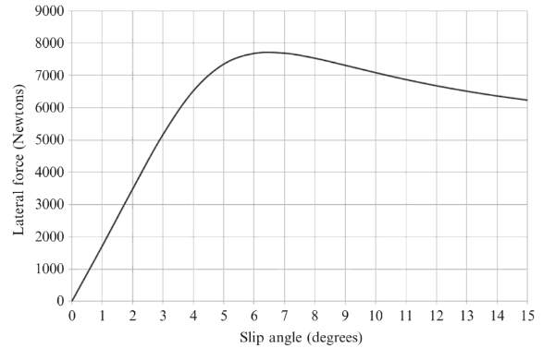
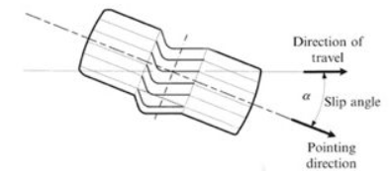
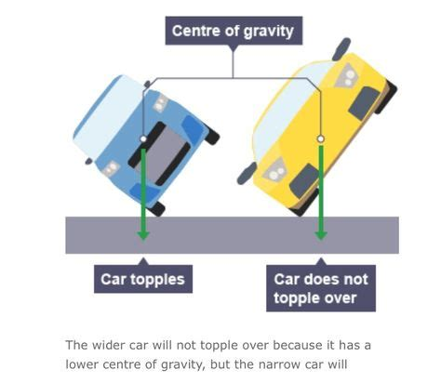
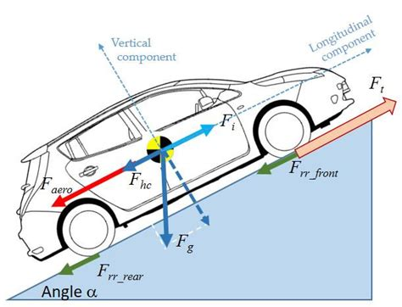



Your Pic
Technical Lecture Review: Introduction to Vehicle Dynamics
Harri Brown
Andrew Noble
Wales Institute for Science & Art
BEng Automotive Engineering
Introduction
Vehicle dynamics explores how forces and motions affect a vehicle’s behaviour.
It is essential for designing safe, efficient, and high-performance vehicles.
This field integrates mechanical engineering, materials science, and control systems to optimize performance, safety, and sustainability.
Forces Acting on a Vehicle:
Longitudinal (acceleration and braking forces)
Lateral (cornering forces, centripetal force)
Vertical (vehicle weight, road reactions)
Vehicle Drivetrain Layouts:
Front Engine - Front Wheel Drive (FWD)
Front Engine - Rear Wheel Drive (RWD)
Mid Engine - Rear Wheel Drive (MR)
Affect weight distribution and handling dynamics.
Centre of Gravity (CG):
Determines stability, cornering behaviour, and rollover risk.
Lower CG improves performance.
Tyres and Slip Angle:
Slip angle: Difference between tyre heading and actual path.
Tyres generate lateral forces during cornering through deformation.
Figure 1: Longitudinal and lateral forces acting on a moving vehicle (Adapted from Racecar Engineering [1])
Key Takeaways
Vehicle dynamics integrates mechanical forces, tyre physics, and structural engineering.
Understanding forces, suspension, tyres, and CG is critical for safe and high-performance vehicles.
New technologies like ESC and adaptive suspension are making vehicles safer and smarter.
Simulation tools drastically reduce development costs and time while improving design accuracy.
Lateral force vs. slip angle relationship (Balkwill, J. (2017) Performance Vehicle Dynamics)
Innovations & Applications
Electronic Stability Control (ESC):
Automatically adjusts braking at individual wheels to maintain vehicle control.
Adaptive Suspension Systems:
Real-time changes in damping and stiffness based on road conditions.
Simulation and Modelling Software:
Programs like MATLAB and Adams/Car allow engineers to predict vehicle dynamics performance without physical prototypes.
Real-World Examples:
Tesla Model S: Extremely low centre of gravity due to floor-mounted battery pack.
Formula 1 Cars: Precision suspension and Centre of Gravity optimization to maximize cornering speed.
Diagram illustrating slip angle (Balkwill, J. (2017) Performance Vehicle Dynamics)
References
Balkwill, J., 2017. Performance vehicle dynamics: Engineering and contributing factors. Milton: Routledge.
Engineering Explained, no date. Vehicle dynamics and centre of gravity. [online] Available at: https://engineeringexplained.com (Accessed 26 April 2025).
Racecar Engineering, no date. Tyre dynamics. [online] Available at: https://www.racecar-engineering.com (Accessed 26 April 2025).
Figure 2: Impact of CG location on vehicle stability (Adapted from Engineering Explained [2])
Include any logos as appropriate
Wales Institute for Science & Art

