Slide 1
Magazine Covers

Slide 2
The cover is a magazine's most effective advertisement, so the cover story is usually the flashiest subject in the issue and is designed to be something that will pull a reader in from miles away.
It needs to be attention grabbing and have the interest of the consumer otherwise it won’t sell. Billboards are similar as if they aren’t appealing then no one will pay attention to them.

Slide 3
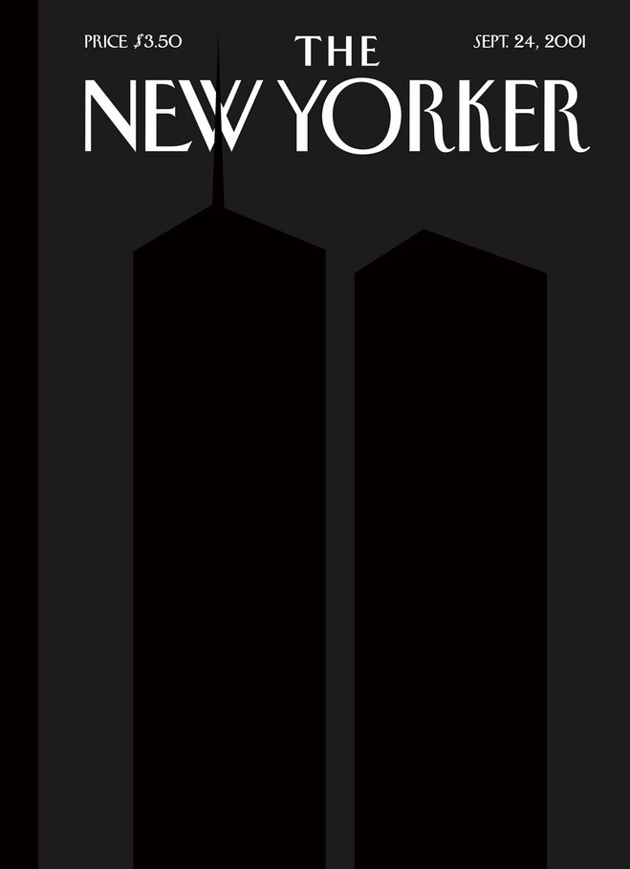
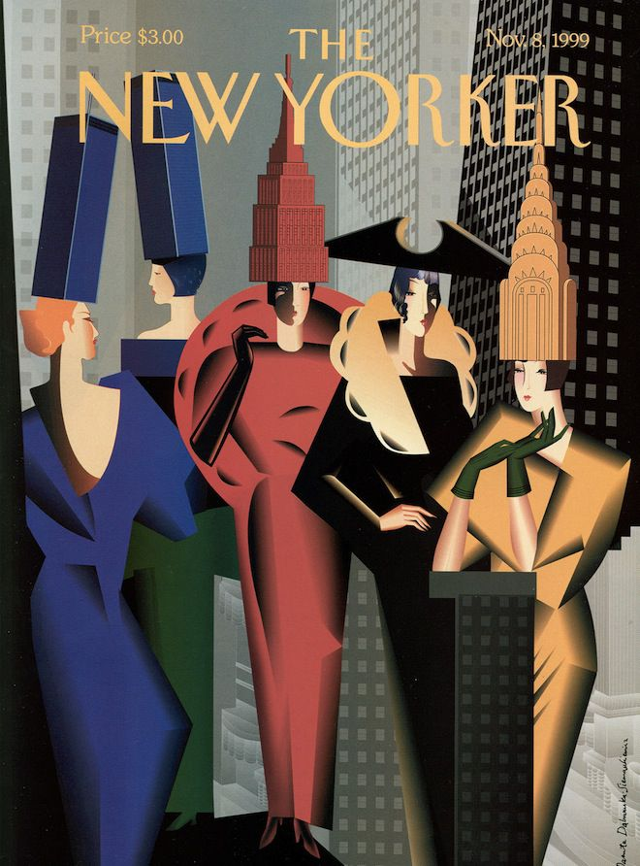

Slide 4
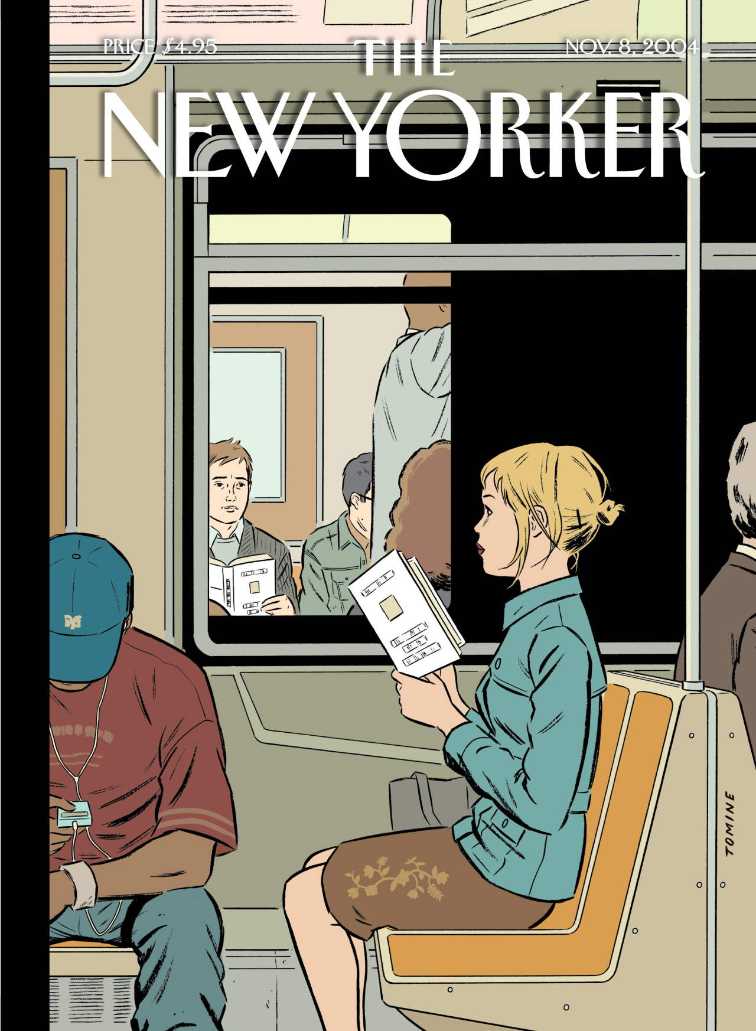
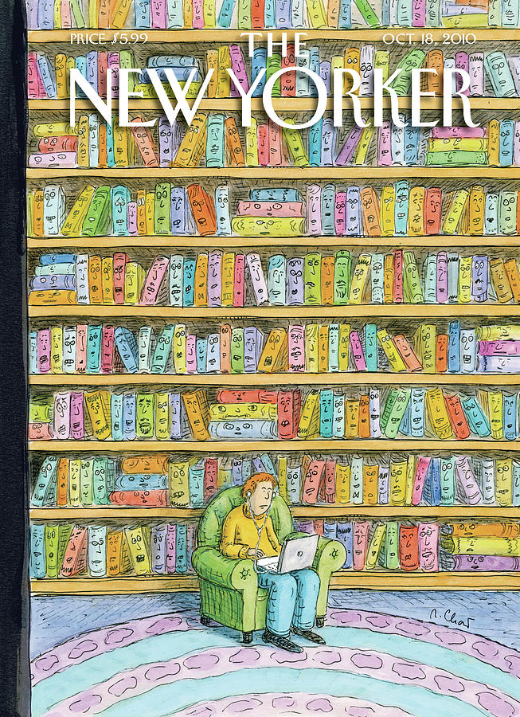

Slide 5
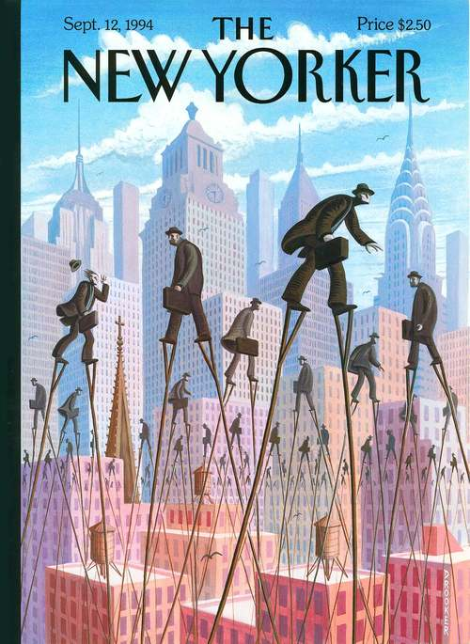
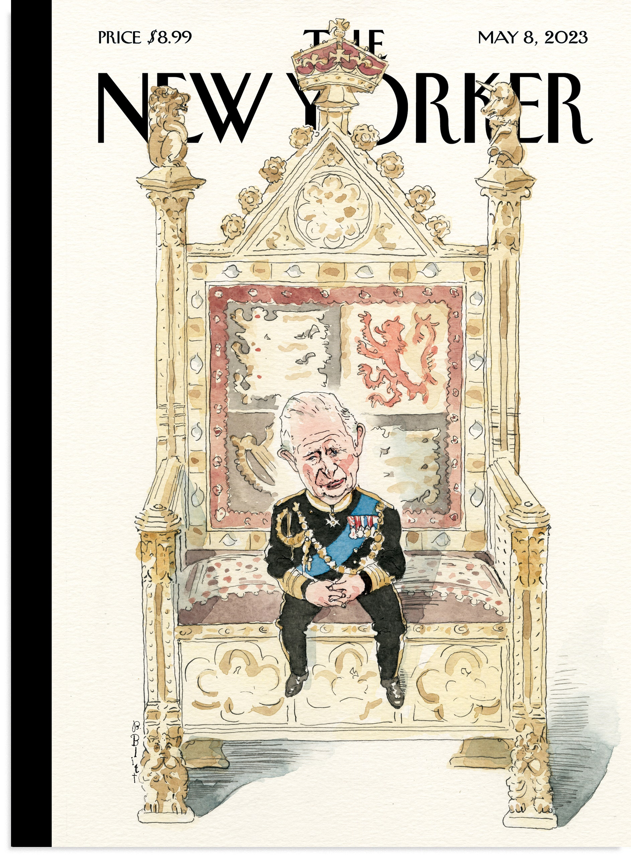

Slide 6
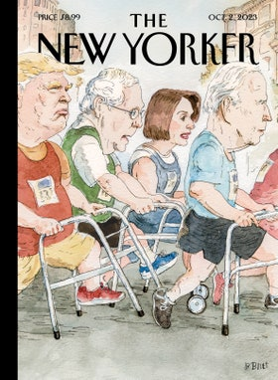
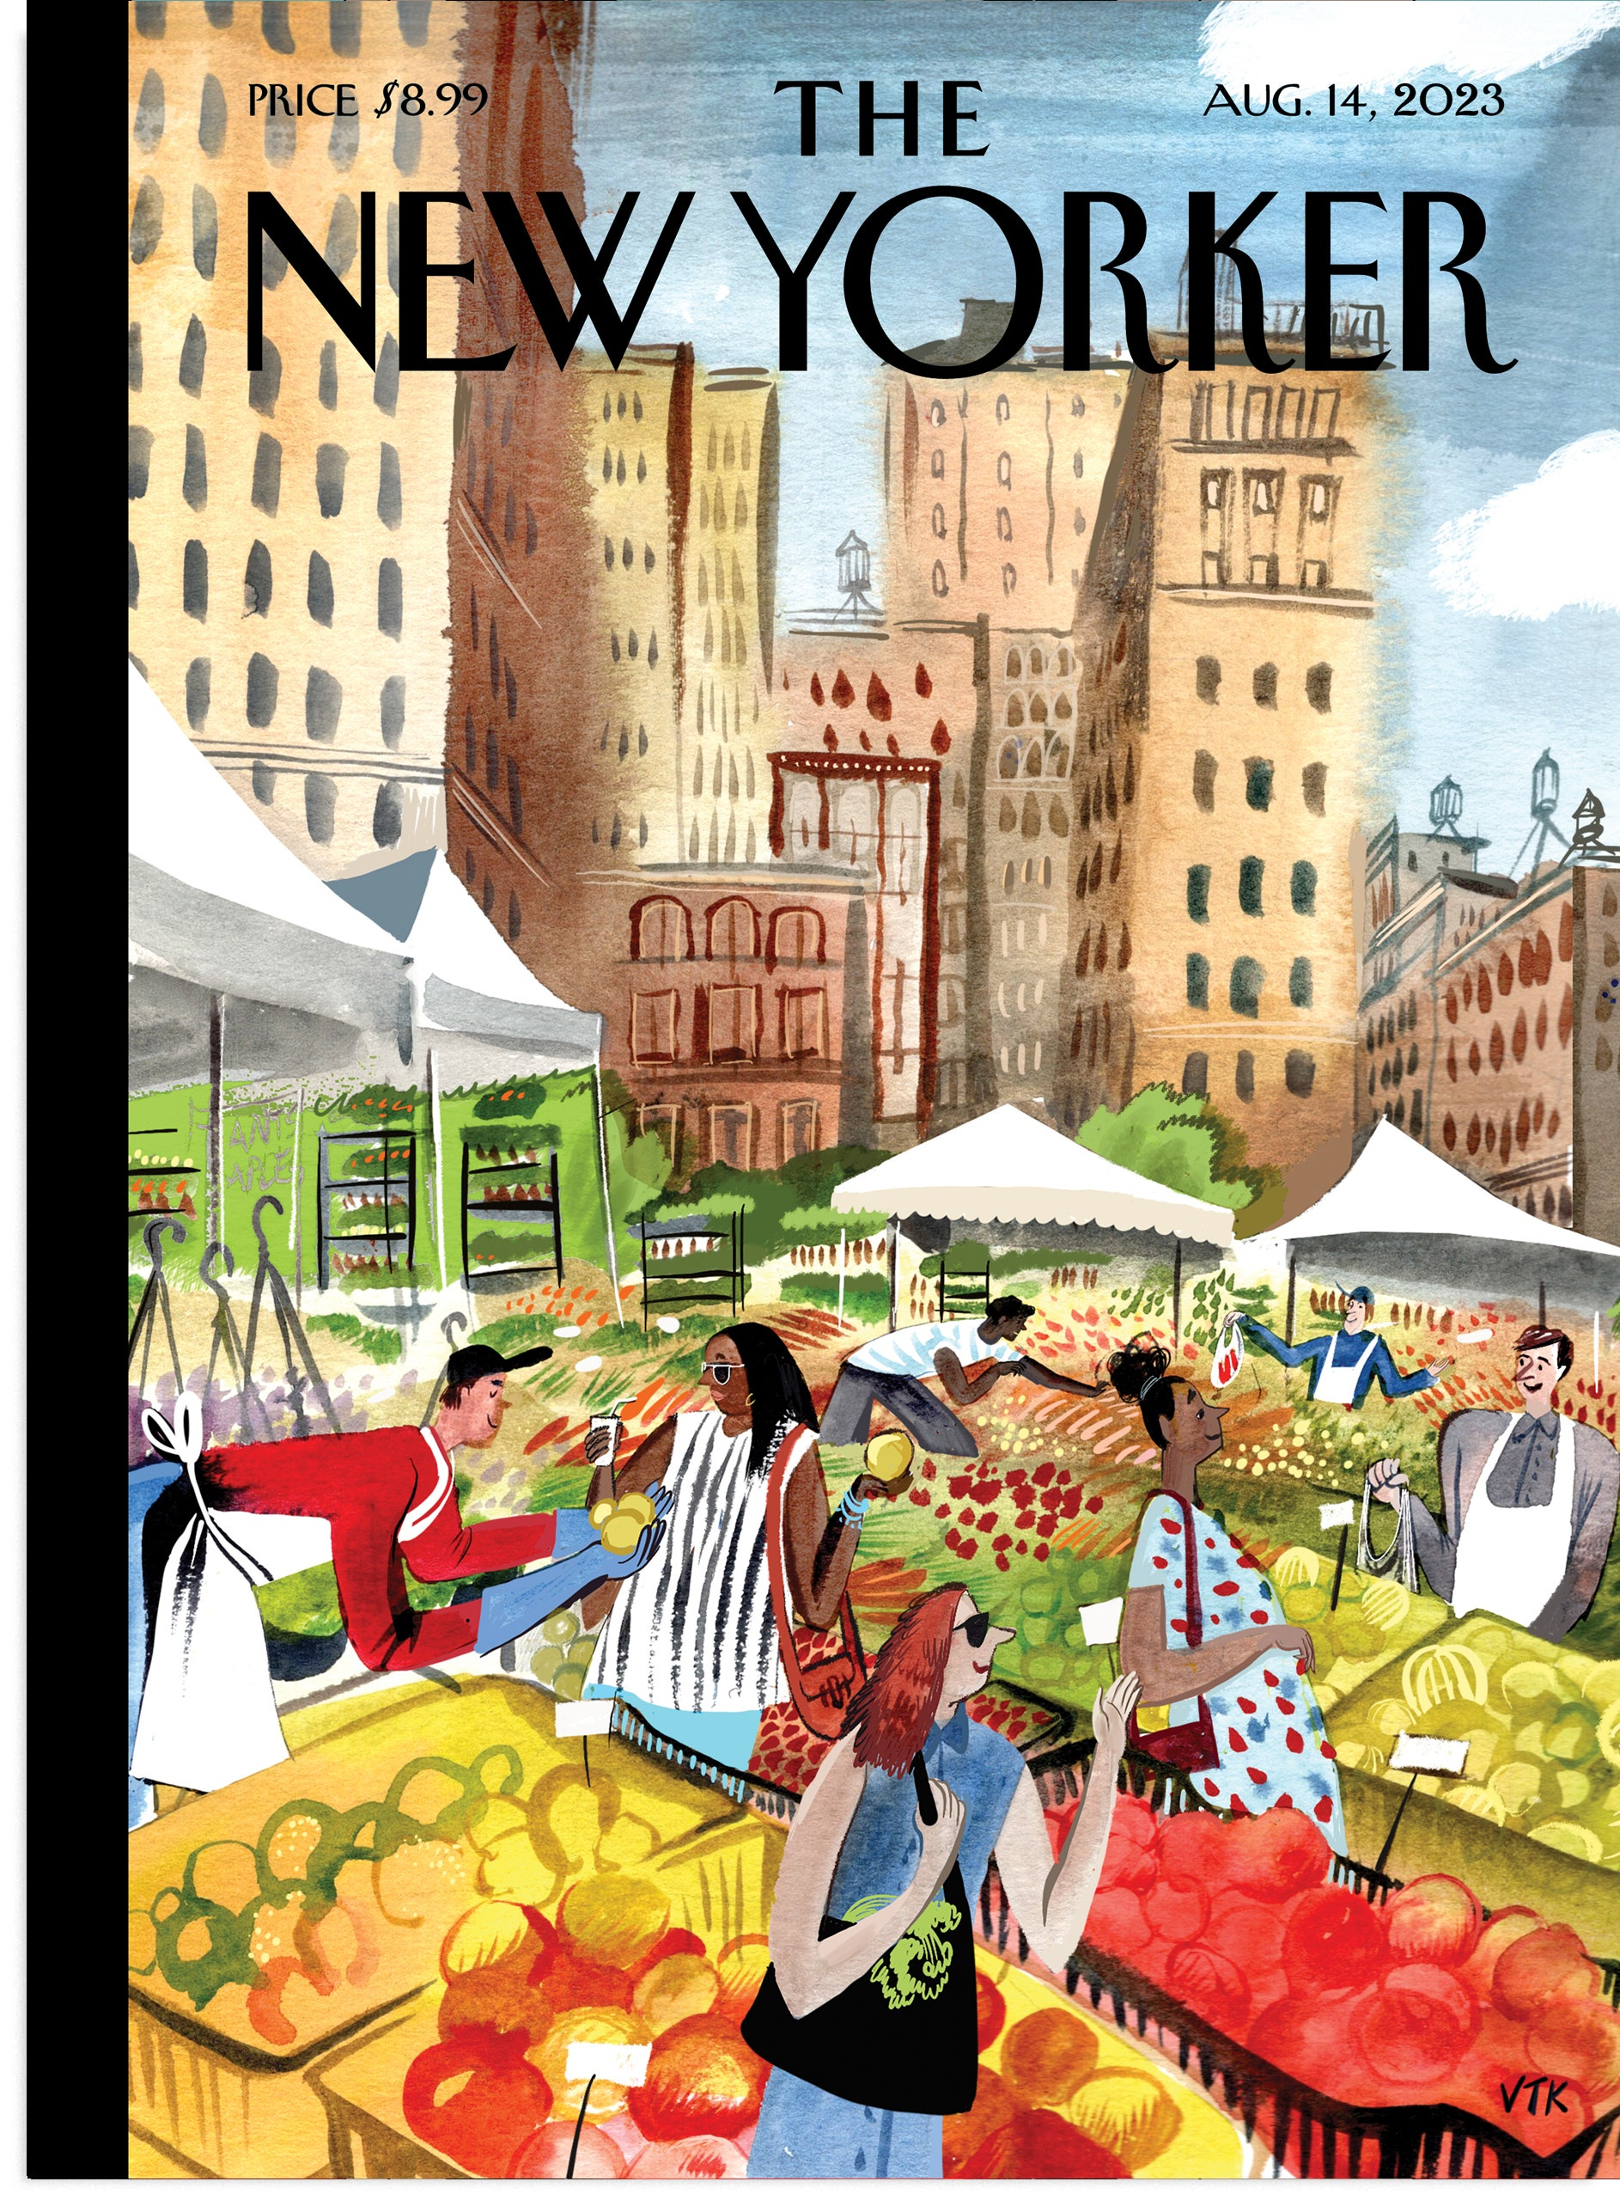

Slide 7
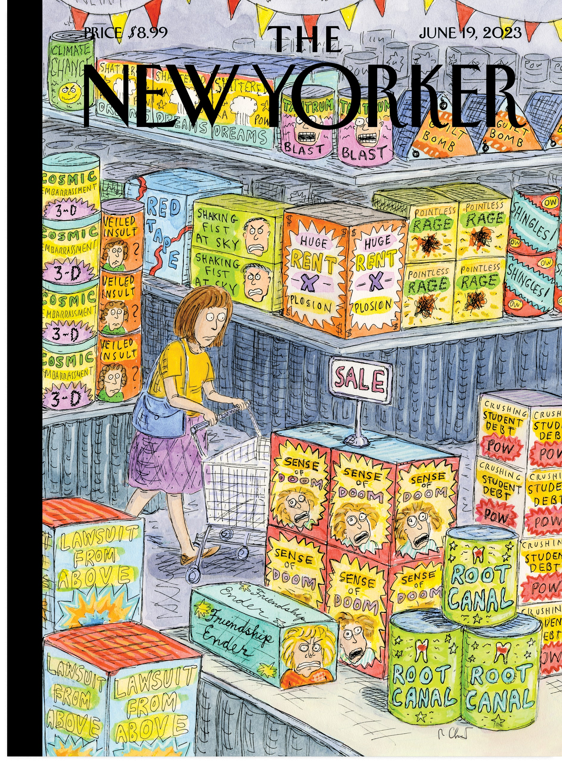
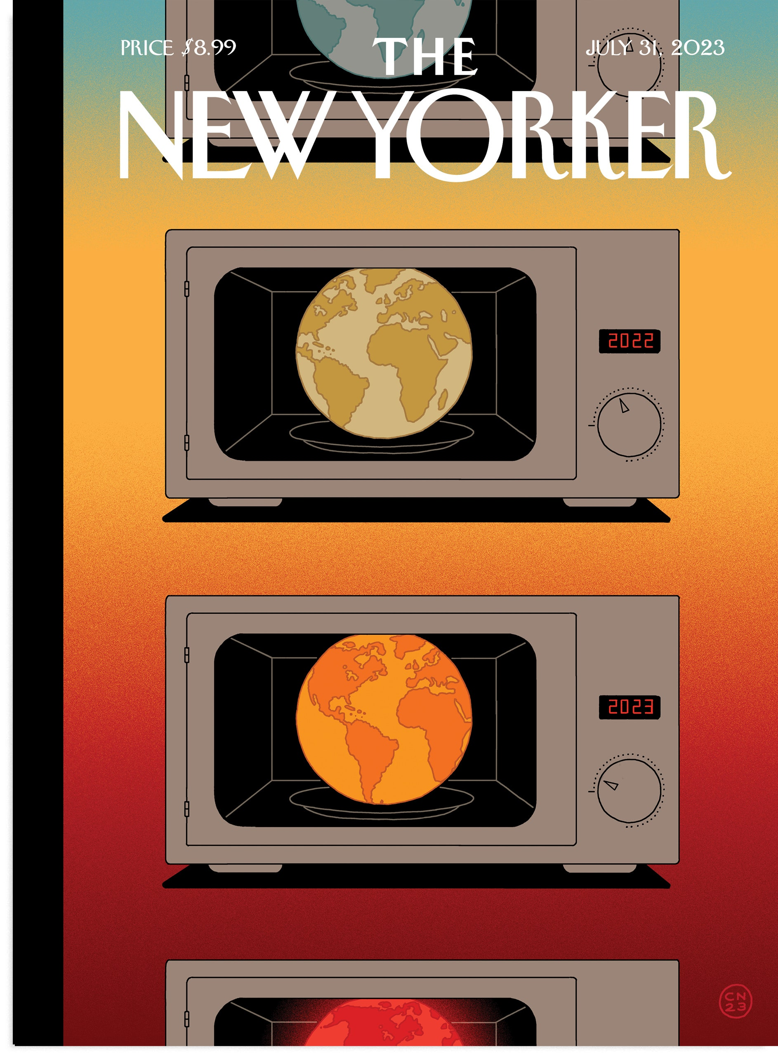

Slide 8
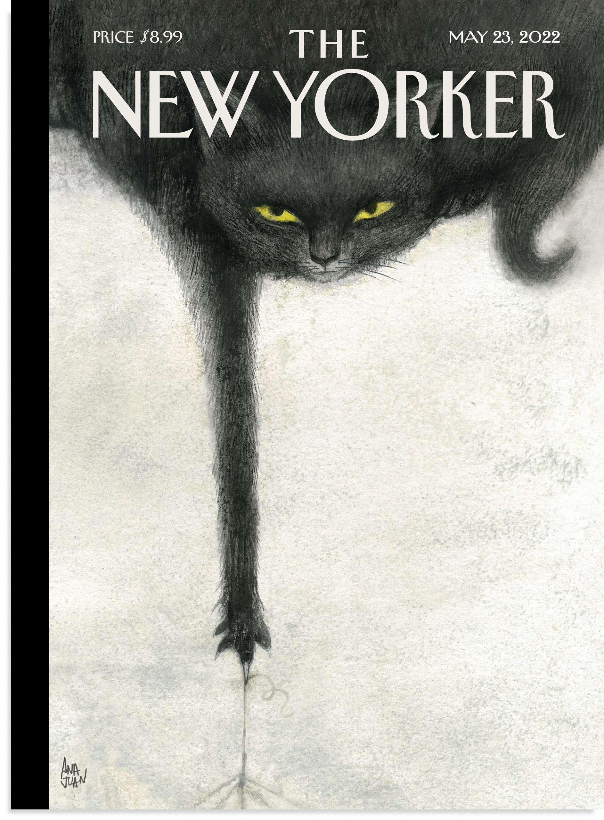
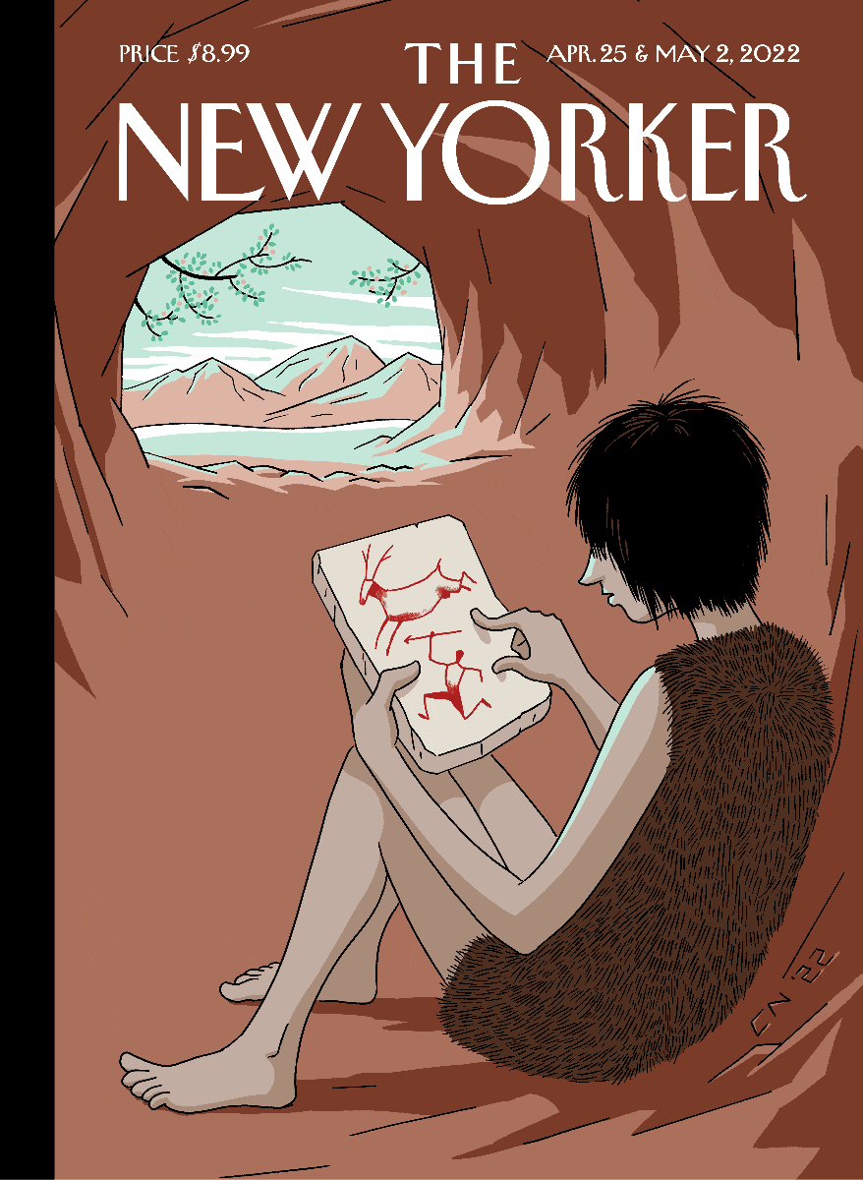

Slide 9
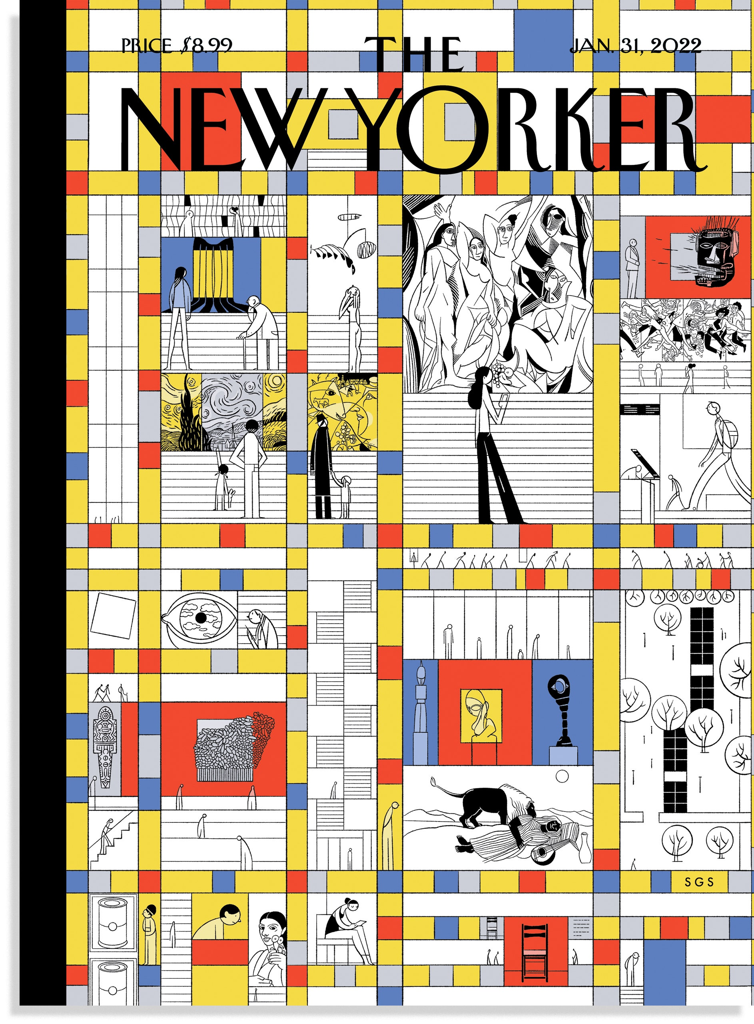
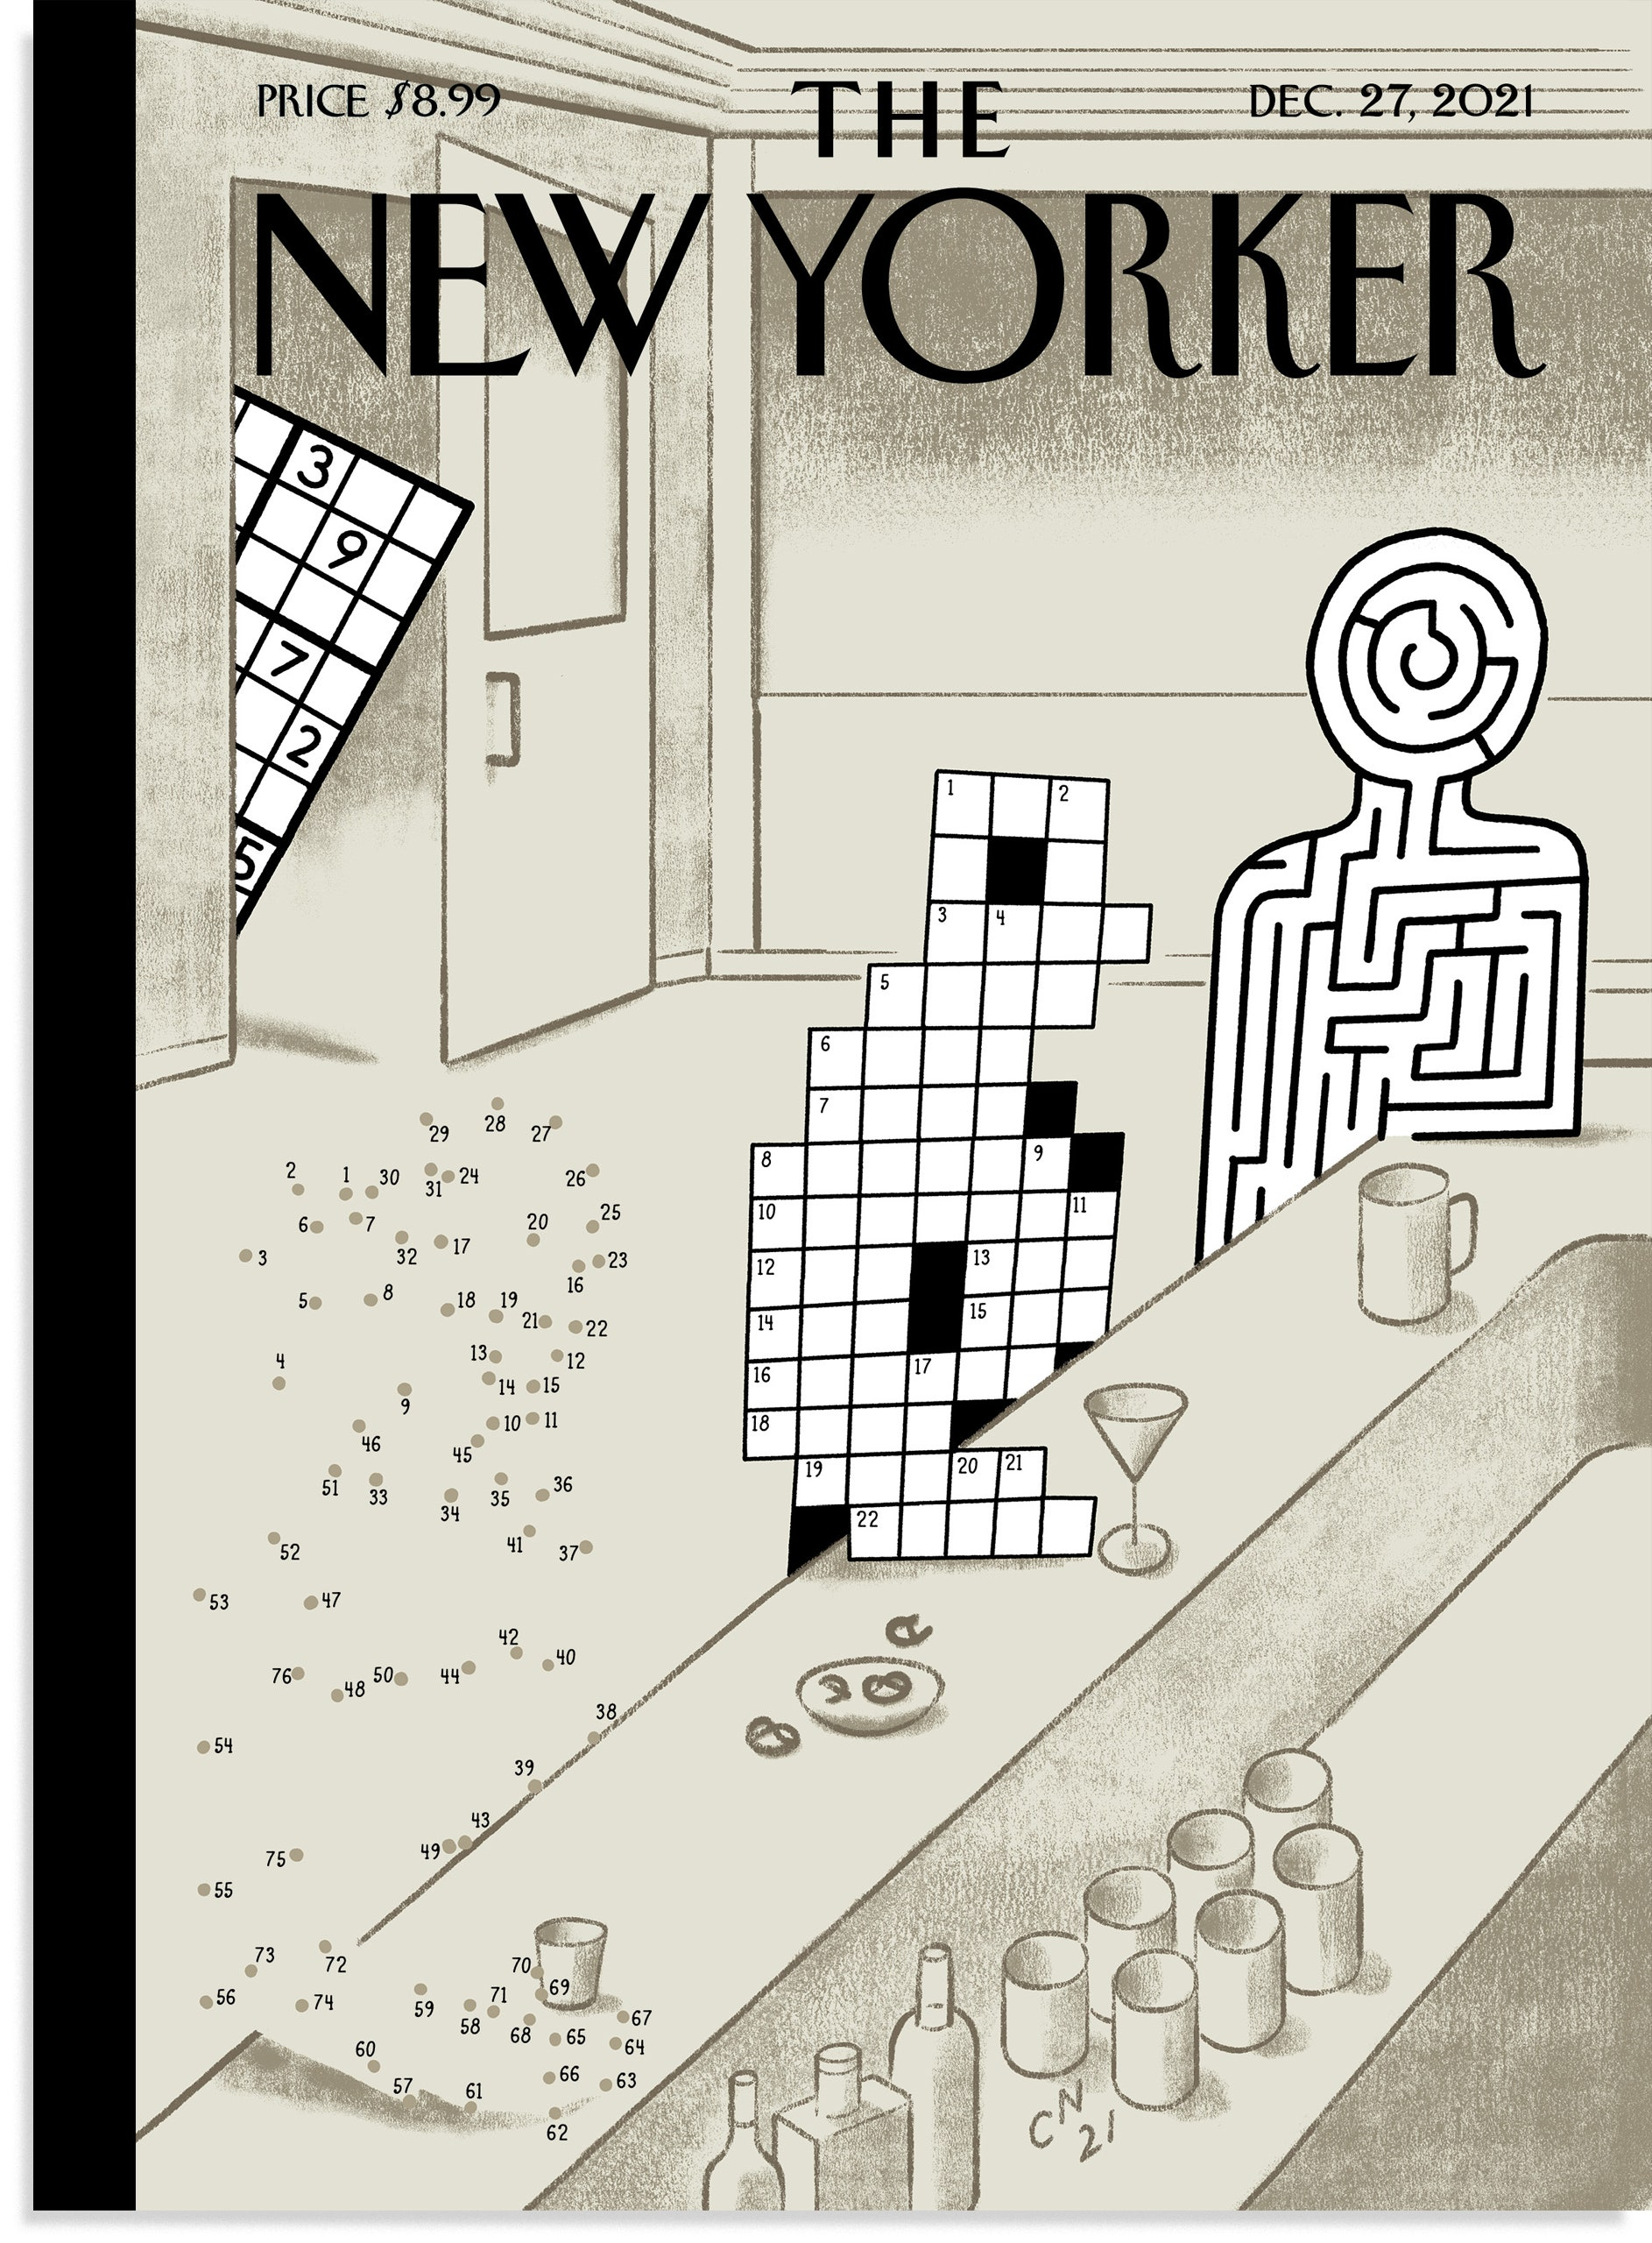

Slide 10
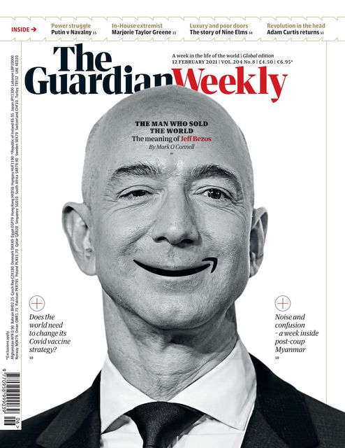
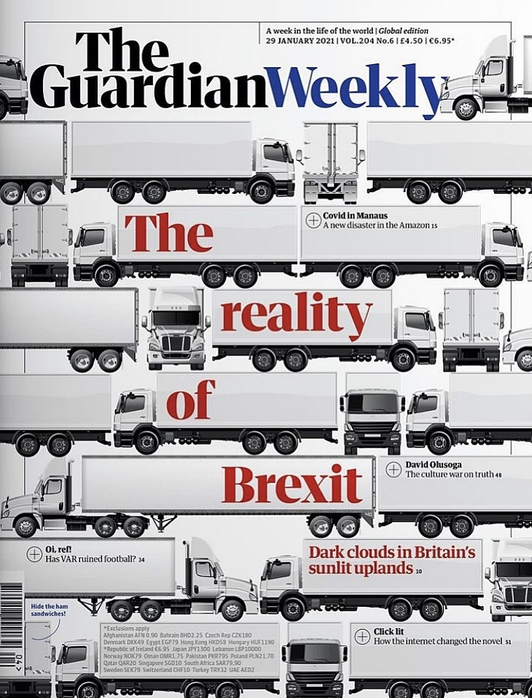

Slide 11
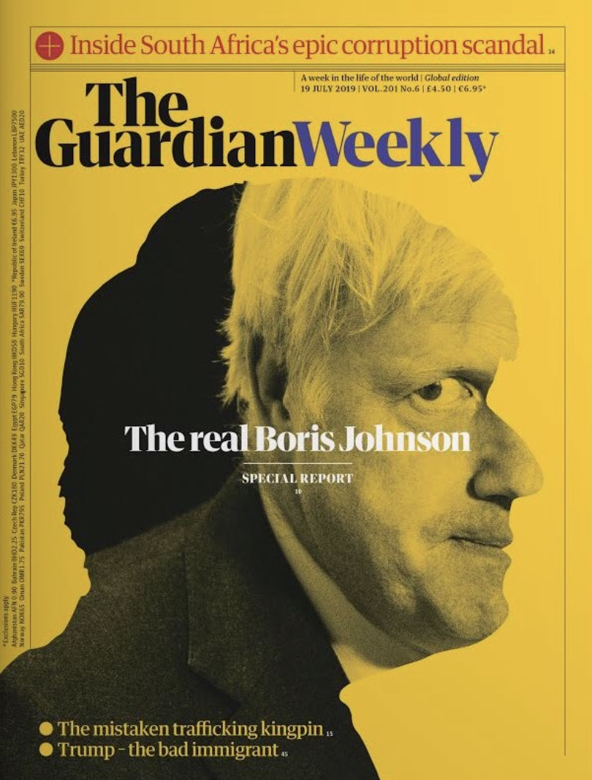

Slide 12
Animated examples

Slide 13
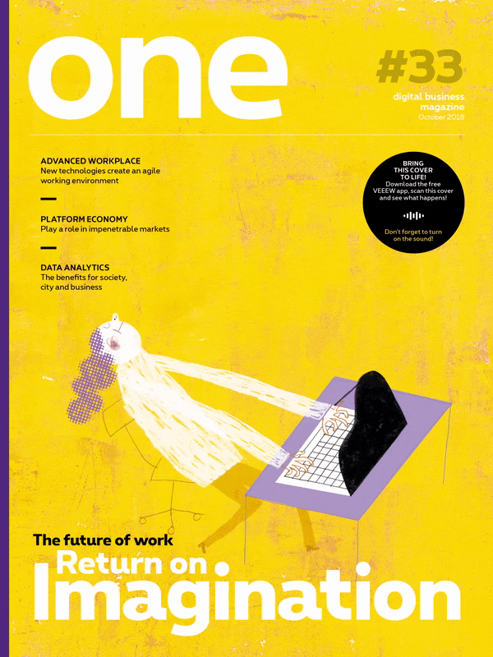


Slide 14


Slide 15
More examples

Slide 16
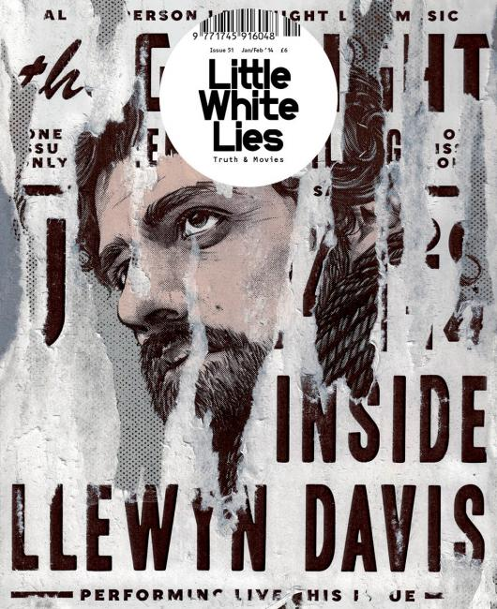
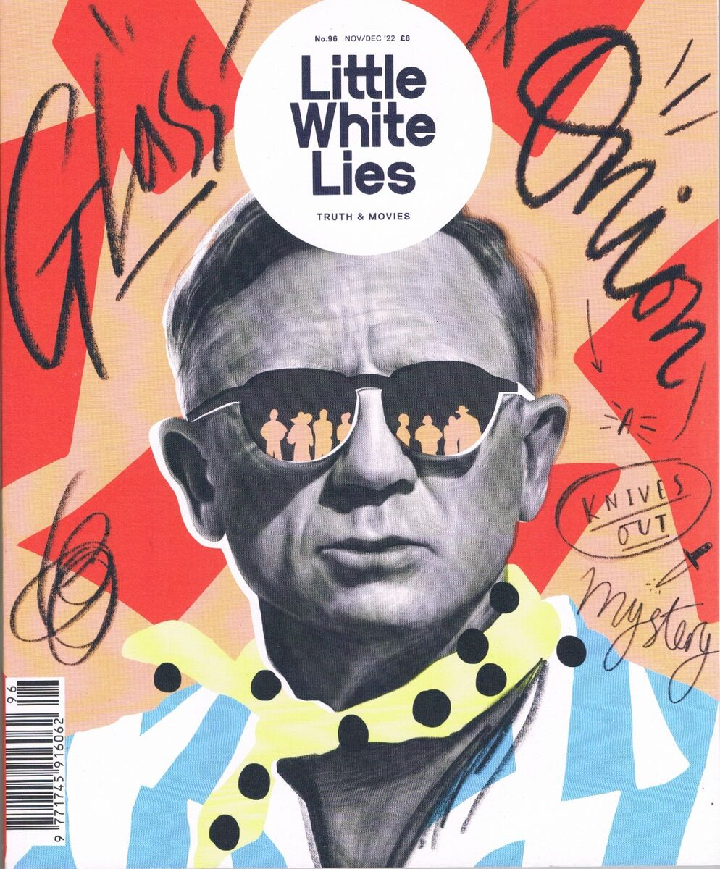

Slide 17
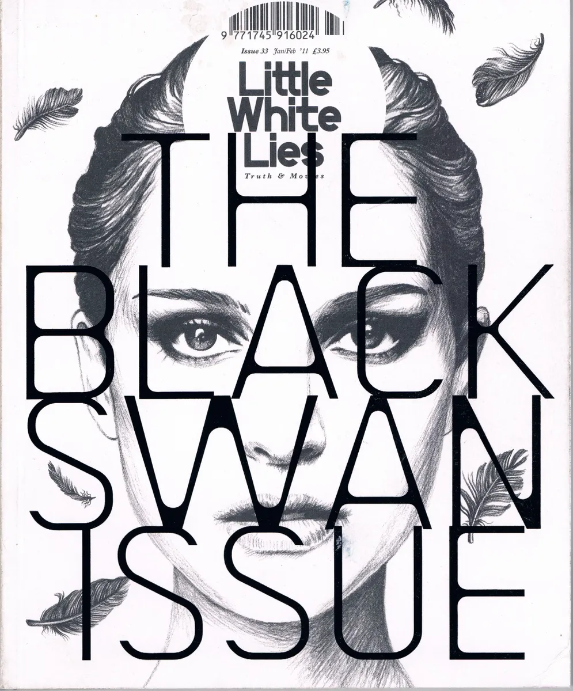
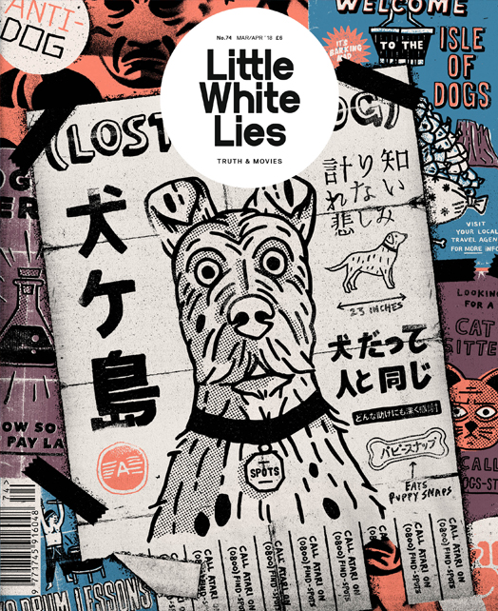

Slide 18
Todays Task
Create two magazine covers related to your billboard theme.
You’ll need to think carefully about typograhy placement as it is as important as the illustration.
You will need to include either your keywords or slogan (both if you can).

Slide 19
By next week
If you haven’t done so already, you will need to start doing reportage work related your theme!!!
GET DRAWING!!
Going to start the billboard development

